Slide 1
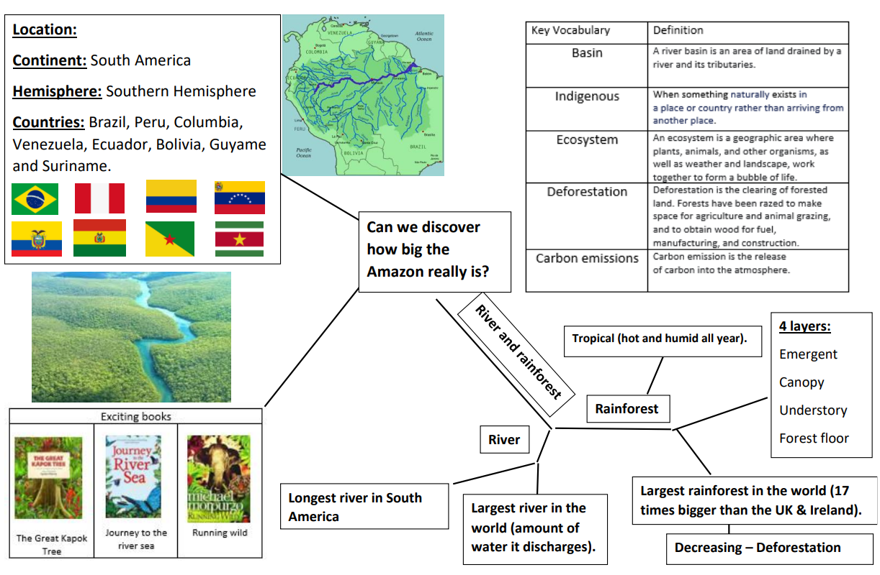
What has South America got that the UK hasn’t?

