Slide 1
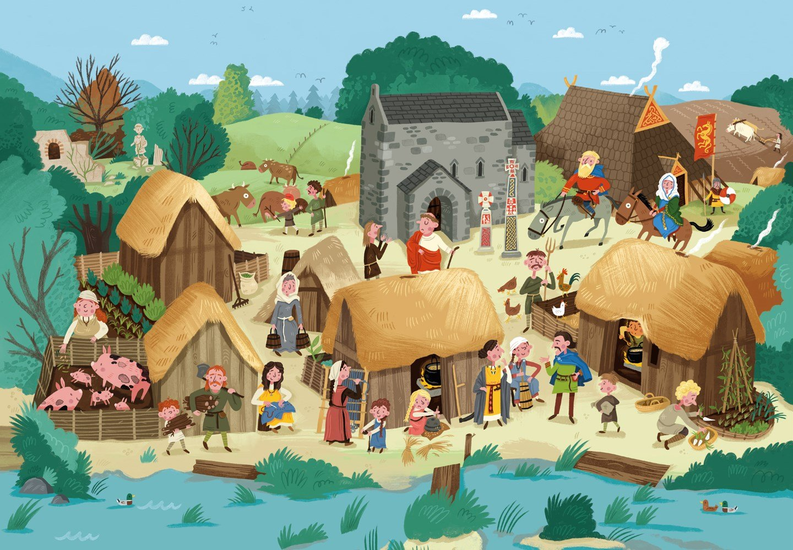
Literacy
We will begin our writing by looking at the text Rooftoppers by Katherine Rundell, where we will create a narrative and a newspaper report. We will apply our VIPERS skills to understand and to develop our writing and to enjoy the novel.
Curriculum – History
This term, our curriculum focus is History. Our learning question is, ‘How do we know what it was like to live an Anglo-Saxon life?
We will be using historical skills to delve into the lives of the people known as the Anglo-Saxons. We will explore their society during this period alongside conflicts, settlements and how the Vikings affected Anglo-Saxon life.
Maths
This term, we will be learning about place value of numbers to one million to ensure we have a strong understanding of the number system. We will then go on to study formal methods of addition and subtraction applying these to reasoning problems. Please keep up practice on timetables at home, as we need to continue to keep our brains ticking and revisit previous learning.
Science
This term, we will be learning and making investigations into properties of materials by comparing materials across different states. We will learn about reversible and irreversible changes, mixing and separating materials and revisit our knowledge of solids, liquids and gases.
Wider Curriculum
Jigsaw – Being me in my world
Computing – E-safety and Digital Literacy
Music – Rock music – Livin’ on a prayer
PE – Body Management and Invasion Game (Football)
Spellings – Suffixes, silent letters, contractions and dictionary work.
PE is on a Friday afternoon – please ensure full kit is in school at all times and our uniform policy is adhered to for health and safety. Our school P.E kit consists of a Middlethorpe P.E polo or and black shorts and sport trainers.
Homework
Children will be assigned homework on a Friday, which will be due in the following Thursday. Children will be given homework books. The same expectations apply with presentation, when completing any homework projects.
Homework will entail research, quizzes and recapping previous learning alongside self-discovery around our curriculum topic of History.
Children may be given additional homework in relation to Literacy and Maths but this will be given at teacher discretion.
If you have any issues with your child returning homework or struggling with homework, please contact Mr Cadman ASAP.
Reading
Please continue to support your child to continue a love of reading. Reading records should be filled in 5 times per week and returned to school every Friday. In our class, we have a reading fluency challenge, where you time yourself for a 1 minute and see how many words you can read. You are aiming for 90-100 words. If you read many more, try a more challenging book to read. Most importantly, enjoy your reading time.

