Slide 1
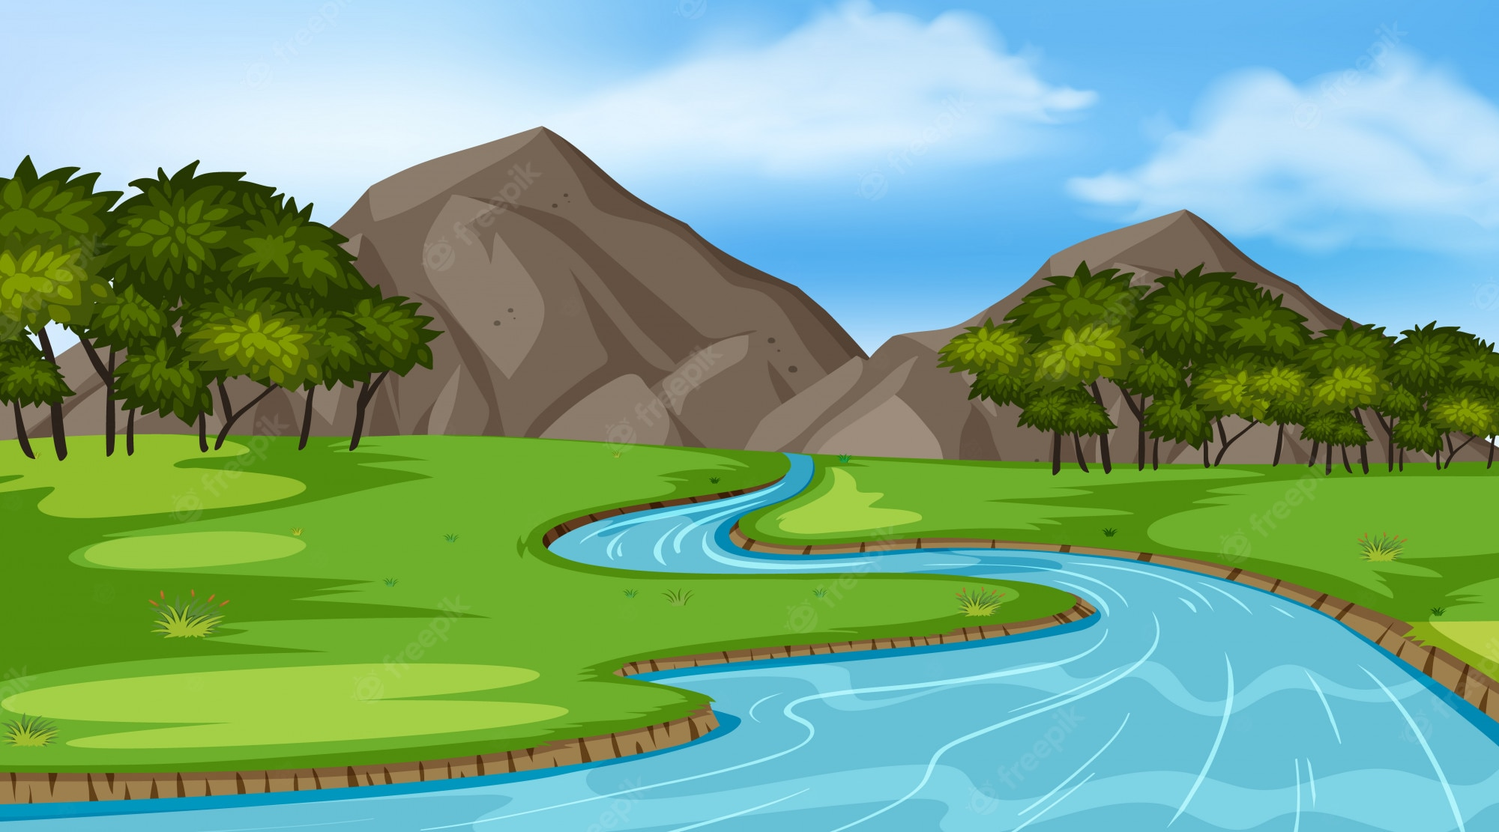
Literacy
We will begin our writing by looking at the text Floodland by Marcus Sedgwick, where we will create a piece of poetry and a persuasive speech. We will apply our VIPERS skills to understand and to develop our writing and to enjoy the novel.
Curriculum – Geography
This term, our curriculum focus is Geography. Our learning question is, ‘How do rivers and Seas influence where we live?”
We will be using geographical skills to discover and understand physical characteristics of rivers and how the Water Cycle impacts our way of living. Furthermore, we will revise and recall key landmarks around the world – continents- and discuss the advantages and disadvantages of living by the Sea.
Maths
This term, we will continue developing our understanding of fractions and continue to develop our understanding of multiplication and division. We will start developing our multiplication methods by using formal methods alongside dividing larger numbers.
Science
This term, we will be learning and making investigations into Earth and Space. We will learn about the Earth and it’s movements alongside other planets in our Solar System and the sun. We will explore day and night and observe and describe the movement of the moon.
Wider Curriculum
Jigsaw – Goals and Dreams
Computing – Lightbot Hour – Computing Science (Coding)
Music – Mr Carlton
Spanish – Continue developing phonetical sounds and basic vocabulary
PE – Swimming and Gymnastics – please continue bringing Swimming kit in on Tuesday.
PE is on a Tuesday – please ensure full kit is always in school and our uniform policy is adhered to for health and safety. Our school P.E kit consists of a Middlethorpe sport polo or white t-shirt and black shorts and sport trainers.
Heather Class – Spring Term 1- Newsletter
Homework
Children will be assigned homework on a Friday, which will be due in the following Thursday. Children will be given homework books. The same expectations apply with presentation, when completing any homework projects.
Homework will entail research, quizzes and recapping previous learning alongside self-discovery around our curriculum topic of History.
Children may be given additional homework in relation to Literacy and Maths but this will be given at teacher discretion.
If you have any issues with your child returning homework or struggling with homework, please contact Mr Cadman ASAP.
Reading
Please continue to support your child to continue a love of reading. Reading records should be filled in 5 times per week and returned to school every Friday. In our class, we have a reading fluency challenge, where you time yourself for a 1 minute and see how many words you can read. You are aiming for 90-100 words. If you read many more, try a more challenging book to read. Most importantly, enjoy your reading time.

