Slide 1
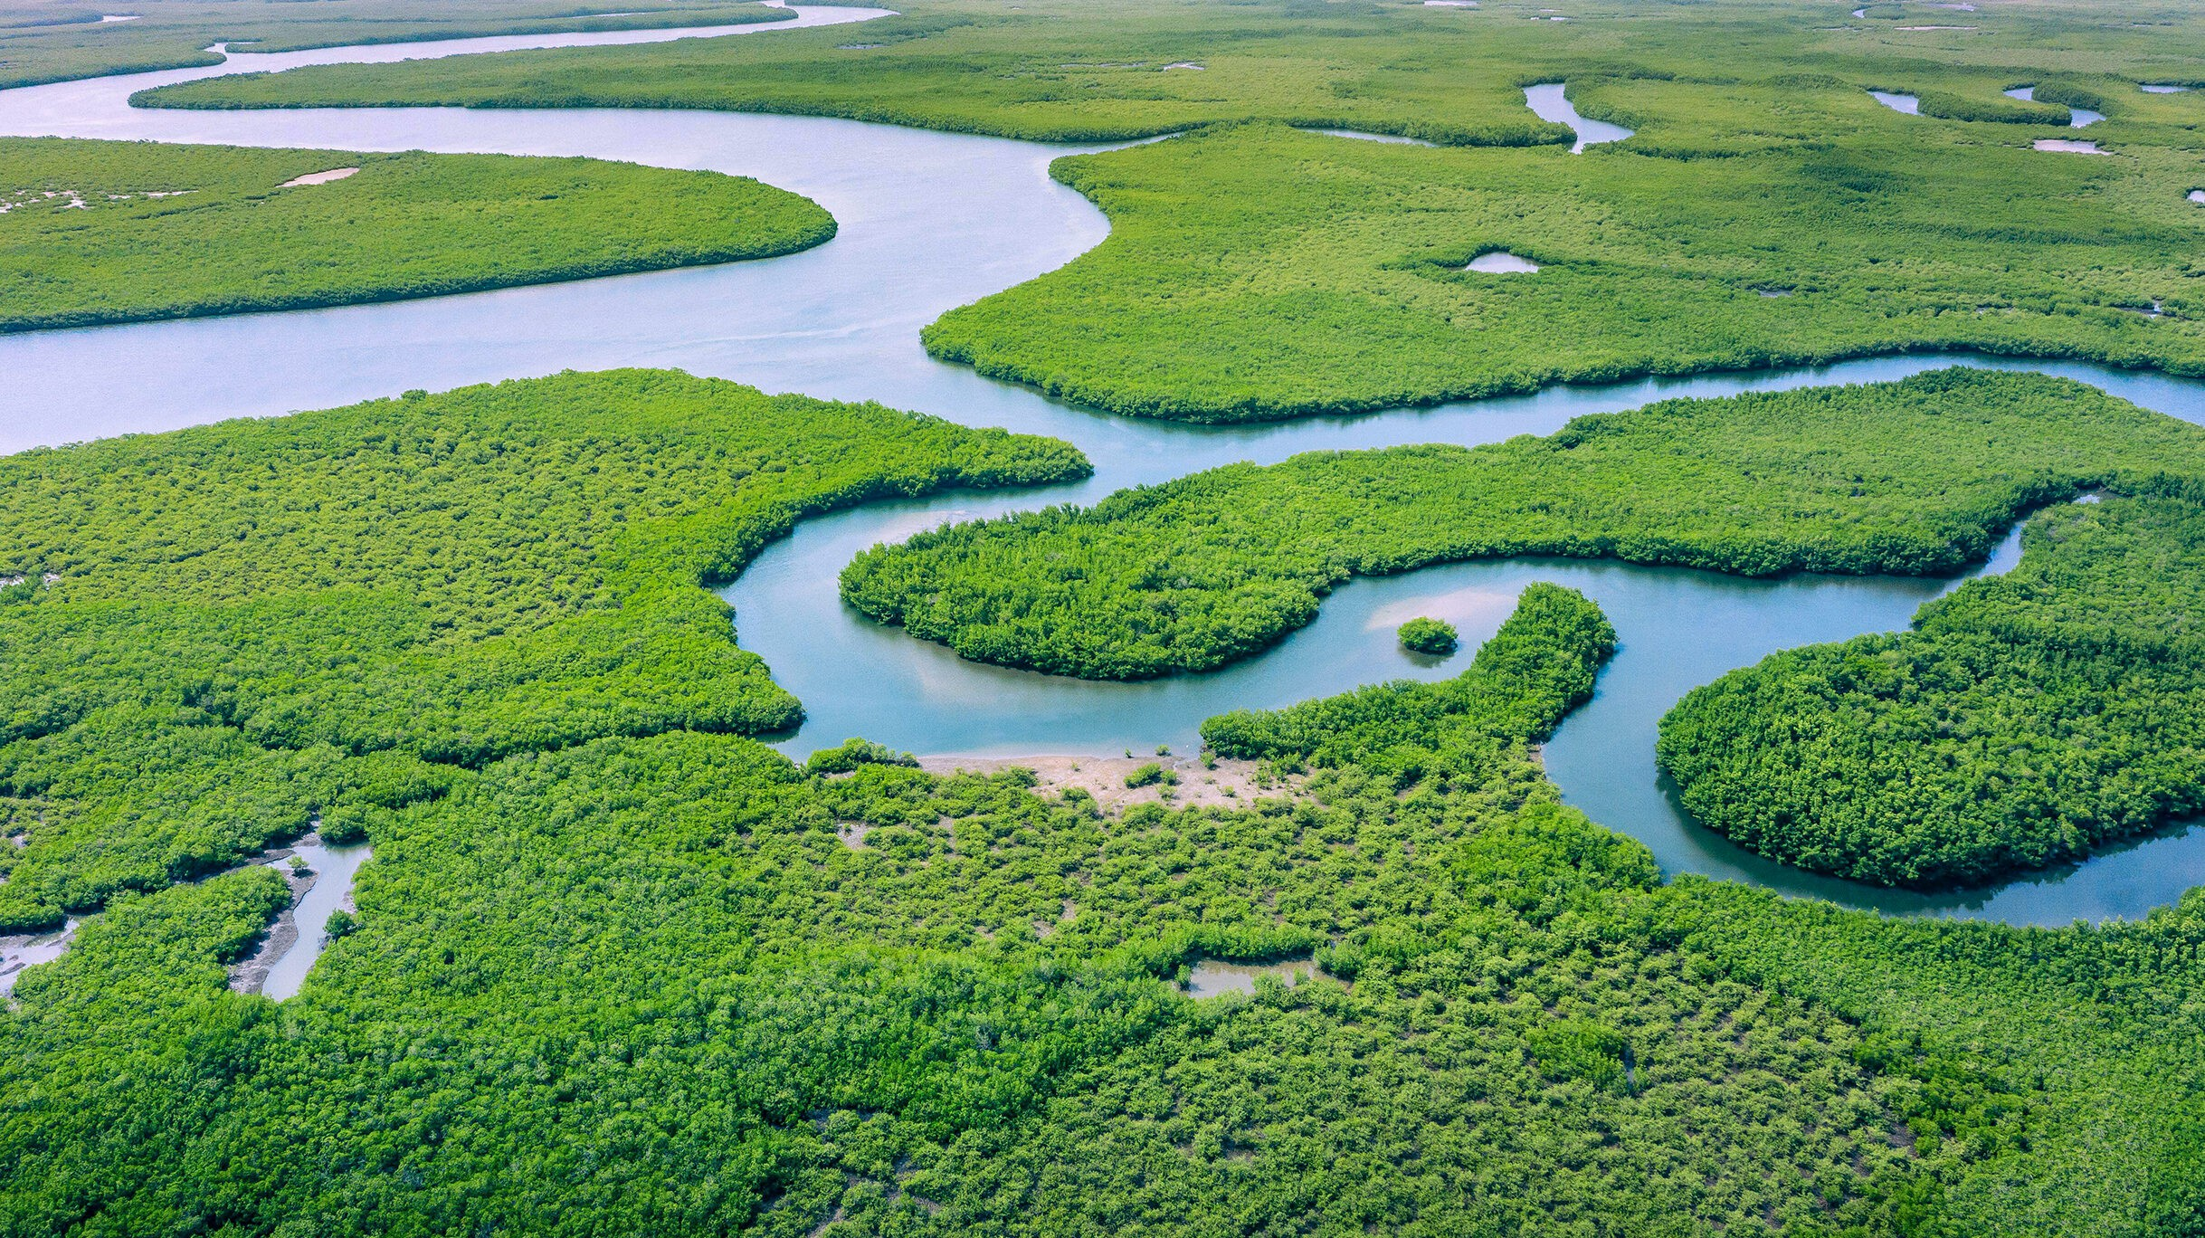
Literacy
We will develop our writing by learning about the text – Journey to the River sea by Eva Ibbotson, which will explore the journey of It is set mainly in Manaus, Brazil, early in the 20th century and conveys the author's vision of the Amazon River.
Curriculum – Geography
This term, our curriculum focus is History. Our learning question is, ‘What has South America got that the UK hasn’t?’
We will learn about; the characteristics of the Amazon Basin, who and what lives there and what is deforestation.
By the end of unit, we aim to be able to construct responses in order to answer our learning question and to have a good understanding of what has South America got that the UK hasn’t.
Maths
This term, we will be developing our understanding of position and direction, decimals, converting units and measurement. Furthermore, we will continue with our daily implementation of Quick Maths and our D.N.As to recall previous learning and to develop our fluency and problem-solving skills.
We will continue to practise our times tables recall, including using TTRS. The ability to recall facts quickly is beneficial in all areas of Maths.
Science
This term, we will be making learning all about Animals and Humans. Our lessons will teach us about human life cycles, why babies grow so quick, what happens when we grow and how does a humans body grow during puberty .
Heather Class
Summer Term 2 Newsletter
Homework
Children will be assigned homework on a Friday, which will be due in the following Thursday. Children will be given homework books. The same expectations apply with presentation, when completing any homework projects.
Homework will entail research, quizzes and recapping previous learning alongside self-discovery around our curriculum topic of History.
Children may be given additional homework in relation to Literacy and Maths but this will be given at teacher discretion.
If you have any issues with your child returning homework or struggling with homework, please contact Mr Cadman ASAP.
Wider Curriculum
Jigsaw – Relationships and Sex Education
Computing – Information technology -
Music – Singing with Mrs Gooch
PE – Tennis and Rounders
Spellings – Continue developing a range of approaches to spelling.
PE is on a Tuesday afternoon – please ensure full kit is always in school and our uniform policy is adhered to for health and safety. Our school P.E kit consists of a Middlethorpe sport polo or white t-shirt, black shorts and sport trainers.
Reading
Please continue to support your child to continue a love of reading. Reading records should be filled in 5 times per week and returned to school every Friday. In our class, we have a reading fluency challenge, where you time yourself for a 1 minute and see how many words you can read. You are aiming for 90-100 words. If you read many more, try a more challenging book to read. Most importantly, enjoy your reading time.

