Slide 1
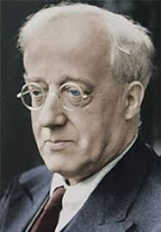
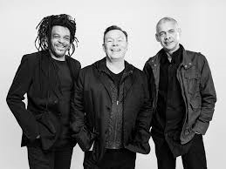
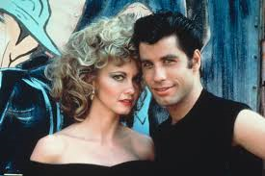
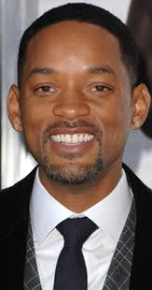
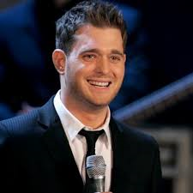
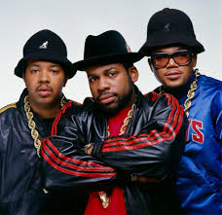
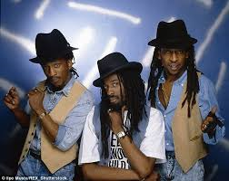
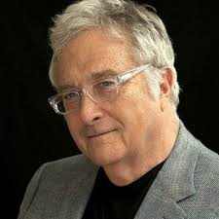
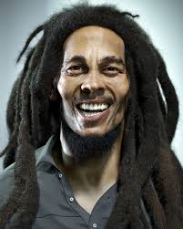
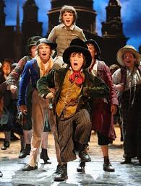
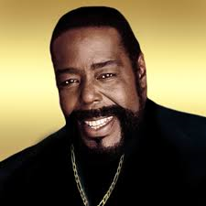
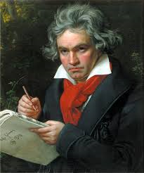
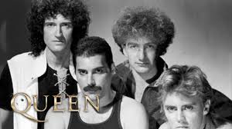
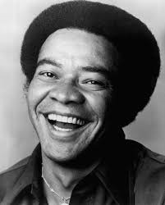
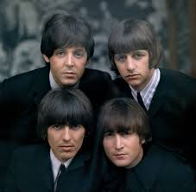
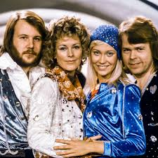
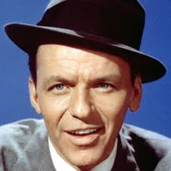
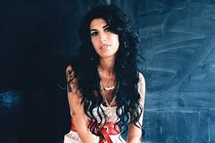
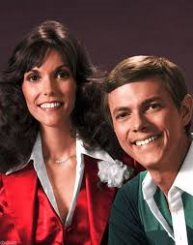
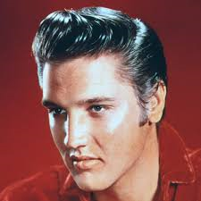
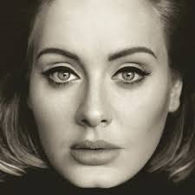
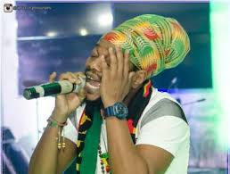
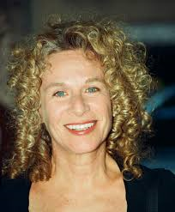
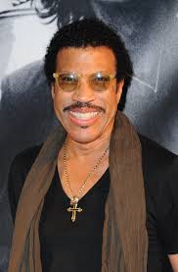
MUSIC AT MIDDLETHORPE (Charanga)
Listen and Appraise. Begin to recognise style indicators, different instruments, find the pulse, start to use musical language, basic musical structure. How music makes them feel. Working together, warm up voices, singing with diction, melody. Perform with pulse and rhythm.
Listen and Appraise. Continuue to understand pulse, rhythm, Sing songs, raps. Playing instruments, Glocks, recorders or band instruments. Sing, play, improvise and play back compositions.
Gustav Holst
Michael Buble
Run DMC
UB40
Grease
Begins to build up a repertoire of songs and dances. Explores the different sounds of intruments. Initiates new combinations of movement and gesture in order to express and respond to feelings, ideas and experiences.
Will Smith
ASWAD
Randy Newman
Barry White
Bob Marley
The children will deepen knowledge and unserstanding of secfic styles and understanding its musical structure. Use voices expressively, singing songs and speaking chants and rhymes. Continue to create more complex melodies (usually in a group) within the context of a song being learnt.
Recognise style indicators and start to recognize diferent instuments, begin to recognize basic musical structure. Build on the understanding that pulse is the foundation of music upon which other dimensions are built.
Oliver
Bill Withers
ABBA
Queen
Beethoven
Amy Winehouse
All Classes
Elvis Presley
The Beatles
The Carpenters
Frank Sinatra
Every Lesson: Exploring and developing ideas, evaluating and developing work
Every Year: Listen and Appraise. Musical Activities. Games, Singing, Playing,Improvisation,Composition, Perform/Share.
Adele
Carole King
Benjamin Britten
Lionel Richie
Appreciate and understand a wide range of high quality live and recorded music drawn from different traditions and from great composers and musicians.
Improvise and compose music for a wide range of purposes using the interrelated dimensions of music. Sing with an appropriate vocal range and clear diction.
Claude Monet
Notes:
© Copyright PresentationGO.com – The free PowerPoint and Google Slides template library

