Slide 1

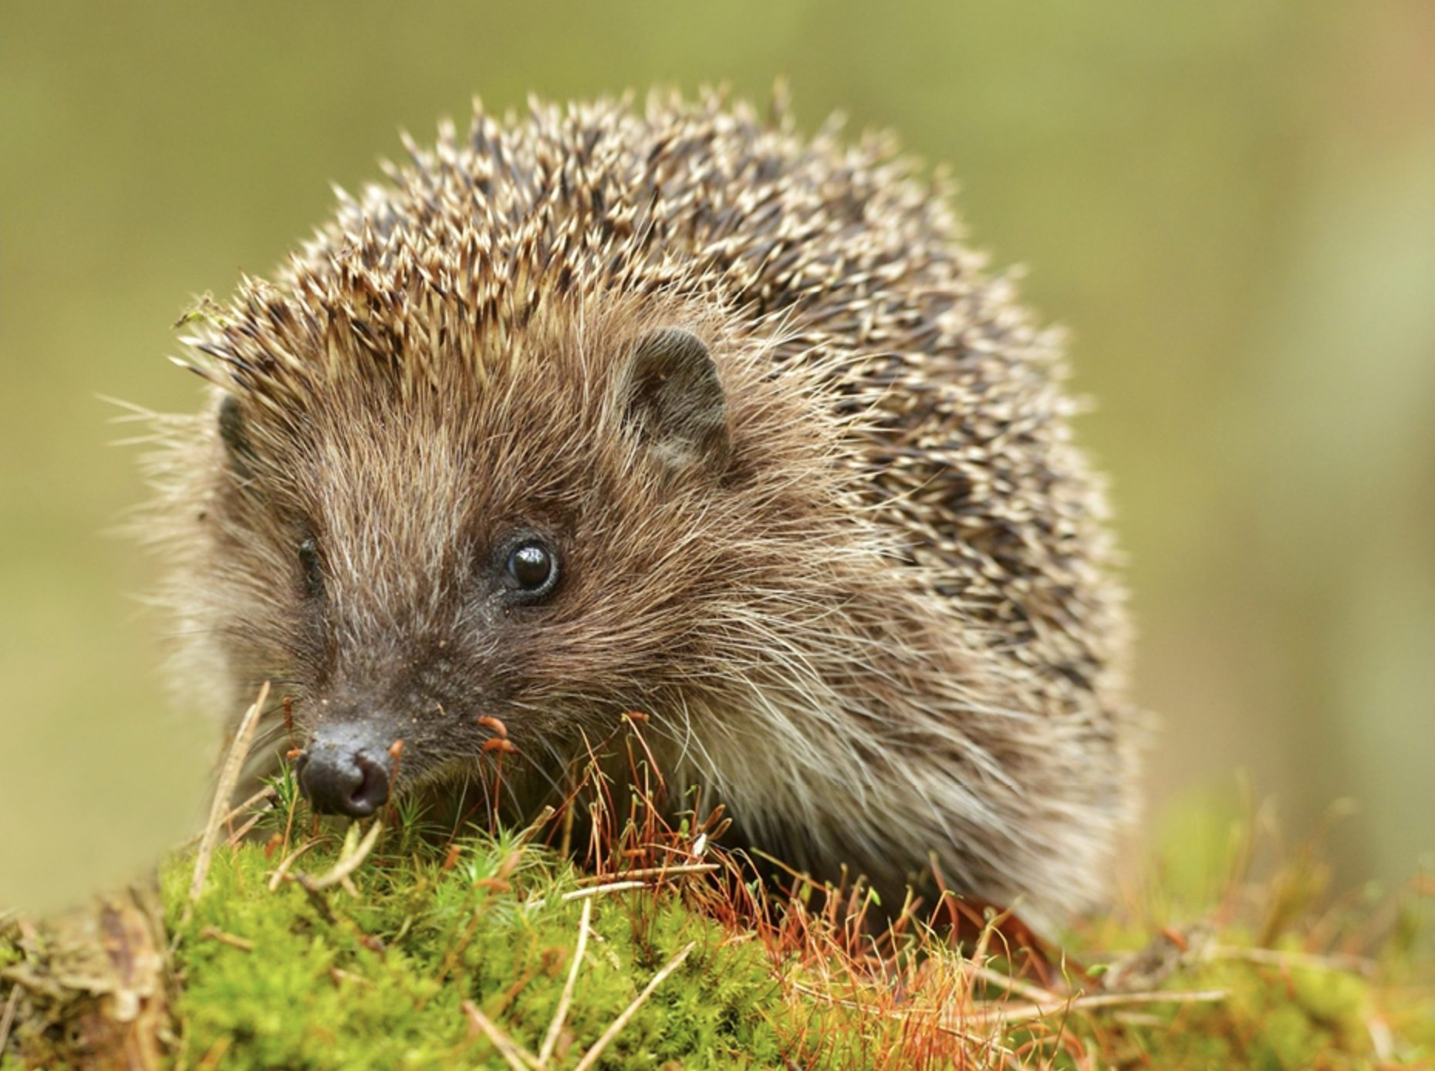
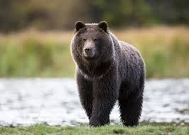
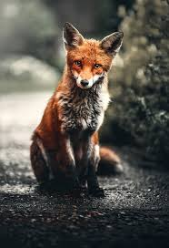
Hedgehogs Bears Foxes
Miss Tilling
Mr Patterson
Mrs Richardson

Slide 2
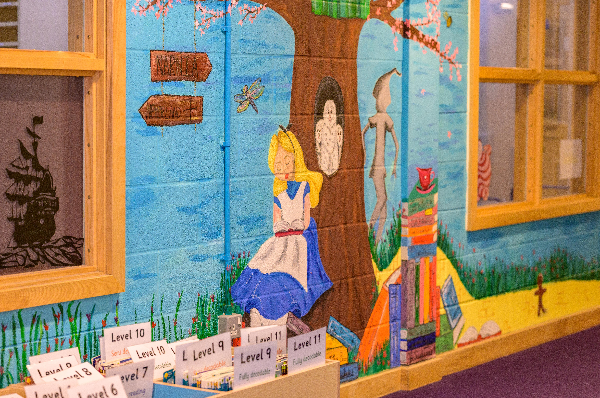


Introduction
Welcome to Year 3 and 4
Hedgehogs: Miss Tilling
Bears: Mr Patterson
Foxes: Mrs Richardson
Mrs Belcher, Mrs Goode, Mrs Freshwater, Mrs Curtis, Miss Burrows-Darley & Mrs Afroze will be working in the team.

Slide 3
In Year 3 and 4
Children are expected to follow the Purple Promises and understand and demonstrate the Millbrook Values.
Children are expected to follow the uniform policy. For PE, this includes the tying back of long hair, earrings covered if they cannot be taken out for PE.
Children are expected to keep themselves organised and to look after their belongings. Please ensure everything is labelled.
Morning snack is not provided in KS2. If you would like your child to have a snack, please send a healthy snack e.g. fruit or a cereal bar.
Children are expected to further develop their independence and resilience with regards to seeking help and support within lessons, including using resources that have been given to them and using the working wall.

Slide 4
Purple Promises
Millbrook Values
We have our ‘Purple Promises’ instead of rules. These are:
I promise to be kind
I promise to listen and learn
I promise to show respect
I promise to fulfil my potential
Democracy – Our Voices Matter
The Rule of Law – We follow the Purple Promises
Individual Liberty – We own our choices and actions
Mutual Respect – We treat each other kindly
Tolerance of those of different faiths and beliefs – We celebrate differences

Slide 5
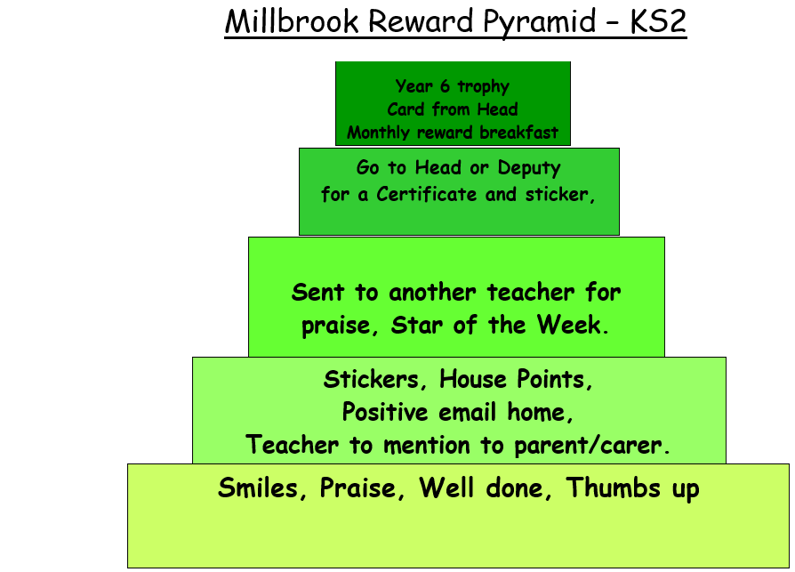

Slide 6
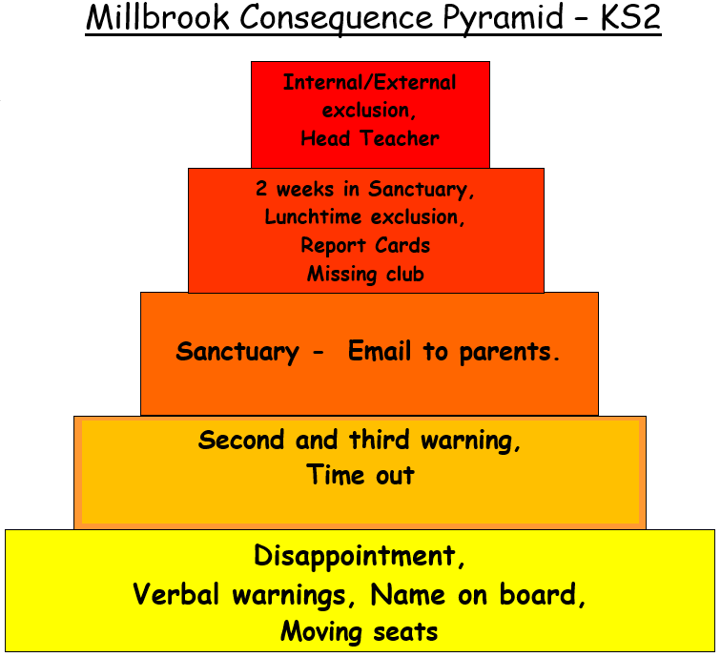
Name
Name
Name
Title
Title
Title
Title

Slide 7
Class Timetable
Morning Job
Start of the Day
8:30-8:45
Children should be in school by 8:45
Children will come in and complete a morning job – this could be spelling and handwriting based or Maths based
Morning Lessons
Children will complete lessons in English, Maths and Reading between 9.00am and 12.00pm with a 15-minute break at 10:45am
Lunchtime
Afternoon Lessons
End of the Day
Children finish school at 3:10 and can be collected from the playground.
Children will complete lessons in a range of subjects including Science, History, French and Music.
PE will take place on Monday and Tuesday for Hedgehogs and Monday and Friday for Bears and Foxes.

Slide 8
Homework Expectations
How often
Expected
Children should read at least 5 times a week to develop fluency and understanding.
Children should practise their spellings every day to ensure understanding and use of the word in context.
Short bursts (10 minutes) of TT Rockstars 5 times a week.
Reading - recorded in their Reading Record book.
Practise and understand Spellings.
Access and use the online game Timestable Rockstars.

Slide 9
Contacting Us
In Person
Via Email
Urgent Messages
If you would like to discuss something about your child, you may catch us on the door first thing in the morning or at the end of the day, however this is to pass on short messages.
If you would like a longer discussion book a meeting via the class email.
hedgehogs@millbrook.swindon.sch.uk
bears@millbrook.swindon.sch.uk
foxes@millbrook.swindon.sch.uk
If you have an urgent message to convey to us during the day, please contact the school office who will relay these to us as we do not always have the ability to check emails.

Slide 10
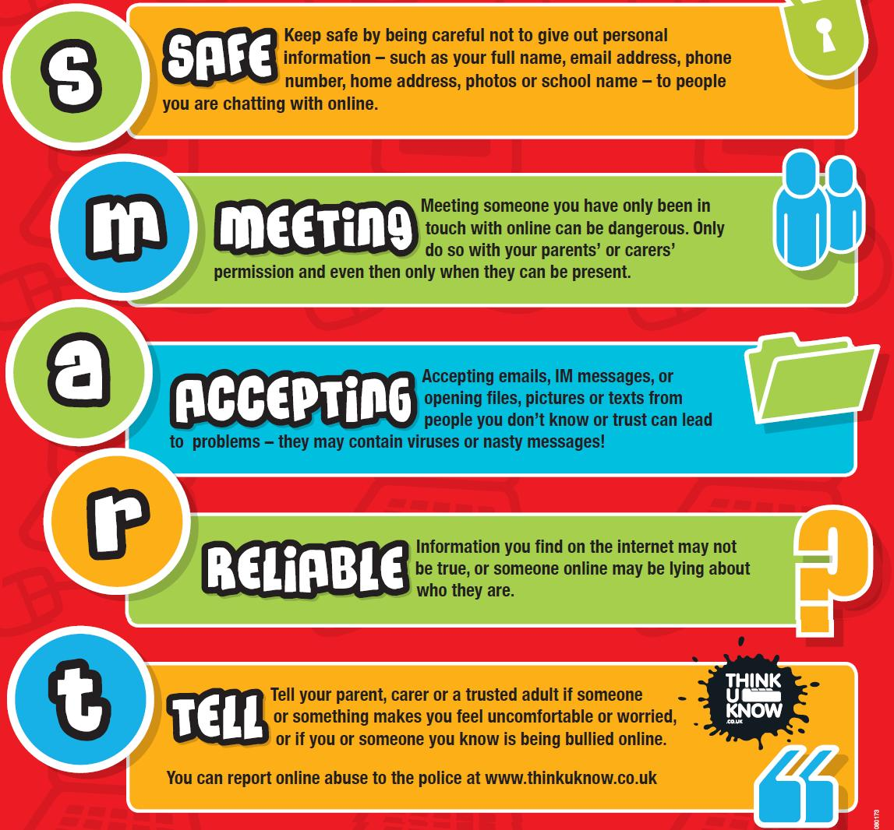
How you can help us:
Your child is capable of being highly successful.
Here are a few things that you might be able to help them with to ensure greater success.
Support your child to reinforce their learning at home.
Encourage independence.
Monitor online behaviour.

Slide 11
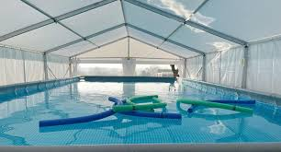
Swimming
Pools to Schools – Swimming pool will arrive at Millbrook for 3 weeks in October.
Children will receive lessons in groups of 12 to help achieve the national curriculum skills, including swimming 25 metres.
They will have lessons every day for two weeks.
Please ensure swimming kit is brought in each day (costume, towel, goggles, swimming cap, flip flops/Crocs)
No cosmetics products.
Some children will have extra lessons during the third week if they are still to achieve the 25 metres swim.

