Slide 1
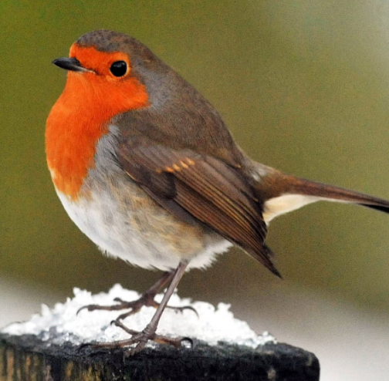
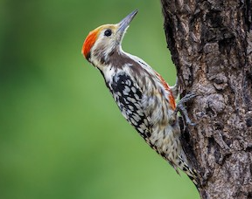
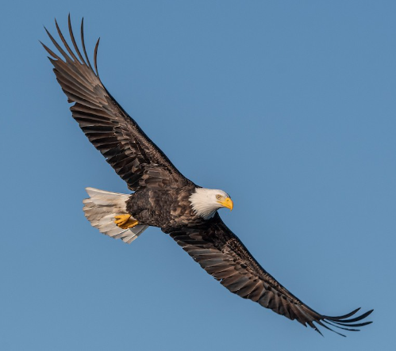
Robins Woodpeckers Eagles
Miss Webb
Mrs Gurupatham
Mr Adams

Slide 2
Introduction
Welcome to Year 5 and 6
Robins: Miss Webb, Miss Ledbury and Mrs Meredith
Woodpeckers: Mrs Gurupatham and Miss Gurung
Eagles: Mr Adams and Mrs Gomersall

Slide 3
In Year 5 and 6
Children are expected to further develop their independence with regards to seeking help and support within lessons, including helping themselves to resources appropriate to their task.
Children are expected to follow the guidelines set out for keeping safe. i.e. Long hair tied back; earrings covered or taken out for PE.
Children are expected to follow the Purple Promises and understand and demonstrate the Millbrook Values.

Slide 4
Purple Promises
Millbrook Values
We have our ‘Purple Promises’ instead of rules. These are:
I promise to be kind
I promise to listen and learn
I promise to show respect
I promise to fulfil my potential
Democracy – Our Voices Matter
The Rule of Law – We follow the Purple Promises
Individual Liberty – We own our choices and actions
Mutual Respect – We treat each other kindly
Tolerance of those of different faiths and beliefs – We celebrate differences

Slide 6
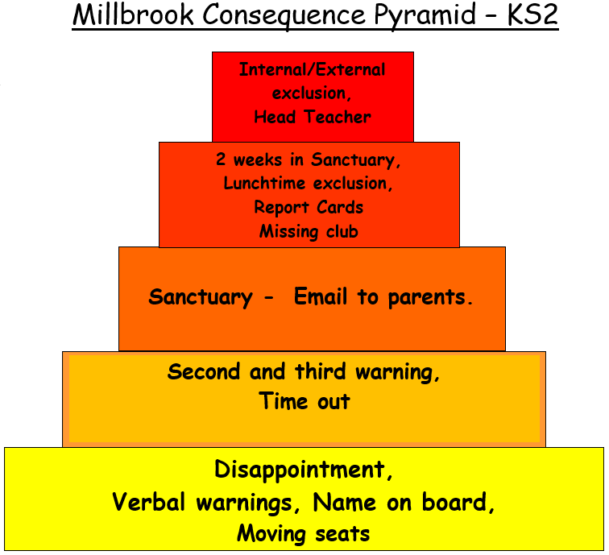
Name
Name
Name
Title
Title
Title
Title

Slide 7
Class Timetable
Morning Job
Start of the Day
8.30-8.45
Children should be in school by 8.45
Children will come in and complete a morning job – this could be spelling and handwriting based or Maths based
Morning Lessons
Children will complete lessons in English, Maths and Reading between 9.00am and 12.00pm with a 15-minute break at 10.45am
Lunchtime
Children can have a hot dinner, please speak to the office to set up ParentPay to pay for these. They can also have a packed lunch – ensure that this is a balanced lunch.
Afternoon Lessons
End of the Day
Children finish school at 3.10 and can be collected from the playground. Afterschool Club is available – please speak to the office about how to book this. Email class teacher about walking home.
Children will complete lessons in a range of subjects including Science, History, French and Music.
PE will take place on Monday and Wednesday for Eagles and Wednesday and Thursday for Robins and Woodpeckers.

Slide 8
Homework Expectations
Expected
How often
Reading - recorded in their Reading Record book.
Practise and understand Spellings.
Complete activities and games on TT Rockstars.
Children should read at least 5 times a week to develop fluency and understanding
Children should practise their spellings every day to ensure understanding and use of the word in context.
Children need to know their Times Tables fluently to complete various Maths problems so should be practising daily.

Slide 9
Contacting Us
In Person
Via Email
Urgent Messages
If you would like to discuss something about your child, you may catch us on the door first thing in the morning or at the end of the day, however this is to pass on short messages.
If you would like a longer discussion book a meeting via the class email.
Now the children are more independent you may wish to allow them to trial walking home alone, in this case please send us an email with details of when the permission is given.
robins@millbrook.swindon.sch.uk
woodpeckers@millbrook.swindon.sch.uk
eagles@millbrook.swindon.sch.uk
If you have an urgent message to convey to us during the day, please contact the school office who will relay these to us as we do not always have the ability to check emails.

Slide 10
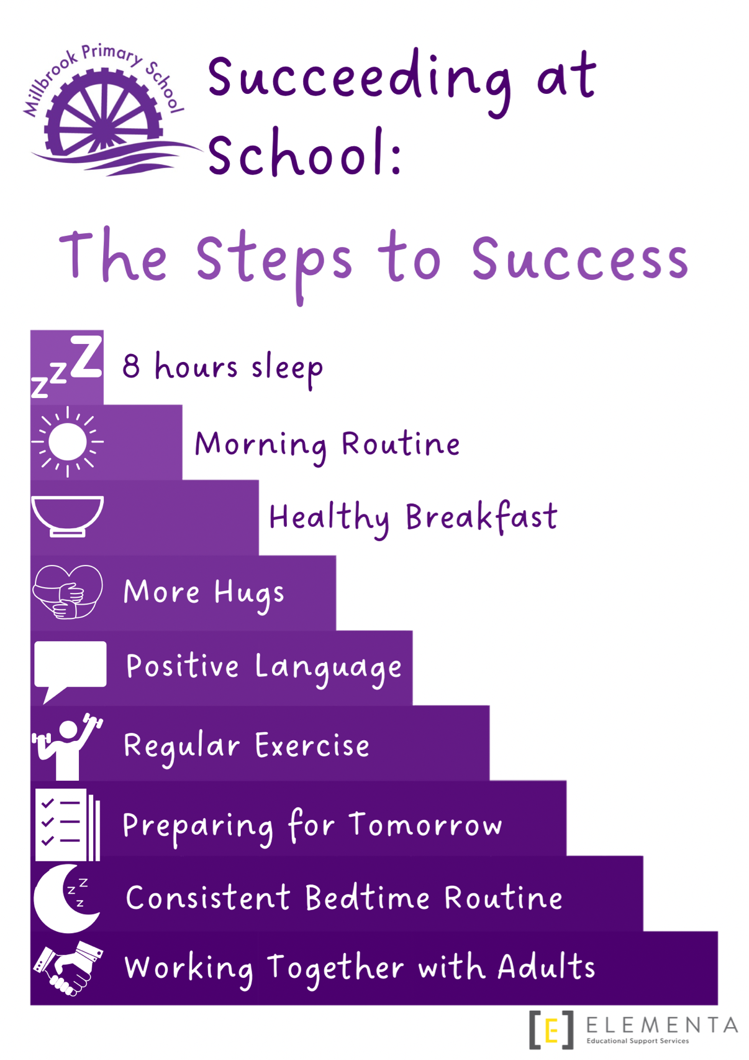
Your child is capable of being highly successful.
Here are a few things that you might be able to help them with to ensure greater success.

Slide 11
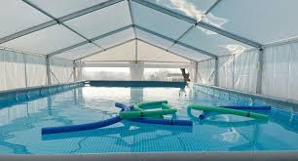
Swimming
Pools to Schools – Swimming pool will arrive at Millbrook for 3 weeks from 30th September.
Children will receive lessons in groups of 12 to achieve the national curriculum skills, including swimming 25 metres.
They will have lessons every day for two weeks.
Some children will have extra lessons during the third week if they are still to achieve the 25 metres swim.

