Slide 1

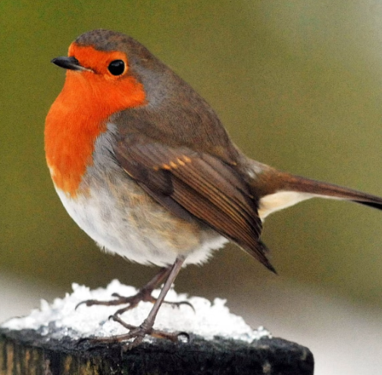
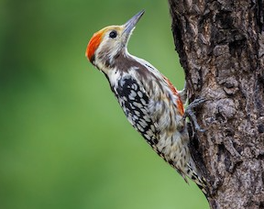
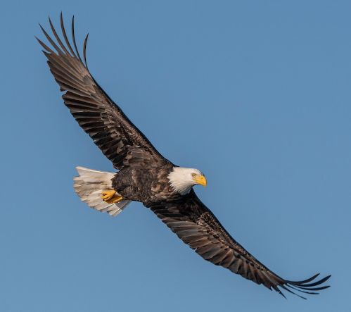
Robins
Woodpeckers
Eagles
Miss Webb
Mrs Gurupatham
Mr Adams

Slide 2
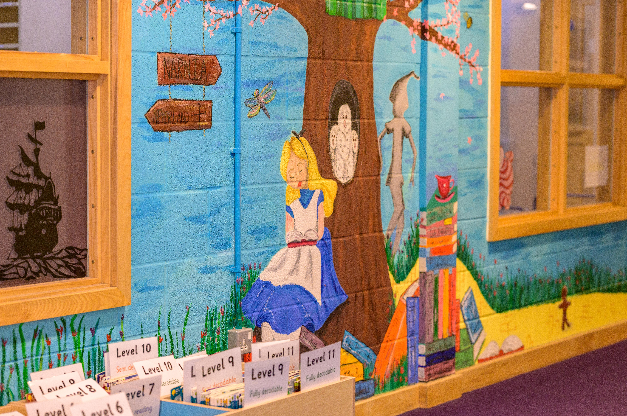

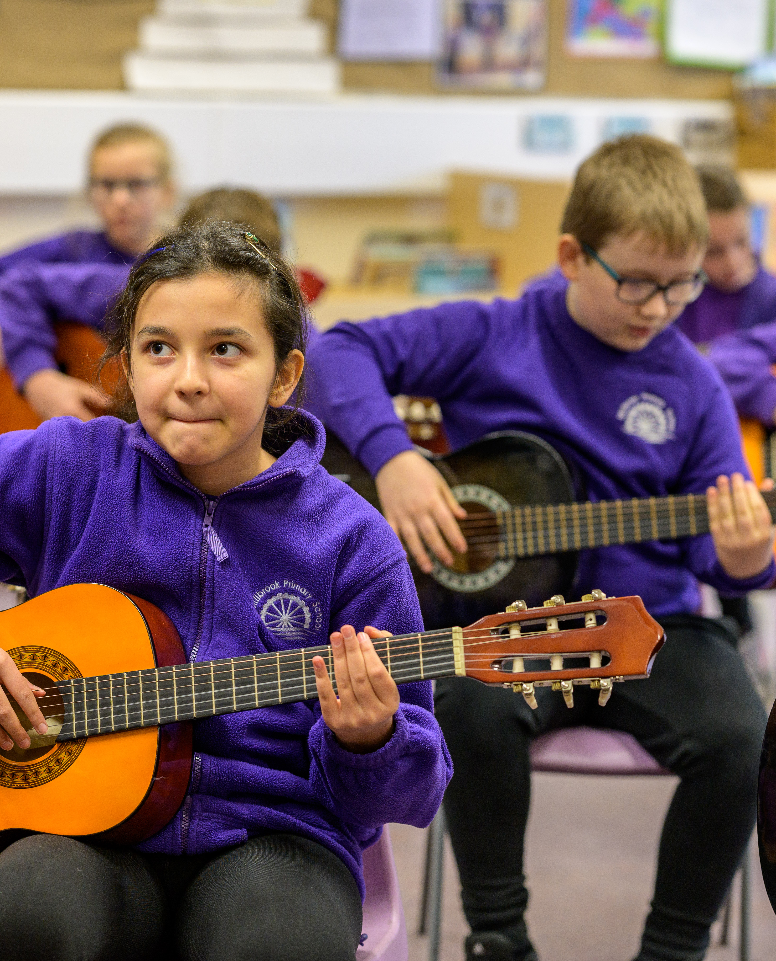

Introduction
Welcome to Year 5 and 6
Robins: Miss Webb
Woodpeckers: Mrs Gurupatham
Eagles: Mr Adams
Miss Ledbury, Mrs Meredith and Mrs Gomersall will be working across the Year 5/6 Team

Slide 3
In Year 5 and 6
Children are expected to further develop their independence with regards to seeking help and support within lessons, including helping themselves to resources appropriate to their task.
Children are expected to follow the Purple Promises and understand and demonstrate the Millbrook Values.
Children are expected to follow the guidelines set out for keeping safe. i.e. Long hair tied back; earrings covered or taken out for PE.
Children are expected to keep themselves organised and to look after their belongings. Please ensure everything is labelled.
Morning snack is not provided in KS2. If you would like your child to have a snack, please send a healthy snack e.g. fruit or a cereal bar.

Slide 4
Purple Promises
Millbrook Values
  We have our ‘Purple Promises’ instead of rules. These are:
I promise to be kind
I promise to listen and learn
I promise to show respect
I promise to fulfil my potential
Democracy – Our Voices Matter
The Rule of Law – We follow the Purple Promises
Individual Liberty – We own our choices and actions
Mutual Respect – We treat each other kindly
Tolerance of those of different faiths and beliefs – We celebrate differences

Slide 5
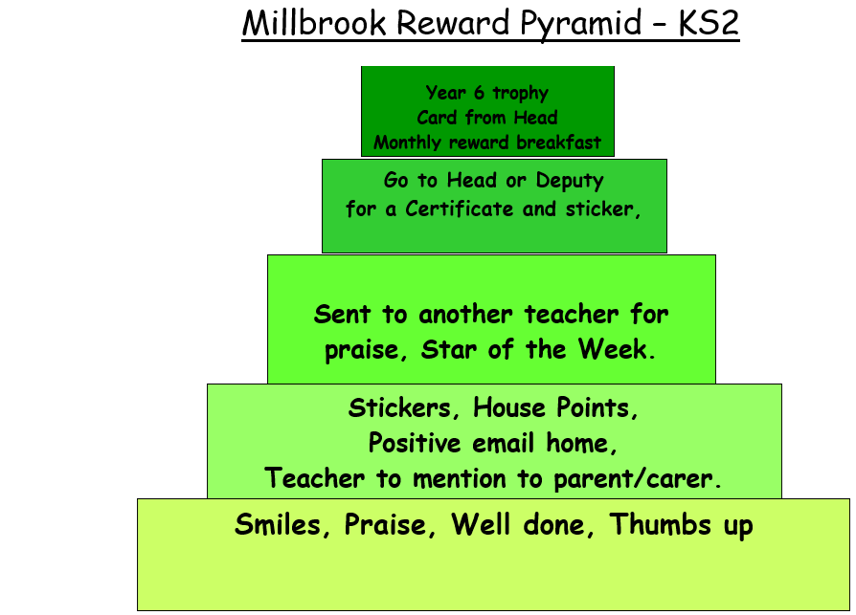

Slide 6
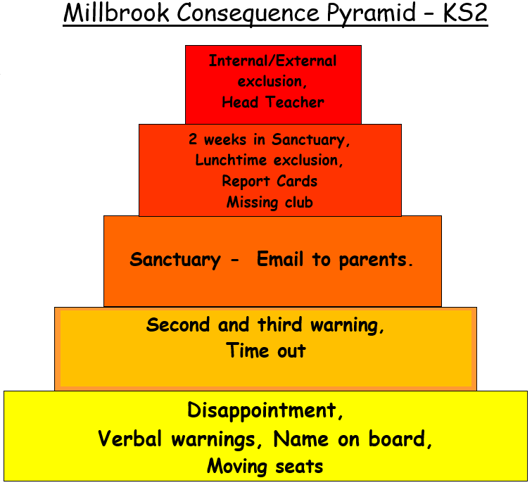
Name
Name
Name
Title
Title
Title
Title

Slide 7
Class Timetable
Morning Job
Start of the Day
8.30-8.45
Children should be in school by 8.45
Children will come in and complete a morning job – this could be spelling and handwriting based or Maths based
Morning Lessons
Children will complete lessons in English, Maths and Reading between 9.00am and 12.00pm with a 15-minute break at 10.45am
Lunchtime
Afternoon Lessons
End of the Day
Children finish school at 3.10 and can be collected from the playground.
Email class teacher about walking home.
Children will complete lessons in a range of subjects including Science, History, French and Music.
PE will take place on Monday and Wednesday for Eagles and Wednesday and Thursday for Robins and Woodpeckers.

Slide 8
Homework Expectations
How often
Expected
Children should read at least 5 times a week to develop fluency and understanding
Children should practise their spellings every day to ensure understanding and use of the word in context.
Complete the work set on Mathletics. This will be updated in line with what is being covered in Maths.
Reading - recorded in their Reading Record book.
Practise and understand Spellings.
Complete activities and games on Mathletics. It is essential that children know their times tables in Year 5 and 6.

Slide 9
Contacting Us
In Person
Via Email
Urgent Messages
If you would like to discuss something about your child, you may catch us on the door first thing in the morning or at the end of the day, however this is to pass on short messages.
If you would like a longer discussion book a meeting via the class email.
Now the children are more independent you may wish to allow them to trial walking home alone, in this case please send us an email with details of when the permission is given.
robins@millbrook.swindon.sch.uk
woodpeckers@millbrook.swindon.sch.uk
eagles@millbrook.swindon.sch.uk
If you have an urgent message to convey to us during the day, please contact the school office who will relay these to us as we do not always have the ability to check emails.

Slide 10

How you can help us:
Your child is capable of being highly successful.
Here are a few things that you might be able to help them with to ensure greater success.
Support your child to reinforce their learning at home.
Encourage independence.
Monitor online behaviour.

Slide 11
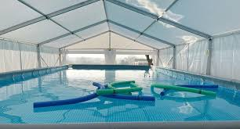
Swimming
Pools to Schools – Swimming pool will arrive at Millbrook for 3 weeks in October.
Children will receive lessons in groups of 12 to achieve the national curriculum skills, including swimming 25 metres.
They will have lessons every day for two weeks.
Some children will have extra lessons during the third week if they are still to achieve the 25 metres swim.

Slide 12
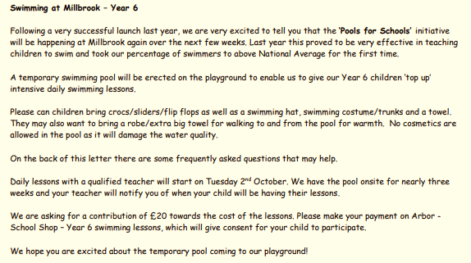

Slide 13
