Slide 1
SATs
Monday 11th May – Grammar, Punctuation and Spelling
Tuesday 12th May - Reading
Wednesday 13th May – Maths Paper 1 (Arithmetic)
Maths Paper 2 (Reasoning)
Thursday 14th May – Maths Paper 3 (Reasoning)

Slide 2
What can I do to help my child?
Don’t panic ☺
Times tables – the children need to be fluent
Read every day
Spellings – help/motivate children with their spelling work
Attendance

Slide 3
PGL Residential
12th – 15th June 2026

Slide 4
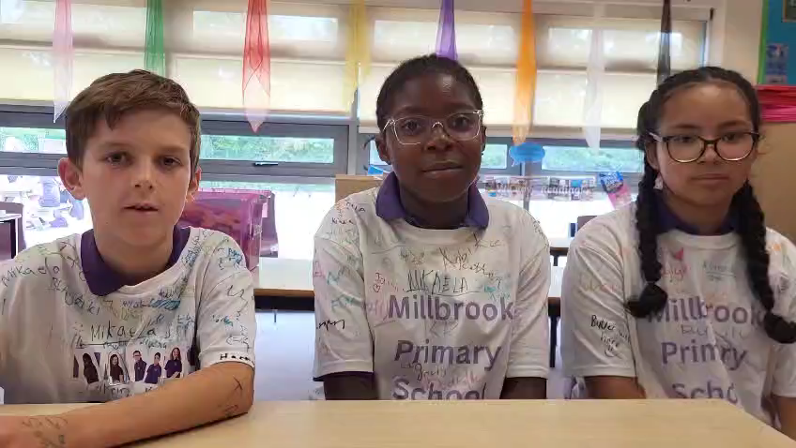

Slide 5
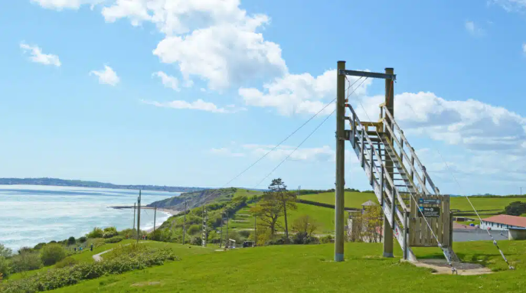
PGL osmington bay, weymouth

Slide 6
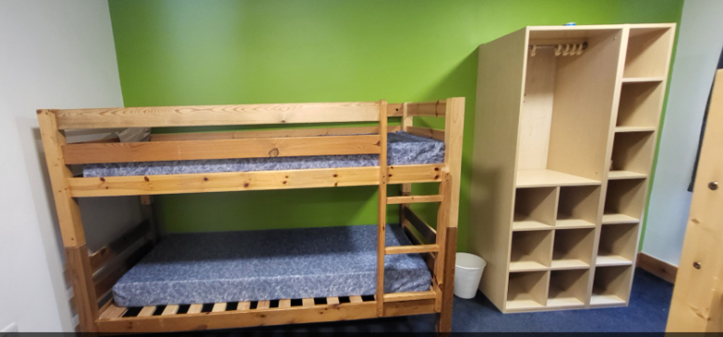
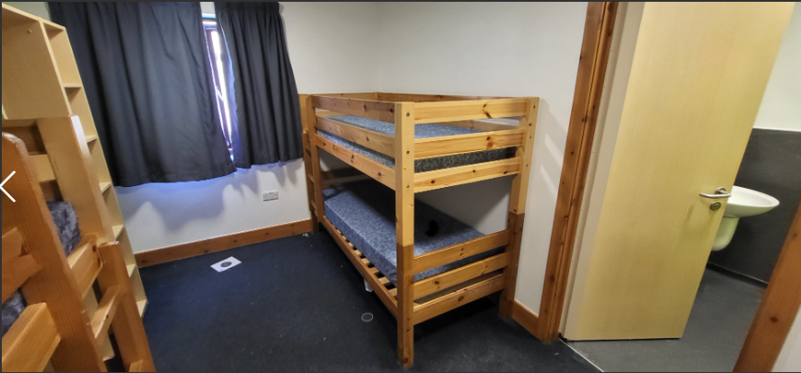
Accommodation
Ensuite Rooms with bunk beds - sleep 4

Slide 7
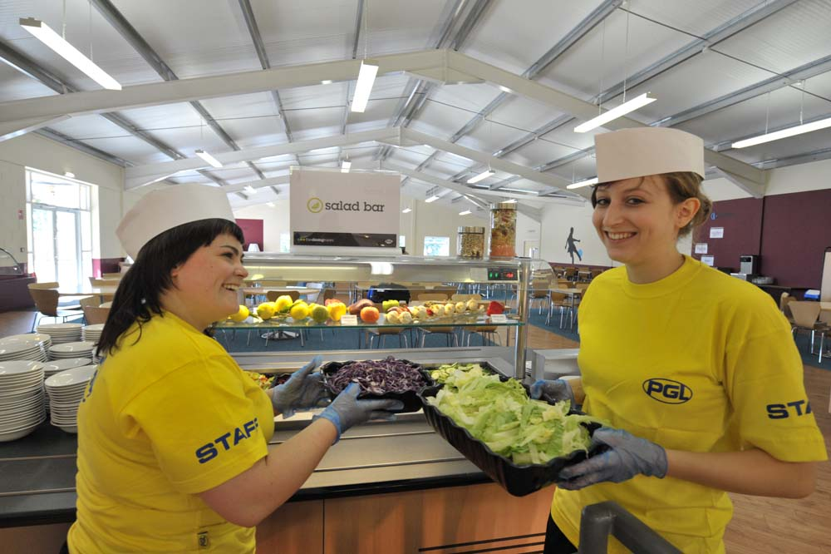
Catering
& dietary needs
3 nutritious, balanced
meals per day
Vegetarian option
Salad bar
Special diets catered for
by prior arrangement
Notes:
Continual investment in healthy menus
Fresh ingredients fully traceable to audited suppliers
Freshly cooked
Processed food avoided
Meals meet Local Authority guidelines
Caterers can deal with most dietary requirements but please ensure the party leader is aware of any dietary requirements well in advance.

Slide 8
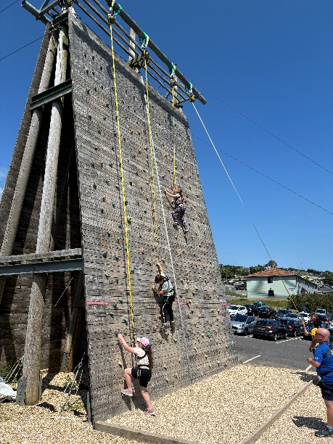
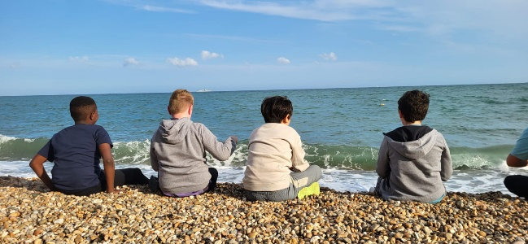
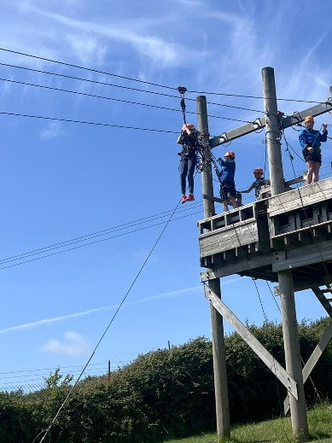
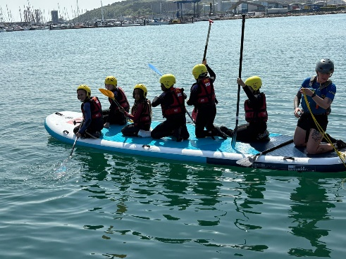
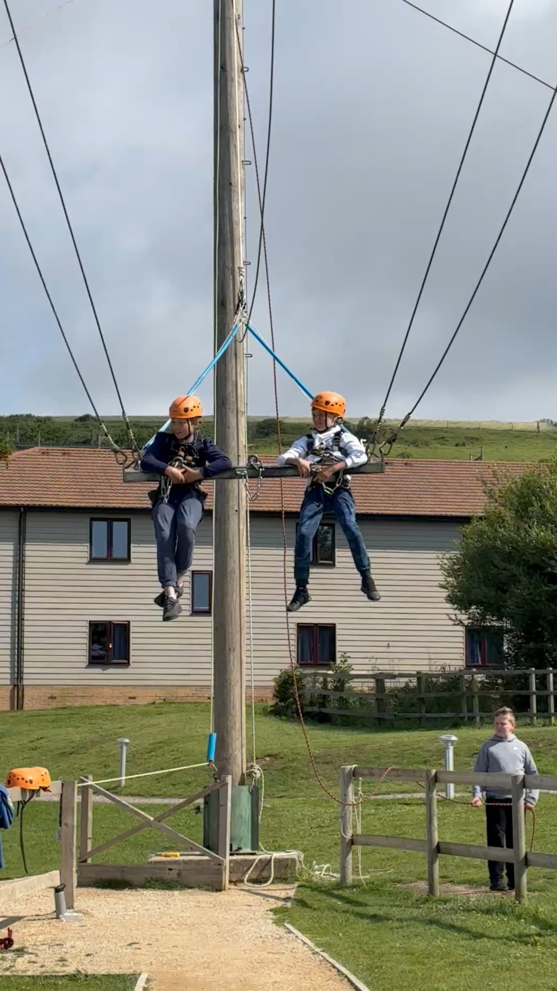
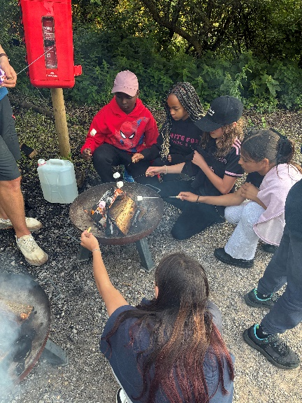
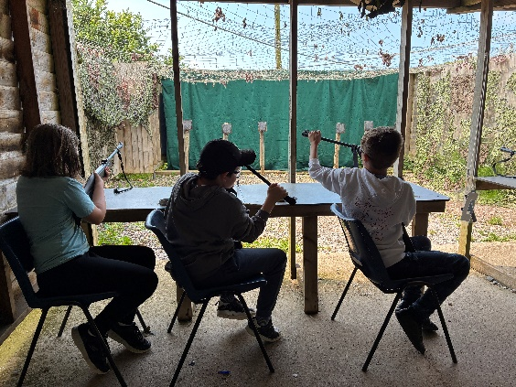
Our Activities
Abseiling
Aeroball
Archery
Campfire
Canoeing
Challenge Course
Climbing
Giant Swing
Jacob’s Ladder
Zip Wire
Paddleboarding
Rifle shooting

Slide 9
What Might Our Day Look Like?
Saturday and Sunday
07.00 - PGL staff wake up the group
08.15 - Breakfast
09.00- First activity session
10.30 - Break
10.45 - Second activity session
12.15 - Hot lunch or packed lunch
13.45 - Third activity session
15.15 - Break
15.30 - Fourth activity session
17.00 - Supervised free time
17.30 - 19.00 - 2 course evening meal
19.00 - 20.30 – Evening entertainment. Group Leaders assist until 21.00.
21.00 - 23.00 there will be PGL staff on active night duty. Through the night there will always be a senior PGL staff member on call.
Friday
Leave school at 9:30 am
Stop for Lunch
Arrive PGL 3:30pm
Introduction to group leaders; tour of site and rules
5:30 pm - 2 course evening meal
19.00 - 20.30 - Evening entertainment.
From 21.00 - 23.00 there will be PGL staff on active night duty. Through the night there will always be a senior PGL staff member on call.

Slide 10
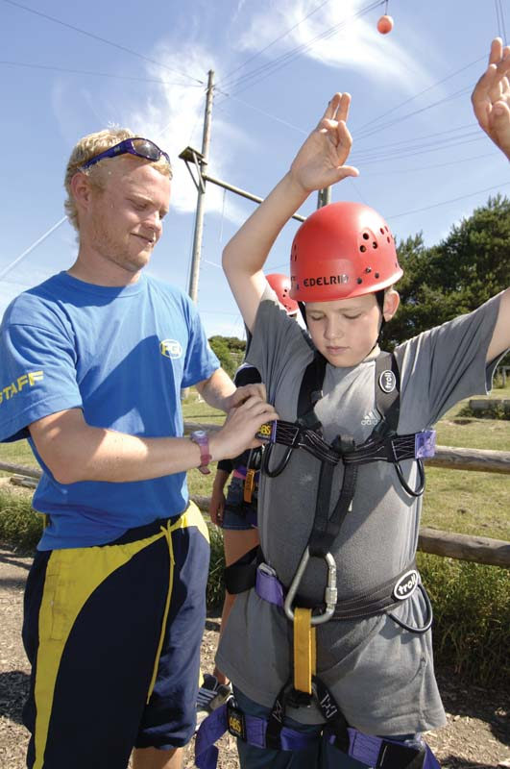

Staying safe!
The PGL Code of Practice describes all safety and
operational procedures both on and off-site including:
  sample risk assessments
  staff to pupil ratios
  staff vetting and training
  equipment specifications
  site security
  medical cover
  emergency procedures
Notes:
All centres and activities are fully risk assessed every year
The PGL Code of Practice details all the control measures put in place to minimise risk
Sample risk assessments are available on line and specific assessments are available from PGL on request
All our instructors are specifically trained for our programmes to ensure the delivery of safe and rewarding sessions across a wide range of activities
The staff recruitment process is as follows:
Detailed application form completed and submitted
Vetted by a dedicated HQ recruitment officer
Verification of all references, List 99 check and Criminal Records Bureau clearance obtained
Successful applicants undergo a compulsory probationary period lasting a minimum of ten days
Original qualification certificates checked
Prior to the beginning of the operating season, instructors and group leaders who have not worked for PGL before attend a residential training course
Job offer confirmed. On-going support, development training and assessment under the supervision of Senior Instructors.
At every PGL centre you will find an experienced and professional Centre Manager who is in charge of Centre operations and has overall responsibility for the success of your course and the performance of our staff.
Operating procedures conform to National Governing Body guidelines where these are relevant to the activity in question and the level being undertaken.

Slide 11

PGL Kit List
You may also want to pack:
Comfortable shoes/slippers for in rooms
Cuddly toy
Reading book
Travel games (NO ELECTRONIC GAMES ; IPODS OR MOBILE PHONES!)
Labelled plastic bin liner for smelly clothes.
Camera – disposable/digital
Roll-on deodorants – NO SPRAYS
Spending Money:
£10 for on-site shop
Essentials:
Sleeping bag and pillow
Rucksack
Suitcase or holdall
Named water bottle
Pyjamas
Leggings/track suit bottoms/cargo trousers etc (NO JEANS!!)
T-shirts
Socks and undies (lots)
Swim wear
2 pairs of old trainers (1 pair may get wet)
Waterproof jacket
Jumper/fleece
Toiletries (showers every night!)
2 towels

Slide 12

Medicines
If your child needs any form of medication (including morning or night time inhalers, Calpol etc) this needs to be named with full instructions and handed to the member of staff responsible for medicines on the morning of our departure.
We must have your signature on the GENERAL INFORMATION SHEET which allows us to administer any medicines/inhalers etc or to seek medical help if we need to.
If your child gets travel sick, please buy travel medicines. We will be travelling by coach on Friday and Monday.
Any child with Asthma, who needs an inhaler during the day, must carry their inhaler with them at all times and will not be allowed to try activities unless they have their inhaler with them!

Slide 13

Important things to remember
We will take good care of your children and have loads of fun!
Some children do get home-sick but we do not encourage phone contact with home as this often makes them feel worse.
On the Friday your child will need a packed lunch, snack and drink. Please put these in a plastic bag rather than a box.
Any spending money for the PGL site should be put in a named wallet/purse and handed to teacher. We suggest up to £10.
In case of emergency, we will take necessary steps to safeguard your child and contact school, who will contact you.
If you need to contact us, during school hours please speak to Mrs Spencer or Mrs Cox. Outside school hours, please see the contact sheet.

Slide 14
Finally
Please email Mrs Cox secretary@millbrook.swindon.sch.uk if you have any more questions after this meeting.
Total cost £254
Please log into your Arbor account, tick the consent box and pay your deposit of £30 by Monday 22nd September
A payment plan is offered of 6 payments of £32. Alternatively you can make a one-off payment of £222 – as well as the deposit. The full amount must be paid by April 24^{th.}

