Slide 1



Welcome to
Year 1 and 2
Mrs Lympany and Miss Moulding
Mrs Pringle and Mrs Thompson
Miss Steele

Slide 2
Key Stage 1 Topics
Once Upon a Time
Let’s Celebrate
Up, Up and Away!
Britain is ‘Great’!
Under the Sea
Down in the Garden

Slide 3



Slide 4
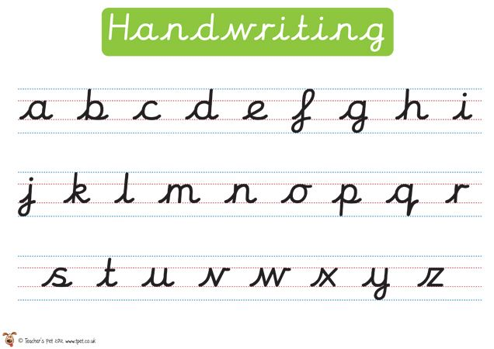
Handwriting
Year 1 Handwriting
In Year 1 the children are taught to write using cursive script. This is when all of the letters whoosh-in and whoosh-out.
form lower case and capital letters in the right direction
to know which letters, belong to which handwriting ‘families’
Year 2 Handwriting
form capital letters and digits of the correct size, orientation and relationship to one another and to lower-case letters
use spacing between words that reflects the size of the letters

Slide 5
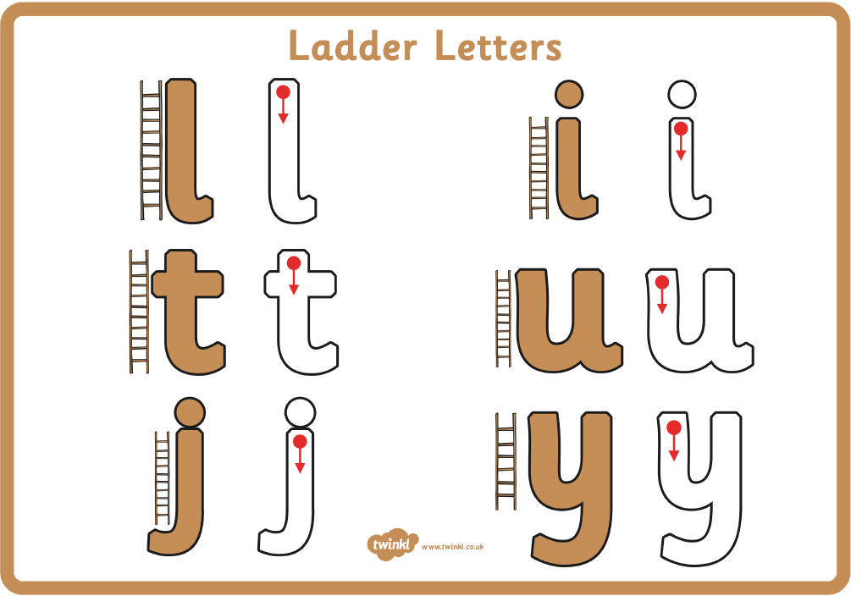
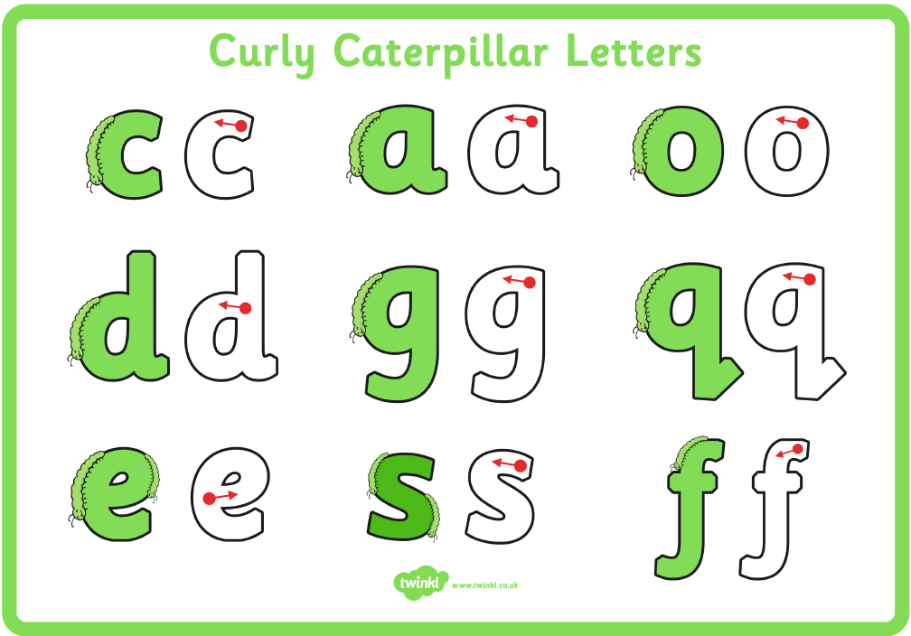
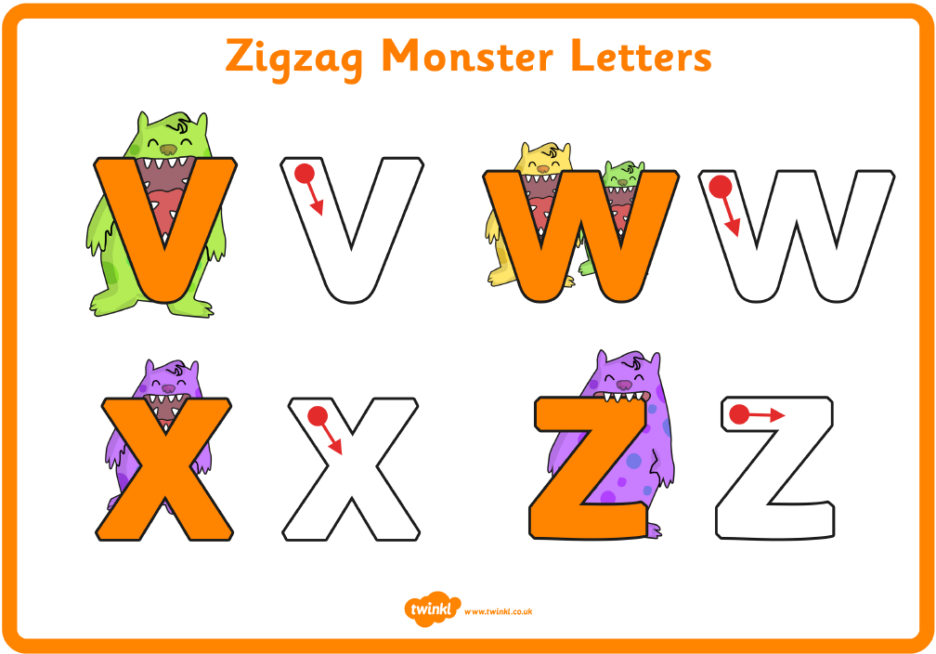
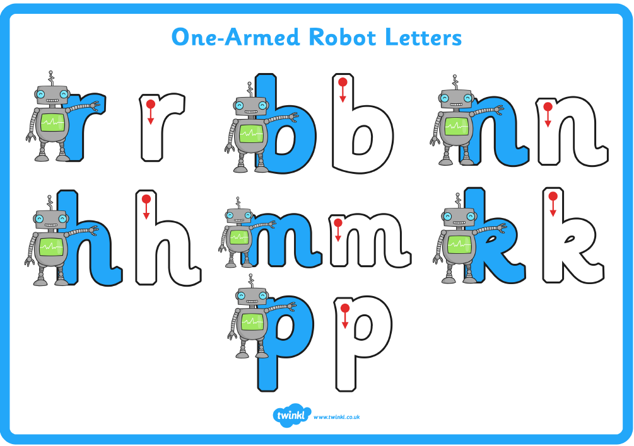
Letter Families

Slide 6

Communication

Slide 7

Communication with parents
We will send out a Key Stage 1 Newsletter via email or as a
text with a link each term. Any additional letters will be sent
out this way too. If you are not receiving these, please
inform the school office.
Letters will provide details of what we will be learning,
information about upcoming trips and about how you can
support your child with their learning at home.
You can also look up Seahorse, Turtle and Octopus Class pages on our website
We will continue to use Dojo at the beginning of Year 1.
This Photo by Unknown Author is licensed under CC BY-SA-NC

Slide 8
How to contact us…
If information is urgent, and during the school day, please call the school office.
turtles@millbrook.swindon.sch.uk
octopus@millbrook.Swindon.sch.uk
starfish@millrook.swindon.sch.uk

Slide 9

Reading
This Photo by Unknown Author is licensed under CC BY-NC

Slide 10
Reading
In KS1 children will read with the class teacher or teaching assistant at least once a week. Sometimes this will be will be in a group.
Reading at home has a huge impact to support reading, the end of year aim is that Year 2 are looking to reach level 10.
In Year 1 the aim is to reach level 6.
We are not looking to race up the reading levels, we are looking to develop children’s inference, fluency and a love of reading which will help them throughout their time in school.
Reading a mixture of schoolbooks and home books is encouraged!

Slide 11
How To Help Your Child With Reading At Home
Please try to read 5 times a week. Reading at home has a huge impact on a child’s ability to read.
Help them to blend phonemes to read unfamiliar words. Encourage them to spot Common Exception Words. These are on the final slide for your information.
Talk to them about the book asking questions such as what has happened so far? What do think will happen next? Why did that character say that? How is this character feeling and why? How do you know this? How would you feel if you were ....? How can I find information about…?

Slide 12


This Photo by Unknown Author is licensed under CC BY-NC

Slide 13

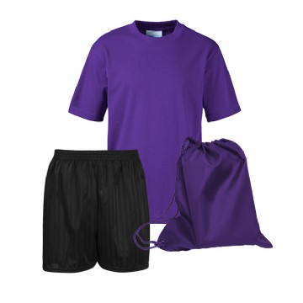
PE Days are:
Tuesday and Thursday
Long hair should be tied up and earrings should not be worn.
Tell Me Time
We have sent out the timetable for this and this will be updated each term to ensure that each child has an opportunity to share something they have achieved outside of school.

Slide 14

Support at Home

Slide 15
Other things to do at home
Maths homework we will be using NumBots or Times Table Rockstars. You should now have received your login.
Year 1 will use NumBots to support children’s development of counting and number bonds.
Year 2 begin to use Times Table Rockstars to begin developing their understanding of their times tables starting with 2s, 5s and 10s.
Wonder words - To widen vocabulary, we will send out weekly ‘wonder words’ for you to discuss with your child. Please talk about the meanings of these and encourage your child to use these in sentences.

Slide 16
Other things to do at home
Spellings will be given out at the end of each term ready for the new term. Your child will then have a spelling test every Friday.
The spellings are linked to phonics, topic words, Year 1/2 spelling rules and common exception words. We use a bronze, silver and gold system to differentiate our spellings.

Slide 17
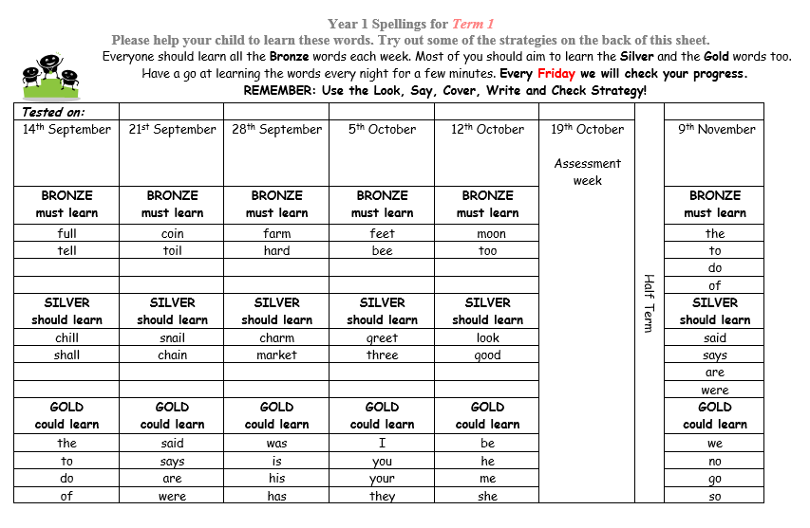
Example of spelling sheet.

Slide 18
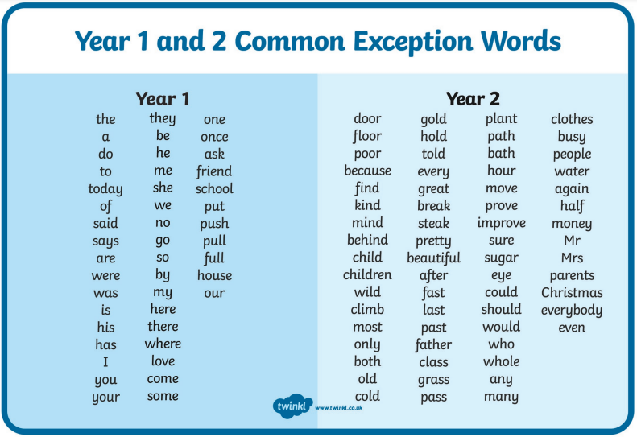
Common exception words – these will be an important focus for us to both read and spell in year 1 and year 2.

Slide 19
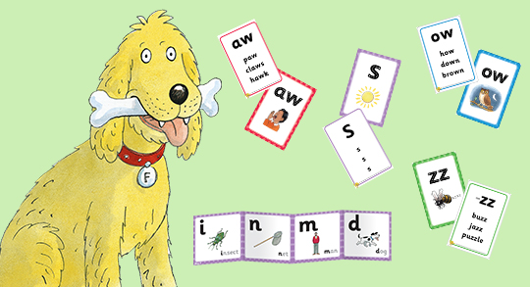
Phonics
Year 1 and 2 – Phonics is taught daily.
Year 1 children will take part in a Phonics screening in June.
Children who did not pass the screening check at the end of Year 1 will take the test again in June 2025.

Slide 20
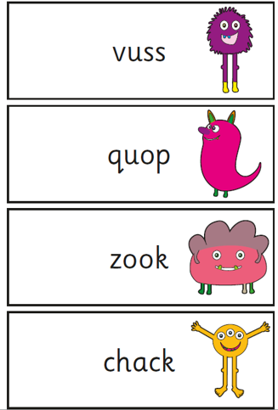
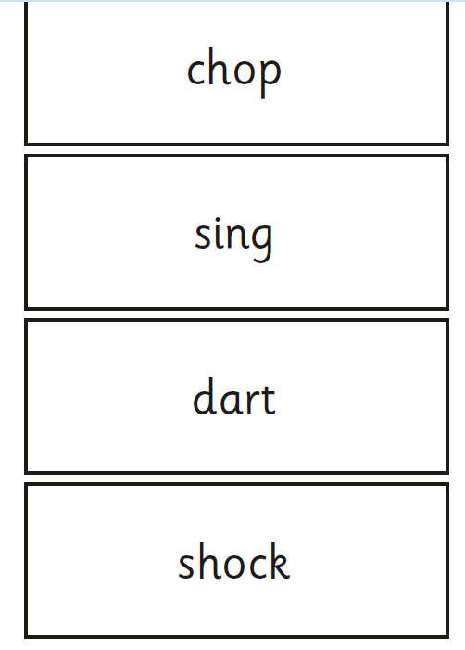
Phonics screening check – examples of words

Slide 21


