Slide 1
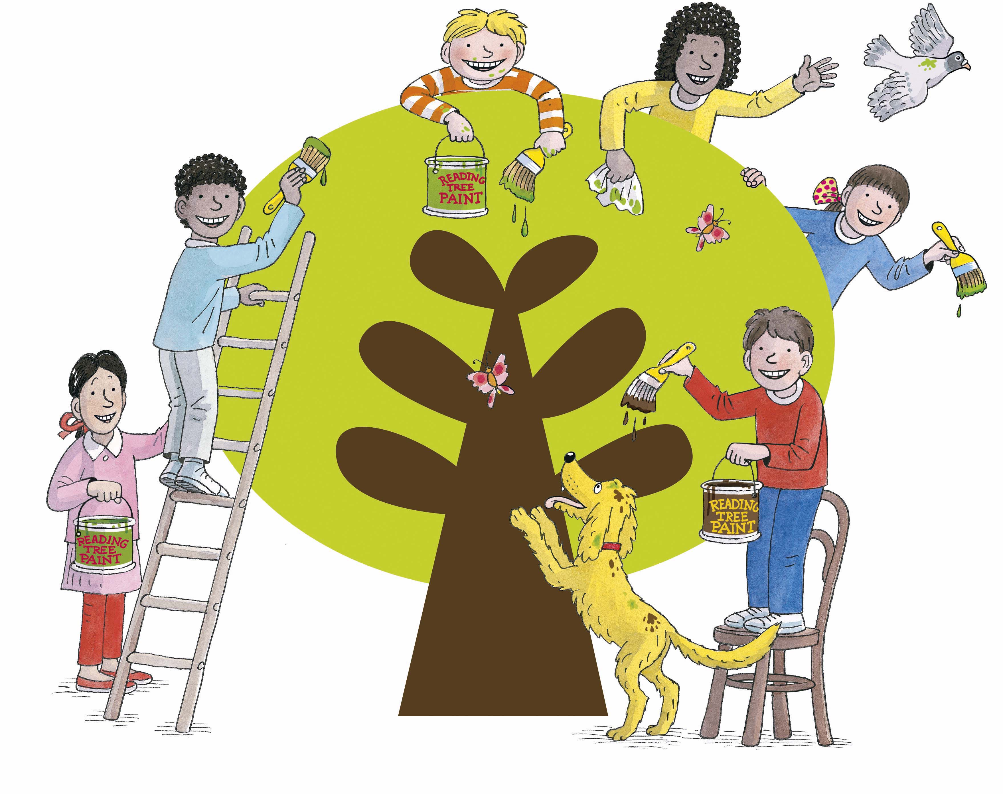
Phonics at Millbrook

Slide 2
Sounding out
Blending
What do we mean
by ‘Phonics’?
Tricky words
Phoneme
Grapheme

Slide 3

Some Definitions
A Phoneme
This is the smallest unit of sound in a word.
How many phonemes can you hear in
cat?

Slide 4

A grapheme
These are the letters that represent the phoneme.
The grapheme could be 1 letter, 2 letters or more!
b ai ear

Slide 5
Grapheme Key Vocabulary
Digraph
Trigraph
Split diagraph
2 letters making one sound ( ai, ee, oo)
3 letters making one sound ( igh , dge )
Where the two letters are not adjacent
( a-e, e-e )

Slide 6
Oral blending
Pre reading and writing skills
Oral segmenting
Splitting up the sounds in a spoken word. E.g. hat = h-a-t.
Merging the sounds in a spoken word.
E.g. h-a-t = hat

Slide 7
Blending (for reading)
Recognising the letter sounds in a written word.
c u p
Merging them in the correct order to pronounce the word.
cup
Sometimes we put sound buttons under each phoneme to help us read a word.
cup

Slide 8
Put the sound buttons under these words
dog
food
crawl
slight

Slide 9
Segmenting (for spelling)
Identifying the individual sounds in a spoken word (e.g. h-i-m , s-t-or-k) and writing down letters for each sound (phoneme) to form the word.
We use our segmenting arms to do this.

Slide 10
How many phonemes are in each of these words?
Word | Phonemes
bleed
flop
cow
short

Slide 11
In addition to this, the children learn ‘tricky words’.
We also call them ‘helpful words’.
These are words that are not spelt phonetically and can’t be sounded out. We just have to learn them.
the to no
go she
we me be

Slide 12
What does Phonics look like at Millbrook?
It is a requirement that reception children are taught 20 mins of Phonics per day.
It is recommended that Year 1 and 2 children also receive 20mins per day.
At Millbrook, if a child is not confident at applying their phonic knowledge by the end of Year 2, they will continue to learn Phonics through the Project X Code intervention in KS2.

Slide 13
A typical Floppy’s Phonics lesson…

Slide 14
How can I help my child?
PLEASE pronounce the phonemes correctly.
Little and often (at least 5 times a week is what we recommend).
You don’t need to read the entire book in one go – a couple of pages of quality reading and discussion is plenty.
Encourage your child to use their Phonics skills.
Talk about the book and ask your child questions (examples will be given out at parents’ evening).
Reread books to encourage fluency and confidence.
Please let us know if any books are damaged so we can fix these.

Slide 15
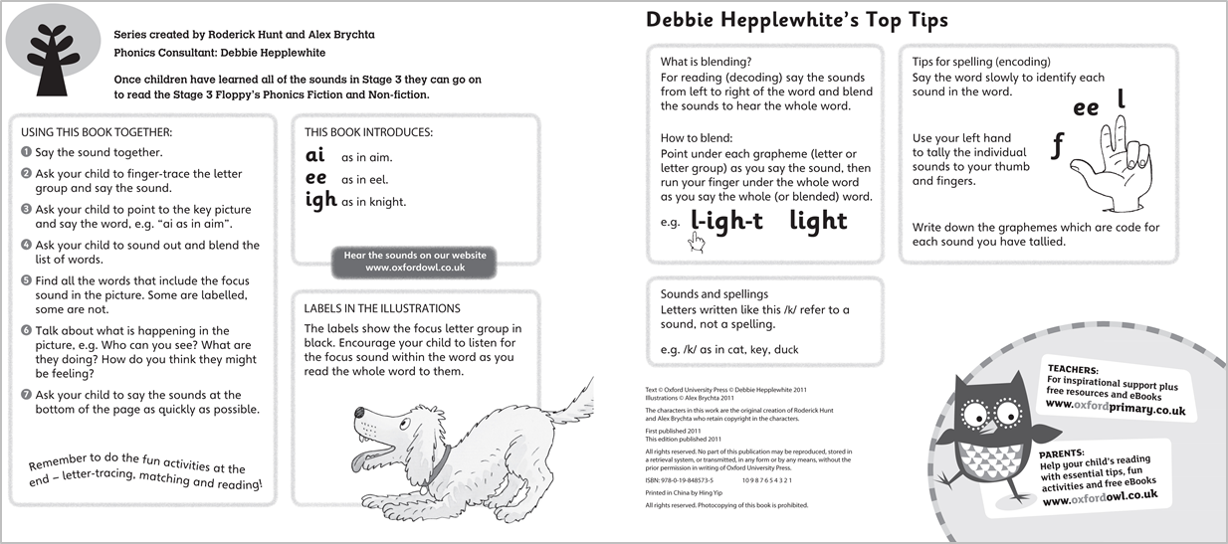
Cover notes in the Floppy’s Phonics Books provide guidance for you to support your child:
Notes:
Many current UK cumulative decodable reading books provide explicit guidance for the supporting adults in the cover notes for blending.
The FP Sounds Books give guidance for both blending and segmenting for spelling.

Slide 16
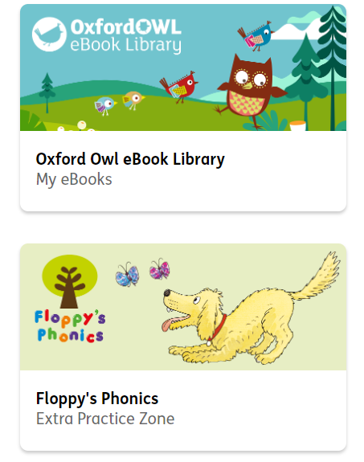
Using the Floppy’s Phonics website

Slide 17

Reading for pleasure
Books are a rich source of new words for your child; words you would not use in everyday conversations appear in books.
Children need to have a wide vocabulary to understand the meaning of books, so read aloud and share books as often as you can.
They will enjoy it and it will be useful to them when they come across these words in their own reading later on.

Slide 18

The importance of speaking
Your child will not be able to write in sentences until they can speak clearly in sentences!
Speaking and listening are the foundations for reading and writing.
Even everyday activities such as preparing meals, tidying up, putting shopping away and getting ready to go out offer you the chance to talk to your child, explaining what you are doing. Through these activities, children hear the way language is put together into sentences for a purpose.

