Slide 1
Milverton Community Primary and Pre-school
SEND Information Report 2024-2025
Co-produced by the School SENCO, Staff, Governors and School Parent Forum

Slide 2
Our Core Offer At Milverton Community Primary and Pre-School we value inclusion for all children and ensure that everyone in our school community prioritises and embodies our school values: We Care. We Aspire. We belong. We have high expectations and aspirations for everyone regardless of differences in academic attainment, interests and attitudes. We aim to provide an environment where all pupils feel safe and can flourish. We are committed to providing an education that enables all pupils to make progress with the right level of support, care and encouragement to achieve their best and become confident individuals living fulfilling lives. Some children may require additional support to help meet their needs or progress with their learning. The additional support may be through: specific resources, teaching approaches, interventions or adult support. The decision to implement additional support is made as part of a team approach involving the school, parents and children and is based on a variety of factors including each child’s social, emotional and academic needs. As a school we understand that children’s social and emotional development is key to their academic progress and value the importance of supporting children’s self-esteem, self-regulation and resilience. The need for additional support may also be identified through assessments carried out by teaching staff or other professionals. It may also be based on ensuring children have a smooth transition into school, or through different phases within school, or if a child is going through significant change either at home or school. A pupil has SEND where their learning difficulty or disability calls for special educational provision that is different from or additional to that normally available to pupils of the same age. A pupil may also have SEND if they a significantly greater difficulty in learning than the majority of their peers of the same age. This information report describes the range of provision and support available to identified children as and when appropriate. This information is subject to change depending on budgetary constraints and policy review. Milverton Community Primary School is a maintained primary school with no specialist provision on site.

Slide 3
Who are the best people to talk to in school about my child’s difficulties with learning?
Mrs Meera Pow is the school SENCO. She is qualified with a Postgraduate Certificate in the National Award for Special Educational Needs Coordination. She is responsible for the day-to-day implementation of the SEND Policy and coordination of specific provision to support pupils with SEND. Her working days are Mondays,Wednesdays, Thursday mornings and Friday mornings. She can be contacted via the school office on 01823 400439 or email: SEND@milvertonprimary.co.uk
Your child’s class teacher – they are responsible for your child’s learning and progress and are the first person you should talk to if you have any concerns.
Mrs Nicola Stoddart is the Headteacher. She is responsible for the management of all aspects of the school.
Dr Clare Adams is the SEND Governor. She is responsible for developing and maintaining an awareness of Special Educational Needs provision within the school on behalf of the Governing Body.

Slide 4
What different types of SEND are supported at Milverton School?
There are 4 broad areas of need. Milverton Community Primary and Pre-School staff have resources and training to support all 4 areas of need. Where needs are more complex or requiring specialist support, beyond what we can provide under ordinary provision in school, we will liaise with outside agencies to ensure appropriate support is provided where possible.
Communication and Interaction
Cognition and Learning
Social, Emotional and Mental Health
Sensory and/or physical
Children may have difficulties communicating with others. This includes speech, language or social communication difficulties. This includes children with Autism Spectrum Condition.
Children and young people may learn at a slower pace than their peers, even with appropriate adaptive teaching. This covers moderate learning difficulties (MLD), severe learning difficulties (SLD) . This also includes specific learning difficulties (SpLD) such as dyslexia, dyscalculia and dyspraxia.
Children may have underlying mental health difficulties such as anxiety or depression, self-harming, substance misuse, eating disorders or physical symptoms that are medically unexplained, which may lead to withdrawn or challenging behaviours. Other children and young people may have conditions such as attention deficit hyperactivity disorder (ADHD) or attachment disorder. Challenging behaviour is not in itself a SEN but a communication of underlying difficulties.
Children may have a difficulty or disability which prevents or hinders them from making use of the educational facilities or opportunities generally provided.

Slide 5
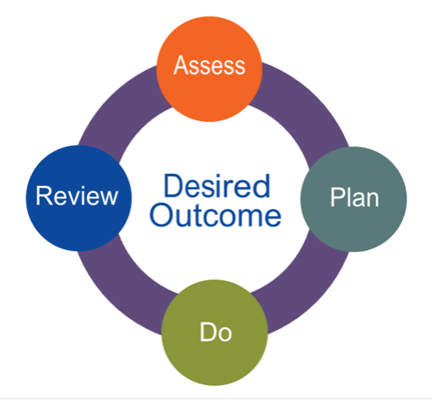
What will happen if the school or I have concerns about my child? How will I be involved?
The Graduated Response
When identifying children who may have SEND and require additional support we follow the four part cycle of Assess, Plan, Do and Review (APDR)
Plan
Once an area of need is identified and baseline assessments have been carried out, the class teacher and SENCO will agree any additional support and interventions and set desired outcomes for the term ahead. This will all be recorded on a My Learning Passport and shared with parents/carers and pupils.
Assess
To enable us to have a clear understanding of the child’s need/s, teaching staff will use ongoing class observations and assessments, along with the views of parents/carers and pupils and previous progress and attainment information to identify any potential barriers to learning or additional needs. They may request additional specialist assessment or support to be provided by the school SENCO/outside professionals.
Do
The class teacher remains responsible for the progress of the child whilst the additional support and intervention is carried out and will liaise with any adults providing additional support and parents/carers and pupils regarding this support.
Review
Termly reviews of the pupil My Learning Passports will be carried out by class teachers, supported by the SENCO and the desired outcomes evaluated. Continued and further support and outcomes will be agreed and shared with parents/carers and pupils if required.

Slide 6
What different types of support are available to children with SEND at Milverton School?
The Graduated Response
As part of the Graduated Response to supporting additional needs and SEN we use resources within Somerset’s Graduated Response Tool for supporting children with additional needs. The strategies and recommendations within this inform our school provision map (on the next page) and tiered support for children.

Slide 7
What different types of support are available to children with SEND at Milverton School?
Milverton Community Primary and Pre-School Provision Map
Specialist – EHCP/High Needs
Highly adapted and adjusted curriculum planning and 1:1 support with additional input and specialist support from external agencies and a possible EHCP.
Specialist
EHCP/High Needs
Targeted – SEN Support
Universal high quality teaching adaptive practice in place and in addition:
individual speech and language support, personalised social stories, personalised Now and Next cards, individual ELSA support, additional Forest School, individual English and maths support in addition to class teaching. Individual precision teaching/phonics/reading. Support from external professionals, often involving care plans (SALT, OT), AATT provision (ICT). Environmental adaptions to the classroom (such as own work station).
Targeted
SEN Support
Universal – High Quality Teaching
Whole Class: Adaptive teaching and planning for activities/delivery/outcomes. In class TA support. In class targeted teacher support. Adapted phonics, reading bands. Increased: visual aids, chunked instructions, additional modelling, visual timetables, writing frames and scaffolds, word banks., multisensory teaching practice, alternative forms of recording, access to ICT, school Managing Relationships and Behaviour policy adaptations, adapted school PSHRE curriculum, proprioception / movement breaks, wobble cushions, pencil grips, fiddle toys, buff paper, reading rulers, coloured overlays etc.,
Small Group: Pre/Post teaching. Priority readers. Additional phonics boosters. Speech, language, communication and social skills groups (Time to Talk, Talk Boost, Socially Speaking, NELI, LEGO Therapy, small group ELSA support). Gross and fine motor support. English and Mathematics boosters. Precision teaching. Numicon. Specific proprioception exercises.
Universal
High Quality Teaching
(Whole Class and Small group)

Slide 8
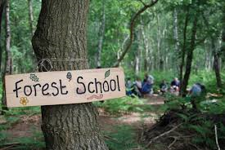
How is extra support allocated to children?
The school budget is received from Somerset County Council. The Headteacher makes decisions on the allocation of the budget for SEND in consultation with the School Governors, Finance Officer and SENCO. This is allocated on the basis of the needs within the school and is reviewed regularly. Funding is allocated depending on individual children’s level of need and the support they require. For some children whose learning needs are high, complex or lifelong, additional high needs funding is provided by the local authority through an Education, Health and Care Plan (EHCP). The school budget is limited but we will always endeavour to do our best to support the pupils with SEND within our school. All classes are supported by teaching assistants to support in delivering the curriculum and any additional provision identified.
At Milverton School we use our SEND budget to provide the following additional support. We have 2 trained Emotional Literacy Support Assistants (ELSA) and a weekly Forest School provision to support children’s social and emotional development. Please see our wellbeing page of our school website for further information.

Slide 9
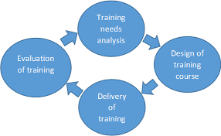
How are the teachers in school supported to work with children with SEND?
The SENCO attends regular development opportunities within the local cluster of schools and half termly meetings for the local area, which she then shares with other staff members through staff meetings.
Termly Pupil Progress Meetings are held with class teachers, the SENCO and the Headteacher to discuss and support individual and groups of children.
The SENCO runs regular staff meetings to develop staff knowledge in the different areas of need and how they can support pupils within their class.
Regular review meetings are held with staff, the SENCO, parents and pupils for those children with identified needs on the SEN register, to identify the things working well and things that need improving.
Staff training may be provided by external professionals, such as an Educational Psychologist or Access to Inclusion team, focused on areas identified within the school action plan. Individual members of staff identified as having specific training needs are supported internally, where possible, or through trainings provided by Somerset’s Support Services for Education, where relevant.
A SEND Planning Meeting is completed annually, with our link Educational Psychologist and Access to Inclusion Team to identify areas for focus for the coming year and an action plan written to address these.

Slide 10
Who are the other people providing services to children with SEND in this school?
Our school is supported by professionals from Somerset Partnership NHS Trust. These services provide support for individual pupils with additional needs. This includes support from Occupational Therapists (OT), Speech and Language Therapists (SaLT), Physiotherapists (PT) and the Children and Adolescent Mental Health Services (CAMHs).
Our school is supported by professionals from the Support Services for Education from the Local Authority. These services provide support and training for school staff, when relevant. These include The Educational Psychology Service, Access to Inclusion Service, Virtual School, Early Years Areas SENCOs, Hearing Support Team and Access and Assistive Technology Team.
Our school works in partnership with Taunton Deane Partnership College to support individual pupils and staff development with Social, Emotional and Mental Health Needs (SEMH) where additional support or strategies is deemed necessary.
We are part of the Mental Health in Schools Team (MHST) network and have a link Education Mental Health Practitioner who works with individual children and families, as well as supporting needs across the school to promote positive mental health within our school community.

Slide 11
What support is available for me as a parent of a child with SEND?
We value our relationships with parents and carers and encourage regular communication. We work closely and collaboratively with you to identify your child’s needs and consider how we can work together to support your child to achieve their full potential. We value your views and opinions and try to involve you in all aspects of your child’s support through regular review meetings, including discussions regarding support that we may seek from external professionals.
We signpost you to access support through SENDIAS and the Parent Carer Forum as well as opportunities to attend workshops run by professionals such as sensory workshops and parenting courses. We also encourage you to understand the Local Offer through exploring the website for what services are available and accessible in Somerset.
Our school Parent and Family Support Advisor (PFSA) Tean Rowland is available to support you and your family, if needed. Referrals are made through the school SENCO, Mrs Pow or Assistant Headteacher for Wellbeing and Pastoral, Mrs Smith.

Slide 12
How will you support my child with SEND when they are joining the school /moving to a new class / moving to a new school?
When your child is moving to Secondary School we hold a transition review meeting with the SENCO from your child’s new school to share information and carefully plan any additional support they may require, including additional visits. We will pass on any paper or digital files to the new school once they are on role there.
When starting school in the Early Years Foundation Stage we hold a School Entry Plan Meeting with parents and all professionals involved in your child’s care to share information and carefully plan their transition to school and the support they will need, including additional visits.
At the end of each academic year, we hold a transition review meeting where the current teaching team share information and current provision with the new teaching team for the year ahead and carefully plan any additional support they may require going forward.
If your child moves to another school during their time at primary school then we will contact the SENCO at the new school to share information and ensure that all records (both paper and digital) are passed on to them as quickly as possible.
If your child moves to Milverton during their time at pre-school or primary school then we will make contact with the SENCO from their previous school to request information and will arrange a transition meeting with you to share information and carefully plan any additional support they may require.

Slide 13
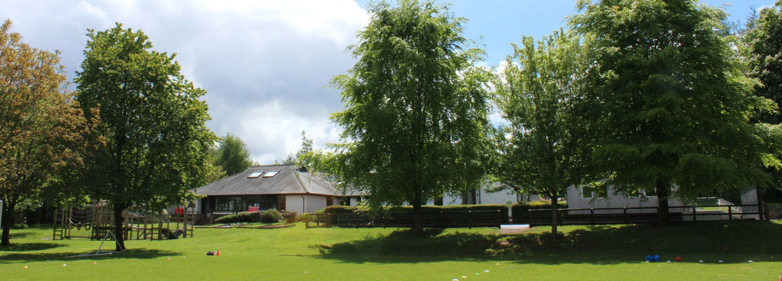
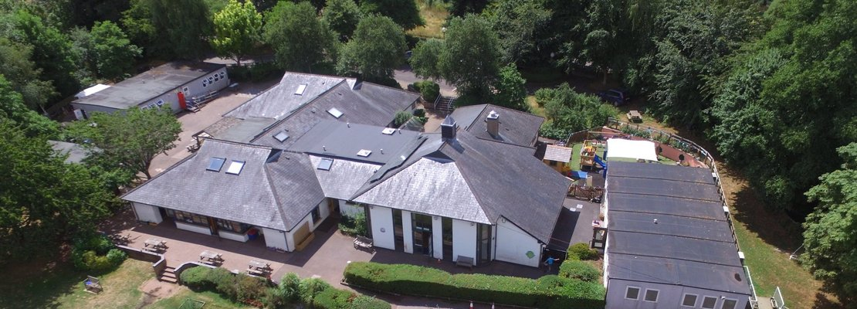
How have you made the school accessible for all children?
Milverton School is fully wheelchair accessible. We have a disabled toilet with a hoist and changing table and a designated disabled parking space at the front of the school. The school grounds are mostly accessible with sloped areas leading on to the school playing field. We have a designated area to support children in developing their social, emotional and mental health needs. Our school provision includes Emotional Literacy Support Assistants (ELSA) and a Forest School Provision (one afternoon per week) for children identified by the school as requiring either of these provisions. We liaise with the Access and Assistive Technology Team within the Local Authority regarding individual pupils to ensure we are supporting their auditory, visual and physical, as well as medical needs and seek support from this team to advise on details within our Accessibility Plan reviews.

Slide 14
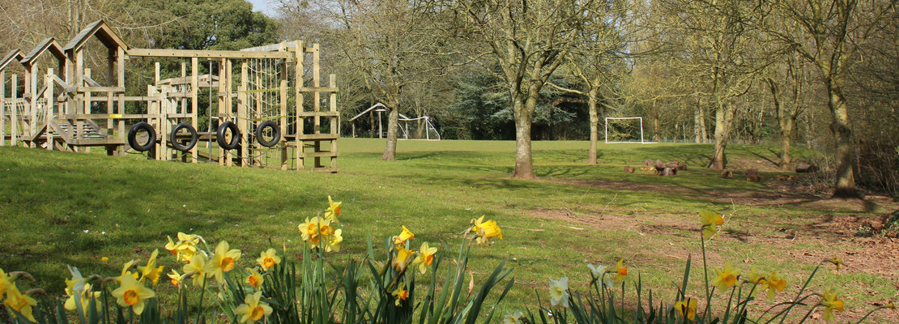
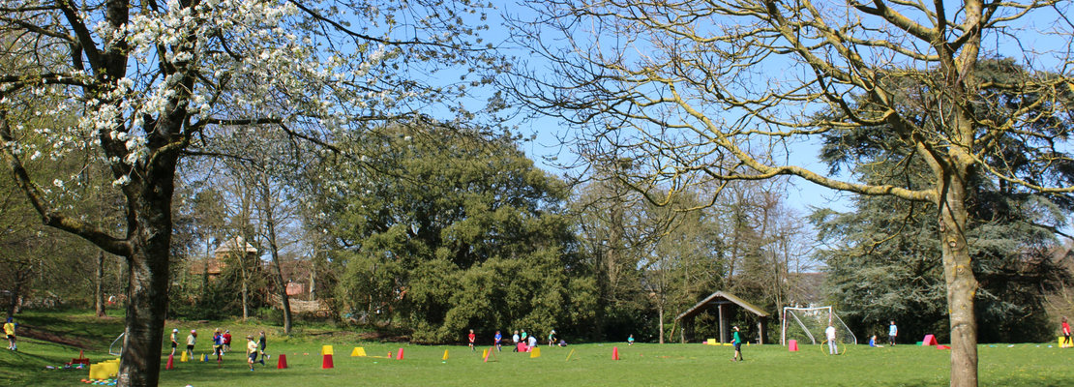
What further information do you have about how SEND is supported in school?
This SEND Information Report should be viewed and considered in conjunction with the school’s SEND Policy that is available on our website. Further information can be gained through contacting the school office at office@milvertonprimary.co.uk

