Slide 1
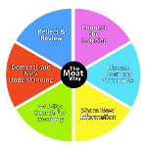
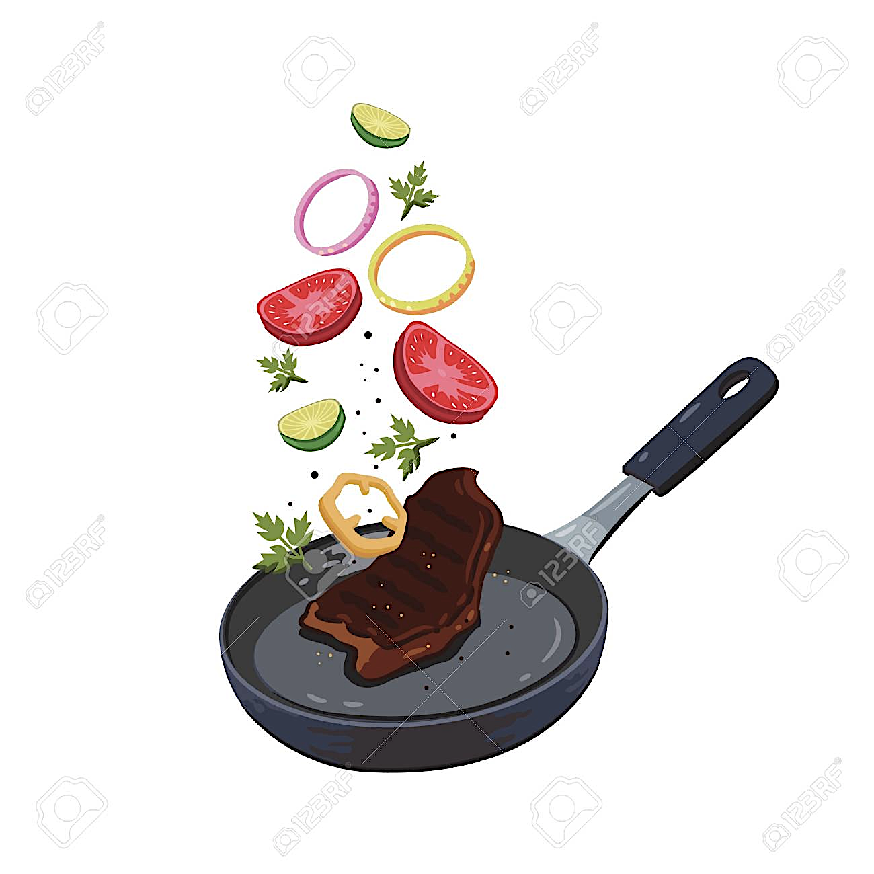
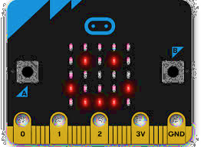
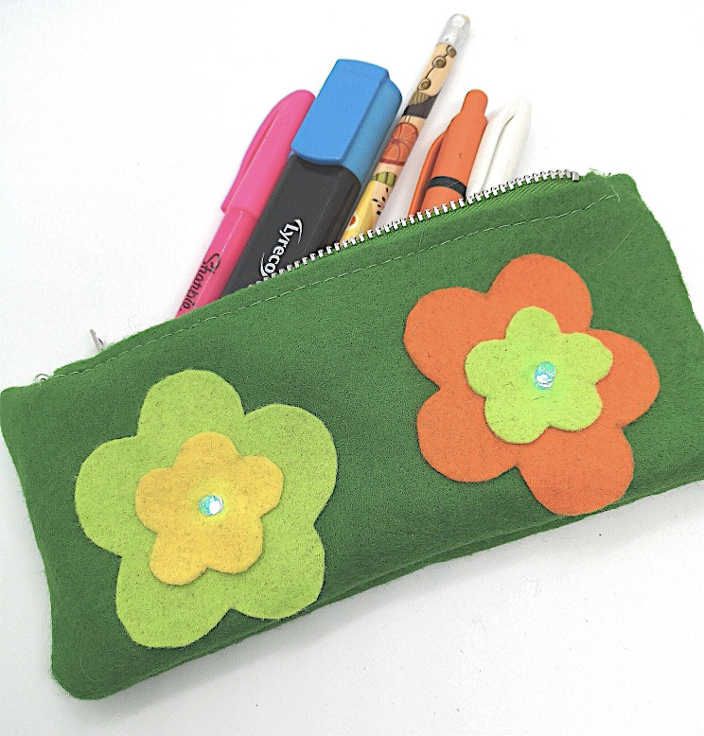
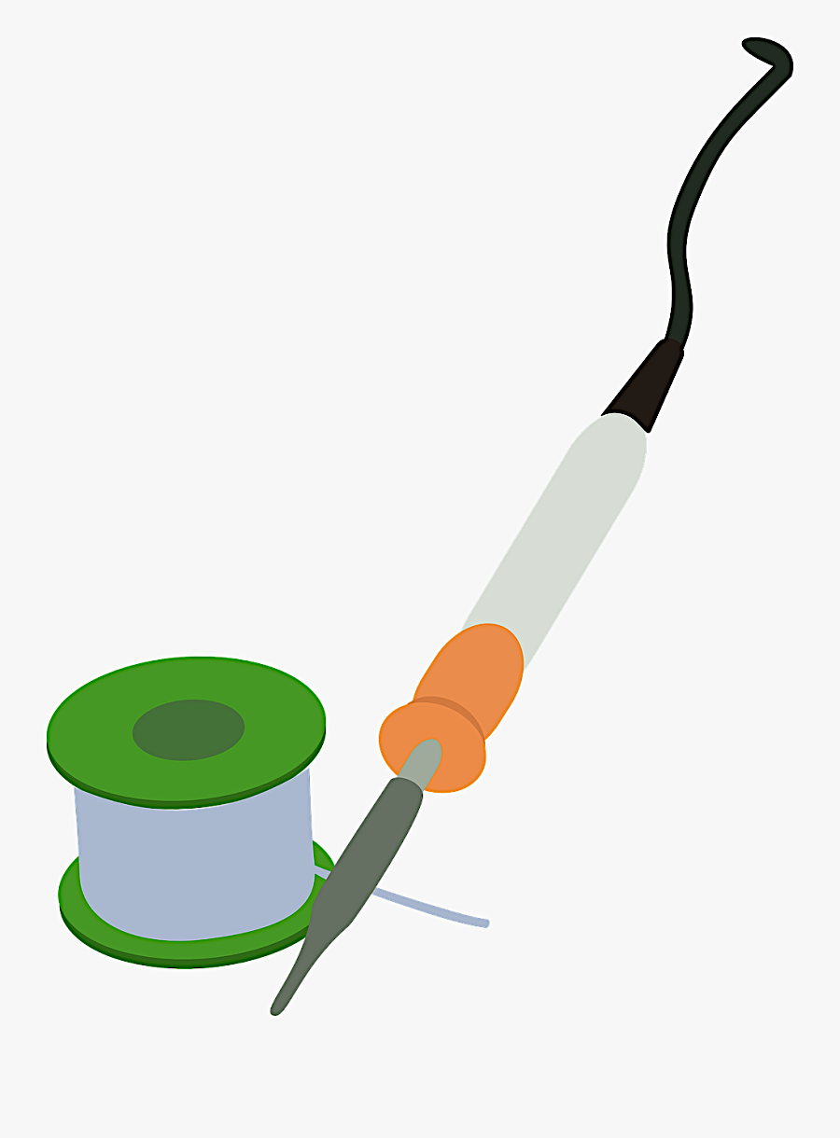
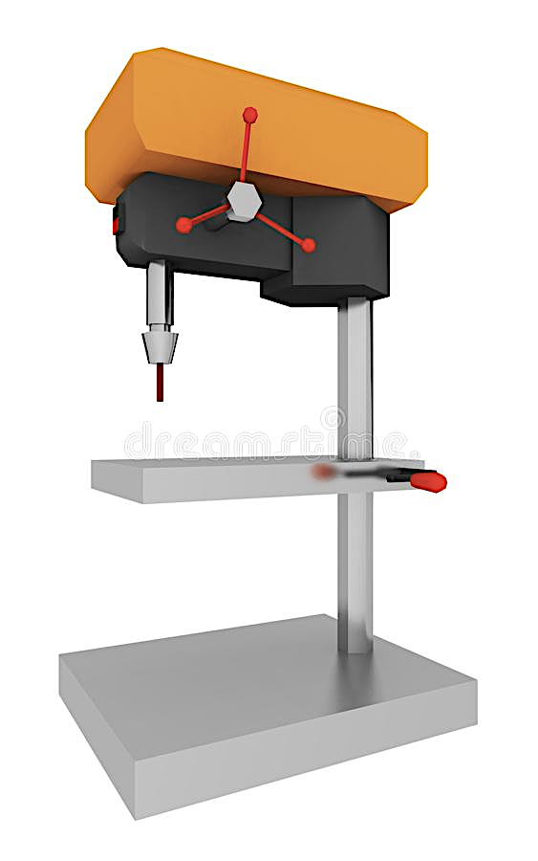
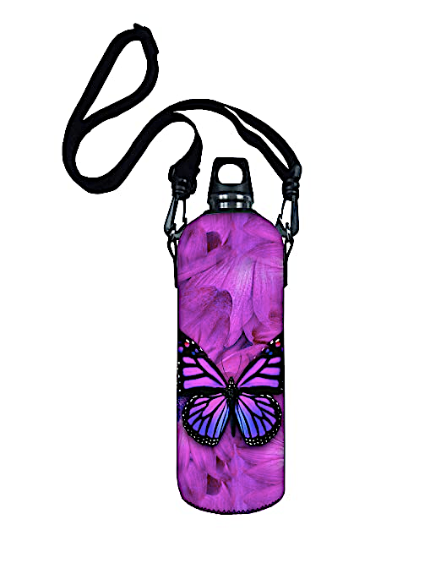
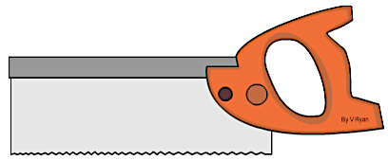
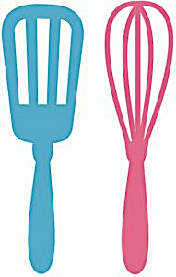
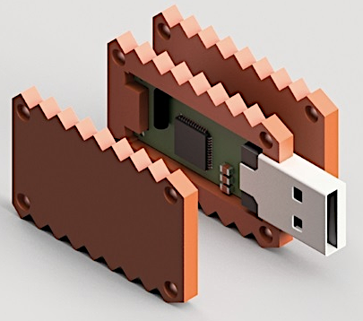
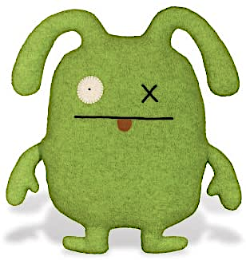
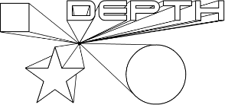
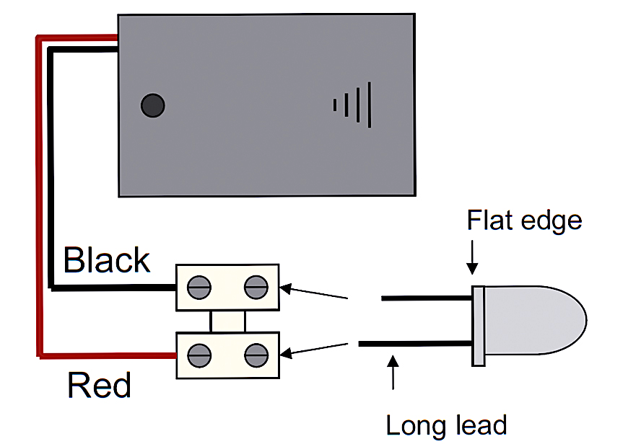
D&T KS3 Implementation Map
KS4
START OF
KEY The National Curriculum (KS3 DT 2014) is divided into the following subject contents
KS3 Food &
Nutrition
KS3 Product
Design
KS3 Textiles
KS3 Systems
& Control
This science, technology, engineering and maths (STEM) topic is designed to challenge curious minds and encourage hands-on experimentation. Students learn about design engineering in order to understand the skills necessary to become an engineer.
Students are introduced to computer programming using BBC Micro-bit hardware and a wide range of accompanying accessories., Tasks set involve Micro-bit programming connecting it to real world scenarios, driving devices or responding to sensors.
Students investigate fundamental scientific principles of cooking & nutrition that underpin balanced diets, healthy lifestyle and wellbeing. They consider factors that influence food choice including cultural & religious belief and dietary needs, e.g. Diabetes. Students also explore sustainability, British cuisine and current government guidelines on healthy eating. HEG2016/UKGOV
Students will face real world issues with challenging STEM mini projects, including climate change, renewable energy, food security and disaster preparedness. Whether students are developing a floating garden, designing a hand-washing station or reusing plastic for enterprise, students will develop their own ingenious solution to a real world problem.
Sustainability
Project
Engineering
Micro-bit
Robotics
Food
Tech’ 3
Students learn how to sew in a zip and creating a fully lined pencil case using the sewing machine. They learn about a textile designer and produce their own fabric pattern using a dye sublimation machine.
Students improve upon workshop skills using an iterative design cycle approach testing, refining and evaluating “components” for mechanical systems including, cranks, cams, followers and linkages. Emphasis on independent thinking and learning to work with tools and equipment safely and efficiently to solve tasks is encouraged for KS4 preparation
Students learn to use CAD Sketchup to complete 3 mini projects which guide them towards being able to independently complete a professional CAD Interior design of a room/s.
Students “build” on prior skills in electronics and woodwork to develop a light sensor alarm circuit which is encompassed within a MDF box. Students develop electronics skills using breadboards and electronic CAD software
Pencil
Case
CAD
Alarm Box
Project
Students independently designing a game of their choice on the computer. Students then go on to developing a variety of cutting and joining techniques along with laminating. They will finish by completing counters, cards, and a holder for the game
Students are encouraged to drink water throughout the day for hydration and improve concentration and less sugary drinks by designing and making an insulated quilted water bottle holder that will keep their water cool, stops their books from getting wet and encourage students to drink more water and encouraging them to be more health conscious
Workshop
Skills 2
Students “build” on prior skills to become increasingly competent in “modifying” recipes and dishes. A deeper understanding of the function of ingredients related to health and nutrition leads to creative adaptations and sustainability by utilising leftover ingredients. Students make connections to cooking as a means of supporting and improving personal health and wellbeing through a nutritional balanced diet.
Food
Tech’ 2
Board
Games
Water
Bottle
Students “build” on prior skills in electronics to design and develop a portable audio amp device. Soldering an amplifier circuit, students l create a ‘music graffiti’ laser cut stand to house their circuit. (CAD/CAM)
Students are taught how to measure, cut, fold and construct paper to form increasingly complex mechanical movement. Students develop imaginative approaches to problem solving and take creative risks to design and assemble imaginative Pop up book, greeting cards and packaging.
Students develop their drawing skills, whilst learning about the basic principles of prototyping. An overview of iconic Leicester buildings are discussed, helping to develop students cultural capital, leading to a “brief “ to design a commercial building in Leicester, which must in some way be environmentally friendly
Students design and make a cushion cover taking inspiration from letter styles (Font Styles). The cushion must have a letter by incorporating CAD CAM into their design. The students will use Applique and Embroidery techniques.
Audio Amp
Project
Pop-Ups
Project
Architecture
Design
Cushion
Covers
Students design and make a casing for a USB stick This project introduces research and development, leading students to use CAD software, then the CAM laser cutter.
A step up from Moodlight electronics students drill and solder a ‘Flip-Flop’ circuit which acts as a flashing warning LED circuit. The circuit is placed on their own custom made interactive door hanger
Students develop skills in a design workshop environment, working with tools safely building on an understanding of materials, exploring the iterative design cycle approach, encouraging independent design thinking in the design development process of working products.
Students follow recipes safely with emphasis on traditional British cuisine, world foods, health, nutrition and diet. Students develop essential life skills to make a range of savoury and sweet dishes to realise the importance of feeding themselves preparing ingredients and cooking safely using a variety of methods, equipment and utensils.
Food
Tech’ 1
USB Pen
Project
LED Door
Hanger
Workshop
Skills 1
Students are encouraged to design and make a monster doll toy for others. They will gain fabric cuttings skills along with “applique” and a variety of embroidery techniques.
An introduction to electronics requiring no soldering and only screwdrivers to connect their LED to terminal blocks. Students design & make a ‘Moodlight’ that illuminates a ‘cut out’ design with a rainbow LED circuit to.
light up a silhouette image in a variety of different LED colours.
An introduction to basic drawing skills such as shading, blending and rendering, leading onto 3 sections of work: isomeric, 1 and 2 point perspective.
KS3
START OF
Monster
Dolls
Moodlight
Project
Engineering
Drawing

Slide 2
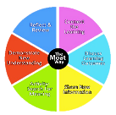
D&T KS3 Curriculum Intent
D&T KS3 at Moat Community College builds on KS2 and prepares for KS4
KS2 D&T knowledge and understanding is developed further at KS3 D&T, by ensuring key skills are enriched. These are applied through knowledge and understanding of the following key areas: Researching, Developing, Modelling, Evaluating, Testing, Principles of Nutrition and Learning how to Cook.
Year 7 students are introduced to specialist classrooms and learn about basic foundation skills that they will build upon in KS3. Student focus is on the iterative design process, materials and properties as well as designing and making for a purpose.
At key stage 3, students will be encouraged to be creative, explore materials, technologies and take risks, through a variety of practical tasks. Students combine these practical skills with an understanding of wider world issues.
In Year 7, students learn more complex ways of assembling products, health and safety issues, manufacturing methods, cooking techniques, drawing skills and wider world issues such as sustainability.
In year 8, students continue to apply and develop key skills: increasing their knowledge of aesthetic, technical, cultural, health, social, emotional, economic, industrial and environmental issues and changing technologies.
The two year course is designed to prepare students for the necessary skills needed for KS4 Design & Technology, Food & Nutrition and Engineering and the complexity of learning increases as students progress through the key stage, the department incorporates learning from all areas of the curriculum, including mathematics, science, English and computing to enable student transition into DT KS4 easier.
D&T KS3 National Curriculum delivery at Moat Community College
Aim: Design and technology at Moat Community College aims to ensure that all students:
develop a creative, technical and practical expertise needed to perform everyday tasks confidently and to participate successfully in an increasingly technological world
build and apply a repertoire of knowledge, understanding and skills in order to design and make high-quality prototypes and products for a wide range of users
critique, evaluate and test their ideas and products and the work of others
understand and apply the principles of nutrition and learn how to cook.
Attainment Targets: By the end of key stage 3, our students are expected to know, apply and understand the matters, skills and processes specified in the current national curriculum (2014).
Subject content at key stage 3: Through a variety of
creative and practical activities, Moat students are taught knowledge,
understanding and skills needed to engage in an iterative
process of designing and making. They should work in a
range of domestic and local contexts (e.g. the home, health,
leisure and culture), and industrial contexts (e.g engineering,
manufacturing, construction, food, energy), agriculture,
(including horticulture) and fashion). When designing and making
at Moat, students are taught to:
Design (Product Design, Textiles and Systems & Control)
use research and exploration, such as the study of different cultures, to identify and understand user needs
identify and solve their own design problems and understand how to reformulate problems given to them
develop specifications to inform the design of innovative, functional, appealing products that respond to needs in a variety of situations
use a variety of approaches (e.g. biomimicry and user-centred design), to generate creative ideas and avoid stereotypical responses
develop and communicate design ideas using annotated sketches, detailed plans, 3-D and mathematical modelling, oral and digital presentations and computer-based tools
Make (Product Design, Textiles and Systems & Control)
select from and use specialist tools, techniques, processes, equipment and machinery precisely, including computer-aided manufacture (CAM)
select from and use a wider, more complex range of materials, components and ingredients, taking into account their properties
Evaluate (Product Design, Textiles and Systems & Control)
analyse the work of past and present professionals and others to develop and broaden their understanding
investigate new and emerging technologies
test, evaluate and refine their ideas and products against a specification, taking into account the views of intended users and other interested groups
understand developments in design and technology, its impact on individuals, society and the environment, and the responsibilities of designers, engineers and technologists
Technical knowledge (Product Design, Textiles and Systems & Control)
understand and use the properties of materials and the performance of structural elements to achieve functioning solutions
understand how more advanced mechanical systems are used in their products to enable changes in movement and force
understand how more advanced electrical and electronic systems can be powered and used in their products (e.g., circuits with heat, light, sound and movement as inputs and outputs)
apply computing and use electronics to embed intelligence in products that respond to inputs (e.g. sensors), and control outputs (e.g. actuators), using programmable components (e.g. microcontrollers).
Cooking and nutrition
As part of their work with food, students should be taught how to cook and apply the principles of nutrition and healthy eating. Instilling a love of cooking in students will also open a door to one of the great expressions of human creativity. Learning how to cook is a crucial life skill that enables students to feed themselves and others affordably and well, now and in later life.
students should be taught to:
understand and apply the principles of nutrition and health
cook a repertoire of predominantly savoury dishes so that they are able to feed themselves and others a healthy and varied diet
become competent in a range of cooking techniques (e.g., selecting and preparing ingredients; using utensils and electrical equipment; applying heat in different ways; using awareness of taste, texture and smell to decide how to season dishes and combine ingredients; adapting and using their own recipes)
understand the source, seasonality and characteristics of a broad range of ingredients.
Learning is knowledge and skills based
The national curriculum can be divided at KS3 DT into the following subject areas:
Product Design
Textiles
Food & Nutrition
Systems & Control
From subject areas, the following skills are assessed throughout DT KS3:
Research
Design
Make
Evaluate
Technical Knowledge
Cooking and Nutrition.

Slide 3
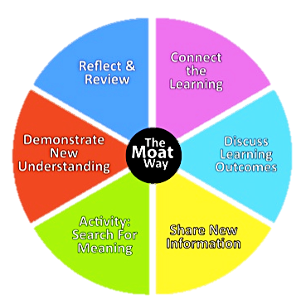
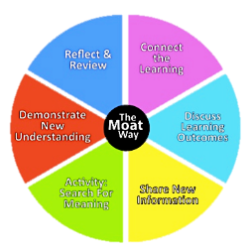
D&T KS3 Curriculum Implementation
DT KS3 curriculum plan at Moat Community College
The Design Technology department
The Design Technology department aims to develop essential and transferable skills for each and every student whilst providing them with exciting learning experiences. We want our students to develop resilience when faced with a problem, be tenacious when things go wrong and be creative when challenged.
Keeping Track of Our Students
The DT cover sheet which is mostly
generic consists of:
Target setting
Weekly objectives
Literacy targets
Improvement targets
Weekly lesson evaluation and
assessment summary sheet
Command key words
When does assessment take place and what happens as a result?
Students are regularly assessed through four homeworks over the ten week block , classwork, end-of-topic product assessment. Homework is set on a two week basis and students are be assessed through activities marked by the teacher through verbal or written feedback.
The ‘Moat Way’ and weekly evaluation
Students complete their weekly evaluation, which is printed on the inside of the students front cover. This is completed at the end of each lesson providing a “diary” of learning and progression. Students write about the following points
Today’s activity
I learnt to (Knowledge)
I will improve by (Target)
My teacher said (Assessment)
Lastly, students reflect how they have used the ‘Moat Way’ within their lesson justifying their point of view
Tracking attainment and progress:
Students are monitored throughout projects and tracked to enable students falling behind to be identified early on (GO4Schools) and given help and support to ensure they reach their potential.
Student achievement and progress is recognised from knowledge and understanding gained in lessons in order to develop problem solvers, competent users of technology and knowledge application developing skills for use in everyday life and increasing cultural capital.
How do we ensure access for all?
Design and Technology is a popular and valuable subject for students of all abilities. Knowledge and understanding is drawn from across the curriculum and helps to develop and enable numeracy, literacy and communication skills that can be applied in practical ways. This consolidates skills from other lessons and reinforces learning with positive outcomes.
Some students find designing activities challenging. Therefore, thought is required to ensure students can access and produce successful initial design work. For example, it is vital to offer a variety of methods of recording ideas quickly. The department is conscious of avoiding a rigid approach when it comes to recording and communicating design ideas and developments, for example, ideas can be done through model making instead of drawings, test circuits allow practice to solder before their final circuits etc.
Activities focused on the physical making of designs should be supported ‘one to one’. Yet it is also important to encourage students to work as independently as possible. For example, by using keywords from their folder, paired work, flowcharts, visual instruction sheets, teacher demonstrations which explain a process in a step-by-step manner.
The road to knowledge and understanding
Our aim in the department is to continually challenge students with complex tasks where students are required to use higher level thinking skills. They learn to analyse, evaluate and create - essential skills in the Design Technology curriculum. In every lesson there are opportunities for students to reach greater depth and students are encouraged to design and make products that test their abilities and challenge their creativeness. Students will revisit learning so knowledge is reinforced & embedded giving time for students to reach their potential.
Years 7 & 8 – following a 10 week carousel rotation
The DT department operates a two year “carousel” rotating block system with art & music for ten mixed ability groups per year cohort with two groups who have the opportunity for extra support, one in each X and Y bands. The department supports planned intervention in the classroom to maximise student potential based on individual needs. Differentiation is part of the planning process.
DT at KS3 is taught twice a week as two separate DT lessons (learning two different DT topics). DT lessons are 1 hour 40 minutes in length. The block carousel rotates for students to study another DT topic and there are four block rotations in a year. This allows students to experience sixteen different DT topics, covering the four key areas of the national curriculum in Years 7 & 8.

