Slide 1
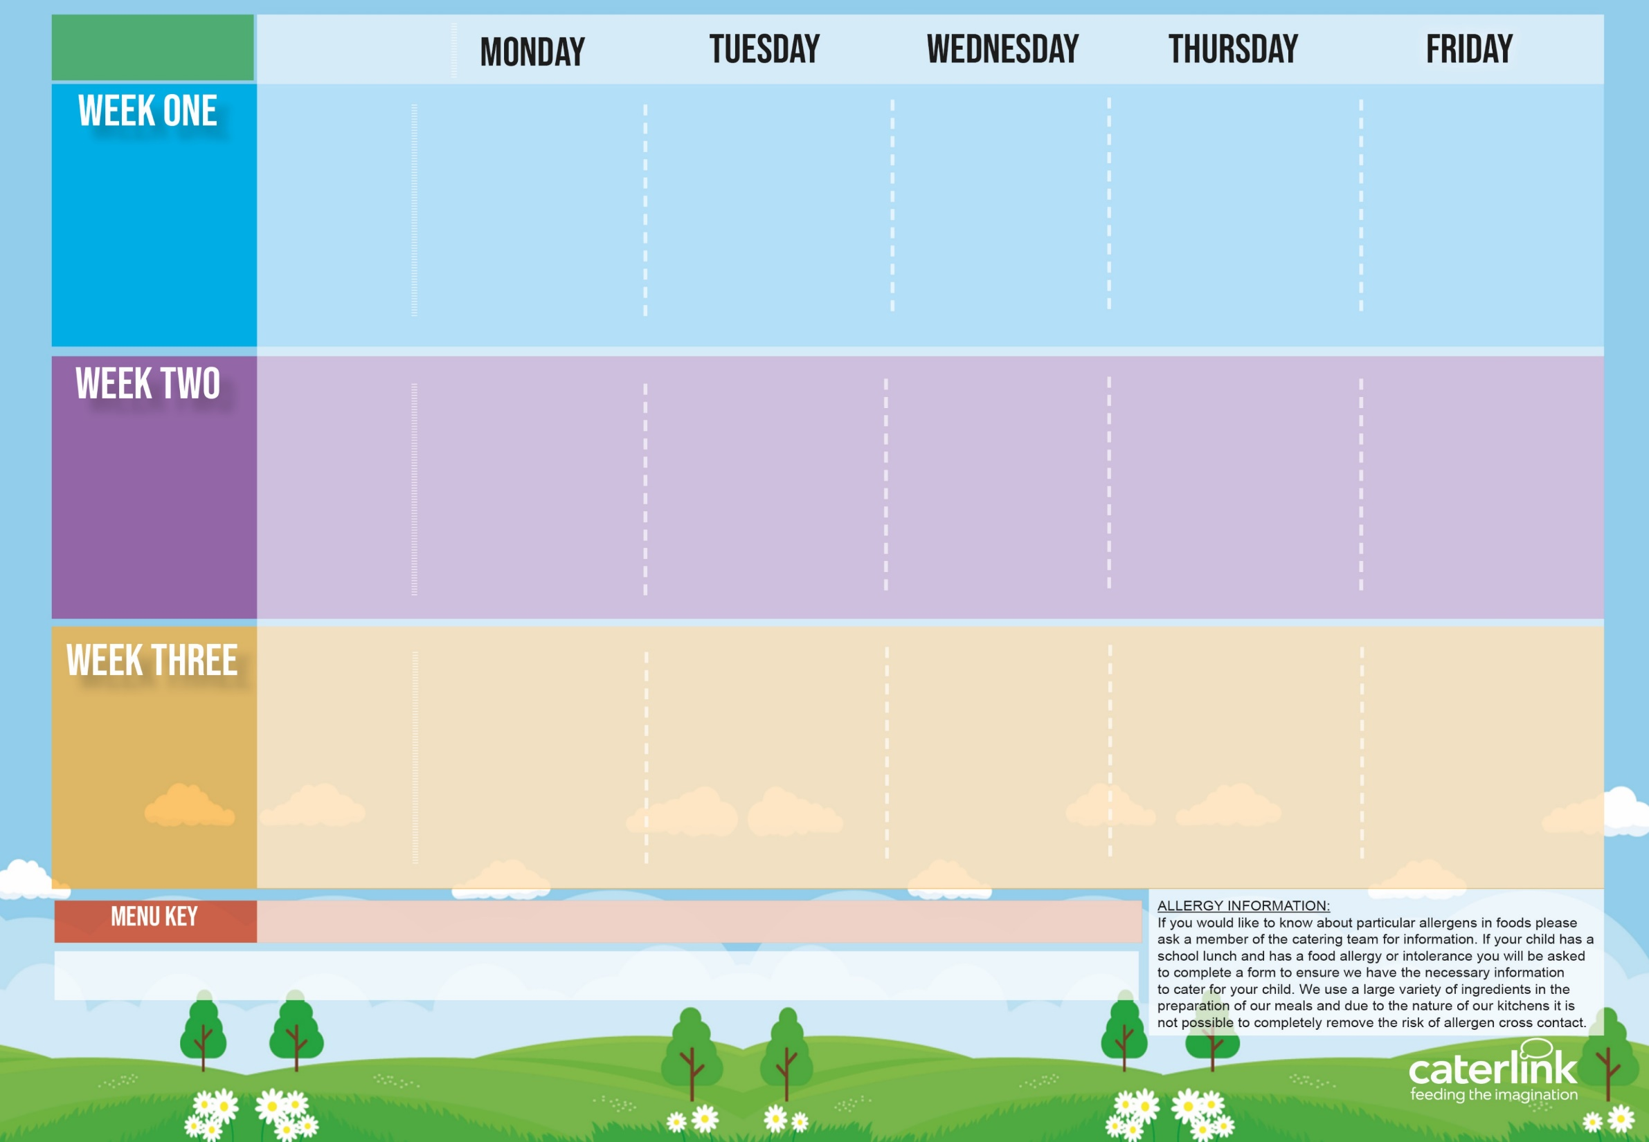
Kent & TKAT Spring Summer
2024
Option One
Option Two
Vegetables
Dessert
Cheese & Tomato Pizza with New Potatoes | Penne Bolognaise | Sausages, Roast Potatoes & Gravy | Greek Chicken Pitta with Rice, & Tzatziki or Cheese & Spinach Whirl with Rice, & Tzatziki | Fishfingers with Chips & Tomato Sauce
NEW Vegetable Tortilla Stack with Rice | Vegan Penne Bolognaise | Vegan Cumberland Sausage, Roast Potatoes & Gravy | or Cheese Whirl with *Rice and Salads | BBQ Quorn with Chips
Peas and Coleslaw | Carrots & Sweetcorn | Green Beans & Carrots | Vegetable Medley | Peas & Baked Beans
Peaches with Ice Cream (cream for serverys) | Vanilla Shortbread with Mandarins | NEW Berry Mousse | Iced Vanilla Sponge | Fresh Fruit Platter
15/04/2024
06/05/2024
03/06/2024
24/06/2024
15/07/2024
09/09/2024
30/09/2024
21/10/2024
Option One
Option Two
Vegetables
Dessert
Pasta Kitchen Tomato Pasta or Creamy Cheese Pasta with Toppings | Burger in a Bun with Potato Wedges & Tomato Sauce | Roast Chicken, Stuffing, Roast Potatoes, & Gravy | Beef Lasagne with Garlic Bread | Fishfingers or Salmon Fishfingers with Chips & Tomato Sauce
 | Vegan Burger in a Bun with Potato Wedges & Tomato Sauce | Vegan Cumberland Sausage Stuffing, Roast Potatoes & Gravy | Vegetable Lasagne with Garlic Bread | Mexican Bean Sausage Roll with Chips & Tomato Sauce
Vegetable Medley | Baked Beans & Peas | Carrots & Cabbage | Green Beans & Coleslaw | Peas & Baked Beans
NEW Chocolate Brownie | NEW Iced Biscuit With Peaches | Jelly with Mandarins | Oaty Cookie | Fresh Fruit Platter
22/04/2024
13/05/2024
10/06/2024
01/07/2024
22/07/2024
16/09/2024
07/10/2024
Option One
Option Two
Vegetables
Dessert
Macaroni Cheese | Chicken Paella with Patatas Bravas or Vegetable Wrap with Patatas Bravas | Roast Gammon, New Potatoes & Gravy | NEW Chicken Wrap with Rice | Fishfingers with Chips & Tomato Sauce
Jacket Potato With a Choice of fillings | or Veggie Meatballs with Patatas Bravas | Vegan Cumberland Sausage with New Potatoes & Gravy | Vegetable wrap with Rice | Cheese & Bean Pasty with Chips
Peas & Carrots | Vegetable Medley | Carrots & Broccoli | Sweetcorn & Peppers | Peas & Baked Beans
Chocolate Shortbread | Summer Lemon Cake | Peaches & Ice Cream (cream for servery) | Syrup Snap Biscuit With Mandarins | Fresh Fruit Platter
29/04/2024
20/05/2024
17/06/2024
08/07/2024
02/09/2024
23/09/2024
14/10/2024
Added Plant Power
Wholemeal
Vegan
Available Daily: - Freshly cooked jacket potatoes with a choice of filling - Cheese, Beans or Tuna, Bread freshly baked on site - Daily Salad Bar, Fruit Selection & Yoghurt

