Slide 1
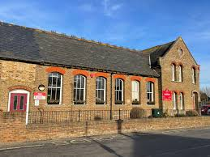

Monkton Church of England Primary School
Information for Parents Guide

Slide 2


Welcome to Monkton Church of England Primary School
We hope this guide will give you some useful information for when your child starts school. You can also find lots of useful information on our website https://monkton.kent.sch.uk/
School Hours - school gates open at 8:30am and children will go directly to their classrooms. Registration is at 8:45am. If children arrive after 8:45am you will need to use the main entrance and sign in at reception. Children should be collected at 3:15pm.
Absence – If your child is ill, please telephone on 01843 821394 or email the school office – office@monkton.kent.sch.uk before 9:00am on each day of absence.
Holidays should be arranged within school holidays; schools are unable to authorise holidays in term-time. If you need to take your child out of school during term-time you can find an application for term-time leave on our website https://monkton.kent.sch.uk/parents/Attendance-punctuality. This may be considered in exceptional circumstances, please complete at least 2 weeks before the absence.
Please try and arrange medical appointments outside of school hours, if this is not possible please let the class teacher and office know that you will be collecting your child or that they will be late in. If you need to collect your child early, please come to the school office.
Attendance - It is expected that children are in school every day and arrive in the morning before the end of registration. We are expected to monitor your child's attendance and will contact you if your child is not meeting the expectation. If there are any issues relating to attendance, please us know so we can work together on ensuring your child is in school.
Child protection – We take safeguarding very seriously and all staff and volunteers have undergone enhanced DBS checks. If you have any concerns or need to raise an issue you can contact the following : designated safeguarding lead Mr. C Marston cmarston@monkton.kent.sch.uk
The deputy safeguarding leads are Mrs. J Guilder jguilder@monkton.kent.sch.uk, Mrs. S Vesty svesty@mandm.school and Mr. P McCarthy pmccarthy@mandm.school
Behaviour – At our school, we believe that every child has the right to feel safe and the right to learn in a positive, supportive environment. To uphold these rights, we maintain clear expectations and consistent approaches to behaviour.
For full details, please refer to our Behaviour Policy. School policies
We actively involve parents and carers in supporting their child's behaviour through regular communication. To keep you informed, we use the Arbor App, which provides daily updates on behaviour – whether it's positive achievements or areas where improvement is needed.
Together, we can ensure a respectful, inclusive, and focused learning environment for all our students.
Breakfast Club – our Breakfast Club is run by our Teaching Assistants and sponsored by Warburtons. It is open term-time Monday to Friday from 7:45am to 8:45am and costs £2.50 per session. Breakfast club needs to be booked and paid in advance. This is done via our Arbor App/Portal and you can find instructions on using this here https://monkton.kent.sch.uk/breakfast-club

Slide 3
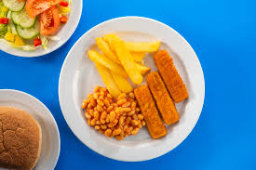

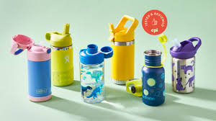





Lunch – The school has its own kitchen where dinners are cooked on site each day. There is a daily hot meal and vegetarian option. Favourite days are Wednesday roasts and fish and chip Fridays. We encourage children to try the lunches; the menus are available on our website https://monkton.kent.sch.uk/parents/Lunch. Year R,1 and 2 are entitled to Universal Infant Free School Meals (UIFSM). You can prebook meals using the ParentPay and we will send out details of how to register later. If you prefer your child can bring a healthy packed lunch. Please avoid chocolate and fizzy drinks. We are a nut free school, so please do not include any items containing nuts. All lunch boxes are stored on trolleys in the classroom so please ensure it is clearly named. You may want to consider use of a cool pack during summer months.
Free School Meals - If you receive certain benefits, your child(ren) may be eligible for Free School Meals (FSM). FSM status also provides additional benefits such as holiday and supermarket vouchers, as well as providing additional funding to the school. You can find more details of the eligibility criteria on our website parents/lunches
Healthy School - we actively promote health, fitness and wellbeing throughout the school. Children in Reception and Early years are provided with daily fruit. Children throughout the school may bring in a piece of fruit for breaktimes but no other snacks.
Water - All the children are encouraged to bring in a water bottle for them to use during the day – water only no fruit drinks or squash. Bottles should be clearly named.
Clubs – Khickster Entertainment provide our general wraparound care after school, and they also offer specialised clubs each term. Details of these clubs are sent out each term in the school newsletter and will also be updated on the website. You can find information about how to book and the sessions they provide https://monkton.kent.sch.uk/after-school-care-club
We also have Football club on Mondays after school from 3:15 to 4:15pm. Please see https://monkton.kent.sch.uk/parents/extra-curricular-clubs
We also offer teacher led clubs during the year and details of these are sent out each term.
Dogs - Dogs are not allowed on school premises – except for medical assistance dogs.
Emergency contacts - Please ensure the office always has your up-to-date contact information. We need to be able to contact you immediately if your child is unwell.
Mobile Phones - Please do not allow your children to bring mobile phones into school. We have procedures in place to deal with any emergency. We also ask parents not to use mobile phones on site in accordance with our school policies .
Holidays/Term Dates – the details of term dates, staff development dates are sent home at beginning of each academic year. You can also find them on our website Term Dates

Slide 4

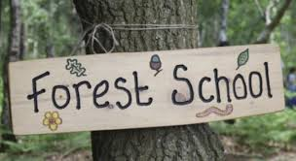
Home learning expectations – to support children's progress and reinforce learning at school, we encourage the following home learning activities:
📚 Reading – All children should read at least 5 times a week. Please record reading in your child's reading diary.
➕ Maths Practice
  Years 1 and 2 – Daily use of Numbots to build number fluency.
  Years 3 to 6 – Daily Times Tables Rock Stars to improve multiplication skills.
✏️ Spellings – Spellings are emailed to parents every Friday. These are linked to either current phonics (KS1) or key spelling rules (KS2). Children will be tested on these the following Friday.
💻 Optional Online Learning – Teachers may set optional activities on Atom Learning for Maths and English to consolidate and extend classwork
Year 6 optional coursework in Term 6 to aid smooth transition into Year 7
Thank you for supporting your child's learning at home!
Outdoor Play and Learning (OPAL) - All Weather Fun!
We are excited to let you know that our school is fully embracing the OPAL approach every break and lunchtime. Our playground and field are open for play every day, rain or shine!
What to expect
Children will have the opportunity to take part in a wide variety of fun and engaging activities, including:
Den building
Mud kitchen fun
Exploring our giant sandpit
Pond-dipping
Adventure trail challenges
Building bug hotels
Enjoying circus school activities in our beautiful bell tent
What your child needs:
As we go outside in all weathers, it is essential that your child is prepared:
Waterproof coat and trousers
Wellies (clearly labelled)
Spare socks – these are often needed after wet play
Please ensure these items are kept in school so your child can fully enjoy everything OPAL has to offer without getting cold or uncomfortable.
Forest School – Forest school is a child-centred, inspirational learning process that offers hands-on experiences in a natural setting. It encourages creativity, builds confidence, and helps develop problem-solving skills as they learn to manage risks and explore outdoors.
To ensure children get the most from these sessions:
Waterproof clothing, including wellies and spare socks, must be kept in school.
On Forest School days, children should come to school dressed in their outdoor gear to maximise time spent learning outside, they will need their school uniform to change into afterwards.
Forest school days will be notified to parents each term and the chalk board outside reception also shows which class will be at Forest School that week.
PE- Children wear their PE kit into school on their PE days. Sports activities are key to our curriculum and help the children be fit and healthy. Children will need black PE shorts and coloured t-shirt depending on which house they are in, red hoodie/sweatshirt and plimsolls. The house colours are Blue – Compassion, Yellow – Courage and Green – Justice.
Uniform – it is our school policy that children wear school uniform when attending school or participating in school-organised events outside of normal school hours. You can find details of our uniform on the website School uniform. Items with the Monkton logo are available from Kent Workwear who are based at Manston.

Slide 5







SEND – Our SEND Co-ordinator (SENCO) is Mrs J Guilder, her email address is jguilder@monkton.kent.sch.uk
You can find lots of information about Special Educational Needs and Disabilities on our website SEND
Thrive – What is the Thrive approach.
Children cannot always put their needs into words, but the way children behave can tell us a lot about how they are feeling. For over 25 years, Thrive has been working with schools and organisations to support the mental health and wellbeing of children and young people.
At Monkton, Thrive is a whole-school approach. We believe that all behaviour is communication, that communication needs to be understood and supported. Thrive feeds into everything we do; celebration assemblies, getting to know everyone and their families, sharing all achievements not just academic ones, celebrating our diversity, and our collective spirit.
We have a page dedicated to Thrive on our website which you can find here Thrive
At Monkton we aim to work with families and support them as much as possible. We have 2 Rainbow counsellors who provide support to children who have experienced a significant loss through death, relationship breakdown or other adverse circumstances. Please contact Mr Marston (cmarston@mandm.school) if you think your child would benefit from this type of support. More information can be found https://rainbowsgb.org/
Arbor – The school uses Arbor Management Information System to manage all pupil information and daily administration. The Arbor Parent Portal/App allows parents to manage their child's activities, including breakfast club and teacher led clubs, payments for trips, attendance and progress.
You will be able to download the app using your email address and a password. We will send out details later.
Letters and communications – all communications to parents are normally sent out via Arbor. Letters home, newsletters and other communications are also put on our website, some may go on our noticeboard which is just by reception, and we will also use our Facebook page to share some items of interest to parents. Please make sure your email address is kept up-to-date to ensure you receive all the relevant information.
Medicines – Very occasionally, your child may need some medication that has to be taken during the school day. Please bring the medicine to the school office and we will ask you to complete a consent form with dosage instructions. All medicines are kept locked in a cupboard or fridge (if needed) and we will ensure medication is given at correct times.
Library Books – Children will sometimes bring home a library book from the school library. This book will have been chosen by your child, it may not be their reading ability, but the idea is for them to enjoy looking at it or sharing with you.
Please name all your children's belongings; even shoes and gloves. Sometimes children will misplace items, and it is easier to return them if they are named.

Slide 6

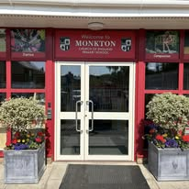
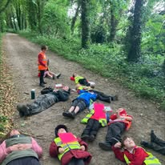
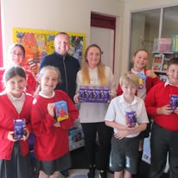
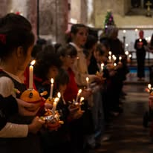
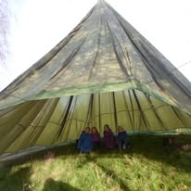
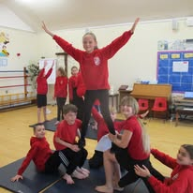
Parking – we try hard to have good relationships with our neighbours, being a small village school, we are aware parking is busy and sometimes dangerous. Please be respectful of residents and consider the dangers to children who are trying to cross safely. Under no circumstances are you permitted to park on the zig zag lines outside the school and we kindly ask parents to refrain from entering or using the staff car park at any time, including for quick drop-offs.
Photographs and consents – Photographs are a fantastic way to document the events in school. We take photos all the time, and we love to share what we are doing via our website, and Facebook page. You can find our Facebook page https://www.facebook.com/MonktonCEP
We will request consent for taking photos of your child to use, as well as consents for Facebook, newspapers/magazines, school website, and external trips. These consents are done via the Arbor app/portal and we write to you when these are ready to be completed.
Volunteers – we love having parents and family members in to help. If you have some time to spare, please let your child's teacher or the office know so we can arrange checks. Children really benefit from having extra help to support with reading, art or creative activities.
PTA – we have an active PTA who organise a raft of events for our children and families throughout the year. Please support them by attending events or offering to help or even better....joining. You can contact the PTA via email Monktonpta@gmail.com
And finally …. our school website. We have already mentioned this several times throughout this document, but you will find a wealth of other useful information on our website, such as school calendar which shows everything going on in the school. Curriculum information, section for Parents/Carers, School life and Mindful Monkton.
We hope you will make full use of the website to find answers to any queries, but you can also contact the office on 01843 821394 if you need further help.
Monkton CEP website https://monkton.kent.sch.uk/

