Slide 1
Montgomery Term Two Week Two
Term One
Week Nine
15th November – 19th November
Notes:
Week 1
Standards Uniform
PRIDE / SMART / EXCEL
House Challenge week 1 -3
Extra Curriculum Timetable
ClassCharts Login
Picture News

Slide 2
Do we need to experience danger to learn how to be safe?
A German professor believes that secure playgrounds prevent young people from finding out important dangers during their early years. Rolf Schwarz, from Karlsruhe College of Schooling in Germany, argued that ‘we want to permit youngsters to return into touch with threat’. Built in 2018, a very high climbing tower, with many risky obstacles in Berlin-Frohnau’s Ludwig Lesser Park is an example of a trend that has become popular in Germany over the last five years. Many educators and manufacturers believe that playgrounds must stop aiming only for safety and instead create challenging spaces that teach children to navigate difficult situations even if the consequence is occasional injury.
This week’s news story: https://bit.ly/3vZgn4u
This week’s useful video: www.youtube.com/watch?v=lztEnBFN5zU
Do you agree with the statement, ‘the more risk in an activity, the more fun it is’? Share your thoughts.
If you could design and build a playground for children and young people, what would you include and why?

Slide 3
Tutor time and Break Time
L
G
E
E
C
H
A
L
N
Week Commencing | Challenge
15th November 2021 | Shoot the hoop at Break Tuesday: Y9 & Y10 Wednesday: Y8 Thursday: Y7 & Y11
Notes:
Monday: 1st break free (9 & 10)
Tuesday: 1st break free (9 & 10)
Wednesday: Split break free (8)
Thursday: All breaks free (7-11)
Friday: 1st break free (9 & 10)

Slide 4
Alcohol Awareness Week- Click on the photos below to watch the clips

Slide 5
Anti-Bullying
Week 2021
15^{th-} 19th November
Anti-Bullying
Assemblies will run next week!
https://www.youtube.com/watch?v=A2PPN3-n7xU&t=2s

Slide 6
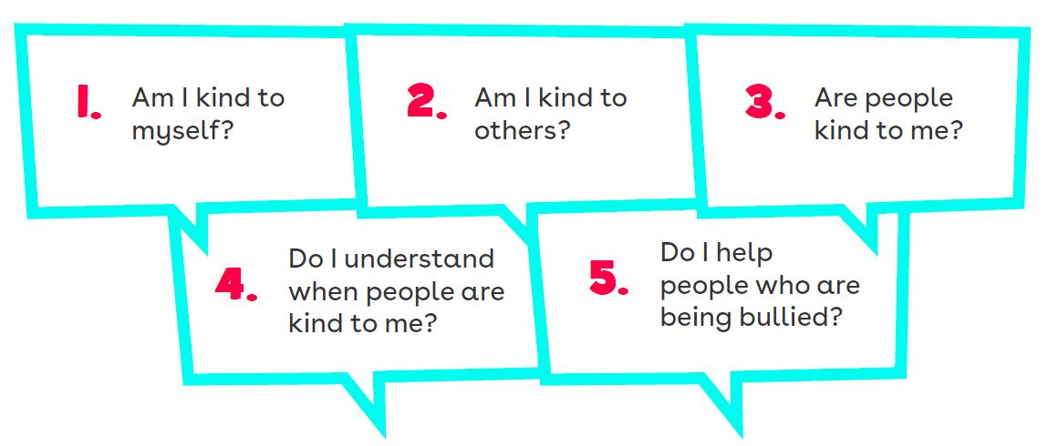
5 Key Kindness Questions
Anti-Bullying Week 2021 – One Kind Word
6

Slide 8
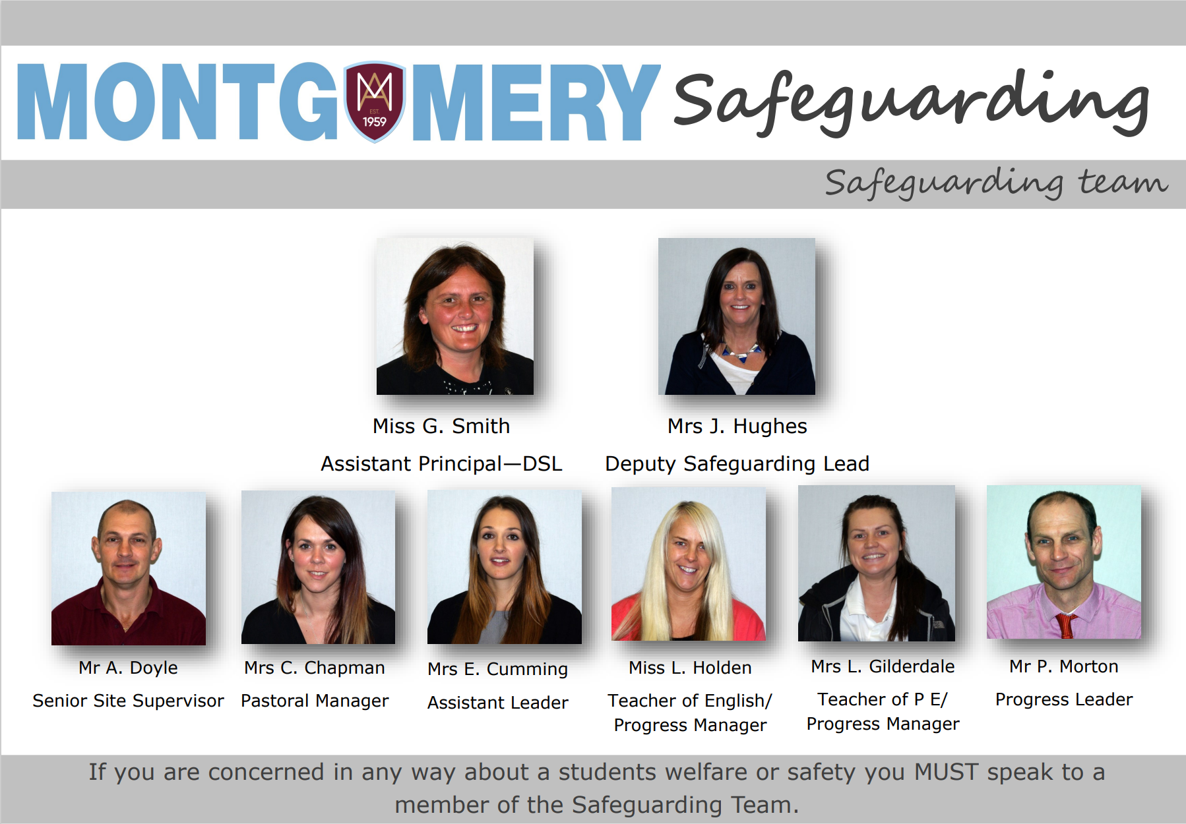
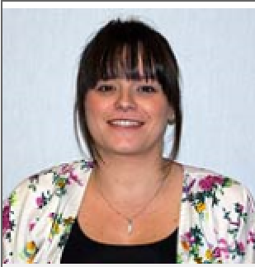
Miss R. Sharpe
Pastoral Manager

