Slide 1
Montgomery Term Two Week Two
Term Two
Week Twenty One
21st February – 25th February
Notes:
Week 1
Standards Uniform
PRIDE / SMART / EXCEL
House Challenge week 1 -3
Extra Curriculum Timetable
ClassCharts Login
Picture News

Slide 2
If someone says sorry should we always forgive them?
Following his admission that he attended a socially distanced event in the garden of Downing Street during the first lockdown, Prime Minister Boris Johnson has apologised. He has faced weeks of calls from both the public and his colleagues in government to resign. At the time of the event, people were only allowed to meet one other person outside their household in order to slow the spread of coronavirus.
In Parliament, Mr Johnson apologised to fellow MPs and to the public for the way he handled the event, saying he attended for around 25 minutes to thank staff for their work during the pandemic. Mr Johnson is still, however getting support from his top team in Parliament, including the Deputy Prime Minister Dominic Raab, Foreign Secretary Liz Truss and Chancellor Rishi Sunak, who all say Mr Johnson is the right person to lead the country.
Learn more about this week’s story here.
Watch this week’s useful video here.
Apart from verbalising an apology, can you think of any actions that show regret?
Why do you think apologising is hard for some people? Do you ever find it difficult to say sorry?
© Picture News 2022

Slide 3
L
G
E
E
Break Time
C
H
A
L
N
Hand Ball Penalty Shoot Out
Week Commencing | Challenge
28th February 2022 | Wednesday: Y8 (10:15-11:35) Thursday: Y7 & Y11 (10:15-11:35)
Notes:
Monday: 1st break free (9 & 10)
Tuesday: 1st break free (9 & 10)
Wednesday: Split break free (8)
Thursday: All breaks free (7-11)
Friday: 1st break free (9 & 10)

Slide 4
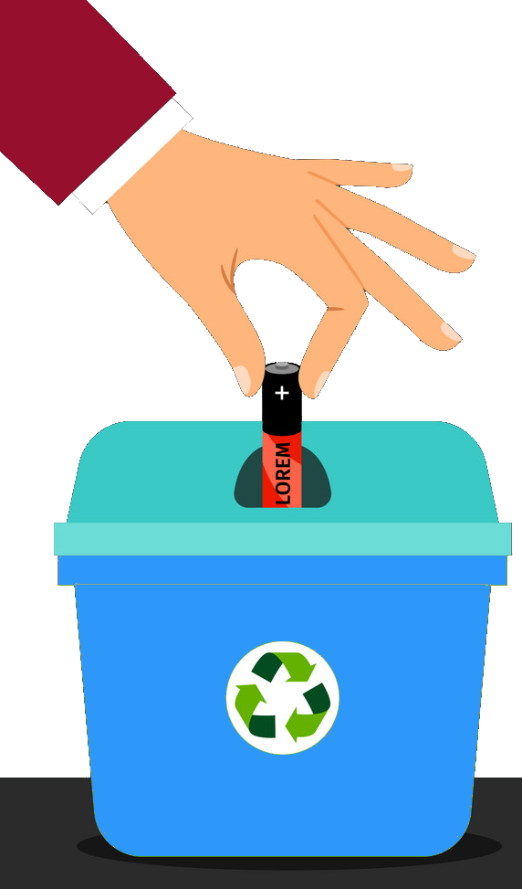
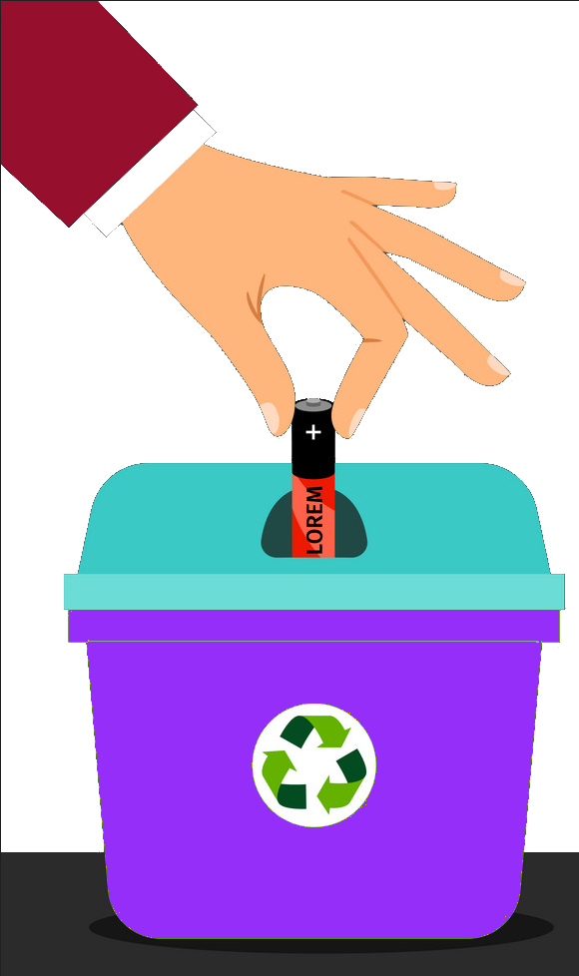
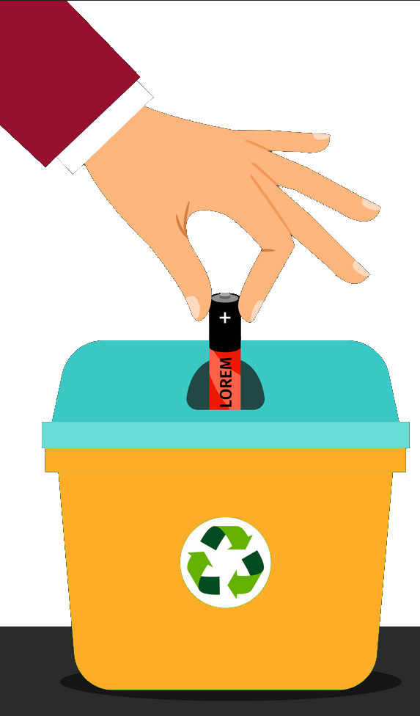
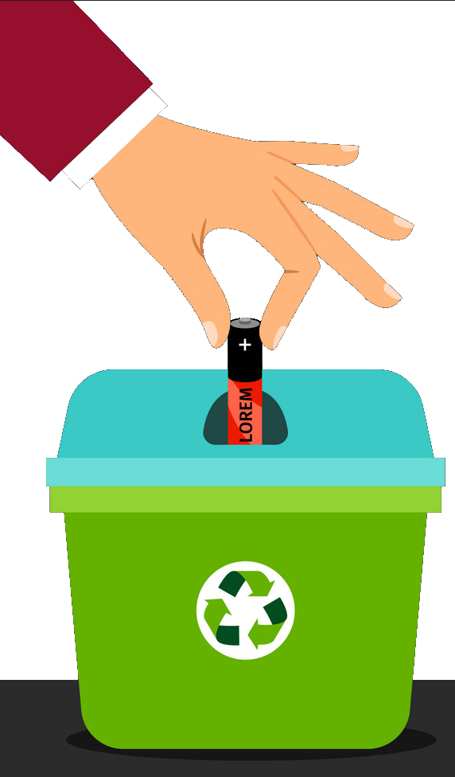
L
G
E
E
Break Time
C
H
A
L
N
Results
House | Battery Donations | Points
Green | 1st | 100
Orange | 2nd | 50
Blue | 3rd | 25
Purple | 4th | 10
House | Dodgeball wins! | Points
Green | 1st | 100
Purple | 2nd | 50
Blue | 3rd | 25
Orange | 4th | 10

Slide 5
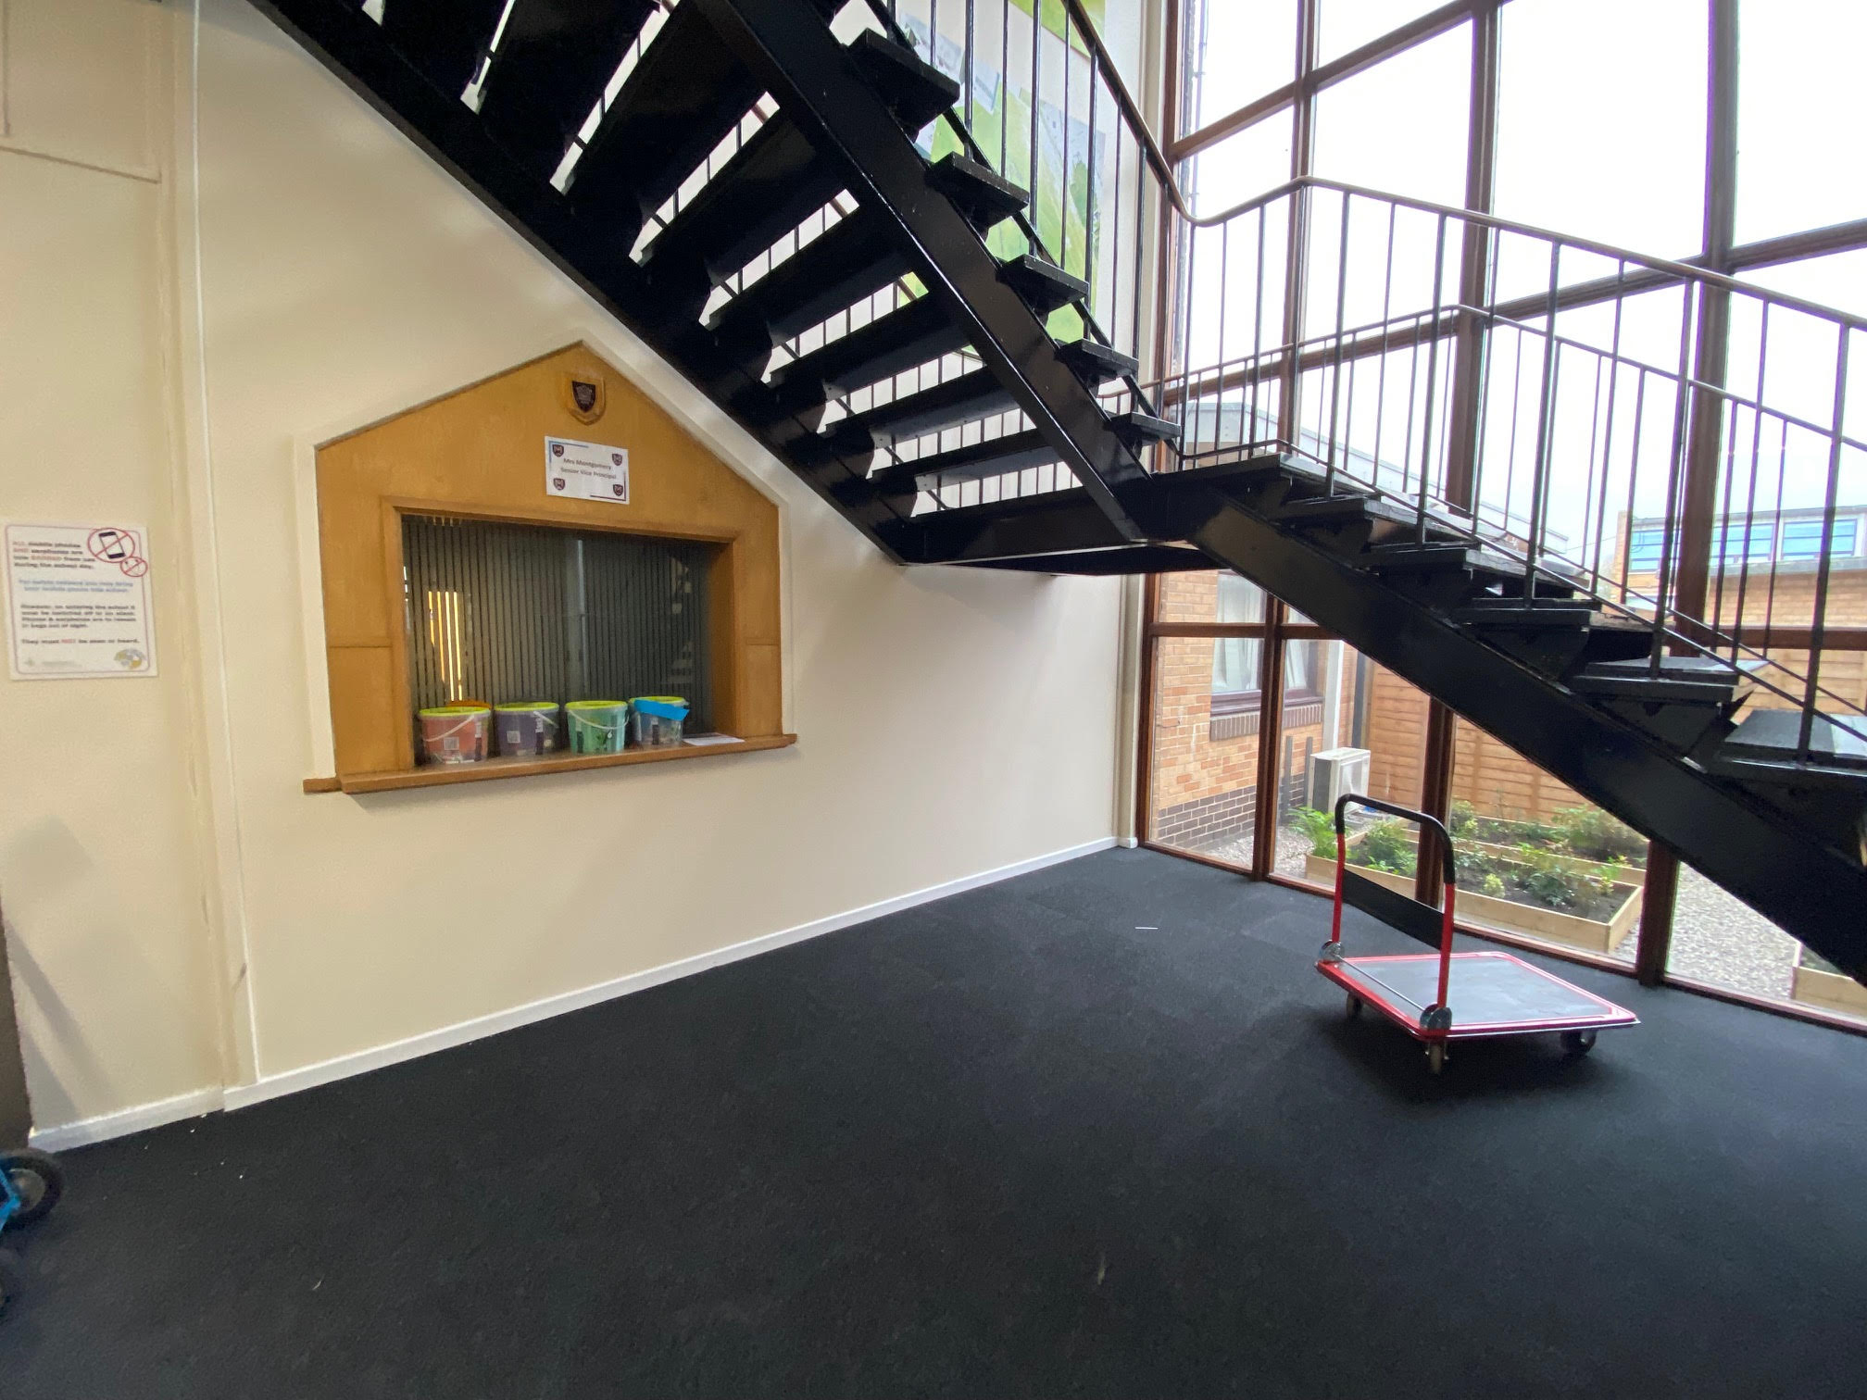
L
G
E
E
Half Term
C
H
A
L
N
This half term we are collecting Food for our Montgomery Families in need.
You can help by donating the following:
Tins of food
Easter Eggs
Use your ambition points to donate to our Montgomery Families in need fund on Class Charts
Notes:
Monday: 1st break free (9 & 10)
Tuesday: 1st break free (9 & 10)
Wednesday: Split break free (8)
Thursday: All breaks free (7-11)
Friday: 1st break free (9 & 10)

Slide 6
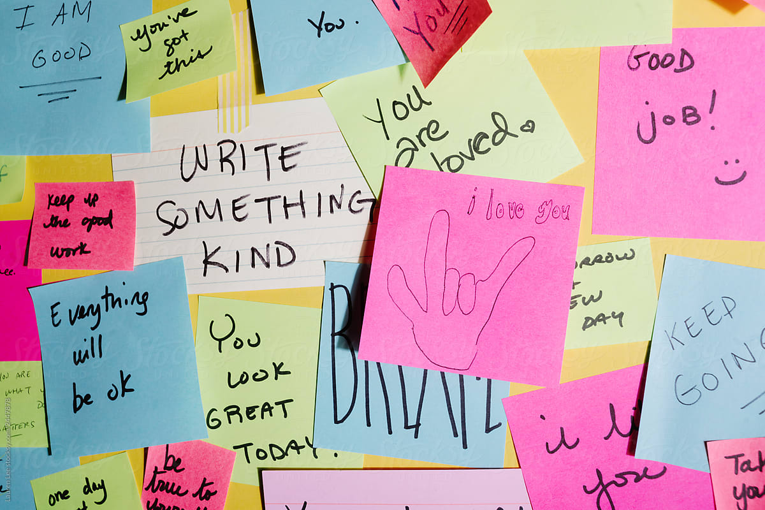
As we are in Mental Health Week the student council would like to make a kindness wall to give those who read it a positive comment or an idea of how to help improve someone’s mental health. Please use the Coloured Cards to share Mental Health and Kindness around Montgomery!

Slide 7
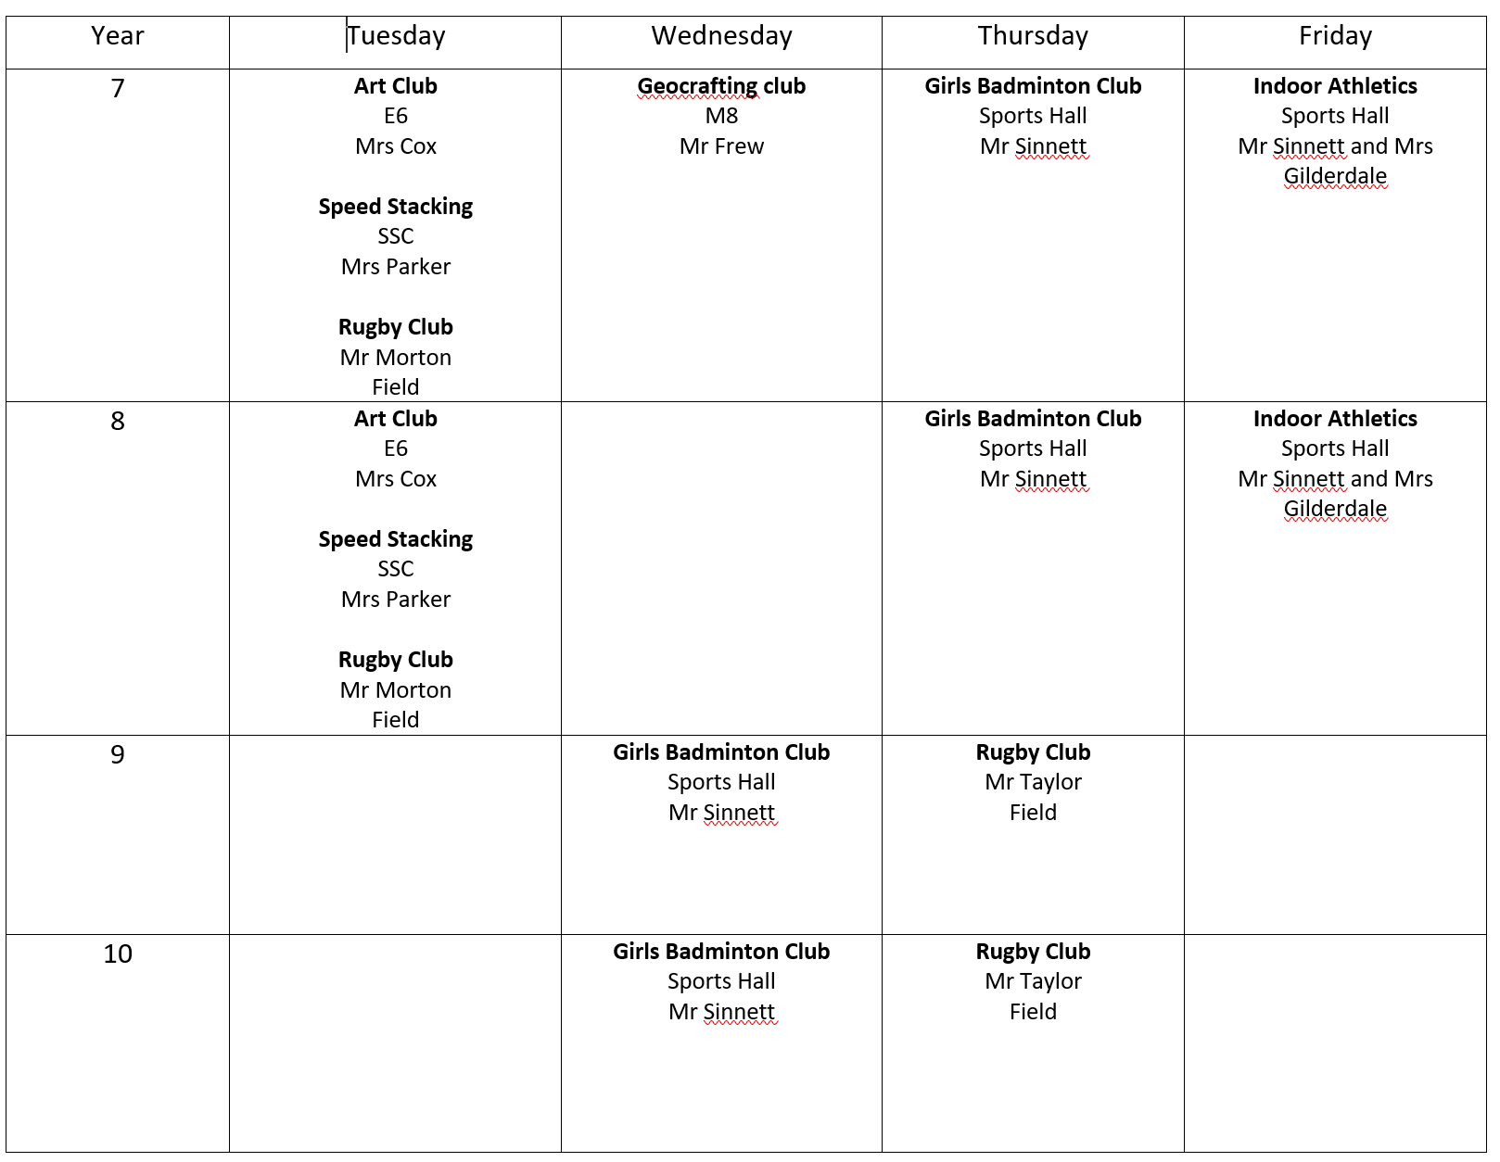
Extra-Curricular Clubs

Slide 8
February is LGBTQ+ History Month
Watch this Newsround clip on LGBT
Watch this short clip on a teachers experience of being LGBTQ+
Test your knowledge now take the Tutor Quizizz – Don’t forget to login! https://quizizz.com/join/quiz/61e6dcb24c7d48001e8b4ee7/
Your February Challenge is to design a circular badge for as an
LGBTQ+ Ally!
Design your circular badge digitally on a phone or pc or by hand – Entry forms are available at the bottom of the SSC stairs in M Block
Return to Mr Hegarty by 25th Feb

Slide 9
https://fcat.mydatadash.co.uk/attendance
Ambition Point totals for since 6th September
1st Place -100 PTS
2nd Place- 50 PTS
3rd Place-25 PTS
4th Place-10 PTS
1620
775
705
650

Slide 10
https://fcat.mydatadash.co.uk/attendance
RUNNING TOTALS
including Attendance, house points and house challenge points
1225
2030
2860
1790
Notes:
As of Friday 26th November includes house points and house challenge points inc attendance

