Slide 1
Montgomery Term Two Week Two
Term Three
Week Five
18th – 22nd May

Slide 2
S
M
A
R
T
Kindness Calendar. Be Kind to our homes
Monday | Kind to me | Keeping your space clean and tidy is a great way to keep your mood and feelings up. Take 30 minutes today to properly and thoroughly clean and tidy up your room at home. After a few hours, write down a few sentences about how it makes a difference to how you are feeling.
Tuesday | Kind to others | Who is keeping your home clean and tidy? Often, as floors are hoovered and messes cleaned up, we forget that someone is working very hard to stay on top of this. Ask members of your household about all the different things they do at home, and then make a list – it may surprise you how much someone cleans.
Wednesday | Kind to the world | Write a short story about two different homes – one where everyone cleans up together, and one where only one person cleans the whole home, while everyone else never cleans. Write the story from the perspective of the person cleaning alone. What can this story tell you about how people think about cleaning?
Thursday | Kind to me | How is your room looking today? Has it stayed tidy and clean, or has it started getting a bit messy? Have you, or someone else, been cleaning and tidying up? Think about how your room has affected your mood and feelings since Monday, and think about how your mood and feelings have affected how clean your room is. Afterwards, write down a plan about how often you should clean your room to keep your mood and feelings up.
Friday | Kind to others | Look at the list you made on Tuesday and help your household clean today. You can help as much as you want, but you should ask a member of your household for help. After you have cleaned, think about what part you enjoyed most. It could be a good idea for you to start helping with this every week.

Slide 3
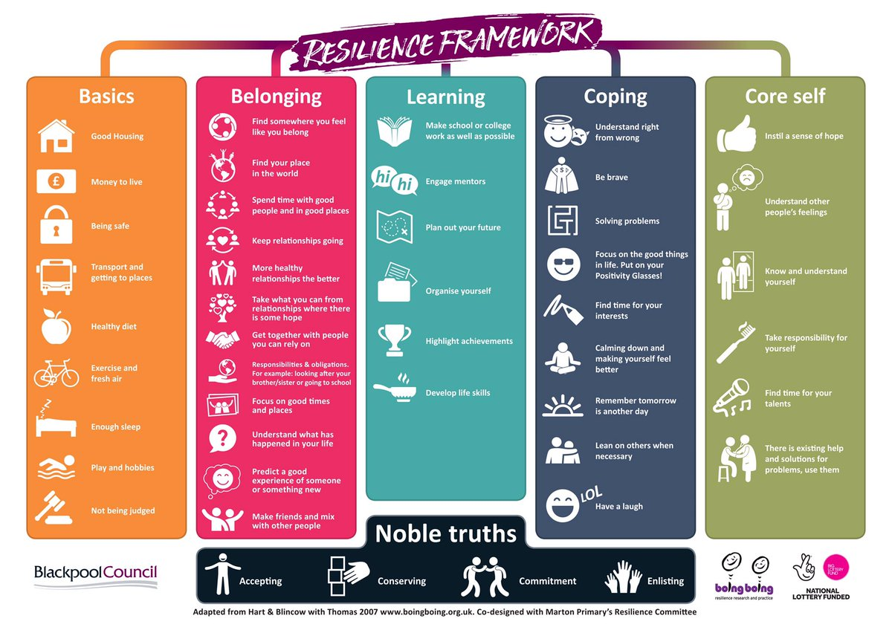
What will be your resilience move this week?

Slide 4
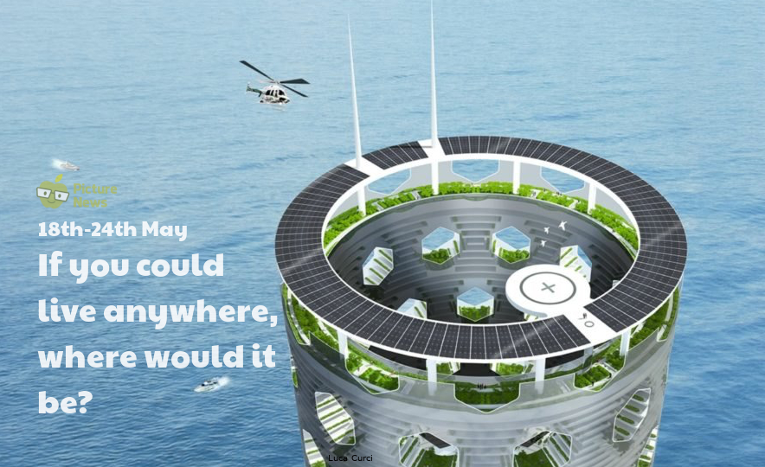
Where we live…
An Italian architect is planning a city of skyscrapers! Luca Curci said that he wanted to build four self-sufficient, interconnected towers with trees, wildlife and farms. He claimed that his buildings, for 200,000 people, would be the best way to tackle population growth, pollution and poverty. He says his project, The Link, could save the world and halt urban sprawl. He says, “We need a sustainable vision, my towers are designed to encourage a sense of community.” He envisages communities rising 300 floors with shops, cafés and recreation areas with homes, complete with solar panels. Trees and plants would recycle all the carbon dioxide produced. Curci’s towers have a horse-shoe shape to create wildlife havens. The blocks would gain stability from their conical form. The communities would be self-sufficient with farms on lower floors.
This week’s news story: https://yhoo.it/2SuVM5G
This week’s useful video: https://bit.ly/2KXsw38
Do you think it is a good idea? Would you like to live there?
Do you think it’s likely this is how lots of people will live in the future? Why?
What do you think is the biggest single factor in deciding where to live?
If you have to use three adjectives to describe your ideal home, what would they be and why?
How is the transport around where you live? Do you need to travel by car or is there public transport, or can you walk to most places?

Slide 5
HOUSE
L
E
C
H
A
L
N
G
E
School Games Virtual Competition Programme
Closing date of Friday 12 June
Passing a rugby ball accurately into a wheelie-bin from the greatest distance!
You’re allowed to tilt the bin to make it easier!
Also ‘keep a ball up with a hockey stick the longest’
Use a bigger ball to help make it easier!
The school with the most entries wins the Lancashire School Games Prizes and the individuals who can keep it up the longest and with the best trick videos will also win a prize.
Send a video clip to Mrs Campbell on M.Campbell@Montgomery.fcat.org.uk

Slide 6
C
HOUSE
L
E
H
A
L
N
G
E
Well Done Green House Winners for sending the most VE Day entries to the house Instagram account @Monty_House_System!

Slide 7
House Points Weekly Totals
1st-40 PTS Green House 2nd- 30 PTS Blue House
3rd-20 PTS Orange House
4th-10 PTS Purple House
184 Points
263 Points
261 Points
235 Points
10
40
30
20

Slide 8
4090
The leader board
3580
3400
3060

Slide 9
B&FC are now holding weekly virtual open events check out the website above.
Complete some of the suggested activities to help you prepare in the best way possible for your courses at Blackpool Sixth.
https://www.blackpoolsixth.ac.uk/newstudenthub/

Slide 10
Resilience Revolution Survey on how you feel about returning to school.
Spare 2 minutes to shape your school! By completing this survey, you can help suggest what is needed in your school.
Lots has changed because of coronavirus, so your views are needed now more than ever.
https://forms.gle/sKoVDF5w8D7ifPZF6
If you would like to get more involved in the Resilience Revolution, you can get in touch with the youth engagement team by emailing sam.richardson@blackpool.gov.uk

Slide 11
Best Apps for Managing Heart Health at Home
In today’s newsletter, we look at some of the best apps for heart health. After using the COVID-19 App Formulary, Dr Tom Micklewright gives another personal, practical view on three apps which can help patients better manage heart health at home.
Details of a webinar in a COVID-19 series, taking place on 27th May: Apps for Managing Patient Heart Health at Home. Register for free to join the session, with guests from top-scoring app developers.
Kardia App Review Here
FibriCheck App Review Here
Fitbit App Review Here

Slide 12
O
N
E
I
N
L
Work can be found on Class Charts and Google Classroom.
If you need to contact a teacher – you can find email addresses on the school website

