Slide 1
PGL 2026!
Wednesday 11th – Friday 13th November

Slide 2


Slide 3
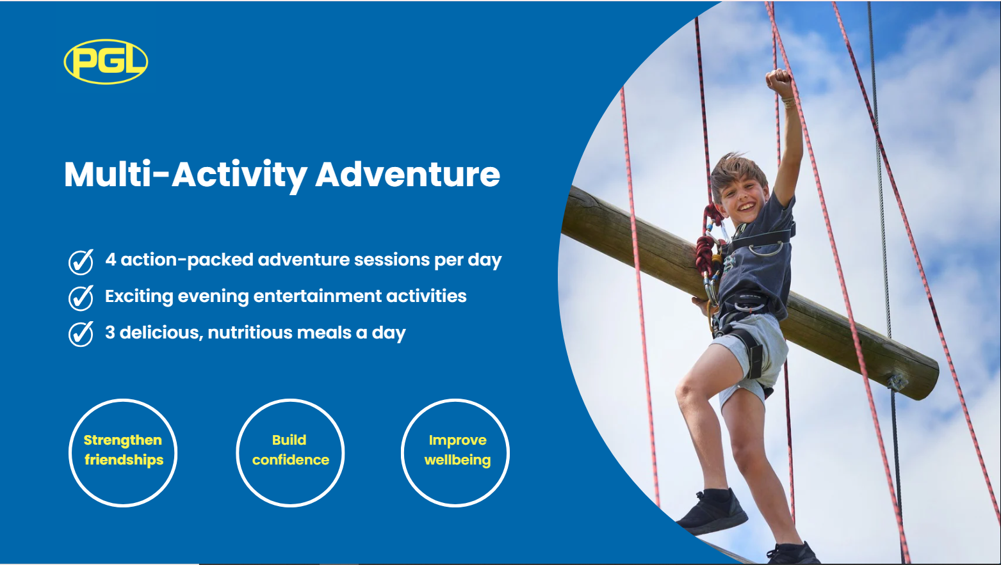

Slide 4
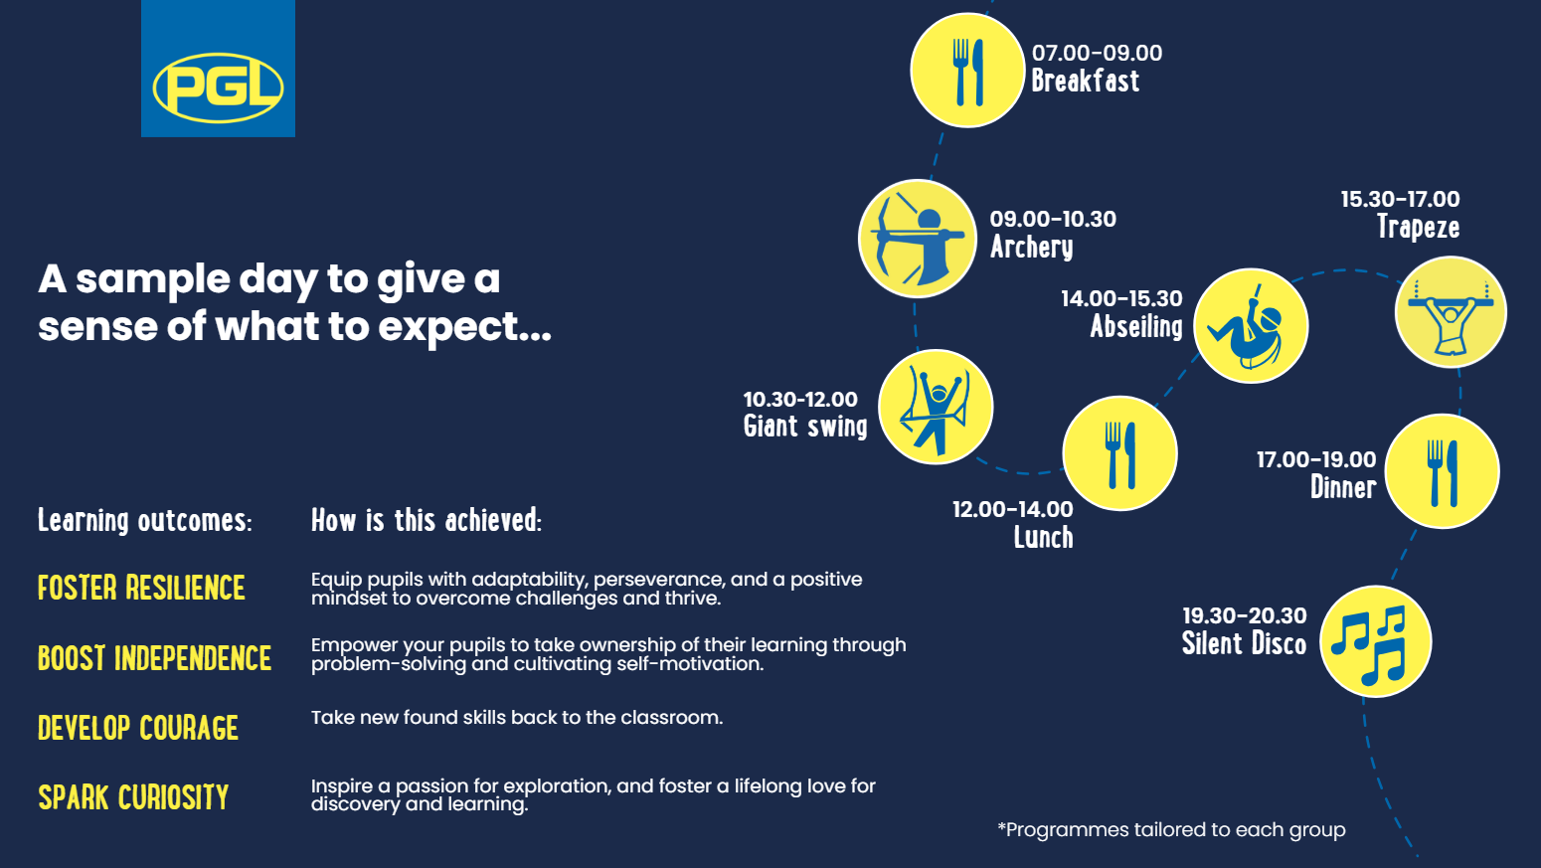

Slide 5
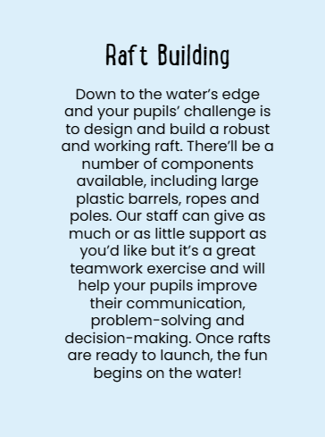
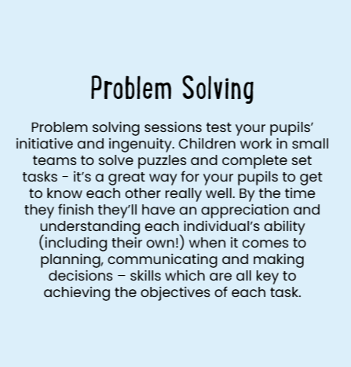

Slide 6
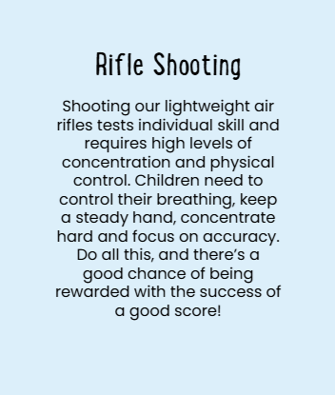
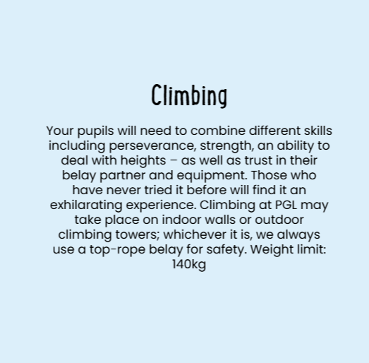

Slide 7
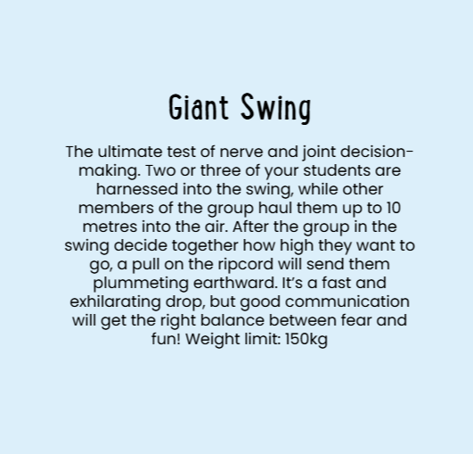

Slide 8
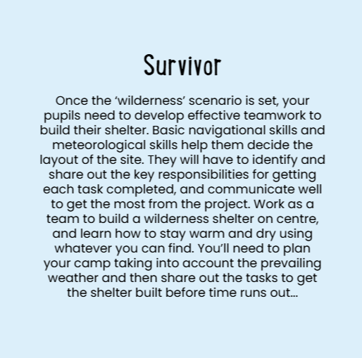
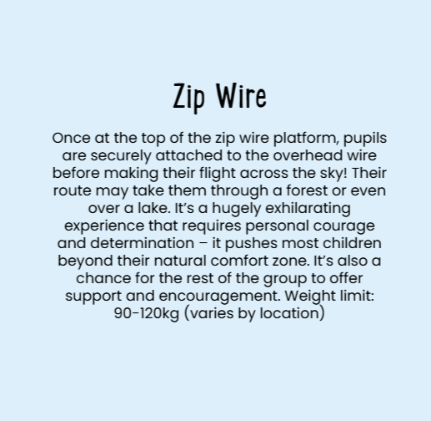

Slide 9


Slide 10
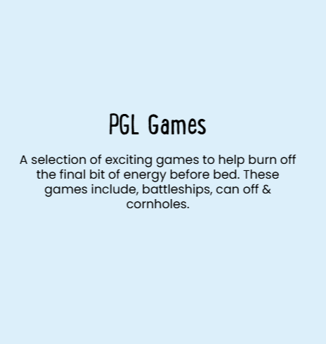
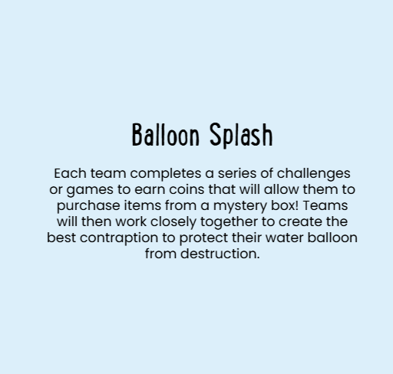

Slide 11


Slide 12


Slide 13
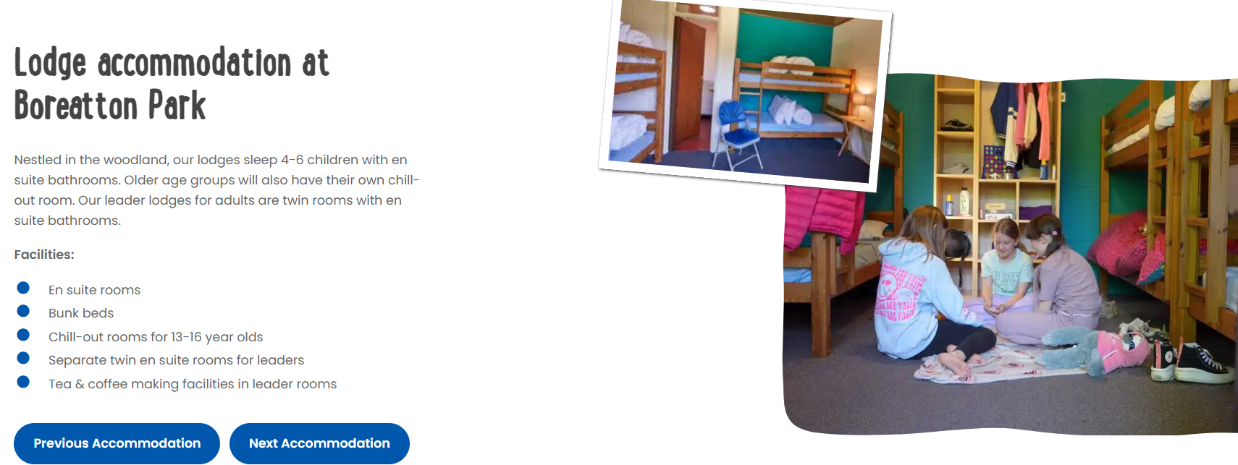

Slide 14
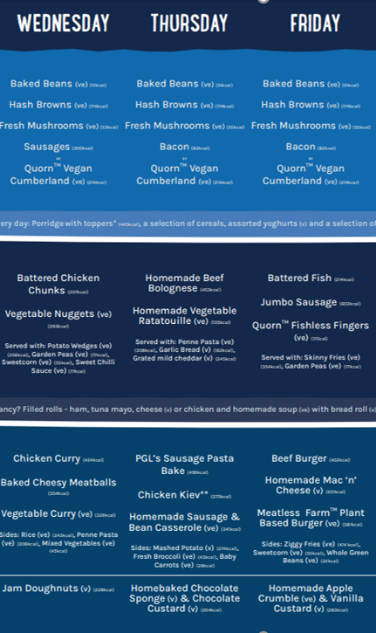
Sample menu
If your child is unhappy with the food choices they must inform a member of staff as PGL can make them something they would prefer.

Slide 15
Wednesday 11th November
Please drop your child off through the office with their bags (each child must be able to carry all their belongings)
Do not attach their sleeping bag to their suitcases.
All medications must be given to the office staff, not in children’s bags.
Money for the gift shop should be placed in their backpacks to be given to their class teacher.
All children must bring a packed lunch that can be disposed of.
Room allocations and groups will be given in class before departure.
We will be leaving school at 10am, feel free to wave us goodbye!
LABEL EVERYTHING!!

Slide 16
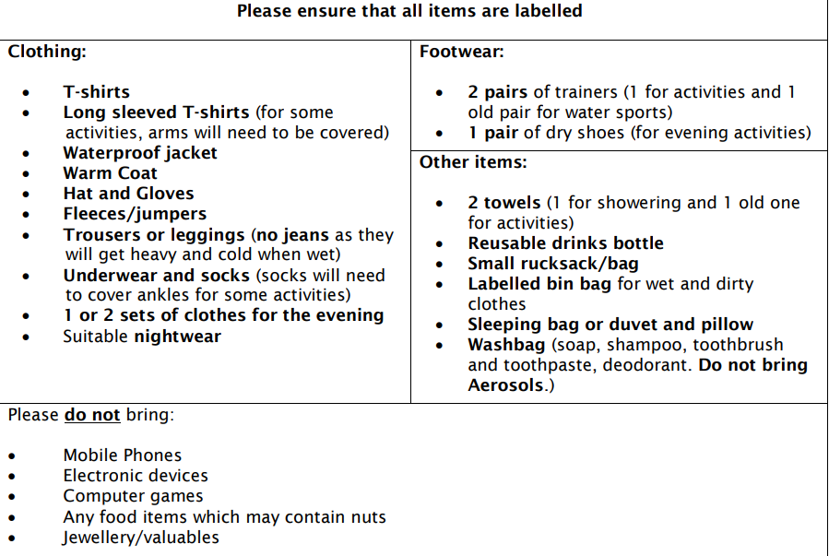
Please pack spare plastic bags for dirty/wet clothes

Slide 17
Friday 13th November
Breakfast
Pack up rooms
Activity
Lunch
Back to school
Pick up from KS2 Hall around 3:30pm (traffic dependant)

