Slide 1
Welcome to Moredon Primary and Nursery School Early Years Open Evening 10th June 2025
Please read through the following information carefully. There is further information and key dates within your induction pack.

Slide 2
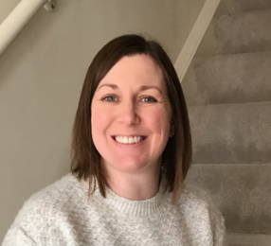
Staff at Moredon
Senior Leadership Team
Mrs Claire Leach
(Principal and Safeguarding Lead)
Mrs Emma Preen
(Assistant Principal, Early Years Lead,
Deputy Safeguarding Lead & Pupil Premium Lead)
Miss Angie Harris
(Special Educational Needs
Coordinator & Deputy Safeguarding Lead)

Slide 3
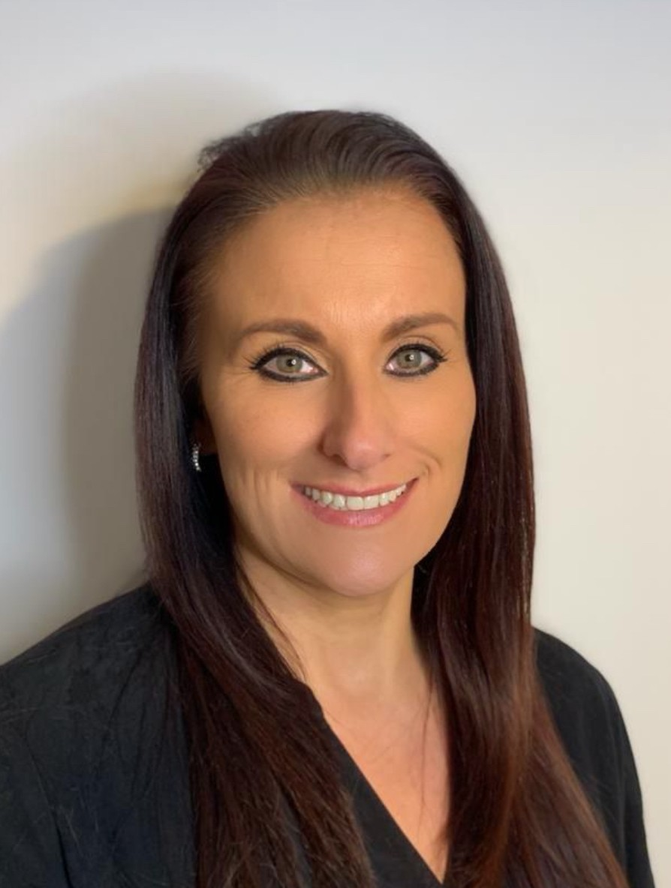
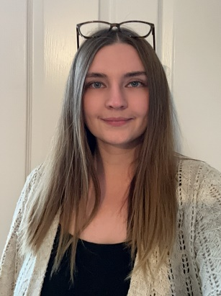
Office Staff
School Office Team
Mrs Helen Slater
(Pupil Services Officer)
Mrs April Newman
(Pupil Services Administrator)

Slide 4
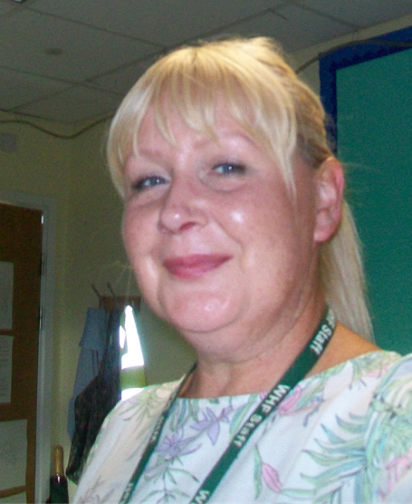
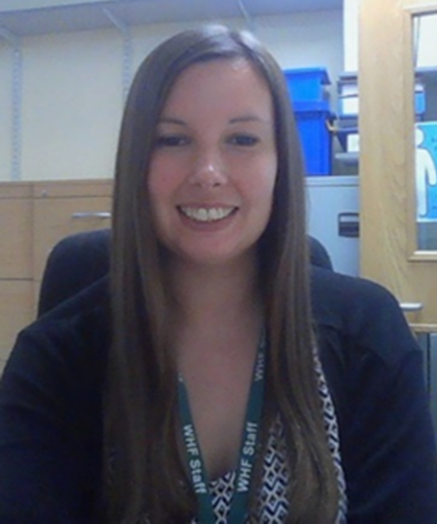
NEST Team
(Pastoral and emotional support)
Miss Angie Harris (SENCO)
Mrs Diane Townsend
(Learning Support Mentor)
Mrs Kirsty Mapstone-Davies
(Family Support Worker)

Slide 5
Reception and Year 1 arrangements for September 2025
For September 2025, we will have 3 classes of mixed Reception and Year 1 children.
We view the benefits to be:
Class sizes will be slightly smaller meaning more time for teachers to focus support.
Each class will still have a Teaching Assistant to further support learning in each class.
All classes will have a ‘reception’ feel with the focus being on child initiated play balanced with adult led activities.
Role models in each class who have been in school for a year and can therefore support the new children to settle.

Slide 6
Reception and Year 1 arrangements for September 2025
All classes will have an outdoor area to ensure the children have access to essential outdoor learning.
All teachers will use the White Horse Federation mixed age planning so that no learning is missed.
All children in the same position so no parents or children are left wondering why they were placed in one class over the other.
All children receive the same offer of education across the 3 classes.
Teachers having time to plan together as a team rather than planning alone which is what is currently happening.

Slide 7
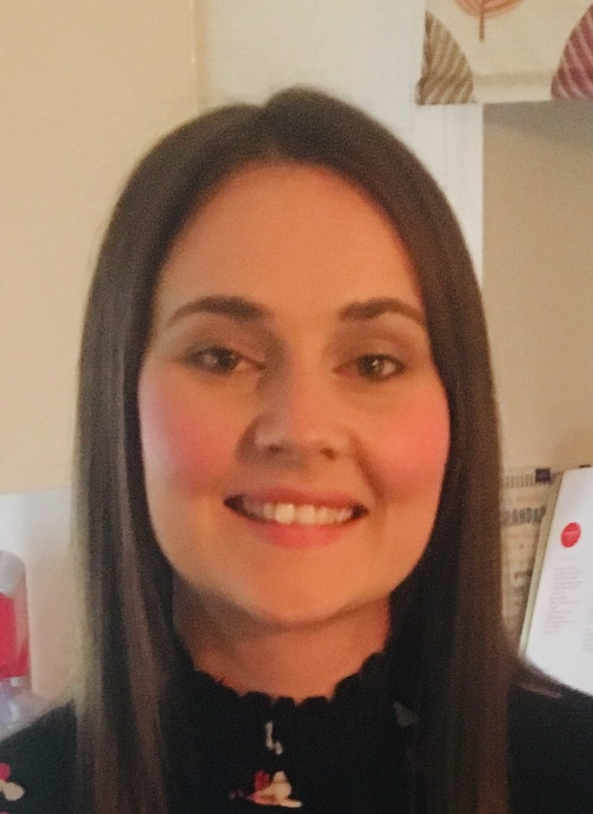
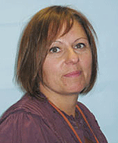
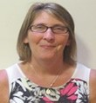
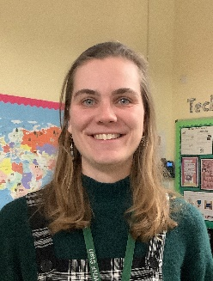
Reception and Year 1 Staff
Class R1CB
Miss Coral Bentley
Class R1MS
Mrs Simone Marr and Mrs Sarah Smith
Class R1BP
Miss Beth Parmenter
Each class will have a full time Teaching Assistant.

Slide 8
Home visits and Transition sessions
Home visits will take place for those children not in our current nursery. You will arrange a date/time with your child’s class teacher tonight for this.
Transition sessions will take place on Thursday 3rd July where your child can meet their teacher and school friends. Your child’s allocated transition session is in your induction pack.
Parents will drop children off for this session. Please can your child bring a named water bottle and a fruit snack with them. If your child attends our nursery, they will attend their usual session time and staff will escort them to their transition session and collect them.

Slide 9
September arrangements
Your child’s school start date is Wednesday 3rd September.
During the first week your child will attend school for half a day to settle them in. Your child will attend a morning session 8:30am – 11:45am for the first two days.
On Friday 5th September all children will attend 8:30am – 1:30pm and have lunch in school (a packed lunch must be provided).
From Monday 8th September, all children will attend school full time 8:30am – 3:30pm including lunch. You will need to provide your child with a packed lunch.
From Monday 15th September your child can have either, a packed lunch which you provide or you can opt to have a school meal which you will need to order through your ParentPay account. Please note that you need to order your child’s school meals by the previous Wednesday for the following week e.g. if you would like your child to have school meals the w/b 15th September then you must order this on ParentPay by Wednesday 10th September.

Slide 10
September school timings
The Reception classroom doors are opened at 8.30am each day. Drop off is between 8:30 – 8:35am. You will need to walk your child round to their classroom door where they will be greeted by the Reception and Year One staff.
It is important that your child is dropped off in time so that they aren’t marked as being late.
Children finish school at 3:30pm from Monday - Thursday.
Children finish school at 1:30pm on Fridays.

Slide 11
What can I do to prepare my child for school?
Talk positively about school. The book ‘Starting School’ by Janet and Allan Ahlberg is a lovely book to share with your child.
Help your child to recognise their name.
Help your child to write their name using only a capital letter at the beginning.
Help your child to orally count to 10 and recognise amounts to 5.
Get your child to practise dressing and undressing into uniform and into PE kit - practise undoing and doing up buttons.
Teach your child how to put on their coat and do up their zip.
Teach your child how to put on their shoes and fasten them.
Teach your child how to use a toilet and wash their hands.
Get your child to practise using a knife and fork or practise opening up their lunchbox.
Play some board games with your child and help them to take turns and share.

Slide 12
Your child will need:
A named PE kit in a named PE drawstring bag – white t-shirt, black shorts, socks and a pair of daps or trainers. It also helps to have a spare pair of underwear just in case of any accidents. It is worth putting in a dark plain jumper and a pair of dark plain tracksuit bottoms in case of cold weather as we do have PE outside too.
A pair of named wellies – we have a welly walk each week where we explore our environment. There are welly racks outside the reception classrooms.
A clearly named bookbag. It’s helpful to attach a keyring/photo keyring to the bookbag so that your child can recognise their bookbag.
A named school uniform – black trousers/skirt/pinafore. Plain red t-shirt. Logo black jumper or cardigan. Black school shoes – please can shoes have your child’s name in as we end of with lots of shoes that are the same!
A named water bottle.

Slide 13
School Uniform
SCHOOL UNIFORM ORDERS: MICHAEL HOPE Uniform with the school logo on can be purchased from the Michael Hope website (michaelhope.co.uk) and selecting Moredon in the ‘School shops’ section.
For new reception children starting in September 2025, any orders placed over the summer holidays must be done by Sunday 3rd August for delivery in time for the start of term in September. This date is for both home & school deliveries and doesn’t guarantee enough time for any exchanges.

Slide 14
Pupil Premium
All children who currently qualify for free school meals based on their family circumstances are entitled to pupil premium. This applies if you receive any of the following benefits:
Universal credit (provided you have a net income of £7400 or less)
Income support
Income-based jobseekers’ allowance
Income-related employment and support allowance
Support under Part IV of the Immigration and Asylum Act 1999
The guaranteed element of state pension credit
Child tax credit, provided that you are not also entitled to working tax credit and have an annual gross income of £16,190 or less
Children who are or have been in care, and children who have a parent who is or was in the armed forces, are also entitled to pupil premium. In addition, pupils who have qualified for free school meals on the above grounds in the past, but are no longer eligible, continue to receive pupil premium for the next six years. If you think your child may qualify for pupil premium then please visit the following website and register:
https://www.swindon.gov.uk/info/20032/schools_and_education/408/free_school_meals
If your child is eligible for Pupil Premium, we will provide your child with a school jumper, school bookbag and PE drawstring bag, all with the school logo on. We have to order this and it normally arrives around November.

Slide 15
Other useful information…
All children receive a piece of fruit each day for snack, as part of a Government initiative.
Children under 5 are entitled to receive a free carton of milk daily. Once your child turns 5, milk can still be ordered by filling in a registration form online, but you will need to pay a small fee for it. You need to register your child on the Cool Milk website which can be found at https://www.coolmilk.com/ It will ask for a start date. Please type in 3rd September.
Reading is a priority. We do expect children to read regularly at home and ask that parents record this in their reading record.
Your child will also receive a sounds pack where you can practise the sounds they have learnt in school at home.

Slide 16
Teachers will communicate with you via ClassDojo. You will need to download the App and your child’s class teacher will provide you with a password in September.
You can contribute to your child’s learning journey by uploading photos/videos onto your child’s portfolio. This will be set up for you in September by your child’s class teacher. Your child can then share things they have done at home with their class.
If your child is absent from school, please let the School Office know by phoning in and leaving a message as soon as possible. They will let your child’s Class Teacher know.
Try to talk positively about starting school at home. It is an exciting time! Have a lovely summer!

