Slide 1
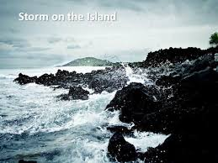
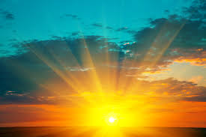
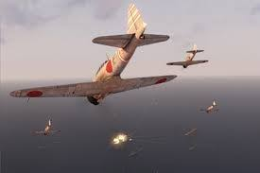
Storm on the island – Seamus Heaney
The Emigree – Carol Rumens
Kamikaze – Beatrice Garland
Who: A community of people on an island
What: Preparing for a storm that is on the way.
Where: A remote island.
Who: A woman who left her city as a child.
What: Thinking about the positive memories of home
Where: A place torn apart by war.
Who: A Japanese Kamikaze Pilot setting off on his mission.
What: His daughter recalls that he decided not o go through with his mission.
Where: Japan – WW2
“Leaves and branches can raise a tragic chorus”
“Spits like a tame cat Turned savage””
“It is a huge nothing that we fear”
“There once was a country I left it as a child”
“I am branded by an impression of sunlight”
“my city comes to me in its own white plane”
“Her father embarked at sunrise…”
“the little fishing boats strung out like bunting”
“and sometimes, she said, he must have wondered which had been the better way to die”
Writers purpose
Nature is powerful and uncontrollable. It has the power to harm or end life. Their confidence turns to fear as they are scared of something invisible.
Writers purpose
The speaker’s views of her home city remain positive no matter what she hears about it. She chooses to ignore the negative things and hold on to only positive thoughts.
Writers purpose
The speaker shows us that pilot’s wife is ashamed of her husband and he wonders if it was better to go through with it and die a hero with a family who loved him. The daughter and the pilot feel regret.
Perspective:
1st person
“we” and “us” implies a collective experience.
Perspective:
1st person
She shares her memories of her home.
Perspective:
^{3rd} Person – narrating the daughters thoughts and feelings.
Form and Structure
Written in blank verse.
1 stanza – compact and sturdy like the houses.
Compare with…
Exposure
Ozymandias
Form and Structure
The first line is written like a story – anecdotal.
Each stanza ends with ‘sunlight’
Compare with…
Kamizaze
Tissue
Checking out me History
Form and Structure
The pilot is not the speaker to show that he has been cut off from society.
Compare with…
Remains
Poppies
The Emigree

Slide 2
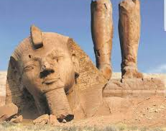
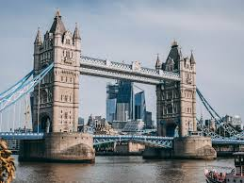
Remains - Simon Armitage
Ozymandias – Percy Bysshe Shelley
London – William Blake
Who: A soldier who has come home from war remembering a raid where a group of soldier shoot a man.
What: He is experiencing PTSD due to the impact war had on him
Where: Much of the poem is his memories of his time at war.
Who: A traveller who tells the story of a statue that he found standing in the dessert.
What: The statue is of a king that ruled a past civilisation. He was proud of his work but also arrogant.
Where: A far away desert land.
Who: The speaker is walking through the city streets.
What: He talks about the misery and despair that he sees on his journey.
Where: London in 1794
“Two vast trunkless legs of stone”
“And wrinkled lip, and sneer of cold command”
“My name is Ozymandis, king of kings”
“I wander through each chartered street”
“In every cry of every man, in every infants cry of fear”
“runs in blood down palace walls”
“probably armed, possibly not”
“and tosses his guts back into his body. Then he’s carted off in the back of a lorry”
“his bloody life in my bloody hands”
Writers purpose
Nature and time made the statue crumble. Shelley wanted to show that no matter how strong something or someone is - nature and time will have more power than anything else.
Writers purpose
Blake shows that he is angry at people who are in power because they could do something to help but they don’t. His message is that the people are also to blame because they need to help themselves if they want things to change.
Writers purpose
The poem in based on an account of a British soldier who served in Iraq to show the impact that war can have on a soldiers mental state.
Perspective:
1st Person perspective
Starts with “we” but changes to “I” to make it more personal.
Perspective:
Written in 1st person - the narrator talks about meeting the traveller who came across the statue
Perspective:
1st person - dramatic monologue
Form and Structure
Anecdotal – written like a story
No regular rhyme scheme
Starts with “we” but changes to
Compare with…
Poppies
Kamikaze
Exposure
Form and Structure
Sonnet – 14 lines and iambic pentameter
Volta (turning point) line 9.
Compare with…
Exposure
Storm on the Island
My Last Duchess
Form and Structure
Unbroken rhyme scheme
Rhythm that reflect his feet as he walks
Compare with…
The Prelude
The Emigree

