Slide 1


Meet the Teacher
2025-26

Slide 2
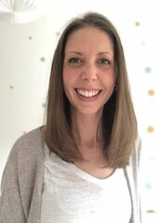
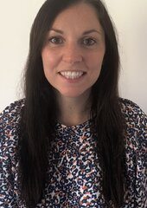
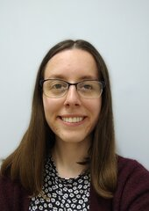

INTRODUCING THE TEACHERS
Mrs Derrien
1DB
Mrs Berridge
1DB
Miss Hill
1H

Slide 3
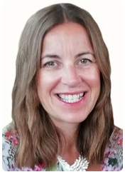
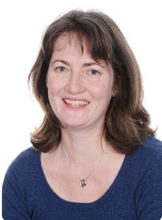
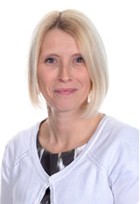
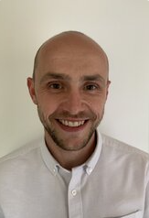
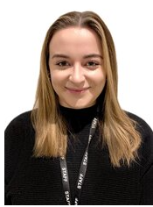
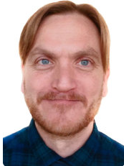
MEET THE TEAM
Gill Kennaugh
Headteacher
Jacky Hansard
Deputy Head
Lower School
Phase Leader
Attendance Officer
Ali Bartlett
Upper Key Stage 2
Phase Leader
Pupil Premium
Leader
Joe Newman
Lower Key Stage 2
Phase Leader
Teaching and
Learning Leader
Emma Mylan
EYFS Leader
Assessment Leader
Alex Bacon
SENDCO
Inclusion Leader

Slide 4
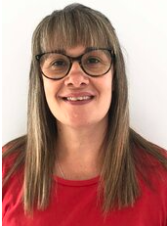
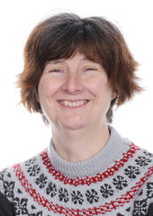
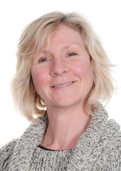
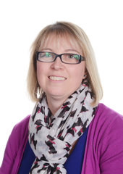
MEET THE TEAM
Viki Stock
ELSA
Mrs Kamal
1H
Ms Hill
1DB
Mrs Hansard
PPA Teacher
Ms Auld
PPA Teacher

Slide 5


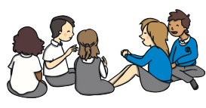
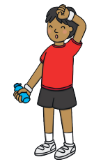


A week in Year 1
Monday –
Tuesday –
Wednesday –
Thursday –
Friday -

Slide 6
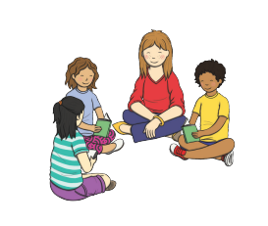




A day in Year 1
8:45 – Fine motor skills
8:55 – Register
9:00 – Handwriting
9:15 – Phonics
9:45 – English
10:20 – Playtime
10:35 – Snack and Show and Tell
10:55 – Maths
11:35 – Guided reading
12:00 – Lunch
1:00 – Quick Maths
1:15 – Curriculum lesson
2:00 – Drawing Club
2:30 – Playtime
2:45 – Story time/assembly

Slide 7
Learning Enquiries
What makes a hero?
How can we keep safe?
Whatever next?
Can you see it?
How can we look after our planet?
Why is this place special?

Slide 8



HOME LEARNING
Reading 3 books sent home each week 3 times a week Reading Record Numbots Login details Little and often

Slide 9


BEHAVIOUR AT NEWBRIDGE
Respectful
Robin
Responsible
Ravi
Safe
Sam

Slide 10
DAYS TO REMEMBER
P.E. will be on a Tuesday and Friday. The children will come to school in their P.E. kit.
Book change will be on a Monday. The children will need their book bag in school every day.
Throughout the year, we will have season days. On these days, we will study how the season effects us and our surroundings. Children will need to wear clothes that you don’t mind getting muddy and that are appropriate for the weather.

Slide 11




WHAT DO THEY NEED?
Season days
P.E.
Every Day
The children will wear:
Long sleeve top
Full length trousers
Trainers
To bring:
Wellies in a plastic carrier bag
Waterproof trousers and coat in a large bag.
Hat and gloves in cold weather.
The children will bring:
Book bag (with reading books and reading record)
Filled water bottle
Waterproof coat (every day please)
Weather dependent:
Cap
Hat and gloves
The children will wear:
House colour P.E. t shirt
School sweatshirt/cardigan
Black shorts/leggings
Trainers/daps
Don’t forget a coat!

Slide 12
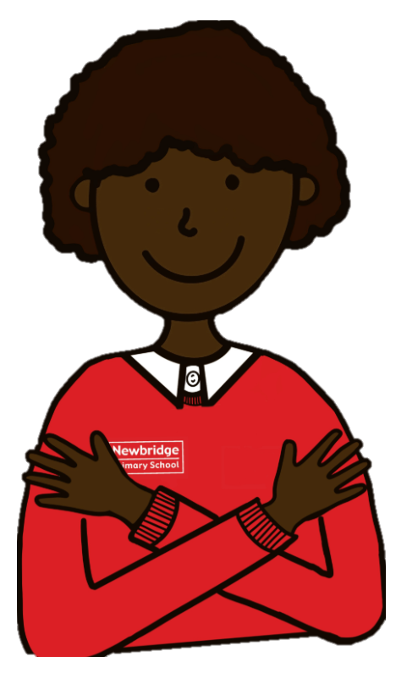
.
ONLINE SAFETY
Each term, one of our computing lessons is dedicated to online safety. Within these sessions we will focus on teaching children the knowledge and behaviours they need in order to conduct themselves in a safe and responsible way online.
You can support your child's online safety learning by regularly talking about how, why and when we use technology.
Understanding all there is to know about online safety can feel daunting, especially with the speed in which changes occur. There will be an online safety training session for parents, organised by Knowsley City Learning Centres on Wednesday 1st October 4-4:45pm. Please look out for a link for this nearer the time.

Slide 13
ADDITIONAL INFORMATION
Medication - any medication (including medicine, medicated creams, medicated lip balms etc) all need to go through the school office before we are able to use these in the classroom with the children.
Spare clothes - if your child is likely to have a toileting accident, it would be helpful if you could please provide named spare clothing in their book bags.
Named items - please can all items be named (including shoes, socks, jumpers, cardigans, coats, water bottles)
Collecting children - If your child is not being picked up by someone who is already authorised by the school office, please remember to email the school with details of who will be picking up.
Packed lunches - Please ensure there are no nuts in packed lunches.

Slide 14



KEEPING IN CONTACT
We post updates on Google Classroom every Friday. This contains a blog about the week, messages from the teachers and key dates/information. If you need any help accessing this, please ask the school office.
Come and chat to us! The teachers will be outside their classrooms at the end of each day if you have anything you’d like to ask.
Please do email the school office FAO your class teacher if you need to get in contact.

