Slide 1


Back to School Meeting
Friday 5th September
2.45pm - 3.10pm

Slide 2
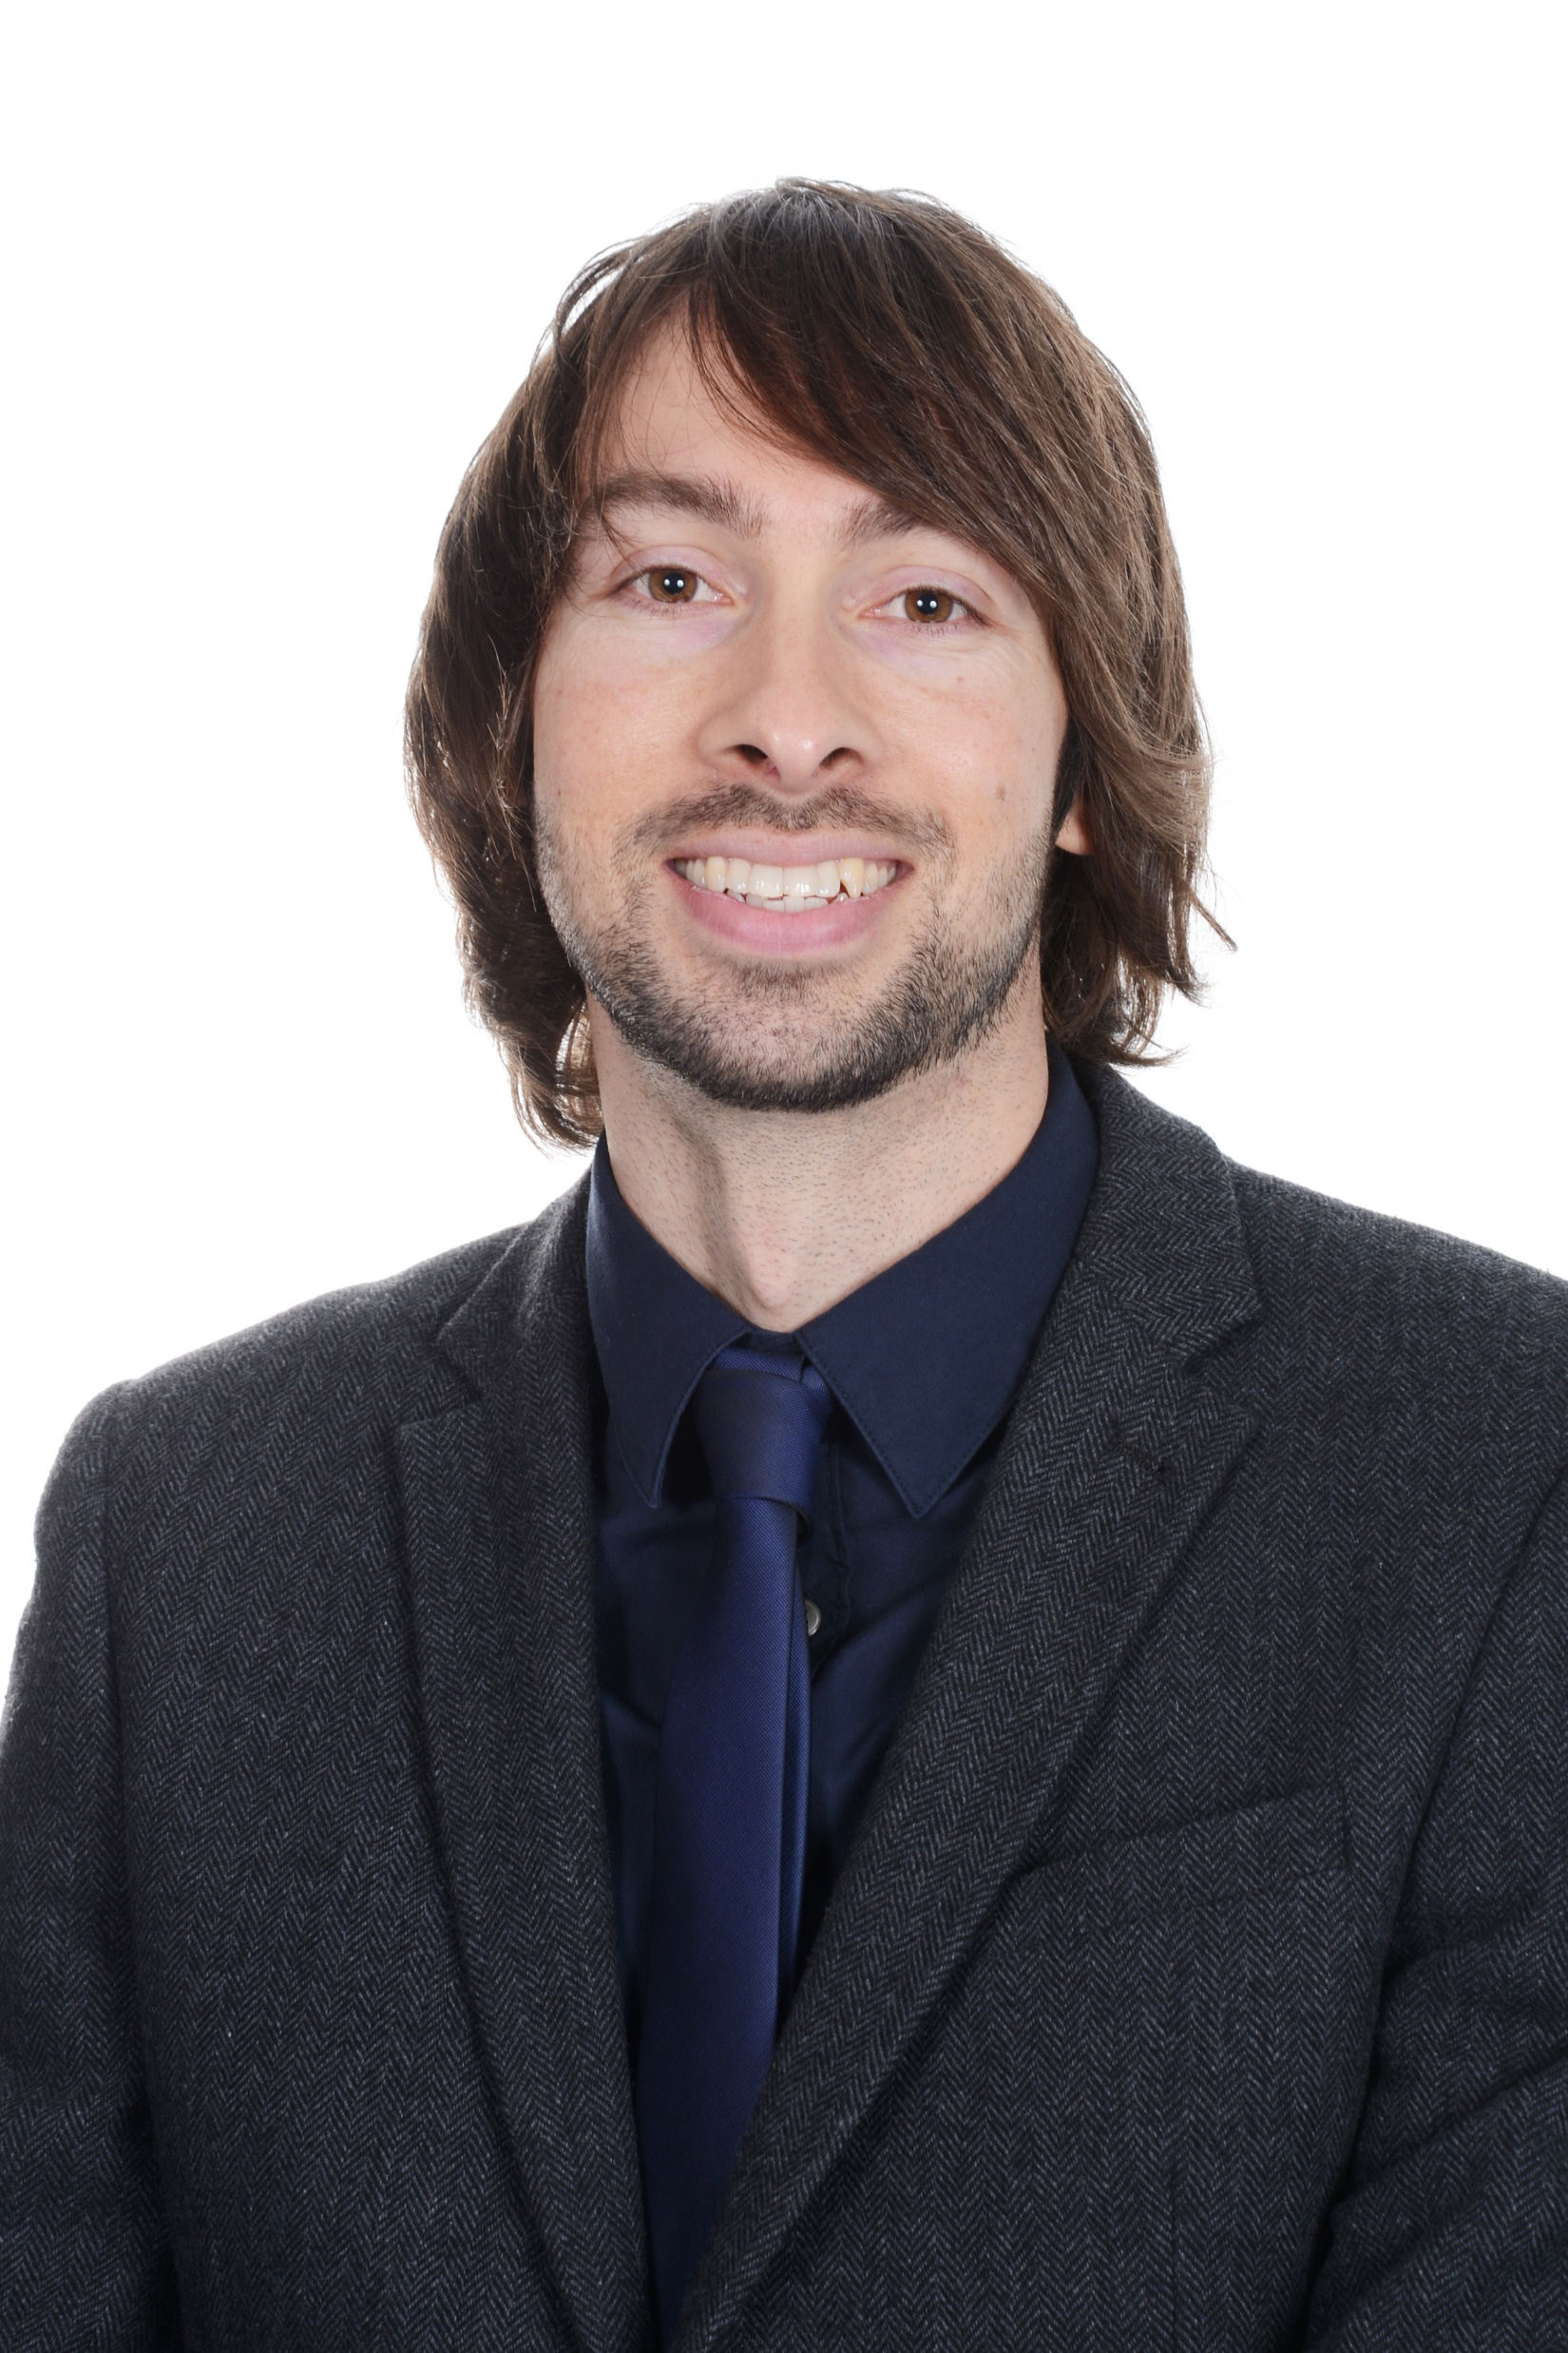
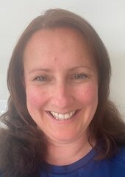
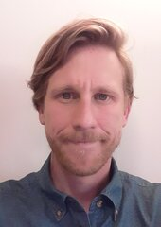

INTRODUCING THE TEACHERS
Mr Handson
Class 5HK
Mrs Keep
Class 5HK
Mr Free
Class 5F

Slide 3
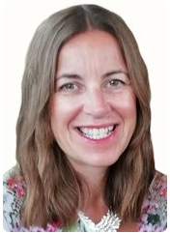
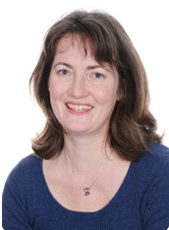
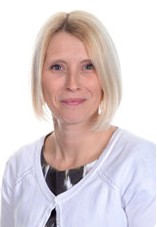
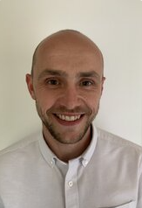
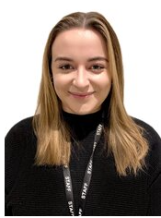
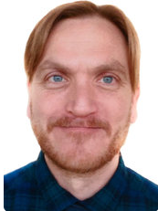
MEET THE TEAM
Gill Kennaugh
Headteacher
Jacky Hansard
Deputy Head
Lower School
Phase Leader
Attendance Officer
Ali Bartlett
Upper Key Stage 2
Phase Leader
Pupil Premium
Leader
Joe Newman
Lower Key Stage 2
Phase Leader
Teaching and
Learning Leader
Emma Mylan
EYFS Leader
Assessment Leader
Alex Bacon
SENDCO
Inclusion Leader

Slide 4
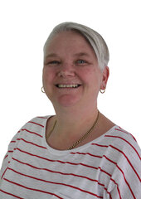
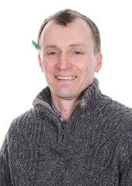
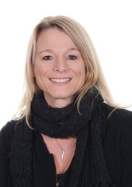
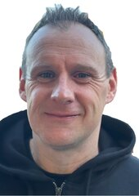
MEET THE TEAM
Mrs Dennis
Teaching Assistant
Mr Ward
Teaching Assistant
Mrs Van Gelderen
Teaching Assistant
Mr Wallace
PPA Teacher
Mrs Davies
PPA Teacher

Slide 5


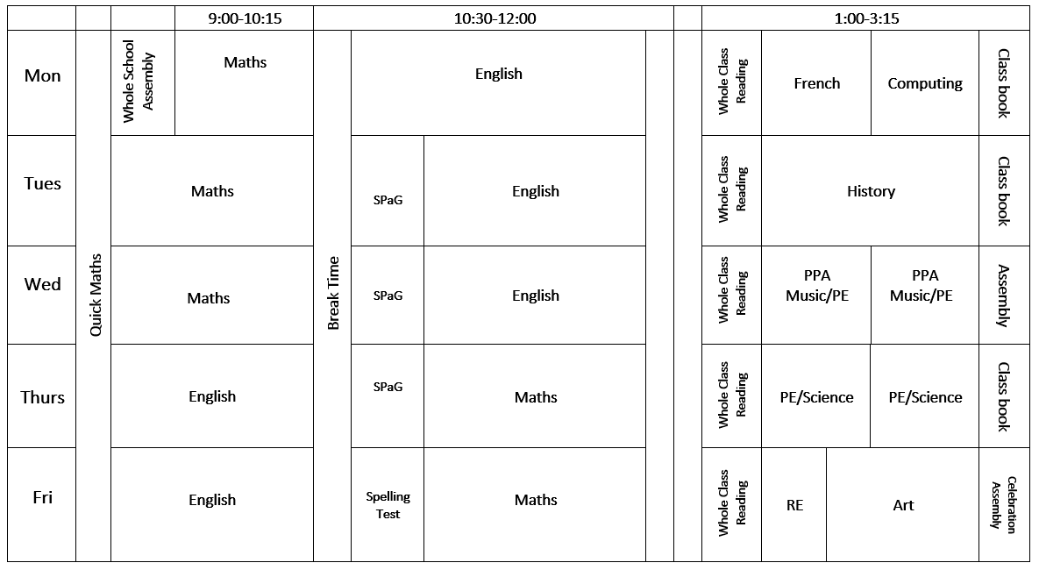
A DAY IN YEAR 5

Slide 6


BEHAVIOUR AT NEWBRIDGE
Respectful
Robin
Responsible
Ravi
Safe
Sam

Slide 7

HOME LEARNING
Weekly homework is set on a Monday and alternates between maths and English/reading comprehension.
Maths
  Set every two weeks
  Accessible via Mathswatch (https://vle.mathswatch.co.uk/vle/)
  Paper copies can also be provided if needed
  Please contact the class teacher via the office if you are unable to access the website
Each piece of homework is due in the following Monday
It is marked in class
Weekly spelling test
Independent reading at least three-four times per week – reading
records are checked every Friday
Times Table Rockstars

Slide 8
DAYS TO REMEMBER
Spellings will be provided on the school website at the start of each term.
The children will practise a different set each week and then be tested on Fridays.
P.E. will be on Wednesday and Thursday afternoons. On these days, the children will come to school in their P.E. kit. Swimming will take place on the week beginning 22.09.2025 for 5HK and week beginning 29.09.2025 for 5F.
Reading Records will be collected, then handed back to each child, on a Friday.
The class teacher will go through each Reading Record book and give out a house point for every child who shows they have read at least 3 times in a week.

Slide 9



WHAT DO THEY NEED?
P.E.
Every Day
The children will bring:
A back pack (with their reading book and reading record)
Filled water bottle
Waterproof coat (every day please)
Weather dependent:
Cap
Hat and gloves
The children will wear:
House colour P.E. t shirt
School sweatshirt/cardigan
Black shorts/leggings
Trainers/daps
Don’t forget a coat!

Slide 10
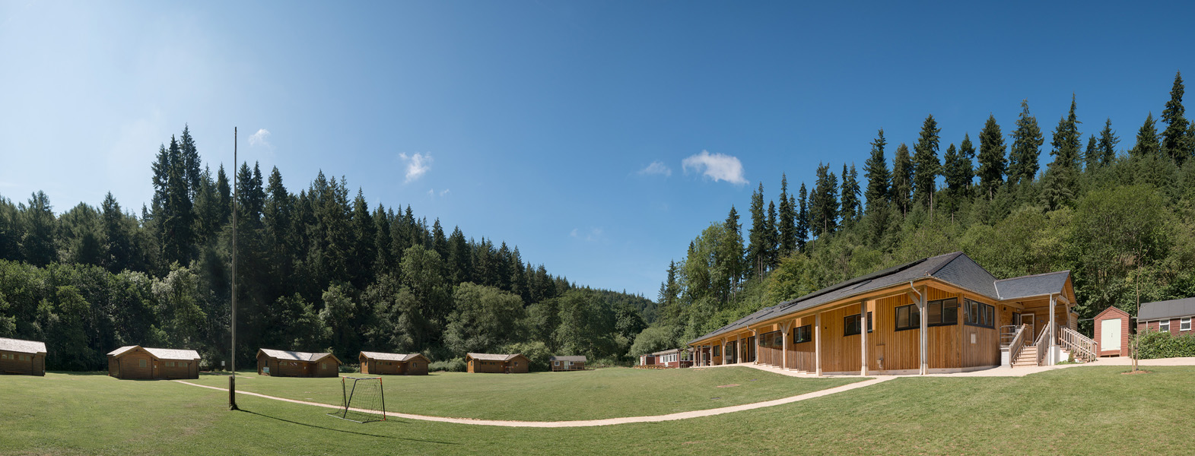
YEAR GROUP MESSAGES
Our Residential visit to Great Wood Camp is booked for Wednesday 22nd – Friday 24th April.

Slide 11

ONLINE SAFETY
Each term, one of our computing lessons is dedicated to online safety. Within these sessions we will focus on teaching children the knowledge and behaviours they need in order to conduct themselves in a safe and responsible way online.
You can support your child's online safety learning by regularly talking about how, why and when we use technology.
Understanding all there is to know about online safety can feel daunting, especially with the speed in which changes occur. We have arranged an online safety training session for parents and carers on Wednesday 1st October, 4.00pm – 4.45pm.

Slide 12
ADDITIONAL INFORMATION
Medication - any medication (including medicine, medicated creams, medicated lip balms etc) all need to go through the school office before we are able to use these in the classroom with the children.
Named items - please can all items be named (including shoes, socks, jumpers, cardigans, coats, water bottles)
Collecting children - If your child is not being picked up by someone who is already authorised by the school office, please remember to email the school with details of who will be picking up.
Packed lunches - Please ensure there are no nuts in packed lunches.

Slide 13



KEEPING IN CONTACT
We post updates on Google Classroom every Friday. This contains a blog about the week, messages from the teachers and key dates/information. If you need any help accessing this, please ask the school office.
Come and chat to us! The teachers will be outside their classrooms at the end of each day if you have anything you’d like to ask.
Please do email the school office FAO your class teacher if you need to get in contact. enquiries@newbridge.bathnes.sch.uk

