Slide 1


Meet the Teacher
2025-26

Slide 2

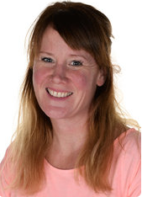
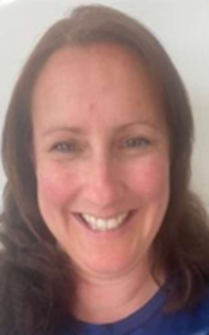
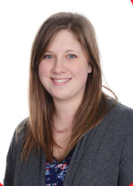

INTRODUCING THE TEACHERS
Mrs O’Gara
2OG
Mrs O’Byrne
2KO
(Tuesday to Friday)
Mrs Keep
2KO
(Monday)

Slide 3
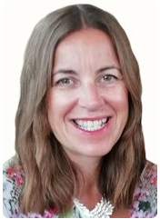
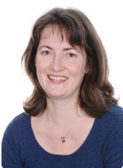
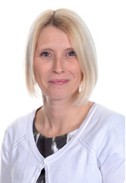
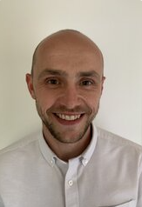
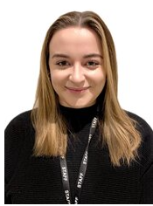
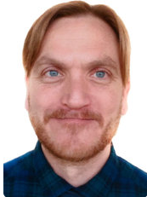
MEET THE TEAM
Gill Kennaugh
Headteacher
Jacky Hansard
Deputy Head
Lower School
Phase Leader
Attendance Officer
Ali Bartlett
Upper Key Stage 2
Phase Leader
Pupil Premium
Leader
Joe Newman
Lower Key Stage 2
Phase Leader
Teaching and
Learning Leader
Emma Mylan
EYFS Leader
Assessment Leader
Alex Bacon
SENDCO
Inclusion Leader

Slide 4
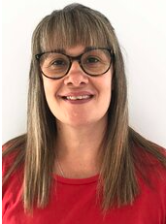
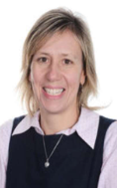
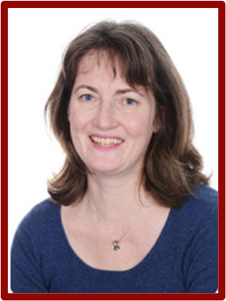


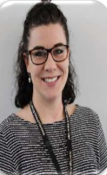
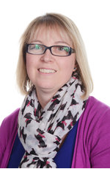
MEET THE TEAM
Mrs
O’Byrne
Viki Stock
ELSA
Teaching Assistant
Year 2
Teaching Assistant
Year 2
PPA Teacher
Year 2
Teaching Assistant
Year 2
PPA Teacher
Year 2

Slide 5


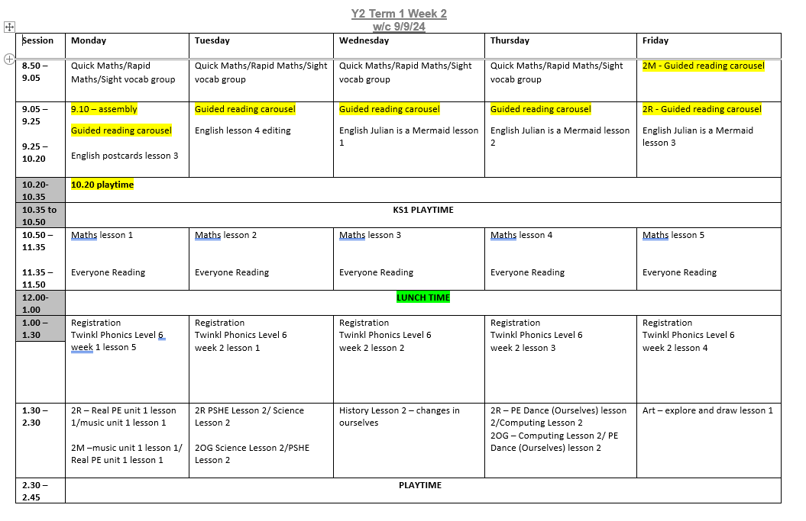
A DAY IN YEAR 2

Slide 6


BEHAVIOUR AT NEWBRIDGE
Respectful
Robin
Responsible
Ravi
Safe
Sam

Slide 7

HOME LEARNING
Reading at home – As a school we place a high emphasis on reading. Please continue to read regularly with your child at home. Our aim is that every child reads at least 3 times a week at home, although daily is even better. The key thing to remember is little and often is best. It is also essential that you ask your child to retell what they have read and for you to ask them some questions about it. Comprehension skills are equally as important as decoding skills, to be a good reader your child must have both.
Reading Record Logs - The purpose of this book is to record a short, positive comment after reading with your child. Books will be changed every Friday, after a comment has been recorded. Please ensure that the Reading Record and reading books are kept in book bags and brought to school every day. If you have any questions about your child’s reading, or their progress, please email the class teacher rather than writing comments in the book.
Phonics and Spellings - An overview of the weekly phonics and spelling pattern we are focusing on is available on the class pages section of the school website. Additional materials to support your child’s phonics will be uploaded to Google Classroom every Friday. Please support your child to practice the spelling patterns and weekly phonics, as well as reviewing all phonics sounds they have previously learnt - several short sessions are more effective than one long one.
Maths – We encourage children to practice their recall of number bonds to 10 and 20 (e.g. 7+3 = 10 and 17+3 = 20), along with reading and writing numbers to 100 and spelling numbers as words to 20. There is no requirement to record any of this home learning, simply discussing numbers and identifying them in the real world will help support their learning. Please also try to practise times tables regularly. The times tables the children need to learn this year are the 2s, 5s and 10s.

Slide 8
DAYS TO REMEMBER
Forest School will be on a Thursday. The children will come to school in their Forest School Clothes. 2KO begin on 11th September and classes will alternate weeks with 2OG beginning on the 18th.
P.E. will be on a Monday and Friday. The children will come to school in their P.E. kit.
Book change will be on a Friday. The children will need their book bag in school every day.

Slide 9




WHAT DO THEY NEED?
Forest School
P.E.
Every Day
The children will wear:
Long sleeve top
Full length trousers
Trainers
To bring:
Wellies in a plastic carrier bag
Waterproof trousers and coat in a large bag.
Hat and gloves in cold weather.
The children will bring:
Book bag (with reading books and reading record)
Filled water bottle
Waterproof coat (every day please)
Weather dependent:
Cap
Hat and gloves
The children will wear:
House colour P.E. t shirt
School sweatshirt/cardigan
Black shorts/leggings
Trainers/daps
Don’t forget a coat!

Slide 10
YEAR GROUP MESSAGES
Planning, Preparation and Assessment (PPA) All teachers are entitled to 10% Planning, Preparation and Assessment (PPA) time. For Terms 1-3 PPA will be on Thursday mornings. Both classes will be taught alternately by Mrs Hansard and Ms Auld.
Please send your child in with a bottle filled with water every day. Snacks are provided every morning by the school.
Learning in Year 2 In Term 1, our enquiry is ‘What makes me special?’ This means we will have the opportunity to learn about each child as an individual, where they come from and who they want to be. You may even like to have a discussion with your child about what they would like to be when they grow up.
Our enquiries for the year include:
Term 2 - What makes a great team?
Term 3 - What is survival?
Term 4 – Where does my food come from?
Term 5 – Why do we have money?
Term 6 – What makes Bath beautiful?

Slide 11

ONLINE SAFETY
Each term, one of our computing lessons is dedicated to online safety. Within these sessions we will focus on teaching children the knowledge and behaviours they need in order to conduct themselves in a safe and responsible way online.
You can support your child's online safety learning by regularly talking about how, why and when we use technology.
Understanding all there is to know about online safety can feel daunting, especially with the speed in which changes occur. We have arranged an online safety training session for parents and carers on Tuesday 22nd October, 5:30-7pm

Slide 12
ADDITIONAL INFORMATION
Medication - any medication (including medicine, medicated creams, medicated lip balms etc) all need to go through the school office before we are able to use these in the classroom with the children.
Spare clothes - if your child is likely to have a toileting accident, it would be helpful if you could please provide named spare clothing in their book bags.
Named items - please can all items be named (including shoes, socks, jumpers, cardigans, coats, water bottles)
Collecting children - If your child is not being picked up by someone who is already authorised by the school office, please remember to email the school with details of who will be picking up.
Packed lunches - Please ensure there are no nuts in packed lunches.
Pick up location – Please could 2KO and 2OG parents stand separately to ensure a speedy handover.
2KO under the walkway by the staff room and 2OG under the walkway towards the hall. Please keep the path to the office clear.

Slide 13



KEEPING IN CONTACT
We post updates on Google Classroom every Friday. This contains a blog about the week, messages from the teachers and key dates/information. If you need any help accessing this, please ask the school office.
Come and chat to us! The teachers will be outside their classrooms at the end of each day if you have anything you’d like to ask.
Please do email the school office FAO your class teacher if you need to get in contact.

