Slide 1


Back to School Meeting
2025-26

Slide 2
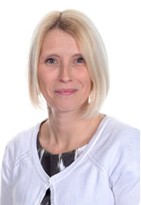
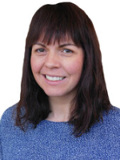
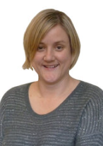

INTRODUCING THE TEACHERS
Mrs Bartlett
Class 6B
Mrs Ross
Class 6KR
Mrs Keynes
Class 6KR

Slide 3
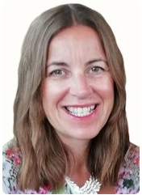
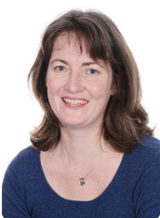
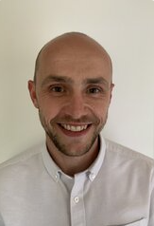
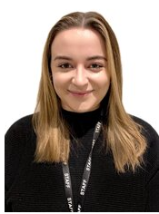
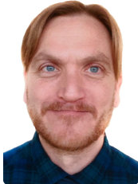
MEET THE TEAM
Gill Kennaugh
Headteacher
Jacky Hansard
Deputy Head
Lower School
Phase Leader
Attendance Officer
Ali Bartlett
Upper Key Stage 2
Phase Leader
Pupil Premium
Leader
Joe Newman
Lower Key Stage 2
Phase Leader
Teaching and
Learning Leader
Emma Mylan
EYFS Leader
Assessment Leader
Alex Bacon
SENDCO
Inclusion Leader

Slide 4
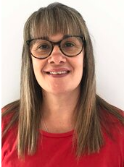
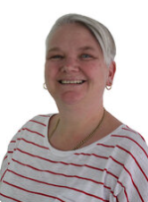

MEET THE TEAM
Viki Stock
ELSA
Emma Dennis
Teaching Assistant
Dave Wallace
PPA Teacher
Susan Davies
PPA Teacher

Slide 5


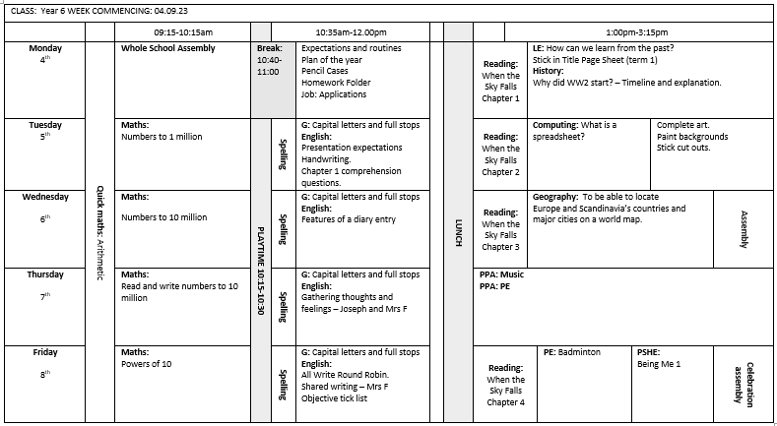
A DAY IN YEAR 6

Slide 6


BEHAVIOUR AT NEWBRIDGE
Respectful
Robin
Responsible
Ravi
Safe
Sam

Slide 7

HOME LEARNING
Weekly homework – 30 minutes
Maths, Reading Comprehension or SP&G
Set on Monday – due on Monday
Marked in class
Folder set up
Reading record/Homework diary
Weekly Spelling Test
Independent Reading

Slide 8
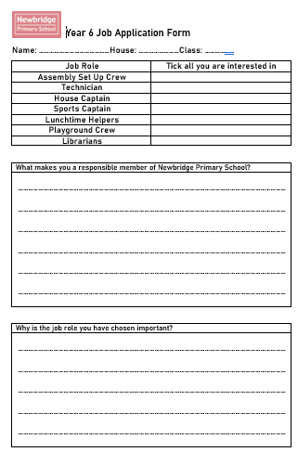
Jobs
Application forms have been given out – deadline in on Monday 11th
House Captains
Sports Captains
Assembly Set Up Crew
Technicians
Librarians
Lunchtime helpers
Playground Crew

Slide 9
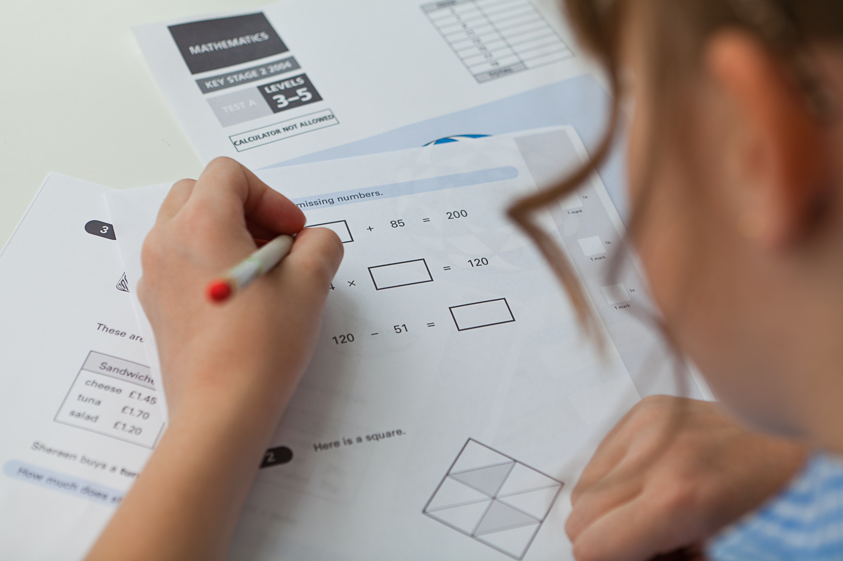
SATS
Monday 11th May – Thursday 14th May
More information to follow
Our ethos
Mock Sats
Papers being sent home can be opted out of (please inform us if you do not wish to receive them)

Slide 10





Supporting the children with being ‘Secondary ready’
In order to support and the prepare the children for secondary school, within the course of the year we will continue to develop:
Independence
Responsibility
Accountability
We achieve this by:
Encouraging the children to take ownership of their learning, including homework.
Developing organisational skills, including equipment inside and outside the classroom.
Ensure they know that there are trusted adults they can speak to, with regards to any worries or concerns.
Have an understanding of the weekly and daily timetable, and be able to transition around the school independently.

Slide 11
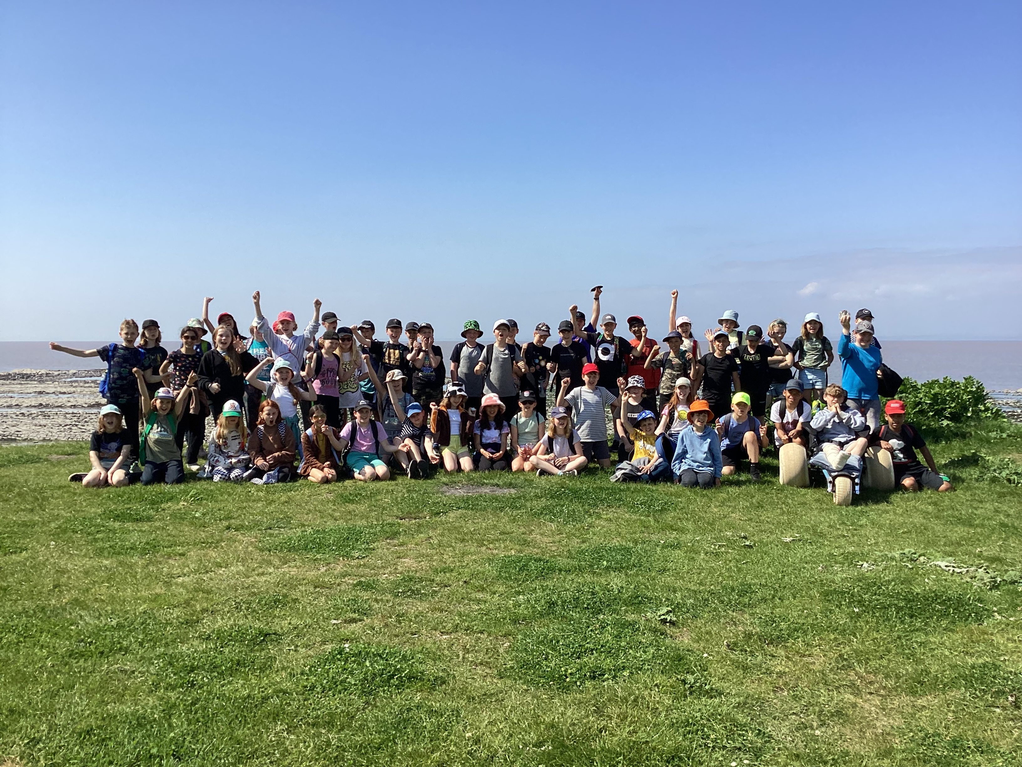
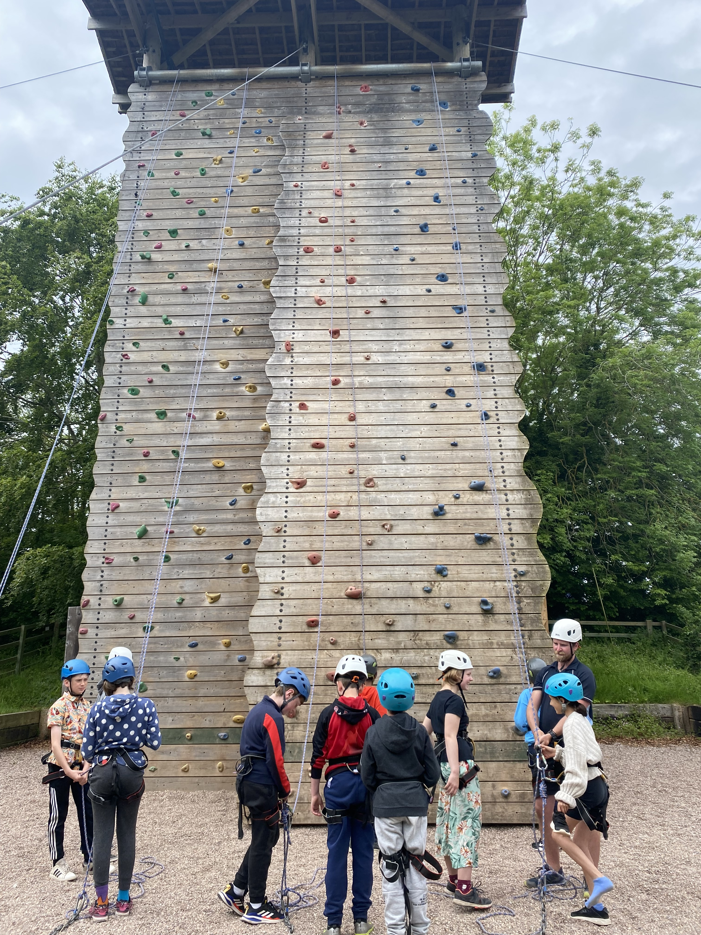
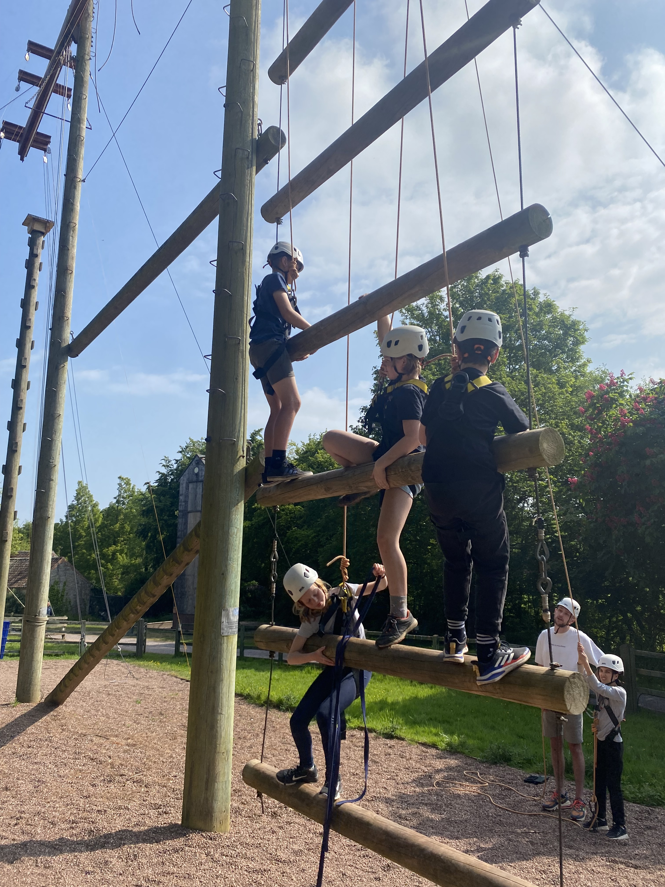
Residential - Kilve Court
Monday 18th May– Friday 22nd May
More information to follow

Slide 12




WHAT DO THEY NEED?
P.E.
Every Day
The children will bring:
School bag
Homework diary
Reading book
Filled water bottle
Waterproof coat (every day please)
Weather dependent:
Cap
Hat and gloves
The children will wear:
House colour P.E. t shirt
School sweatshirt/cardigan
Black shorts/leggings
Trainers/daps
Don’t forget a coat!

Slide 13

ONLINE SAFETY
Each term, one of our computing lessons is dedicated to online safety. Within these sessions we will focus on teaching children the knowledge and behaviours they need in order to conduct themselves in a safe and responsible way online.
You can support your child's online safety learning by regularly talking about how, why and when we use technology.
Understanding all there is to know about online safety can feel daunting, especially with the speed in which changes occur. We have arranged an online safety training session for parents and carers on Wednesday 1st October 2025 – 16:00-16:45.
Mobile phones
We have a no phones policy. Therefore, your child is not allowed to bring a phone into school. If there are exceptional circumstances and you feel your child requires phone at school, then please email Mrs Kennaugh.

Slide 14
ADDITIONAL INFORMATION
)
Medication - any medication (including medicine, medicated creams, medicated lip balms etc) all need to go through the school office before we are able to use these in the classroom with the children.
Named items - please can all items be named (including shoes, socks, jumpers, cardigans, coats, water bottles)
Collecting children - If your child is not being picked up by someone who is already authorised by the school office, please remember to email the school with details of who will be picking up.
Packed lunches - Please ensure there are no nuts in packed lunches.

Slide 15



KEEPING IN CONTACT
We post updates on Google Classroom every Friday. This contains a blog about the week, messages from the teachers and key dates/information. If you need any help accessing this, please ask the school office.
Come and chat to us! The teachers will be outside their classrooms at the end of each day if you have anything you’d like to ask.
Please do email the school office FAO your class teacher if you need to get in contact.

