Slide 1


Back to School Meeting
2025-26

Slide 2
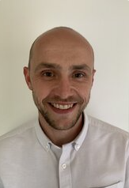
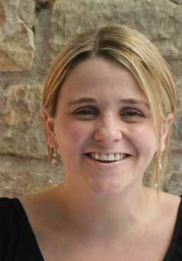
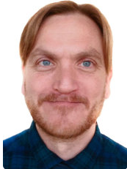

INTRODUCING THE TEACHERS
Mr Newman
Class 4N
Mrs Amor
Class 4AB
Mr Bacon
Class 4AB

Slide 3
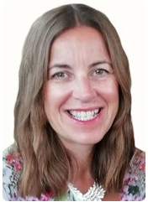
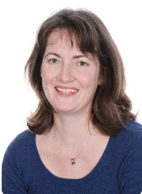
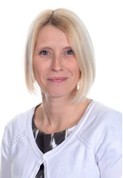
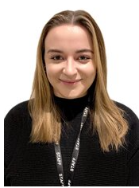
MEET THE TEAM
Gill Kennaugh
Headteacher
Jacky Hansard
Deputy Head
Lower School
Phase Leader
Attendance Officer
Ali Bartlett
Upper Key Stage 2
Phase Leader
Pupil Premium
Leader
Joe Newman
Lower Key Stage 2
Phase Leader
Curriculum, Teaching and
Learning Leader
Emma Mylan
EYFS Leader
Assessment Leader
Alex Bacon
SENDCO
Inclusion Leader

Slide 4
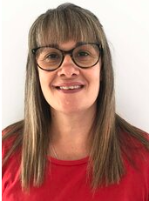
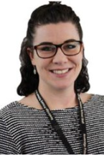
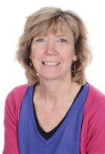
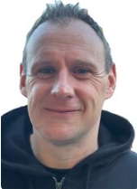
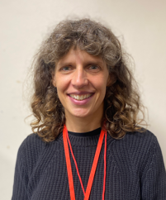
MEET THE TEAM
Viki Stock
ELSA
Mrs Shaw-Butt
Teaching Assistant
(Monday & Friday)
Mrs Watts
(Tuesday, Wednesday & Thursday)
Mr Wallace
PE PPA Teacher
Mrs Davies
PPA Music Teacher

Slide 5


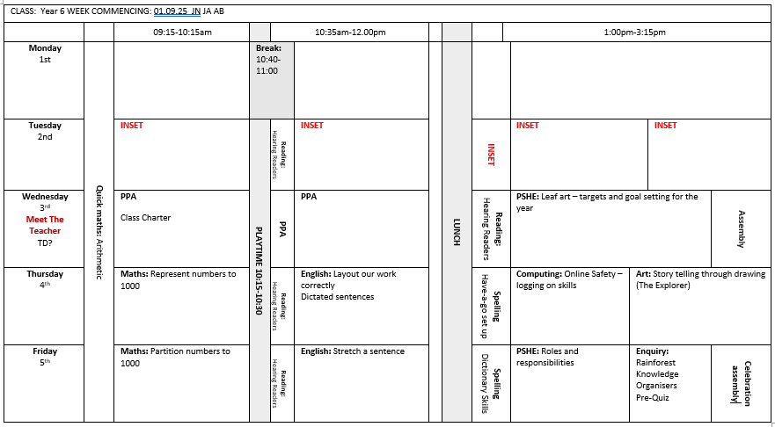
A DAY IN YEAR 4

Slide 6


BEHAVIOUR AT NEWBRIDGE
Respectful
Robin
Responsible
Ravi
Safe
Sam

Slide 7

HOME LEARNING
To support your child, we would like them to read for 30 minutes at least 3 times a week. Please listen to them and ask questions to support fluency and comprehension. Please record all reading in the reading log.
Times tables- TT Rockstars is a fun way to support and we have class battles. They can practise the Multiplication Check Test on www.timestables.co.uk. Multiplication Check.
By the end of Year 4, your child is expected to know up to 12 x 12 in a quick response. This is one of our main focuses this year as not only do we do the official test, but also, this knowledge really helps with our Maths curriculum.
Our first Enquiry is How can we help one another which is centred around collaboration and how our actions can affect others in the world around is.

Slide 8
DAYS TO REMEMBER
Forest School will be on a Tuesday afternoon. The children will come to school in their Forest School Clothes.
4AB will start on Tuesday 9th September
4N will start on Tuesday 16th September.
We will always add this to Google classroom if you forget.
P.E. will be on an alternate Tuesday and every Wednesday.
The children will come to school in their P.E. kit.
Reading logs will be checked every Monday. The children will need them in every day to record their reading and to use for spelling support.

Slide 9




WHAT DO THEY NEED?
Forest School
P.E.
Every day
The children will wear:
Long sleeve top
Full length trousers
Trainers
To bring:
Wellies in a plastic carrier bag
Waterproof trousers and coat in a large bag.
Hat and gloves in cold weather.
The children will bring:
Book bag (with reading books and reading record)
Filled water bottle
Waterproof coat (every day please)
Weather dependent:
Cap
Hat and gloves
The children will wear:
House colour P.E. t shirt
School sweatshirt/cardigan
Black shorts/leggings
Trainers/daps
Don’t forget a coat!

Slide 10
YEAR GROUP MESSAGES
We arrange a number of year group trips and visits in Year 4.
On Friday 19th September, Jonathan Jungle will be coming into school to share some Amazonian creatures. If you are able to support with a donation, that would be great. Donations can be made via School Gateway.
Future trips and visits include:
Roman Baths Visitor
Roman Baths Trip
Cheddar Gorge and Anglo-Saxon Workshop

Slide 11

ONLINE SAFETY
Each term, one of our computing lessons is dedicated to online safety. Within these sessions we will focus on teaching children the knowledge and behaviours they need in order to conduct themselves in a safe and responsible way online.
You can support your child's online safety learning by regularly talking about how, why and when we use technology.
Understanding all there is to know about online safety can feel daunting, especially with the speed in which changes occur. We have arranged an online safety training session for parents and carers on Tuesday 22nd October, 5:30-7pm

Slide 12
ADDITIONAL INFORMATION
Medication - any medication (including medicine, medicated creams, medicated lip balms etc) all need to go through the school office before we are able to use these in the classroom with the children. Inhalers will be kept in a box in the classroom so please return them to school.
Named items - please can all items be named (including shoes, socks, jumpers, cardigans, coats, water bottles)
Collecting children - If your child is not being picked up by someone who is already authorised by the school office, please remember to email the school with details of who will be picking up.
Packed lunches - Please ensure there are no nuts in packed lunches.

Slide 13



KEEPING IN CONTACT
We post updates on Google Classroom every Friday. This contains a blog about the week, messages from the teachers and key dates/information. If you need any help accessing this, please ask the school office.
Come and chat to us! The teachers will be outside at the pick up points at the end of each day if you have anything you’d like to ask.
Please do email the school office FAO your class teacher if you need to get in contact.

