Slide 1


Back to School Meeting
2025-26

Slide 2
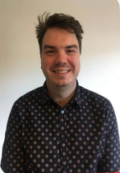



INTRODUCING THE TEACHERS
Mr Mullee
Class 3M
Mrs Dinsdale
Class 3DE
Mrs Edmunds
Class 3DE

Slide 3

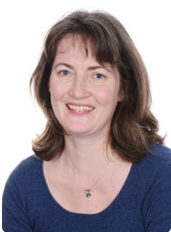
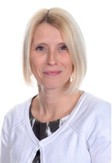
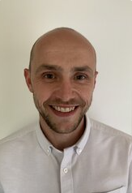
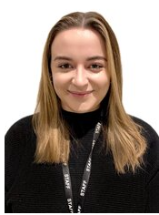

MEET THE TEAM
Gill Kennaugh
Headteacher
Jacky Hansard
Deputy Head
Lower School
Phase Leader
Attendance Officer
Ali Bartlett
Upper Key Stage 2
Phase Leader
Pupil Premium
Leader
Joe Newman
Lower Key Stage 2
Phase Leader
Teaching and
Learning Leader
Emma Mylan
EYFS Leader
Assessment Leader
Alex Bacon
SENDCO
Inclusion Leader

Slide 4
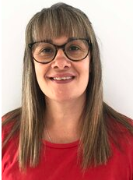


MEET THE TEAM
Viki Stock
ELSA
Mrs Milne
Teaching Assistant
Mr Wallace (PPA)
PE Teacher
Mrs Davies (PPA)
Music Teacher – maternity cover for Mrs Best

Slide 5


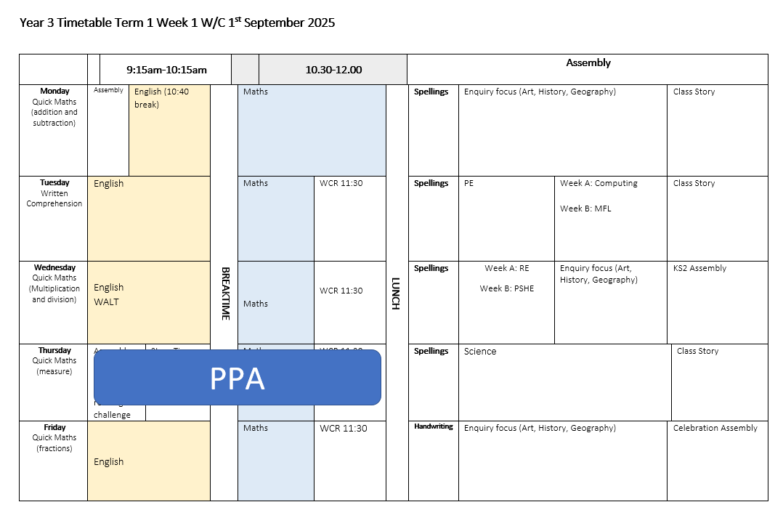
A DAY IN YEAR 3

Slide 6


BEHAVIOUR AT NEWBRIDGE
Respectful
Robin
Responsible
Ravi
Safe
Sam

Slide 7
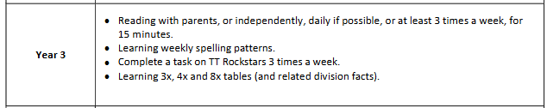

HOME LEARNING

Slide 8
DAYS TO REMEMBER
P.E. will be on a Monday and Thursday. The children will come to school in their P.E. kit.
Book change will be on a Friday. The children will need their reading books and reading record in school every day.
Reading Record Book checks will be on a Monday. The class teacher will go through each Reading Record Book and give out a house point for every child
who shows they have read at least 3 times in a week.

Slide 9




WHAT DO THEY NEED?
P.E.
Every Day
The children will bring:
Bag (with reading books and reading record)
Filled water bottle
Snack (fruit or vegetables only)
Waterproof coat (every day please)
Weather dependent:
Hat and gloves
The children will wear:
House colour P.E. t shirt
School sweatshirt/cardigan
Black shorts/leggings
Trainers/daps
Don’t forget a coat!

Slide 10

ONLINE SAFETY
Each term, one of our computing lessons is dedicated to online safety. Within these sessions we will focus on teaching children the knowledge and behaviours they need in order to conduct themselves in a safe and responsible way online.
You can support your child's online safety learning by regularly talking about how, why and when we use technology.
Understanding all there is to know about online safety can feel daunting, especially with the speed in which changes occur. We have arranged an online safety training session for parents and carers on Wednesday 1st October 2025 4pm – 4.45pm

Slide 11
ADDITIONAL INFORMATION
Medication - any medication (including medicine, medicated creams, medicated lip balms etc) all need to go through the school office before we are able to use these in the classroom with the children.
Spare clothes - if your child is likely to have a toileting accident, it would be helpful if you could please provide named spare clothing in their book bags.
Named items - please can all items be named (including shoes, socks, jumpers, cardigans, coats, water bottles)
Collecting children - If your child is not being picked up by someone who is already authorised by the school office, please remember to email the school with details of who will be picking up.
Packed lunches - Please ensure there are no nuts in packed lunches.

Slide 12



KEEPING IN CONTACT
We post updates on Google Classroom every Friday. This contains a blog about the week, messages from the teachers and key dates/information. If you need any help accessing this, please ask the school office.
Come and chat to us! The teachers will be outside their classrooms at the end of each day if you have anything you’d like to ask.
Please do email the school office FAO your class teacher if you need to get in contact.

