Slide 1
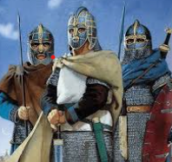
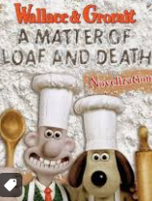
English: We are reading and writing stories with dilemmas and issues. We have begun by watching clips from ‘A Matter of Loaf and Death’ – the children have been asked not to watch this at home as we will be making predictions about the ending.
History and Geography –
Key questions that we will answer this term are -
Why did the Romans leave Britain?
When were the ‘Dark Ages’ and where do
the Anglo-Saxons fit into them?
What was everyday life like for Anglo Saxon
people?
We will also be finding out how Christianity changed Britain and how Sutton Hoo changed the way historians viewed the ‘Dark Ages’
Year 4 Summer 1/Half-term 5 :
‘Anglo Saxons’
Maths: This half term we will learn about…
Decimals
- What are decimals?
- Equivalent decimals and fractions
- Tenth and hundredths
Money
Calculate using money
Convert pence into pounds
Time
- Analogue, digital and 24hr clock
All times table facts – ready for our Multiplication Test
Science:
Data Collection – This term we will be making predictions and observations and recording them. Then we will compare data with others.
Living Things and Their Habitats -
We will be learning about what living things need to survive and how plants and animals are be classified.
Lastly, we will find out what deforestation is and why it happens.
PE: This half term we will be learning about striking and fielding games. We will be working on teamwork and hand-eye coordination skills through learning to play these games with Miss VanRoose-Peer.

Slide 2
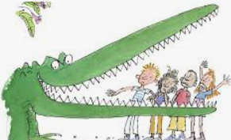
Music: This half term, we will be focusing on the music of The Beatles, particularly a song written about civil rights and slavery called Blackbird. We will be singing in unison and learning to play instrumental parts with the song by ear and/or from notation using the easy or medium part.
Art & Design and Design Technology:
In art, we are looking at the illustrator, Quentin Blake who is famous for illustrating many of Roald Dahl’s book. We will also be producing our own work in his style.
In DT, it is all about chocolate puddings, which do we like, what would we put in one and, importantly, what do they taste like?
Year 4 Summer 1/Half-term 5:
‘Anglo-Saxons’
PSHE:
Keeping Healthy
We will be learning to explain what is meant by a balanced diet and plan a
balanced meal and recognise how too much sugar, salt, and saturated fat in our food and drink can affect us now and when we are older.
We will be looking at nutritional information on packaging to see what it tells
R.E : Islam
We will be looking into the religion of Islam and how Muslim people live their lives. The five pillars of Islam will help us understand what is important to them and why they observe Ramadan. We will also think about the impact that fasting has on the Islamic community.
Computing: This term we will learn about Animation. We will find out about the ‘onion skin’ tool and create ‘stop motion’ animations of our own

