Slide 1
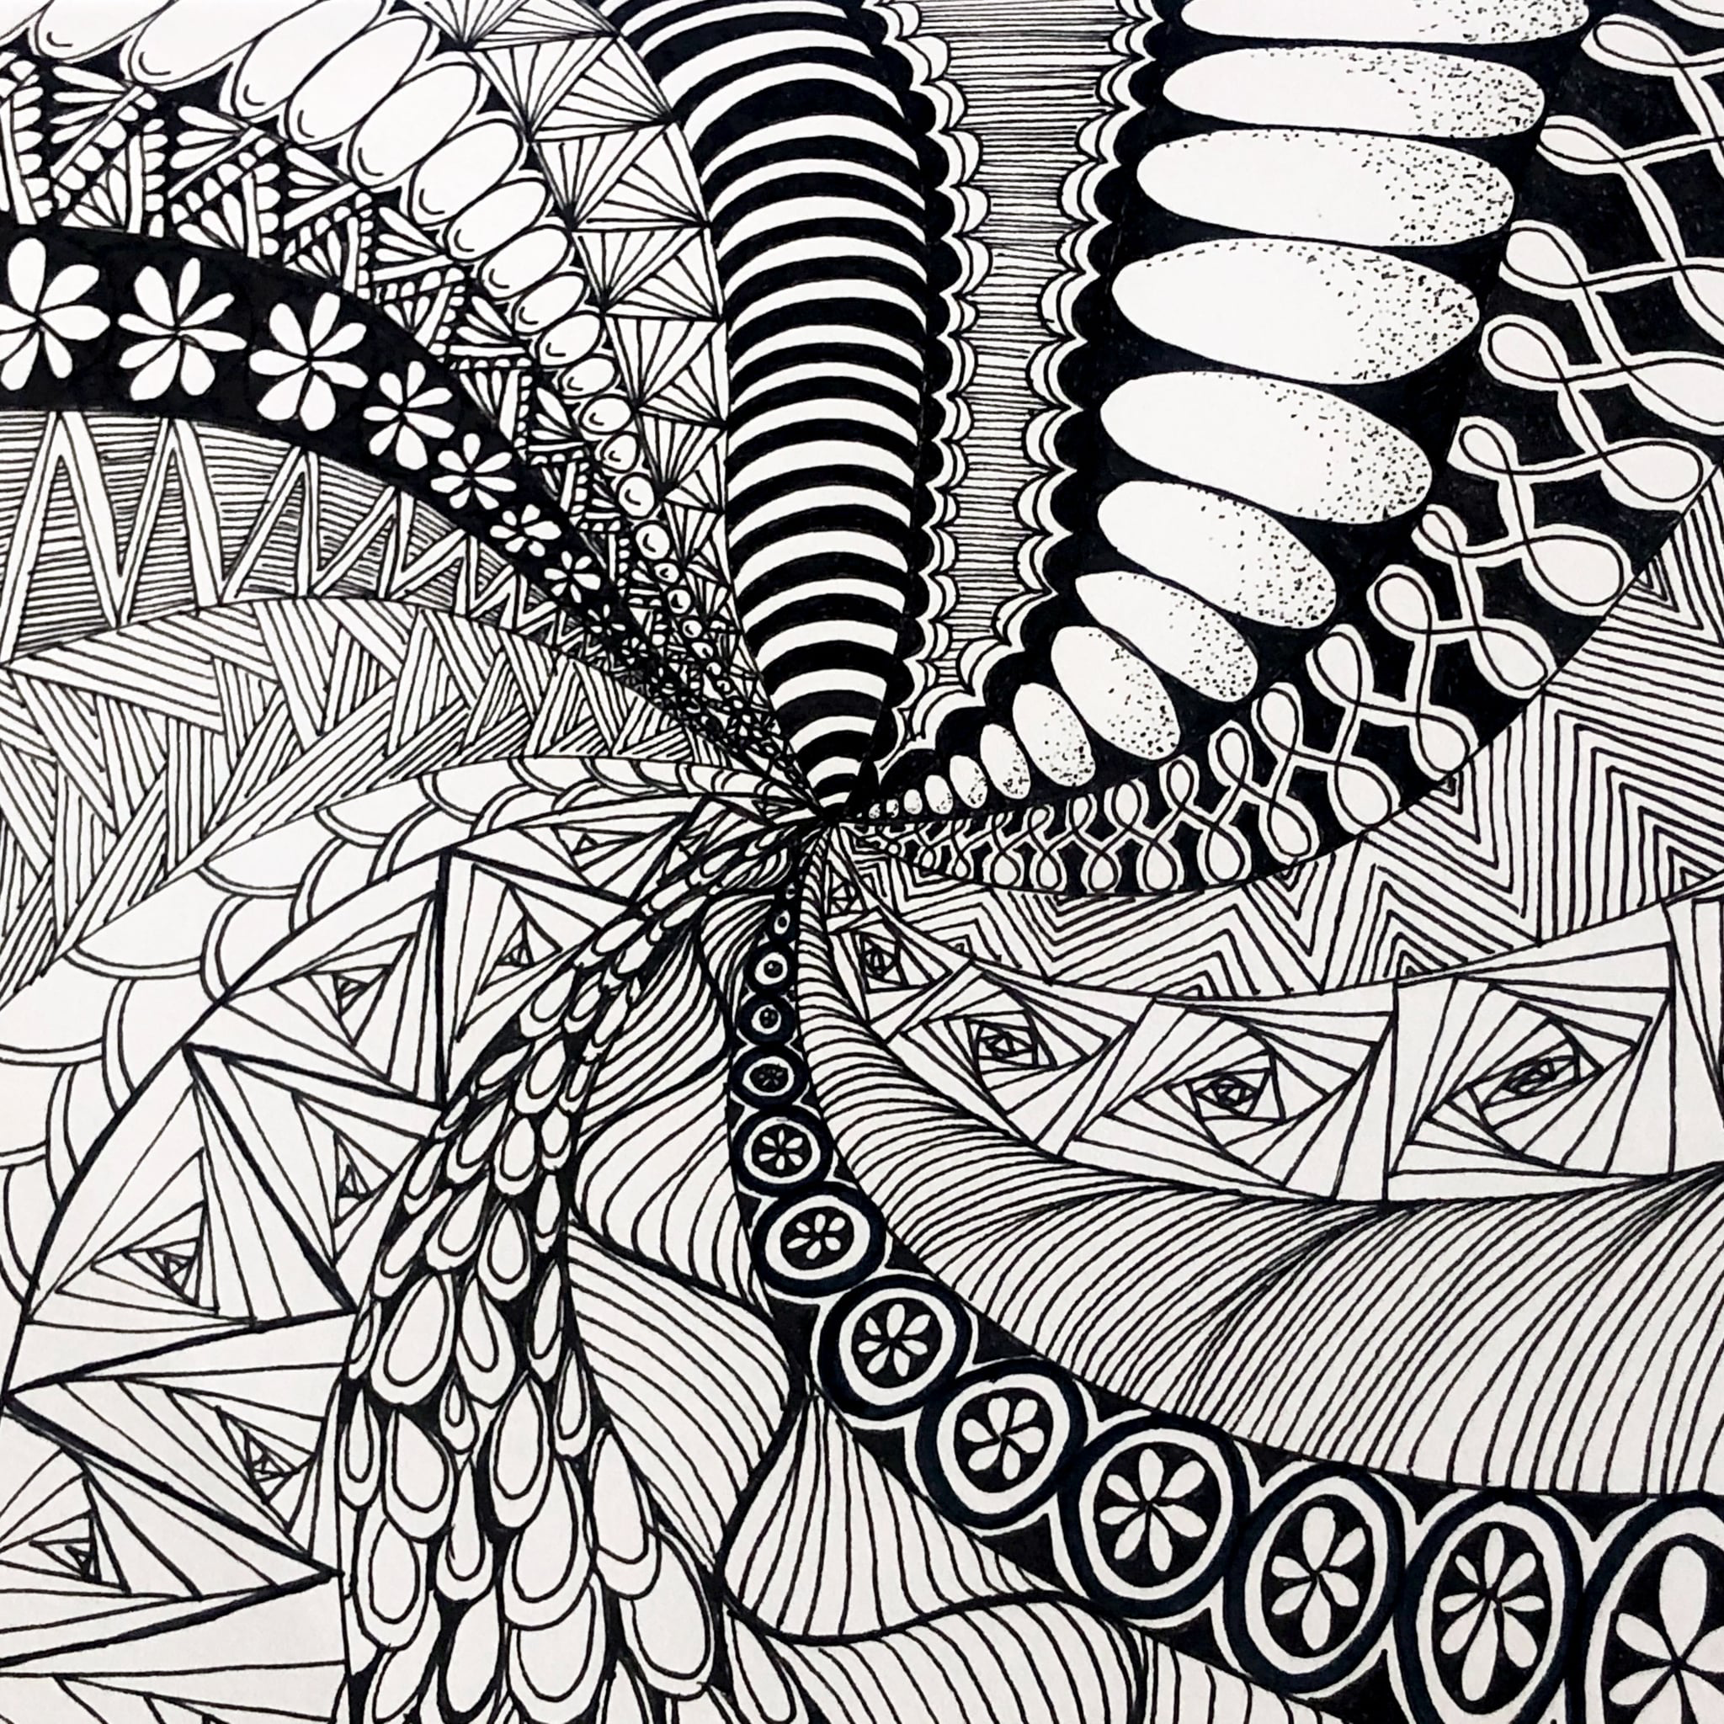
What is a zentangle?
ZEN means calm and TANGLE means a collection of overlapping patterns.
ZENTANGLE is the bringing together of the calm and the pattern.
‘Zentangle patterns are unplanned, abstract, black-and-white art made up of beautiful patterns.’
The process of creating a zentangle is considered a form of artistic meditation.

Slide 2
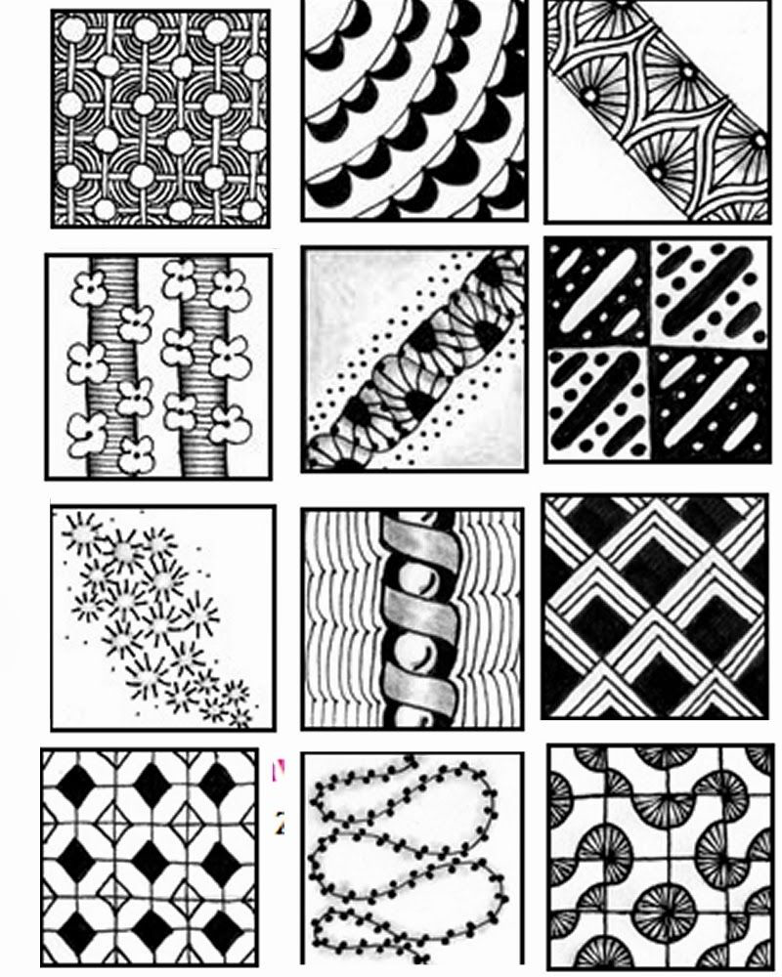
Why Try Zentangle Patterns in the Classroom?
Like meditation, the Zentangle Method is meant to feel freeing and healing. You don’t need special tools or technology because Zentangle patterns are quite simply putting pen to paper.
The Zentangle Method was invented by Rick Roberts and Maria Thomas. The two discovered that the act of drawing abstract patterns with a few basic rules was a meditative art form.
Creating Zentangle patterns can help you
Relax.
With your behaviour and anger management.
nurture and develop your creative abilities.
Improve your eye/hand coordination.
Increase your attention span and ability to concentrate.
With your problem-solving skills.

Slide 3
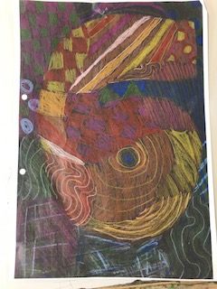
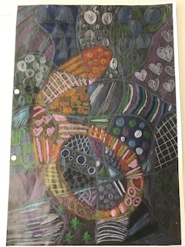
Today you are going to remind yourselves about warm and cool colours.
You are going to design a Zentangle page to divide your year 5 work from your year 6 work in your art folders.
In addition to practising your colour mixing skills you are going to practise creating a variety of patterns.
Looking at warm and cool colours
://www.youtube.com/watch?v=0jFbFXYeqb0&pbjreload=101

Slide 4
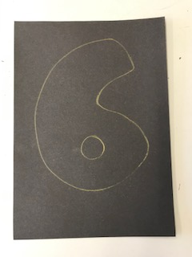
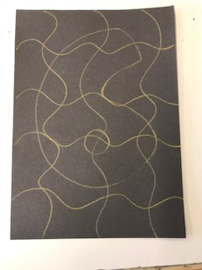
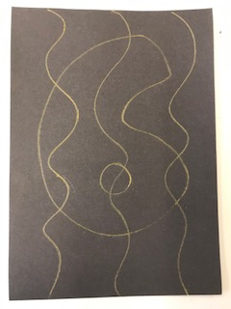
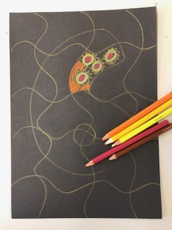
Draw 4 wiggly lines evenly spread out across the paper
Draw out a large six on black paper with a light pencil
Fill the space
L.O.
To practise mixing a large range of Warm and Cool colours.
To use your imagination to create your own patterns for each section.
To colour neatly and with care.
Draw 3 wiggly lines evenly spread out down the paper
Fill each section on the 6 with a variety of patterns using WARM colours
Finally fill in the background sections with COOL colours

Slide 5
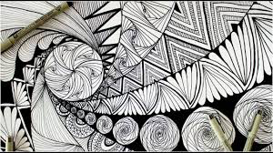
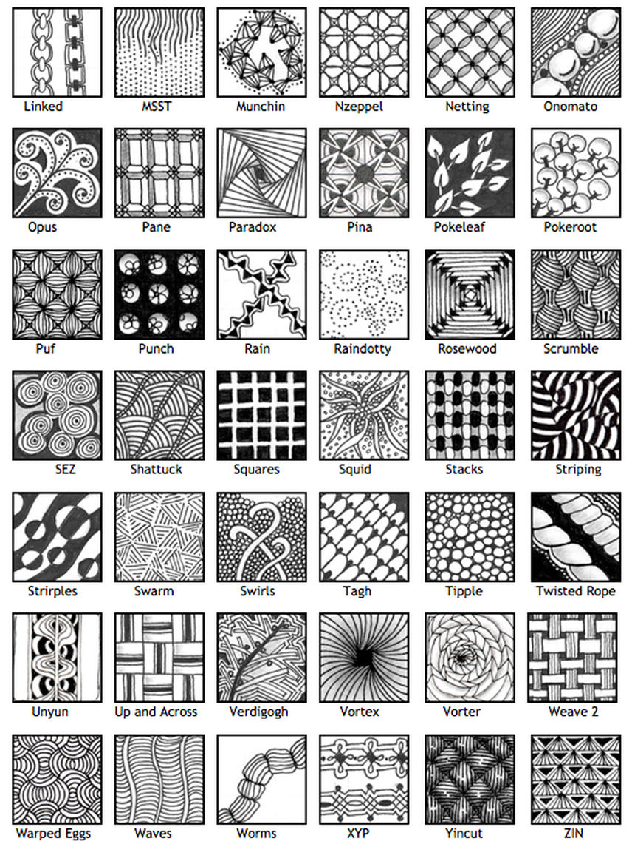
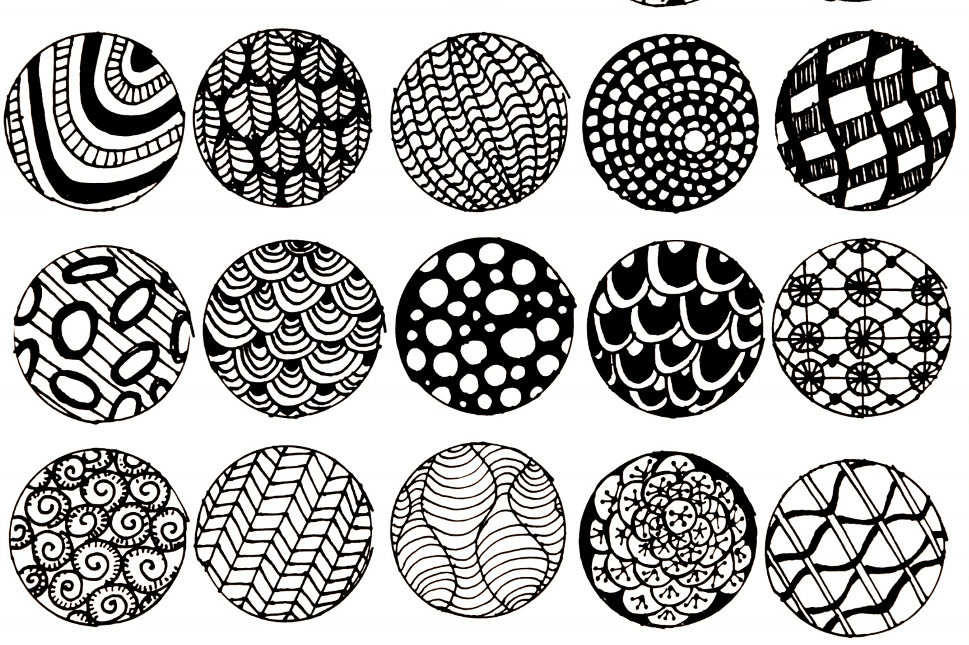
Links to calming music to play in the background.
Stuck for pattern ideas? Use these sheets for inspiration.
https://youtu.be/qYAxV7SlauQ
https://youtu.be/lFcSrYw-ARY
https://www.youtube.com/watch?time_continue=14&v=Dg0IjOzopYU&feature=emb_logo
https://www.youtube.com/watch?time_continue=27&v=13E5azGDK1k&feature=e
https://www.youtube.com/watch?time_continue=19&v=iqmO1RlqorU&feature=emb_logo

