Slide 1
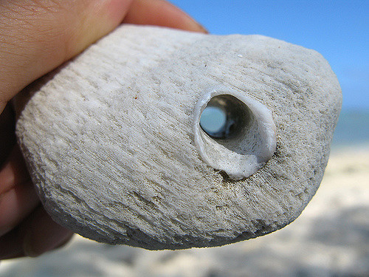
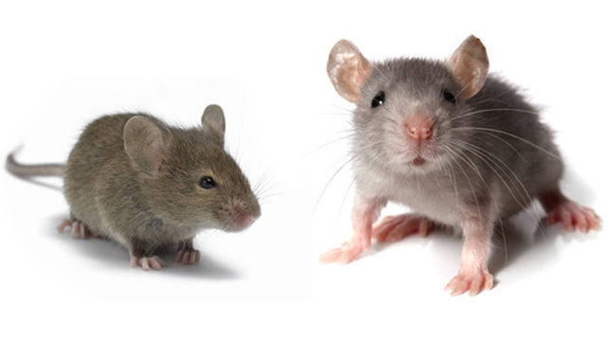
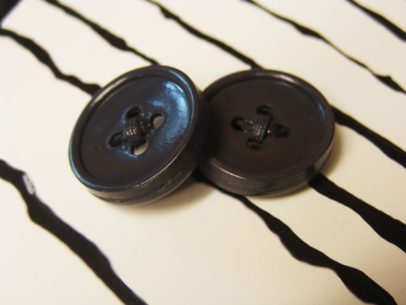

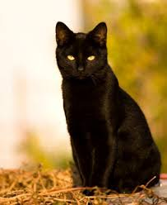
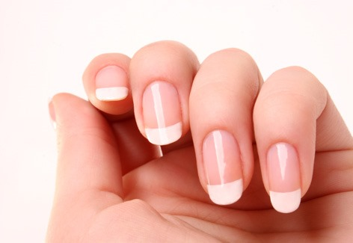
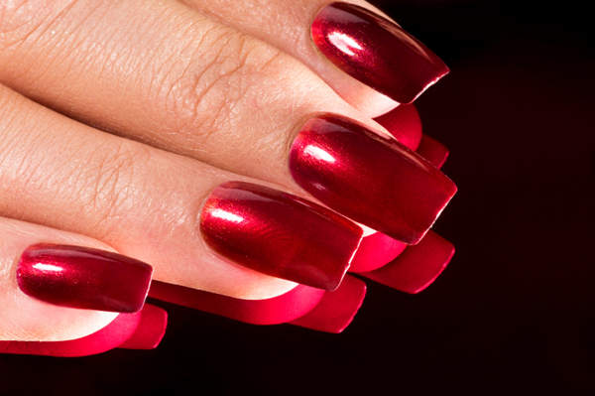
LO – predict what might happen in the story.
What do you think the story is about?
How will these items come into it?

Slide 2
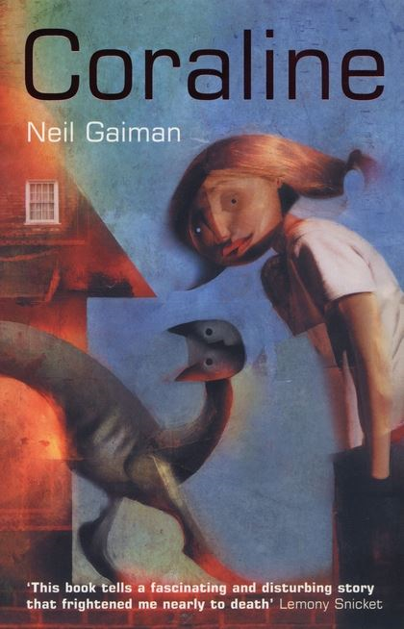
Coraline by Neil Gaiman
Let’s read chapter 1.
What are your first impressions of the story and its characters?
What do you think is going to happen?
Challenge:
Can you identify any warnings of danger?
What do you think about the bricked up door?

Slide 3

LO – Making developed predictions
To achieve 100+ you need to predict what might happen next using evidence from the text.
Have a go at 1-5
PAGE 34-37

Slide 4
LO – To examine the use of superlatives to emphasise the description – pg 17
Highlight the SUPERLATIVES.
Superlatives are adjectives which make the object seem exaggerated to the highest quality – the worst or the best. Clue: look for words which end in ‘est’
Challenge: What is the effect of these words on the reader’s thoughts about the object?
“She reached up, and took a string of keys from the top of the kitchen door frame. She sorted through them carefully and selected the oldest, biggest, blackest, rustiest key. They went into the drawing room. She unlocked the door with the key.”

Slide 5
LO – To examine the use of superlatives to emphasise the description
Challenge: What is the effect of these words on the reader’s thoughts about the object?
It makes the key seem very significant.
“She reached up, and took a string of keys from the top of the kitchen doorframe. She sorted through them carefully and selected the oldest, biggest, blackest, rustiest key. They went into the drawing room. She unlocked the door with the key.”

Slide 6
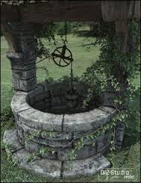
LO – Using evidence from the text to support ideas.
Sketch the garden. Label the key features with QUOTATIONS.
Challenge: Find and write down a quotation which hints about the well being a place of special interest.

Slide 7
LO – Identifying key details
To achieve 100 you need to identify the key details in a text. Don’t forget that the first sentence in a paragraph is called a ‘topic sentence’.
Have a go at exercises 3 and 4
PAGE 12-17

Slide 8

LO – to be able to use inference and deduction
Let’s read chapter 2
You are going to act like a detective looking for evidence when you read this chapter.
Write down as many hints that Coraline is in a dangerous world. Don’t forget to use quotation marks.
Challenge – what does Miss Spinks give Coraline – what use do you think it has?
Hints:
The weather.
Her mother’s instruction.
The crazy old man’s message from the mice.
The tea leaves and Miss Spink’s warnings.
Coraline’s thoughts about her ‘danger’.

Slide 9
LO – Explaining inferences in fiction
To achieve 100+ you need to make inferences and deductions in fiction, drawing on evidence from the text and justifying your views.
Have a go at tasks 1-2
PAGE 22-25

Slide 10

LO – working out the meaning of words
What does the word TASSEOMANCY mean?
Tips:
Does it sound like a word you already know? In another language? French?
Break it down into smaller parts. Does it have a familiar prefix or suffix?
Look it up in a dictionary?

Slide 11
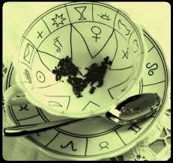
Tasseomancy
Divination with tea leaves
Origin:
French tasse (“cup”)
mancy (“divination”)

Slide 12
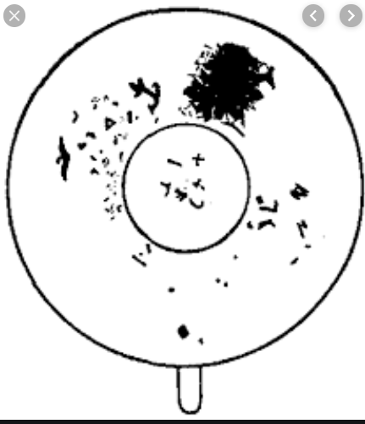
LO – identifying details
What shapes can you see in this teacup?

Slide 13
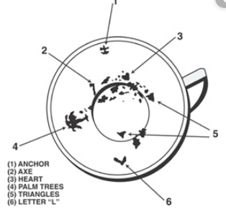
LO – identifying details
What shapes can you see in this teacup?

Slide 14
LO – identifying details

Slide 15
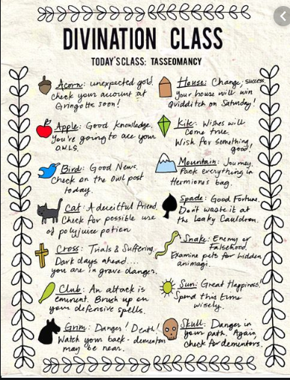
LO – making predictions
Look at the patterns in the tea cups.
Can you identify any shapes that are on the tasseomancy symbols sheet.
Write a paragraph that expands the prediction for your work buddy.

Slide 16
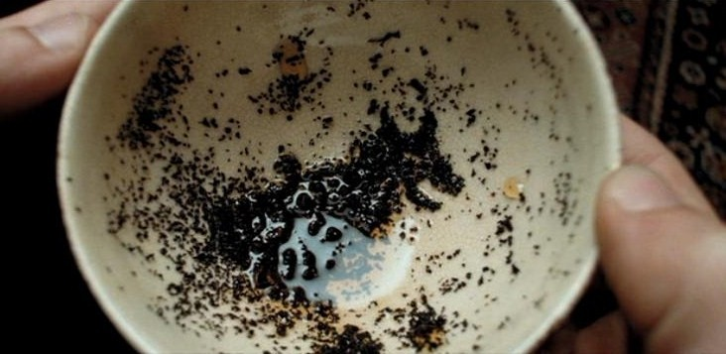
LO – what can you see in this?

Slide 17
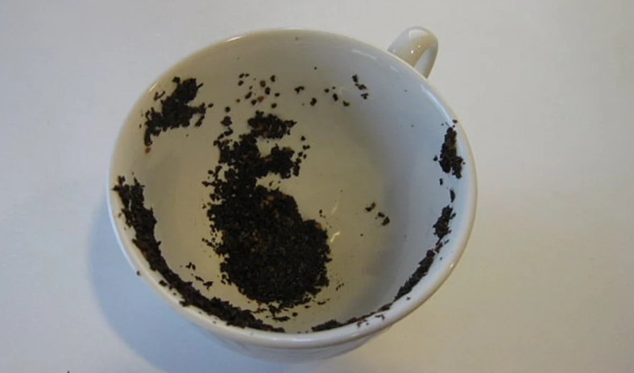
LO – what can you see in this?

Slide 18
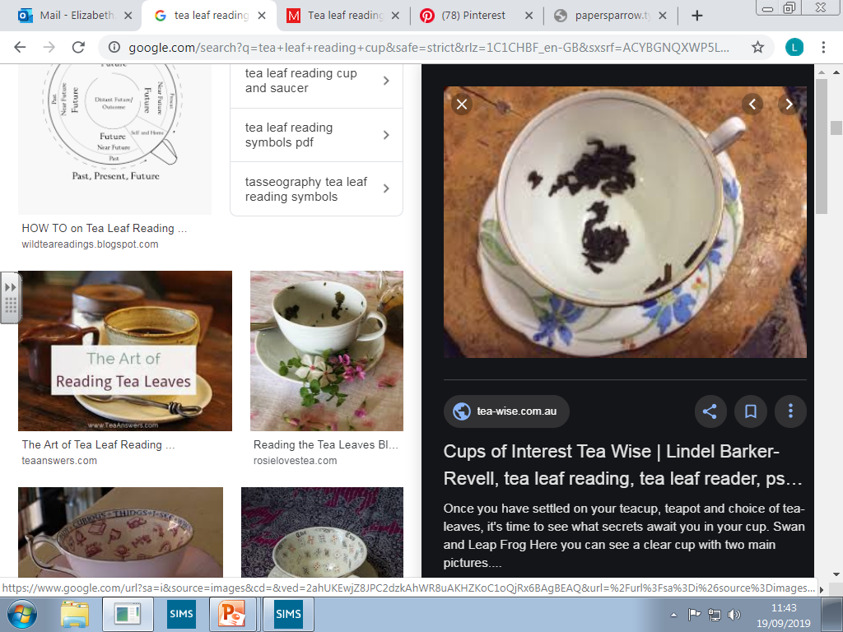
LO – what can you see in this?

Slide 19
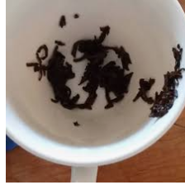
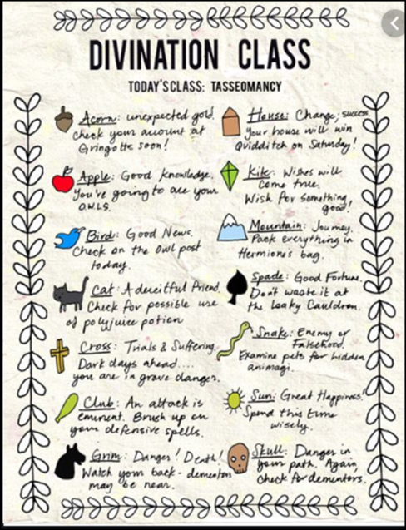
LO – what can you see in this?
Challenge:
Can you make your own Tasseomancy symbol identification sheet?

Slide 20
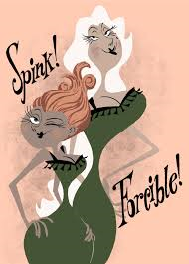
LO – Using evidence from the text to support ideas.
Find and copy QUOTATIONS about the ladies on the ground floor
A quotation is when you copy words directly from a text EXACTLY as they are written. Remember to use quotation marks to show they are quotations.
“Miss Spink and Miss Forcible lived in the flat below Coraline’s on the ground floor.”

Slide 21
LO – Using evidence from the text to support ideas.
“had been actresses,”
“made a point of telling Coraline how dangerous the well was,”
“Miss Spink …looked like a large fluffy egg.”
“They did … ‘Men’”
“The flat smelt of furniture polish and dogs.”
“I’ll read the leaves if you want,”
“She is in danger.”
“She passed Coraline the stone with the hole in it.”

Slide 22

LO – to make comparisons
Let’s read chapter 3.
Coraline finds a parallel world when she goes through the door.
Find similarities and differences between these two worlds
Draw the parents in both worlds.

Slide 23
LO – to make comparisons
“Both of her parents worked on computers.”
“Leave me alone to work.”
“Don’t make a mess.”
“And don’t touch anything.”
“I suppose I shall have to get you new school clothes.” “Remind me, dear, or else I’ll forget.”

Slide 24
LO – to make comparisons
“She looked a little like Coraline’s mother.”
“Only her skin was as white as paper.”
“Only she was taller and thinner.”
“Only her fingers were too long, and her dark-red fingernail were curved and sharp”
“His eyes were buttons – big black and shiny.”
Challenge – write a paragraph describing how her ‘other’ parents treat Coraline differently.

Slide 25
LO – Making comparisons
To achieve 100+ you need to make comparisons in a text.
Have a go at tasks 1 and 2
PAGE 54-57

Slide 26
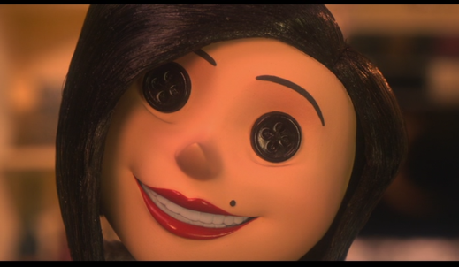
LO – Inference and predictions
Read Chapter 4 up to page 57.
“there’s only one little thing we’ll have to do..”
Think – Pair – Share:
In pairs discuss the events of this chapter so far.
Write answers to:
What do you think Coraline’s feelings are about this ‘other’ world? (inference)
Do you think Coraline wishes to stay in this ‘other’ world? (inference)
What do you think Coraline will have to do if she decides to stay? (prediction)
Challenge – remember to use evidence from to text – quotations – to support your answers.

Slide 27

LO – More predictions!
Read to the end of chapter 4.
What do you think the significance of the button eyes are?

Slide 28
LO – Exploring similes
Read Chapter 5 up to page 66
“then I suppose there is only one thing
left to do …”
Write a sentence to explain what the writer is trying to tell us with the following similes?
Challenge – explore the item that the cat’s voice or the mother is being compared to.
What is the writer trying to tell us about:
The cat’s voice with the simile ‘dry as a dead fly on the windowsill in winter.”? pg 66
The other mother’s appearance with the simile “the hair on her head drifted like plants under the sea.”? pg 58
The other mother’s behaviour with the simile “her other mother’s hand scuttled off Coraline’s shoulder like a frightened spider”
The route back to the real world with the simile “a night black underground darkness that seemed as if things in it might be moving”.

Slide 29
LO – Exploring similes: sentence starters
The simile ‘dry as a dead fly on the windowsill in winter” makes the reader think the cat is speaking in an unhelpful way as a dead fly has no life or use. It is also not a friendly insect suggesting that the cat is also not very friendly.
The simile “the hair on her head drifted like plants under the sea.” makes the reader picture the other mother as ..
The simile “her other mother’s hand scuttled off Coraline’s shoulder like a frightened spider” makes the reader think the other mother to be …
The simile “a night black underground darkness that seemed as if things in it might be moving” makes the reader think that the route back to the real world …

Slide 30
LO – Exploring similes: answers
The simile “the hair on her head drifted like plants under the sea.” makes the reader picture the other mother as something that is a little odd, not like a human as her hair seems to move like it is in water. It gives the impression that she is trying to hypnotise Coraline.
The simile “her other mother’s hand scuttled off Coraline’s shoulder like a frightened spider” makes the reader think the other mother to be a little bit sinister as spiders can be frightening.
The simile “a night black underground darkness that seemed as if things in it might be moving” makes the reader think that the route back to the real world is not a place she wants to go as it is dark and things moving in the darkness are scary.
Now finish Chapter 5.

Slide 31
LO – Discussing language choices in fiction
To achieve 100+ you need to identify and explain how a writer’s choice of language enhances meaning in a fiction text
Have a look at the practise question exploring a simile.
Complete question 3.
PAGE 46 and 48

Slide 32
LO – Discussing language choices in poetry
To achieve 100+ you need to identify and explain how a writer’s choice of language enhances meaning in a fiction text
Have a go at tasks 1-4
pages 50-53

Slide 33

LO – making comparisons from different points in a text
Let’s read chapter 6
In this chapter we are going to identify how the characters and plot develop within a story.
The ‘other’ mother and Coraline are changing!
Key questions:
What event has made these characters change?
How have they changed?
Challenge: Can you think of other stories where this occurs?

Slide 34
LO – Making comparisons
To achieve 100+ you need to make comparisons in a text.
Have a go at exercises 3 and 4
PAGE 54-57

Slide 35
LO – Skills boost
Let’s work through some skills:
Explain the meaning of the words in context | Page 8 | Question 1
Retrieving information and identifying key details | Page 12 | Question 1
Explaining inference in non-fiction | Page 26 | Question 1
Understanding more about non-fiction | Page 38 | Question 1

Slide 36
LO – Skills boost
Explain the meaning of the words in context | To describe the height of the river: It tells you that the river was low. To see a crocodile lying in it, the water would have to be low.
Retrieving information and identifying key details | heavily b) an earthquake c) Russia d) huge
Explaining inference in non-fiction | 3 marks – both positive and negative points with a quote 2 marks – one side: positive or negative Positive – money, food, agriculture, tourism, renewable energy Negative – suffering of local people: they could die, lose homes or livelihood, damage to the environment, decrease in tourism
Understanding more about non-fiction | Could be used instead of plates, it’s cheap, it’s convenient

Slide 37
LO – Skills boost
Let’s work through some skills:
Explain the meaning of the words in context | Page 8 | Question 2
Retrieving information and identifying key details | Page 12 | Question 2
Explaining inference in non-fiction | Page 26 | Question 2
Understanding more about non-fiction | Page 38 | Question 2

Slide 38
LO – Skills boost
Explain the meaning of the words in context | To create something that means to make something. They are man made or created by people. They have been made and are not natural.
Retrieving information and identifying key details | Generous The 18th century Pudding ingredients A kiss
Explaining inference in non-fiction | The have continued to join in because they enjoy / have always been allowed to be part of the action. In Shakespeare’s time the audience booed and threw fruit. In modern panto people sing along and call out.
Understanding more about non-fiction

Slide 39

LO – Comprehension
Read Chapter 7
Why do you think the Other Mother wants to keep Coraline?
Why has the Other Mother taken Coraline’s parents?
What is Coraline thinking about her decision to go through the door at this point?
Why might the Other Mother have forgotten about the three other children?
Read Chapter 8
What kind of games does Coraline challenge the Other Mother to play?
Coraline is willing to have her eyes turned into button eyes if she loses. Why is she so confident she will win?

Slide 40
LO – Comprehension answers
Read Chapter 7
She wants to keep them to feed on her heart and soul. “She stole our hearts, and she stole our souls … she fed on us”
She has taken the parents to make her agree to staying and taking the button eyes.
Coraline probably regrets going through the door.
The Other Mother may have forgotten about the three other children because she has taken what she needs and they are no use anymore.
Read Chapter 8
Coraline challenges the Other Mother to play an exploring game.
Coraline is willing to have her eyes turned into button eyes if she loses. She is so confident she will win because she enjoyed exploring and had a lot of experience in it.

Slide 41
LO – to make comparisons across a text
How has the theatre changed?
Chapter 4
She was in a dark room that smelled of dust and velvet.
She stood blinking on the other side of the velvet curtains, in a poorly lit theatre. Far away, at the edge of the room, was a high wooden stage, empty and bare, a dim spotlight shining on it from above. There were seats between Coraline and the stage. Rows and rows of seats.
Chapter 8
The theatre was derelict and abandoned. Chairs were broken on the floor, and old, dusty spiders’ webs draped the walls and hung from the rotten wood and the decomposing velvet hangings.
Comparison questions:
What is the same?
What is different?

Slide 42
LO – To summarise ideas from a text
Read Chapter 10
Skim and scan chapters 1-10.
In pairs:
Write ONE sentence that summarises each chapter.
Chapters:
1
2
3
4
5
6
7
8
9
10

Slide 43
LO – To summarise ideas from a text
Coraline explores the house and finds the door.
Spinks and Forcible warn Coraline she is in terrible danger.
Coraline goes through the door and finds the ‘Other’ parents.
Coraline meets the cat and watches the ‘Other’ Spinks and Forcible’s play. Coraline is offered button eyes to commit to staying with the ‘Other’ mother.
Coraline’s parents have disappeared so Coraline returns to the other world to look for them.
Coraline is punished and put in the mirror.
Coraline meets the ghost children.
Coraline uses the stone to find two of the souls.
Coraline escapes the ‘remains’ of the Other Father in the cellar.
Coraline finds the third soul in the ‘Other’ crazy old man’s attic with the rats.

Slide 44
LO – Summarising main ideas
To achieve 100+ you need to summarise the main ideas in a text in a text and identify the key details that support these ideas.
Have a go at exercises 3 and 4
PAGE 18-21

Slide 45
LO – Summarising main ideas
Question 3
He was too busy thinking about his land that was ruled by the Viking warriors.
He was too caught up in reading his book that he forgot to look at the bread.
Question 4
Possible headings about natural medicines, cures from a rainforest, natural and modern medicines working together.
Explanation on how the text is about how modern medicines come from rainforest nature.

Slide 46
LO – to identify problems presented in a narrative – retrieving information
All stories contain a ‘problem’. Some stories have multiple problems and these problems need resolving by the end of the story.
What problems does Coraline face during the story?
Which of these problems have been resolved? How? When?
Task
Draw out a table with the column headings:
Challenge – Identify which problems are yet to be resolved. Can you predict how they will be accomplished?
Problems | Solution

Slide 47

LO – to identify problems presented in a narrative – retrieving information
Problems:
Coraline’s parents are missing
Coraline needs to save the children by finding their souls.
She needs to win the game or stay with the Other Mother forever.
She needs to defeat the Other Mother so she does not take any more children.

Slide 48
LO – to identify problems presented in a narrative – retrieving information
Solutions:
She find the snow globe which has her parents in.
She uses the stone with the hole in it to ‘see’ the souls.
She gets the Other Mother to play fair and insists she keeps her promise.
Not resolved! How do you think she accomplishes this?

Slide 49

LO – precition
This feels like the end of the story right?
Wrong!
There are two more chapters.
In pairs, predict what happens in the next two chapters. Write down your shared thoughts.

Slide 50
LO – Explaining inferences in fiction
To achieve 100+ you need to make inferences and deductions in fiction, drawing on evidence from the text and justifying your views.
Have a go 3 and 4
PAGE 24

Slide 51
LO – Explaining inference in non-fiction
Question 3
1 mark – a collector, an explorer, a scientist, a naturalist, a botanist.
1 mark for evidence:
He collected plants.
He kept jars for specimens.
He had a dissecting kit.
He had a microscope.
Question 4
1 mark: Mary was cross with her mum.
2 marks + reference to the text: Mary is cross with her mum because she raised her voice.
3 marks
Mary is cross with her mum

Slide 52

LO – Making comparisons
Write down 5 ways in which the film is different to the book.
Challenge: can you explain why?

Slide 53
LO – Making comparisons
To achieve 100+ you need to make comparisons in a text.
Have a go at exercise 5
PAGE 56

Slide 54
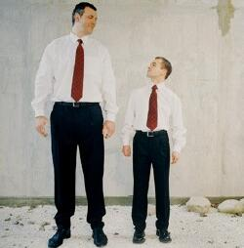
LO – Making comparisons
Question 5
Zach is older and taller than Willie

Slide 55
LO – Understanding more about fiction
To achieve 100+ you need to find and explain how events are linked and contribute to the meaning of the whole text.
Have a go 1 & 2
PAGE 43

Slide 56
LO – Understanding more about fiction
Question 1
He told himself they would be horrible.
He convinced himself that he didn’t want them anyway.
Question 2
They helped each other with the subjects they were not good at.

