Slide 1
Mini Task:
How many different words can you make from…
Chronological

Slide 2
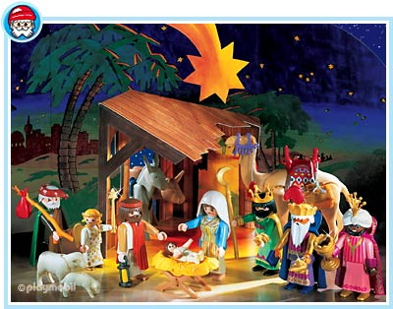
What does BCE mean?
Some events happened before the common empire and we call this B.C.E.(Before the common empire.).
This means that they came before the Year 0 for example the Roman Period started in 753 B.C.E. -seven hundred and fifty three
years before the start of the
common Empire.
Challenge: Can you find
the meaning of AD and BC.

Slide 3
Put the following events in chronological order:
1552
567
250BCE
500BCE
2012
1215

Slide 4
Answers:
500BCE
250BCE
567
1215
1552
2012

Slide 5
There are many different words that we use to describe the past. It is important that we understand these words if we are to become good historians. Sort out the correct heads and tails.
HEADS | TAILS
Century | Anno Domini, these Latin words mean in the year of the lord.(Now CE)
A.D. | One thousand years
Decade | Separate division of time
Periods | Before the Common Empire
B.C.E | One hundred years
Millennium | Every ten years

Slide 6
Feedback
HEADS | TAILS
Century | One hundred years
A.D. | Anno Domini, these Latin words mean in the year of the Lord. (Now CE)
Periods | Separate division of time
Decade | Every ten years
B.C.E. | Before the Common Empire
Millennium | One thousand years

Slide 7
How do I work out the century?
Finding out which year is in which century can be tricky business. The easiest was to decide is to cover the last two numbers up and add one. For example; 1459 is in the Fifteenth Century
Answer the following
The year 1584 is in the ______________ Century.
Do the same for the years 1275, 2010, 1899 and 654.

Slide 8
Feedback
The year 1584 is in the Sixteenth Century.
The year 1275 is in the Thirteenth Century.
The year 2010 is in the Twenty-first Century.
The year 1899 is in the Nineteenth Century.
The year 654 is in the Seventh Century.

Slide 9
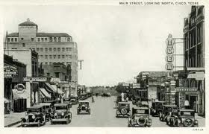
Remember
When people refer to a decade in time they don’t say the say the second decade they say the 20’s.

