Slide 1
1) 19,12,1,22,5,18,25
2) 2,18,9,19,20,15,12
3) 9,14,4,21,19,20,18,25
4) 19,8,9,16,2,21,9,12,4,9,14,7
5) 16,15,18,20 3,9,20,25
Can you use the code and decipher the words above?
They are all key words that will be useful in today’s lesson and you must think about how and when you can use them!
A = 1
B= 2
C= 3
D= 4
E= 5
F= 6
G= 7
H= 8
I= 9
J= 10
K= 11
L= 12
M= 13
N= 14
O= 15
P= 16
Q= 17
R= 18
S= 19
T= 20
U= 21
V= 22
W= 23
X= 24
Y= 25
Z= 26
# Challenge: If you have already cracked the worded codes can you create 3 words that were useful last lesson and test your partner to crack the code?

Slide 2
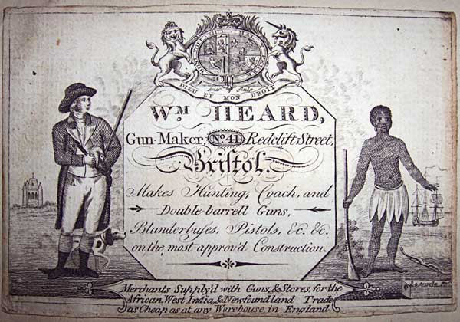
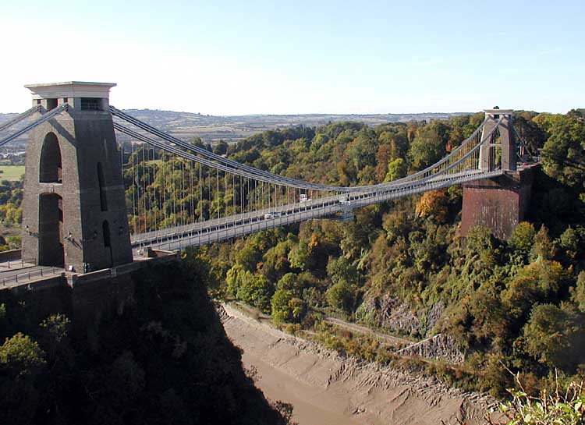
Why was Bristol so successful during the slave trade? Learning Objective: To identify and begin to explain how and why Bristol was ideally suited for success in the slave trade.

Slide 3
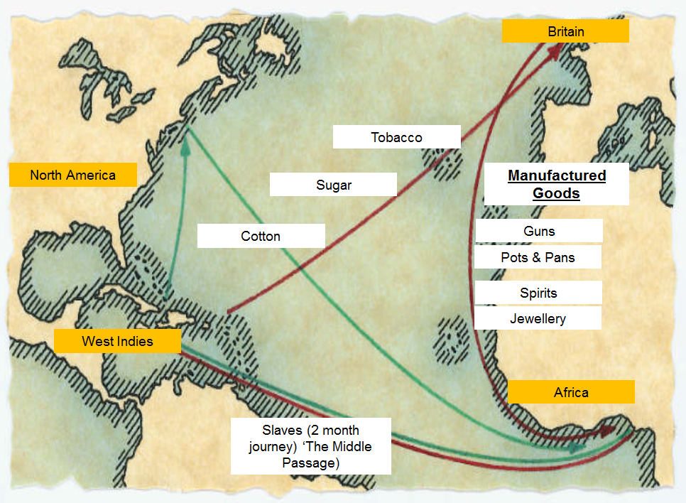

Slide 4
Why was Bristol so well suited for its involvement in the slave trade?
Task: Using the analysis grid on the next slide, read the factor in each box and make links to the categories listed at the bottom.
Which category came out as the most significant to you?
#Challenge: Can you create a 5th category to make links between any of the factors?

Slide 5
Why was Bristol so successful during the slave trade?
After 1645, 10,000 white volunteers and over 3,000 convicts were sent to plantations in the Americas to work. | Many of Bristol’s wealthiest merchants owned plantations in the West Indies that produced both sugar and tobacco. | Bristol was situated on the Severn Estuary, and had already developed a major port. | However, merchants in Bristol soon began to trade slaves illegally.
Bristol was positioned on the west coast of England, allowing easier access to the West Indies and the Americas. | Slaves could originally only be captured legally from London and under guidance from The Royal African Company. | Bristol was a major exit point for these people and between 1645 and 1680 over 10,000 people were said to have been transported across. | There were a lot of insurance companies set up there, which helped with the protection of large, expensive cargo.
Bristol had already established a good shipbuilding industry. | Bristol had a good trade relationship with Portugal, which was the first major colony to begin the trading of slaves. | There was already a strong sugar refinery production line present in Bristol. | Bristol was already involved in colonial (?) trade of products such as cod, log wood, furs and specifically tobacco and sugar.
Bristol was a place that had a lot of wealth and prosperity in its business potential, so only these wealthy could invest in such large scale operations. | It had a well known reputation for constructing high quality glassware. | Voyages were expensive as they lasted for over two years and needed huge financial backing to run. | It offered a natural gateway to the South and Western Midlands of England.
Categories
Wealth
Transport
Geography
Trade

Slide 6
Why was Bristol so well suited for its involvement in the slave trade?
Task: Using your categorised factors to this question from all available information, create a word cloud to demonstrate understanding and apply significance to the reasons as to why Bristol was set up well for success in the slave trade.
#Challenge: Justify the reasons as to why each of your 3 biggest words deserve the status they have been given.
s

