Slide 1
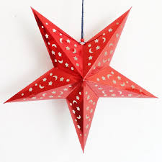
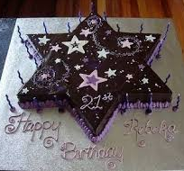
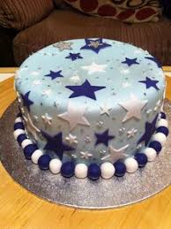
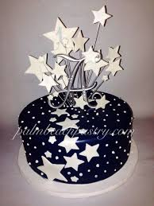
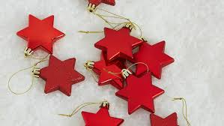
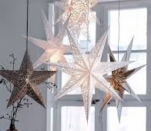
Creating a star themed Christmas cake

Slide 2
Cake Decorating Techniques
Learning objectives:
Choose from a range of icings to decorate your cake based on their properties and use.
You may wish to practice piping and modelling.
Don’t forget jam to go in the middle and stick non fondant.

Slide 3
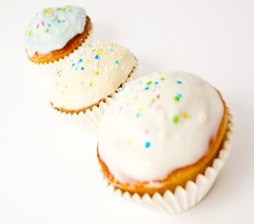
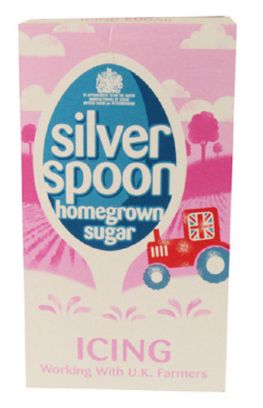
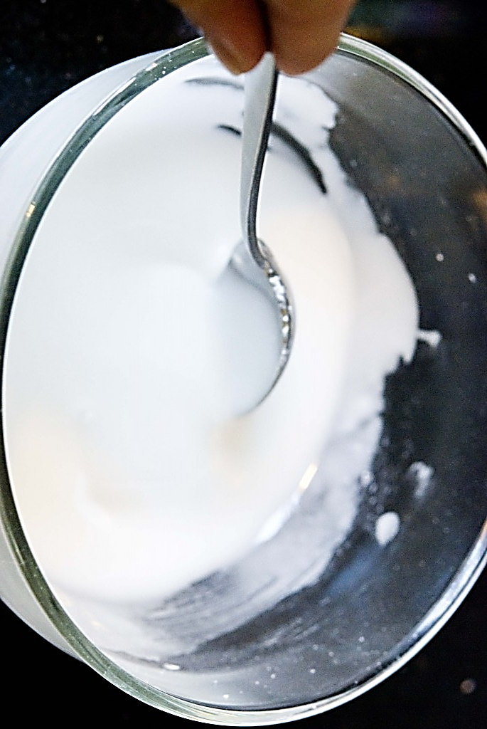
Icing
Icing sugar is a fine powdered sugar used in cake decorating.
You can mix it with water or other liquids
It is very easy to make it too runny.
Start by adding a very small amount of water and mixing really well.
It can be coloured with bottled food colouring

Slide 4
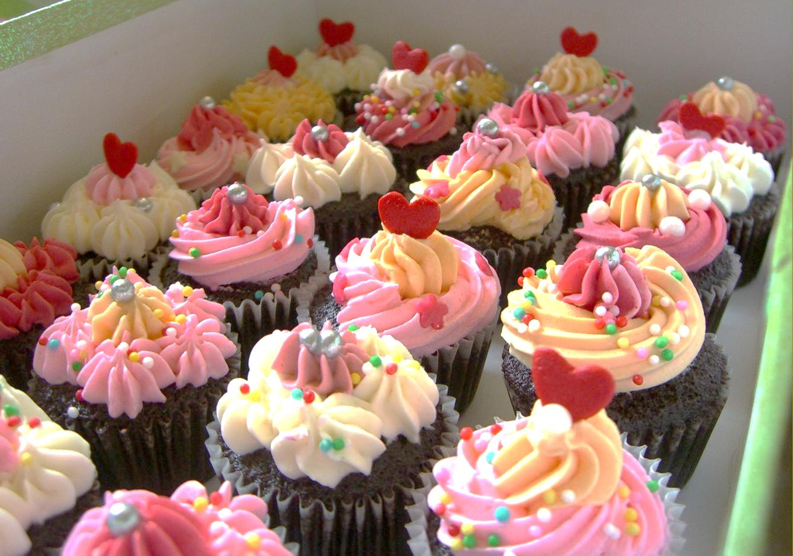
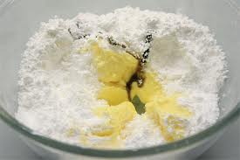
Butter Icing
Mix BUTTER not margarine and icing sugar until light and fluffy.
Use 2parts icing sugar to 1 part butter
E.g. 100g icing sugar 50g butter
It can curdle if you add water or bottled colouring so use very little.
Easy to pipe or spread

Slide 5
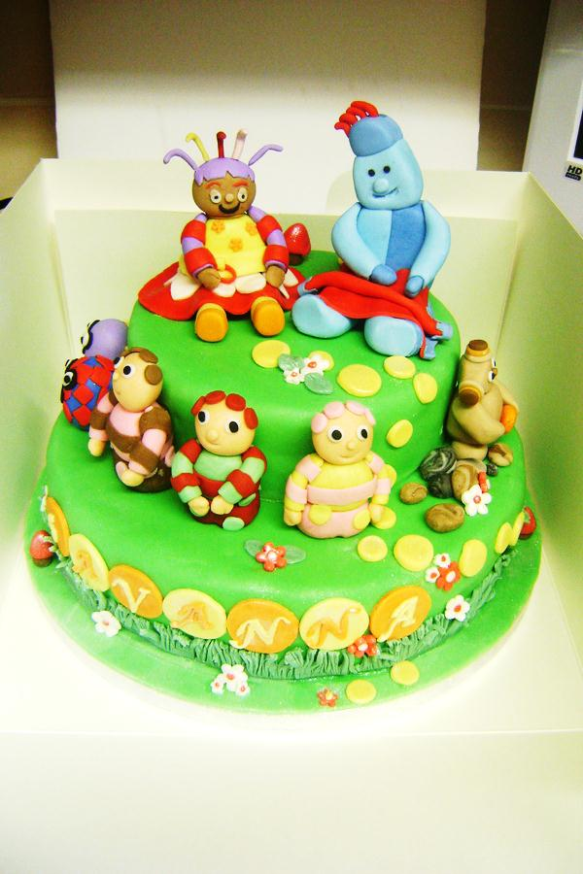
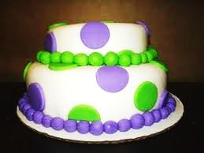
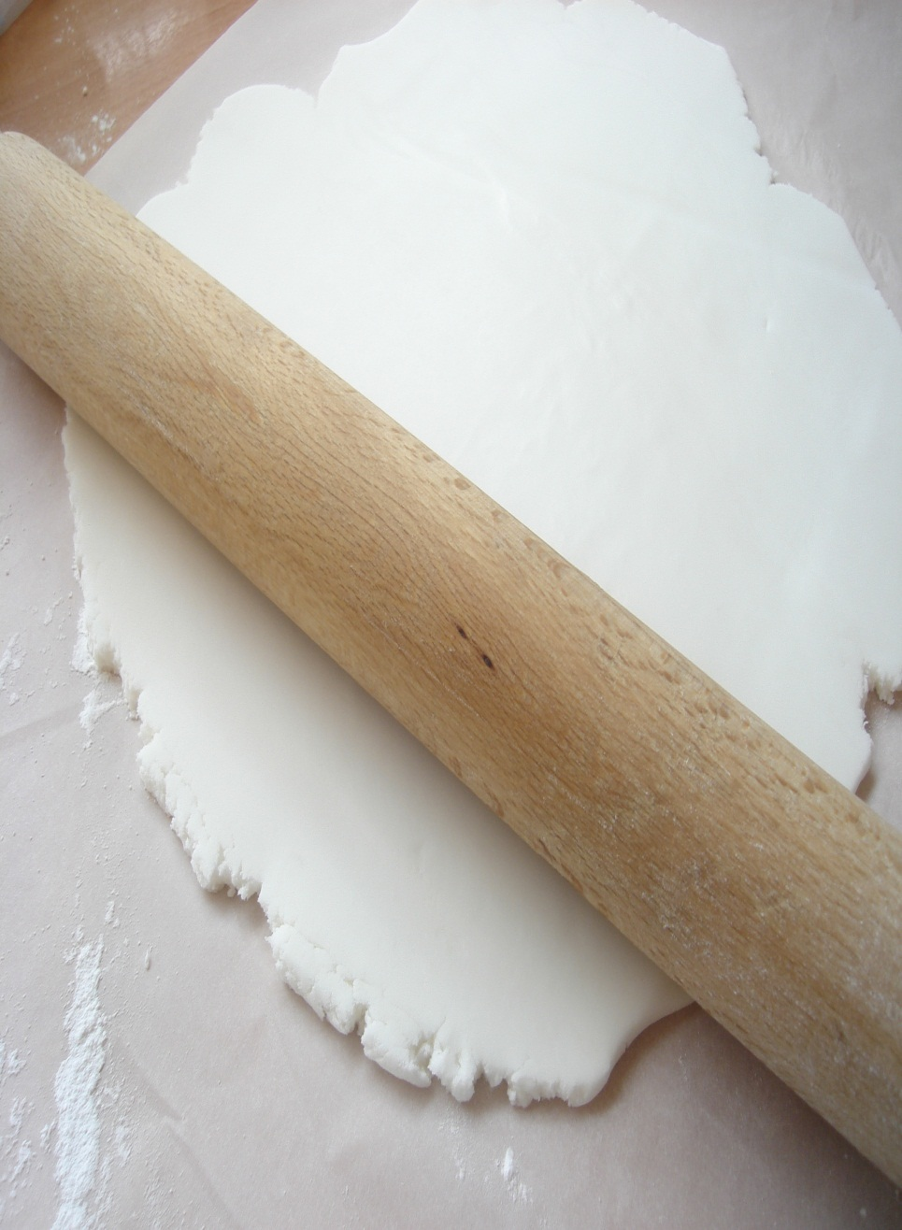
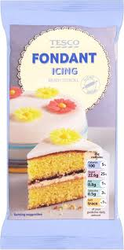
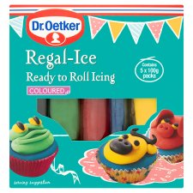
Fondant icing
Buy it ready made. A standard component.
Needs kneading to soften before rolling out or modelling.
Picks up crumbs very easily so can look dirty or messy if you are not clean and tidy.
Buy in white or pre-coloured. Simple effective designs can be achieved.
Or very complicated ones!

Slide 6
http://www.youtube.com/watch?v=A1GRzhLTO1k

Slide 7
Homework task
Using an A4 sheet of paper
Sketch a minimum of 6 ideas
Use 3d
Shade / render the designs
Label designs with detail and possible alternatives

Slide 8
