Slide 1

Computing: Summer Term 2020
Teach-ICT Student Login
Username: ba114jf
Password: gateway5
Learning Objective: To identify your favourite parts of Computing and reflect on everything you have achieved.

Slide 2

Website Design using Online Applications
Create your own business using www.wix.com
What can you do better than last year?

Slide 3
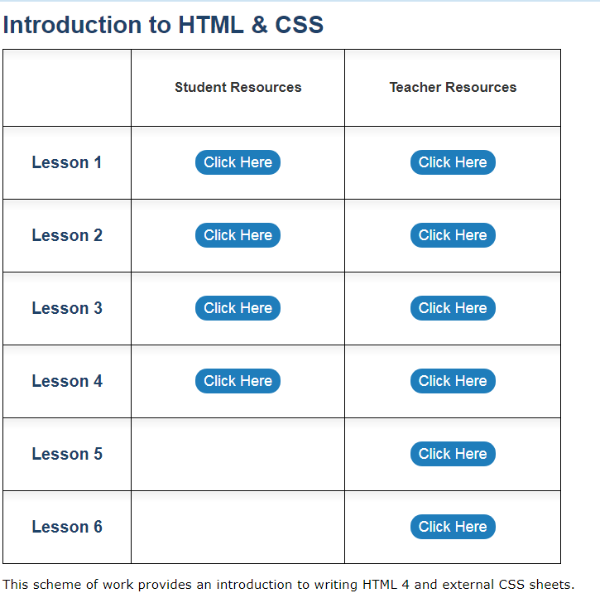
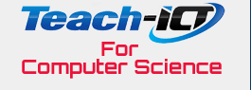
HTML & CSS to build webpages
Continue with the coding of your very own webpage, challenging yourself to make it look as professional as possible.

Slide 4
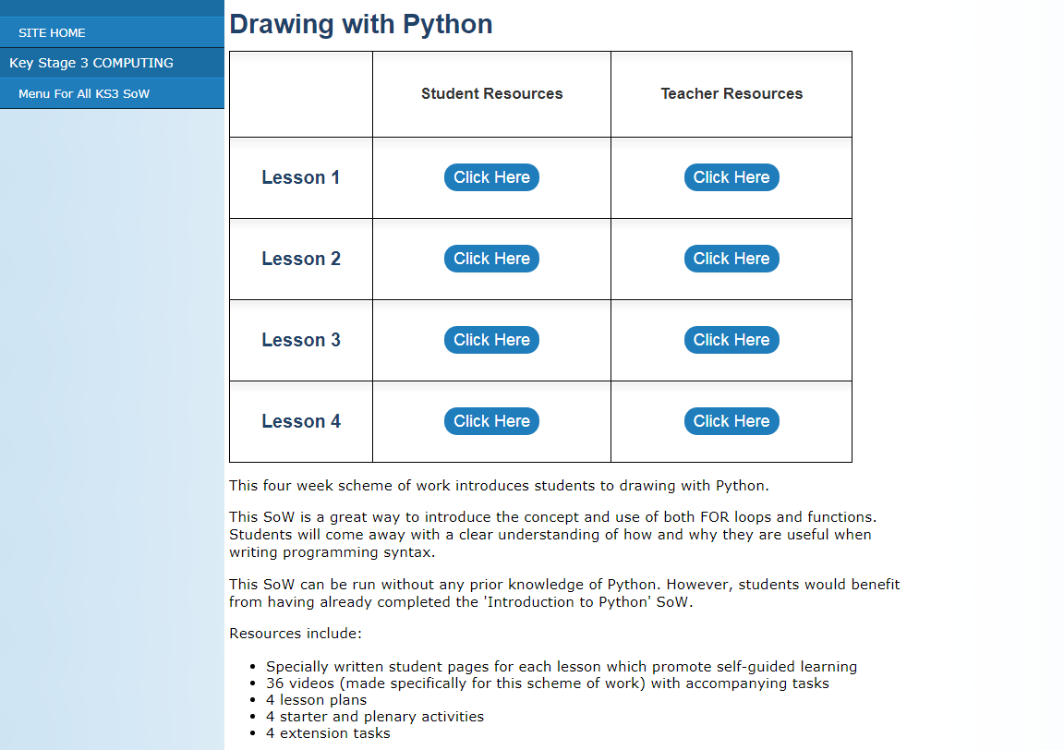
Drawing with Python
Using Python, be more creative by using programming to develop visual computer programs.

Slide 5
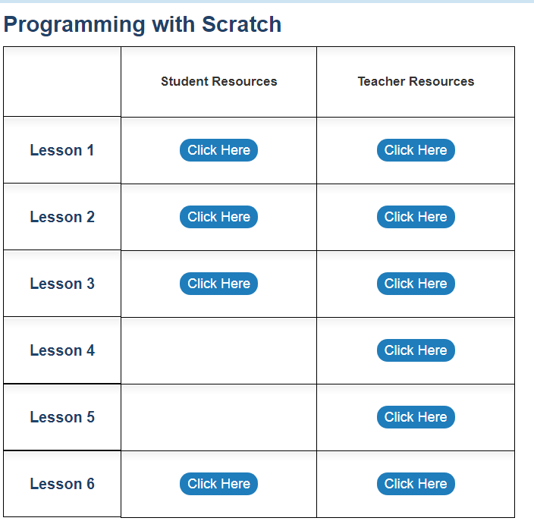
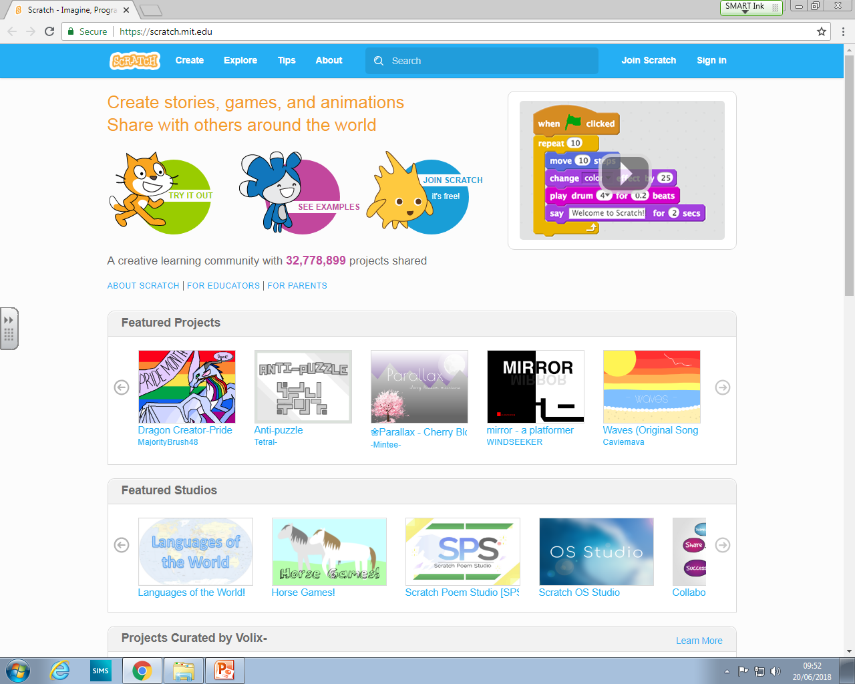
Creating your Own Game in Scratch
Using Scratch, develop your game building imagination.

Slide 6
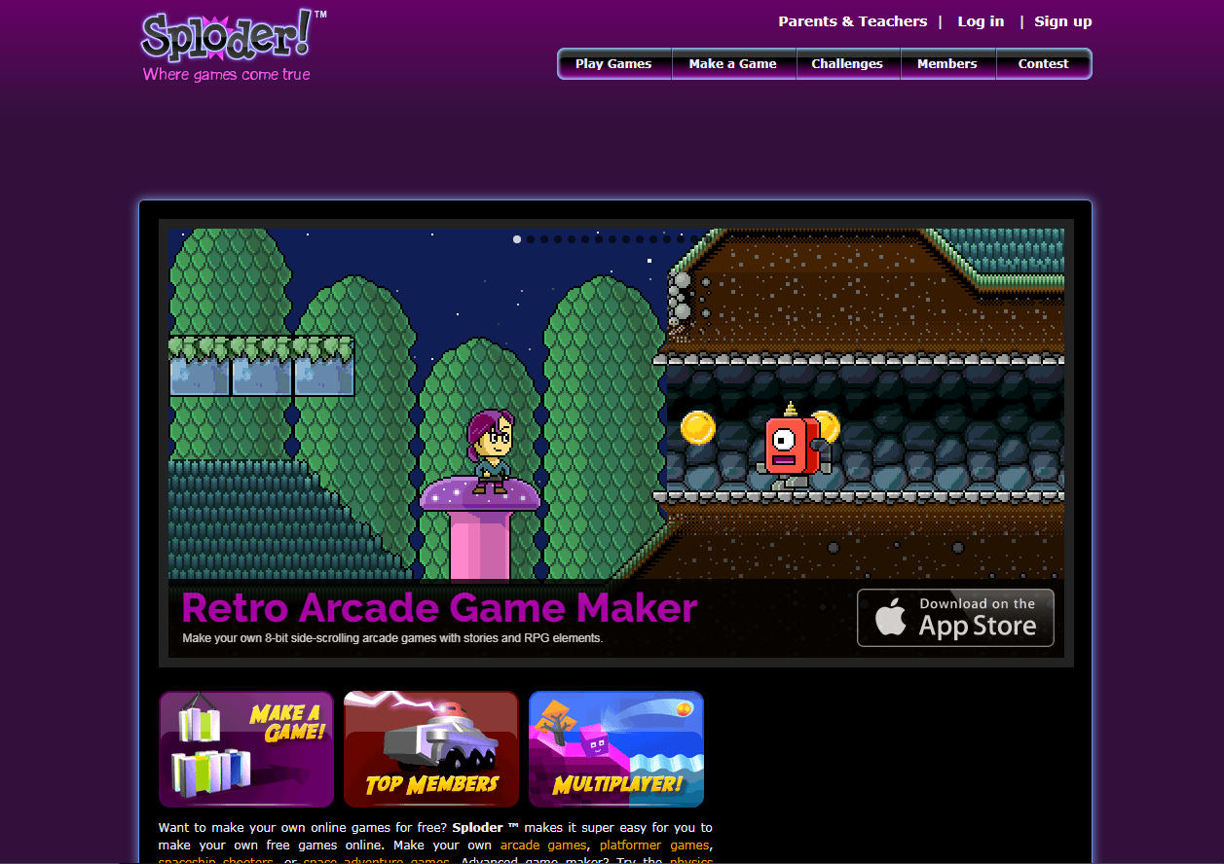
Designing and improving your own Arcade games
#Challenge: Can you improve your game from last time? Can you take an initial idea from someone else to then develop further?
Review, plan and design your own arcade platform games.
www.sploder.com

Slide 7
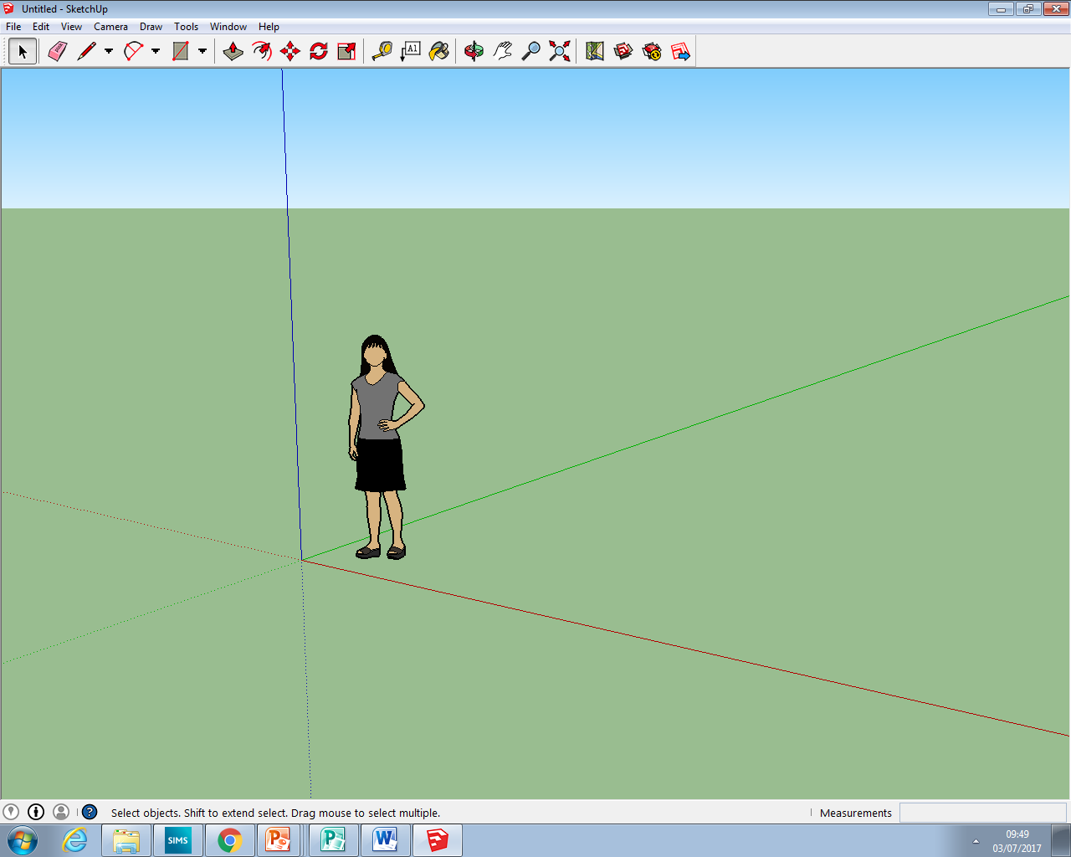
Sketchup
Recreate a landmark of your choice by using Sketchup.
What can you do better now than you could last year?

Slide 8
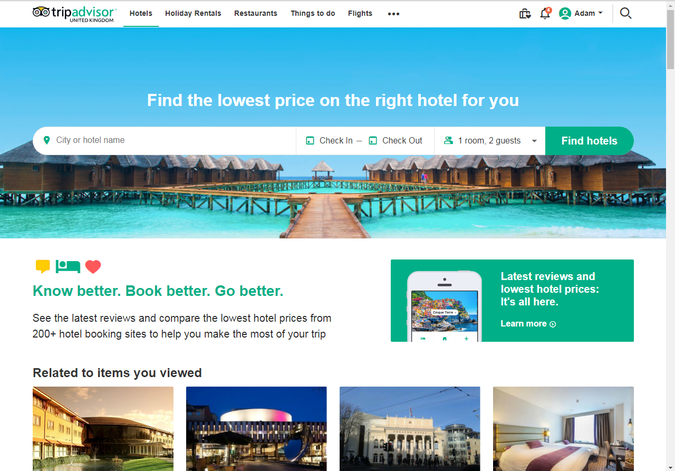
Web Quest
Plan and price up a 4 week trip to take over the summer holiday.
Where would you go?
What would you do?
How much would it cost?
Landmarks?
Food & Drink?

Slide 9
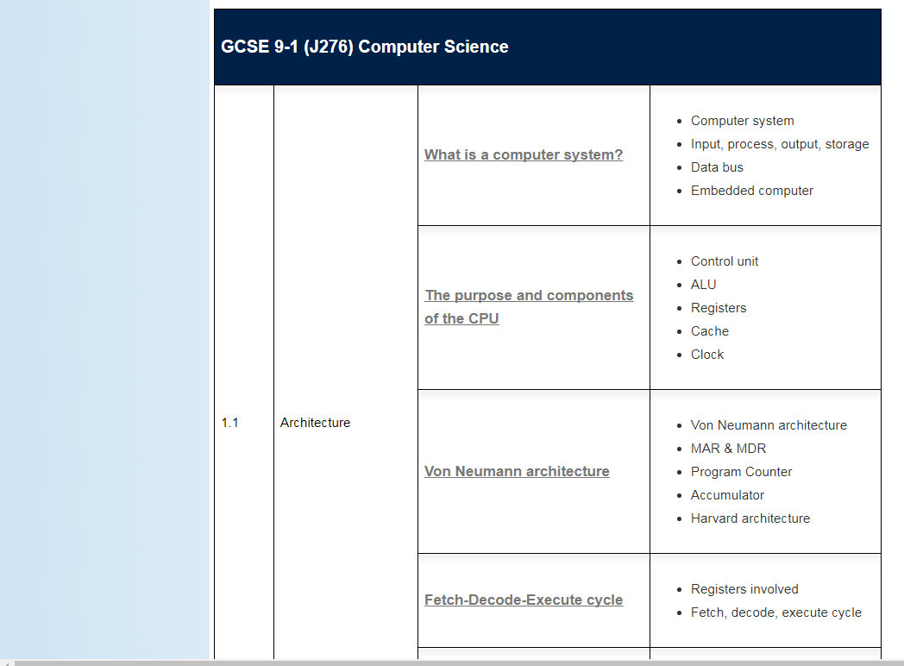
#GCSE Computer Science Unit: What is a Computer System?
OCR 9-1 GCSE
Start studying a GCSE unit of what a computer system is.
Watch the videos, complete the activities and revise the theories.

Slide 10
