Slide 1
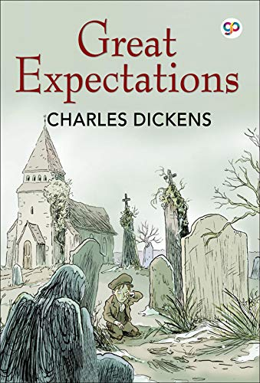
KS3 Learning Journey
Preparing for GCSE
Romeo and Juliet
Year 9 Drama: Small Island
Who Am I?
Identity Poetry
The Art of Rhetoric
Year 9 Novel: Lord of the Flies
Futuristic Fiction
Exploring The Gothic
Year 8 Drama:
Coram Boy
Poetry of the First World War
Crime and Non-Fiction Writing
Year 8 Novel:
Great Expectations
A Midsummer Night’s Dream
Year 7 Novel: October, October
Nature Poetry
Your Planet Needs You!
The Roots of English
Myths and Legends
My Origin Story

