Slide 1
LO: I can answer questions from a text.

Slide 2
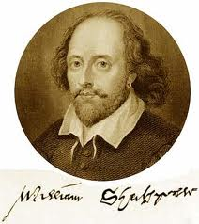
Who do you think this man is?

Slide 3
Watch this clip on The Globe.
Note down facts which you find exciting.
http://www.bbc.co.uk/learningzone/clips/shakespeare-and-the-globe-theatre/3342.html.

Slide 4
Research Shakespeare online- record 7 interesting facts about Shakespeare.

Slide 5
Share and swap a fact about Shakespeare

Slide 6
LO: To create an informative poster.

Slide 7
What do you recall about this man?

Slide 8
Watch this clip on The Globe.
Note down facts which you find exciting.
http://www.bbc.co.uk/learningzone/clips/shakespeares-globe-an-introduction/8383.html

Slide 9
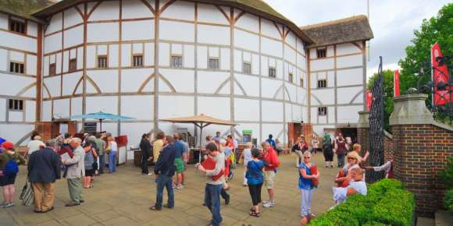
Create a poster about Shakespeare and his Globe theatre.

Slide 10
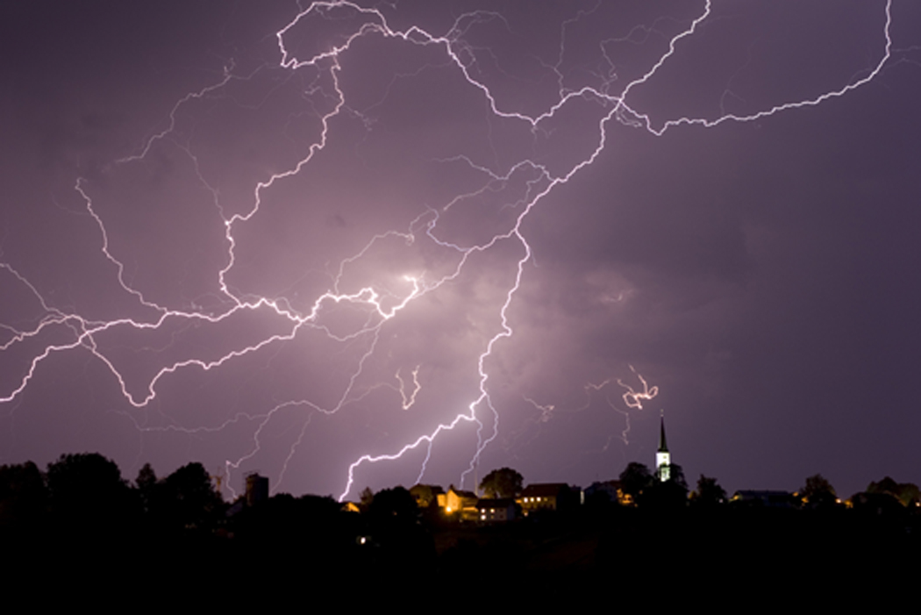
LO: I can write descriptive words and sentences.

Slide 11
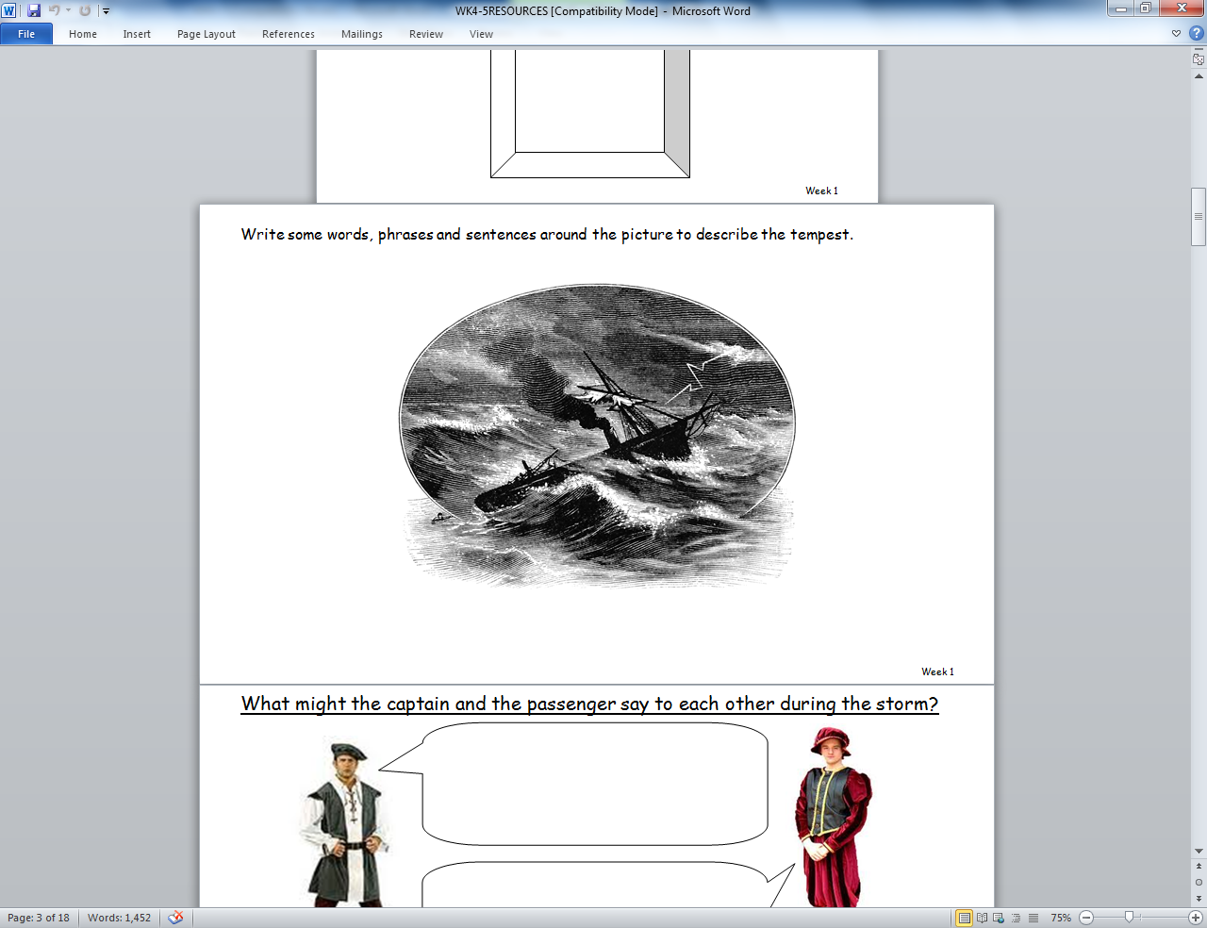
What do you think is happening in this picture?

Slide 12
Use your dictionary to find out what a tempest is.

Slide 13


The tempest is the last play written by Shakespeare.
It starts of with a great storm. In the storm a ship crashes onto a magical island.
Some of the sailors die in the crash but others survive. The sailor who survived are forced to live on the strange island until help arrives.

Slide 14
Many other authors have tried to write children versions of the play.
Can you find any examples online?

Slide 15
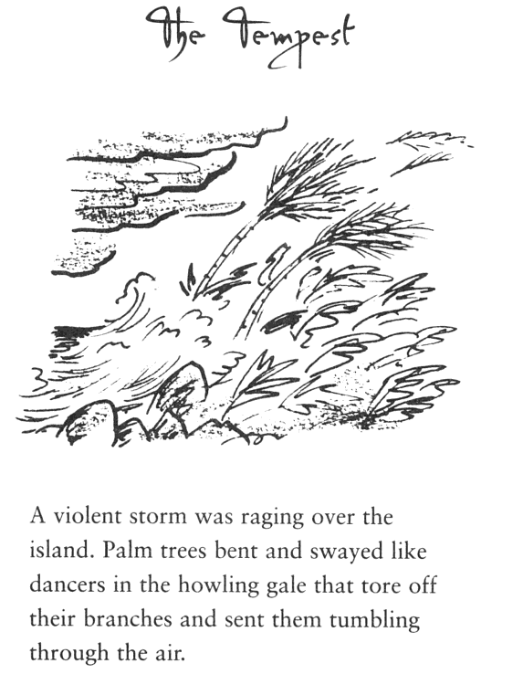

Slide 16
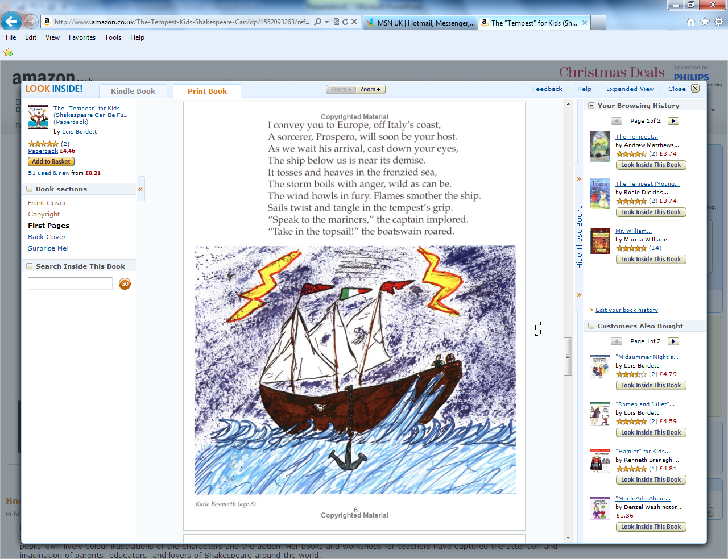
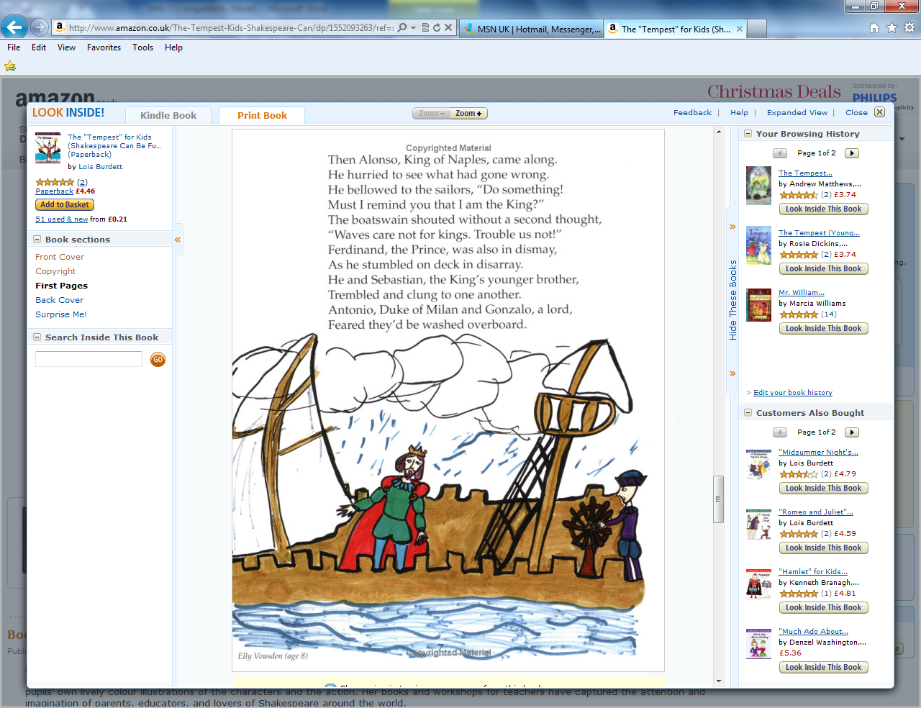

Slide 17
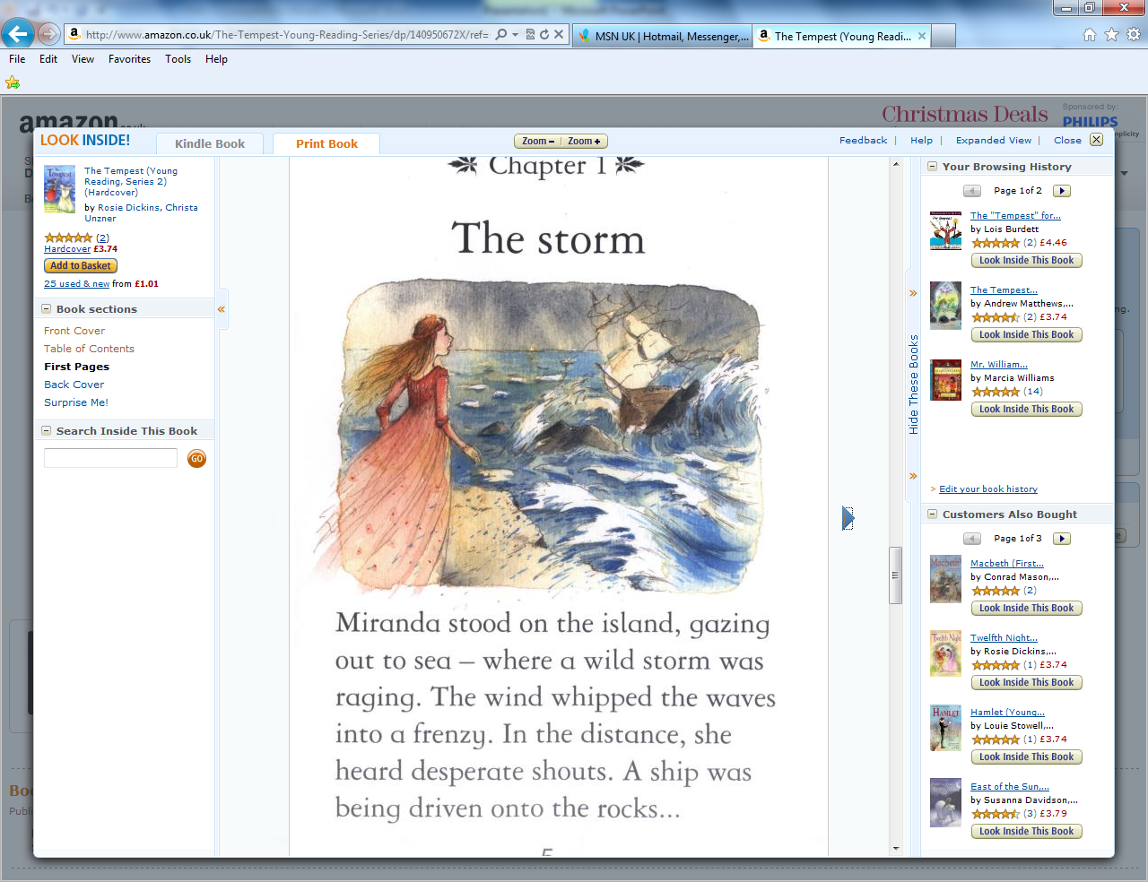

Slide 19
What is a tempest?

Slide 20
Today we are going to write our own opening to The Tempest.

Slide 22



LO: I can write dialogue using speech bubbles

Slide 23
Try to imagine what it would have been like for the sailors and passengers on board the ship in the tempest.
What might the captain and the passenger say to each other?

Slide 24
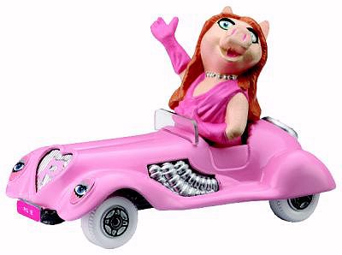
Speech Bubbles
I like driving my pink car!

Slide 25
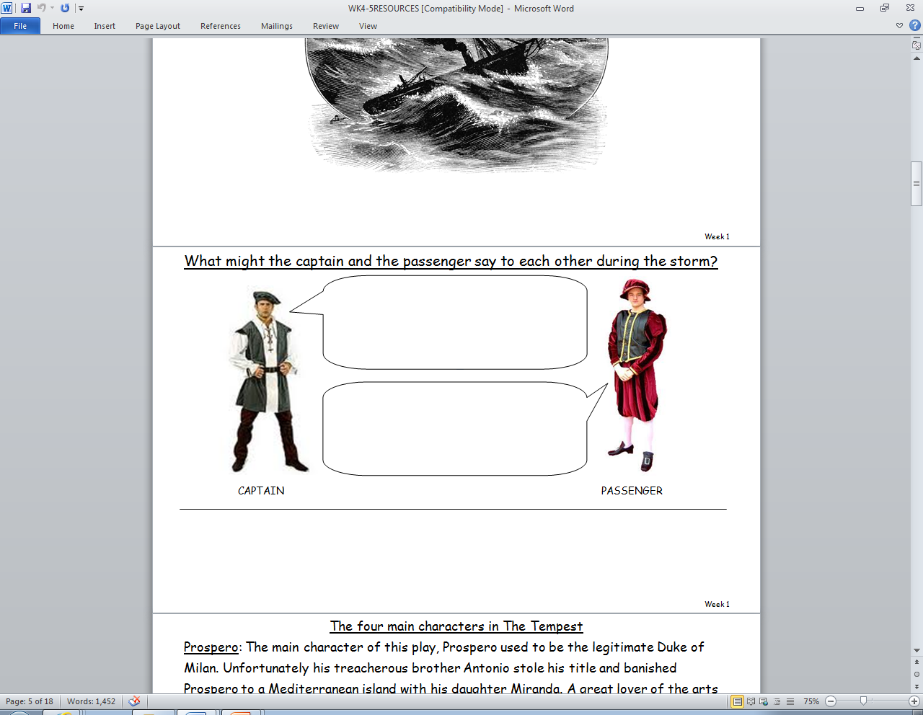

Slide 27

“I like driving my pink car!” said Miss
Piggy.
I like driving my pink car!

Slide 28
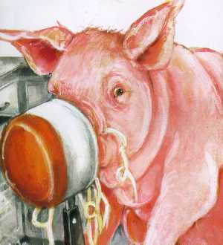
“Oh dear, my big nose is stuck!” said Daddy pig.
Oh dear, my big nose is stuck!

Slide 29
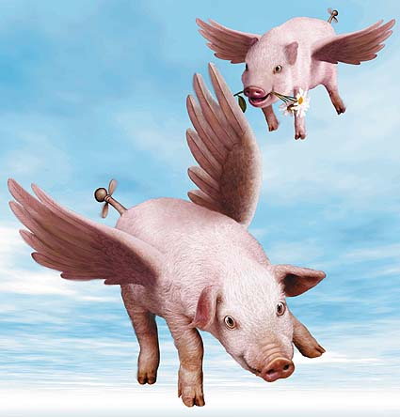
“We can fly high in the sky!”
shouted the pigs.
We can fly high in the sky!

Slide 30
Turn the speech bubble into direct speech.
“ I hope you can swim! The ship is sinking fast” Growled the Captain to the frightened passenger.
“ This is the worse storm I’ve ever seen! I’m sure we’ll all be killed” moaned the terrified passenger.
I hope you can swim! The ship is sinking fast.
This is the worse storm I’ve ever seen! I’m sure we’ll all be killed.

Slide 31
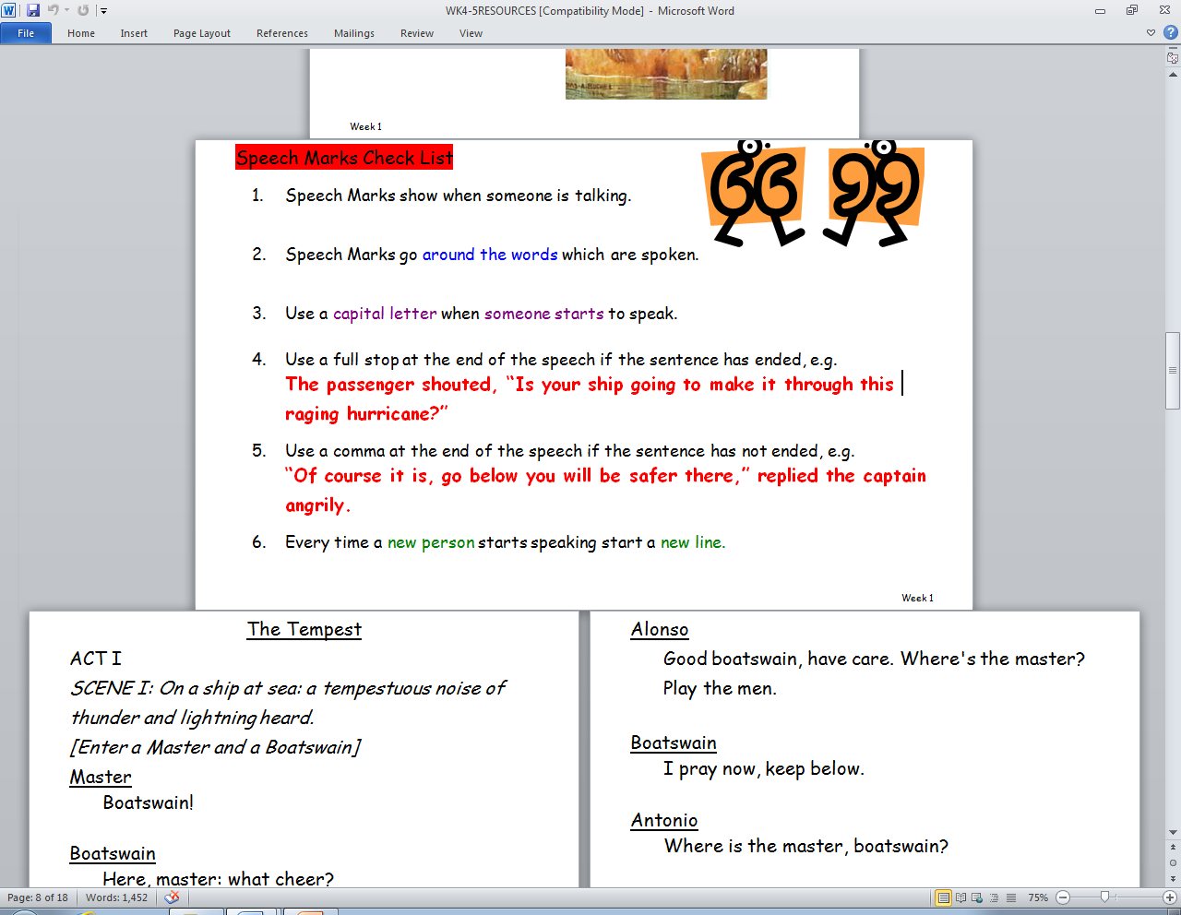

Slide 32
LO: I understand the conventions of play scripts.

Slide 33
What did your learn from this clip?
http://www.bbc.co.uk/learningzone/clips/stories-as-plays/750.html

Slide 34
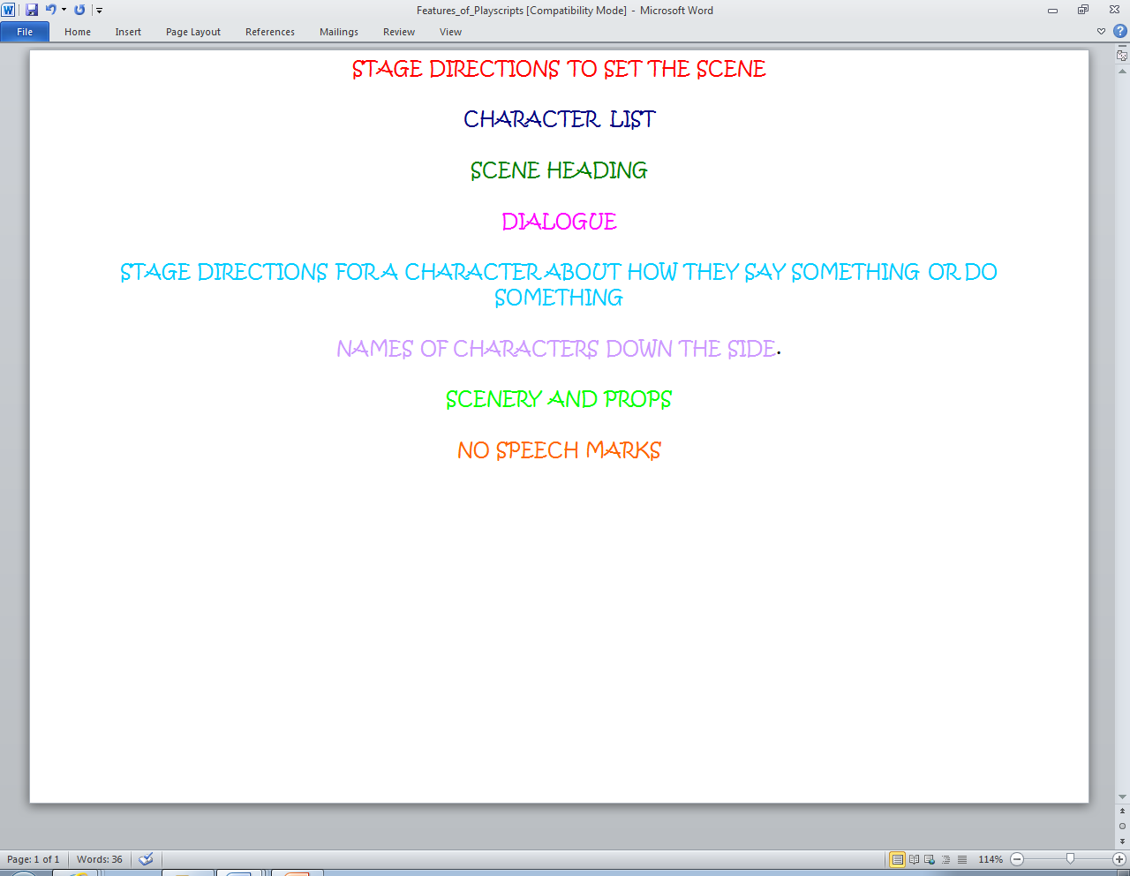

Slide 35
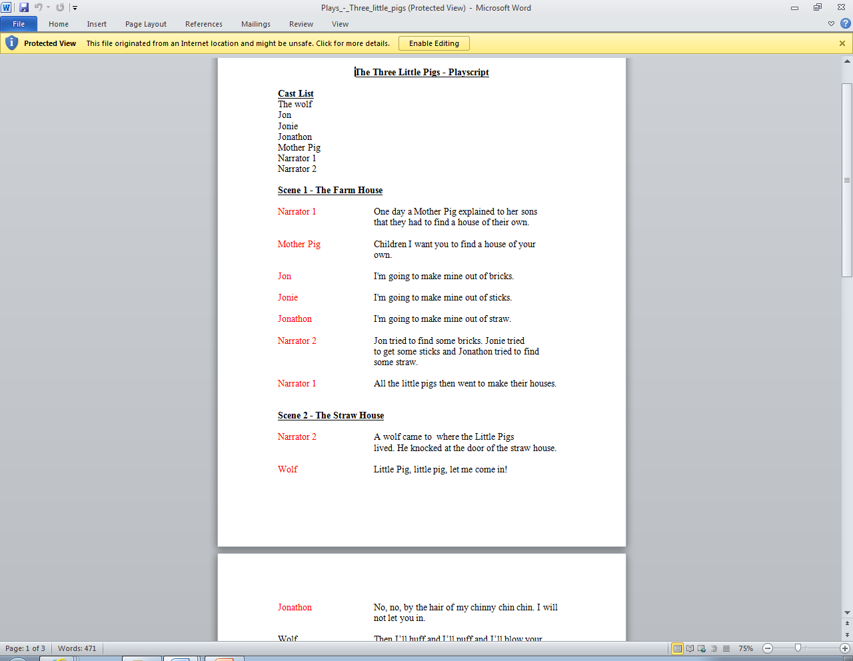

Slide 36
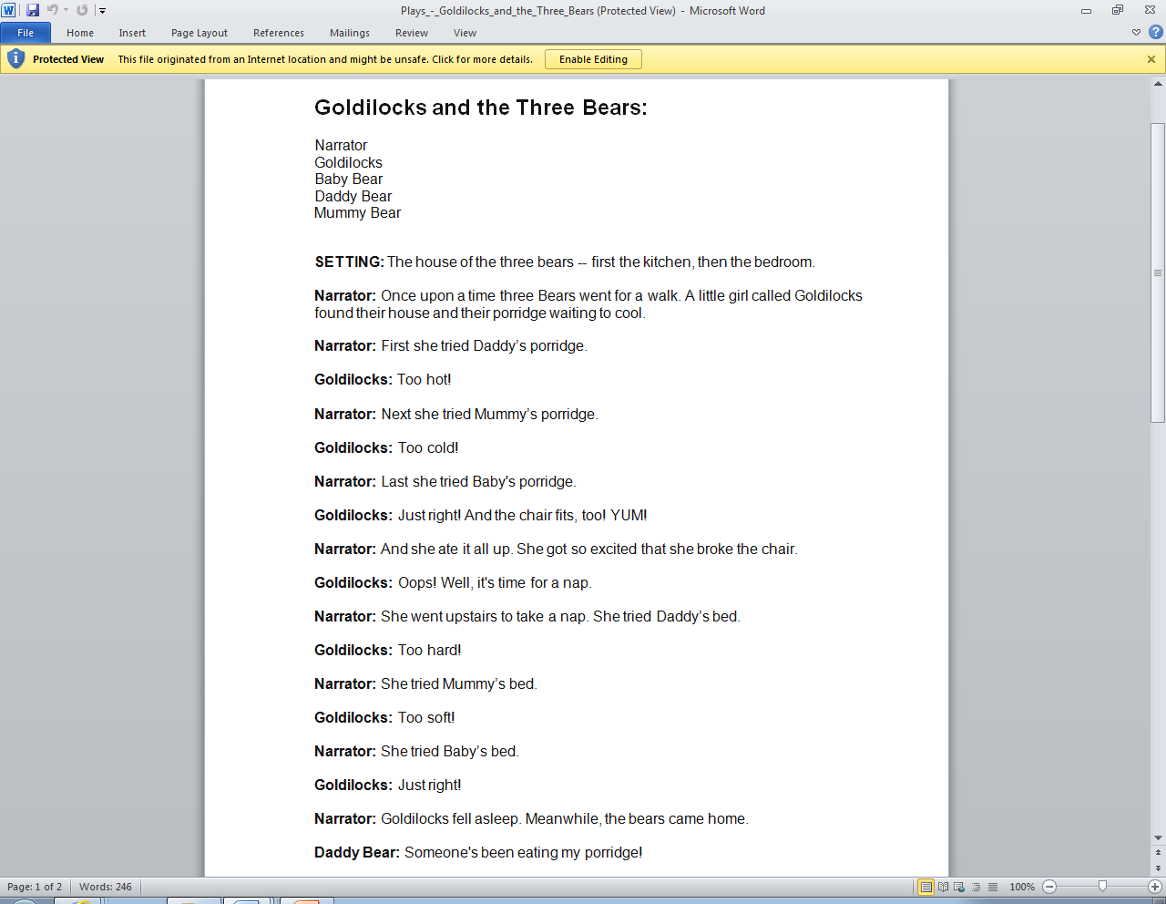

Slide 37
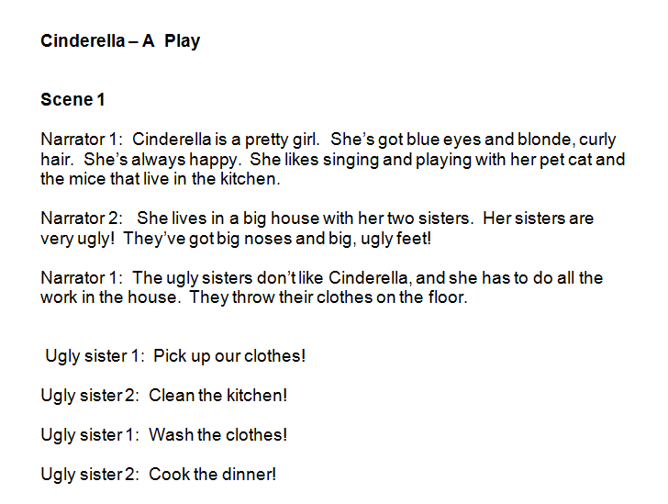

Slide 38
Take a play script and read it out loud. Try performing the characters in various ways.

Slide 39
LO: Discuss settings and characters.

Slide 41
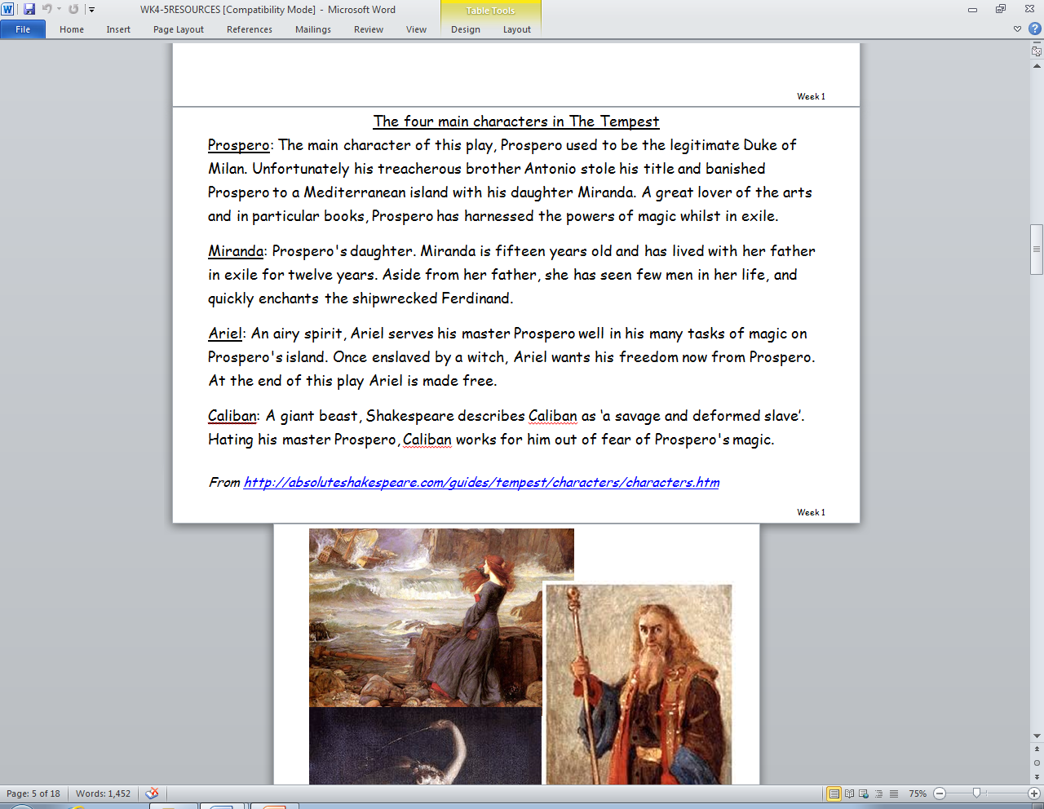

Slide 42
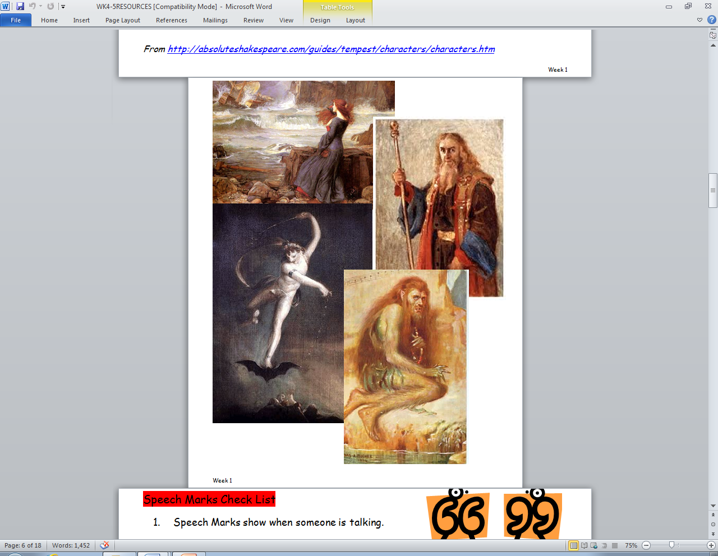

Slide 43

Draw and describe three characters for your script.
The king is terrified during the storm. He thinks that his life is more important than anybody else. He is very bossy and bad tempered.

Slide 44
LO: I can improvise and perform a scene.

Slide 45
Why do actors need to warm up their voice?
http://www.bbc.co.uk/learningzone/clips/voice-warm-ups-for-drama/9893.html

Slide 46

Try saying these tongue twisters
How much wood would a woodchuck chuck
If a woodchuck could chuck wood?
He would chuck, he would, as much as he could,
And chuck as much wood as a woodchuck would
If a woodchuck could chuck wood.

Slide 47
Betty Botter bought some butter,
"But," she said, "this butter's bitter.
If I bake this bitter butter,
It will make my batter bitter.
But a bit of better butter -
That would make my batter better."
So she bought a bit of butter,
Better than her bitter butter,
And she baked it in her batter,
And the batter was not bitter.
So 'twas better Betty Botter
Bought a bit of better butter.

Slide 48
Peter Piper picked a peck of pickled peppers.
Did Peter Piper pick a peck of pickled peppers?
If Peter Piper picked a peck of pickled peppers,
Where's the peck of pickled peppers Peter Piper picked?
She sells seashells on the seashore.
The shells she sells are seashells, I'm sure.
A big bug bit a bold bald bear and the bold bald bear
bled blood badly
Imagine an imaginary menagerie manager managing an imaginary menagerie
Seth at Sainsbury's sells thick socks.
There was a fisherman named Fisher
Who fished for some fish in a fissure.
Till a fish with a grin,
Pulled the fisherman in.
Now they're fishing the fissure for Fisher.
Seventy seven benevolent elephants.

Slide 49
Peter Piper picked a peck of pickled peppers.
Did Peter Piper pick a peck of pickled peppers?
If Peter Piper picked a peck of pickled peppers,
Where's the peck of pickled peppers Peter Piper picked?

Slide 50

What does improvise mean?

Slide 51
LO: I can turn a story idea into a play script.

Slide 52
Using the characters you created, write the opening scene to your own version of The Tempest.

Slide 53
The Tempest
Cast
Captain
Sailor
King
ACT I
SCENE I: On a ship at sea: The setting is tempestuous and the noise of thunder and lightning can be heard.
[Enter a captain and a sailor]
Sailor
Captain!
Captain
I’m here sailor, what’s the matter?
Sailor
The sky looks angry tonight captain ,I fear a terrible storm is on its way.
Captain
I think you’re right Sailor, the waves are already getting choppy. I’ll go and warn the passenger to stay below deck.
Enter The king
King
Captain! Can’t you stop this ship from swaying about so much? I’m starting to feel sea sick!

Slide 54
The Tempest
Cast
Captain
Sailor
ACT I
SCENE I: On a ship at sea: The setting is ---------- and the noise of --------can be heard.
[Enter a captain and a sailor]
Sailor
This storm is dangerous, shall we jump overboard?
Captain
Sailor
Captain

