Slide 1
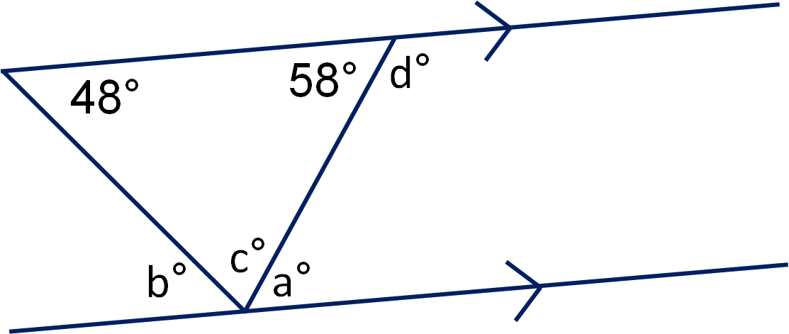
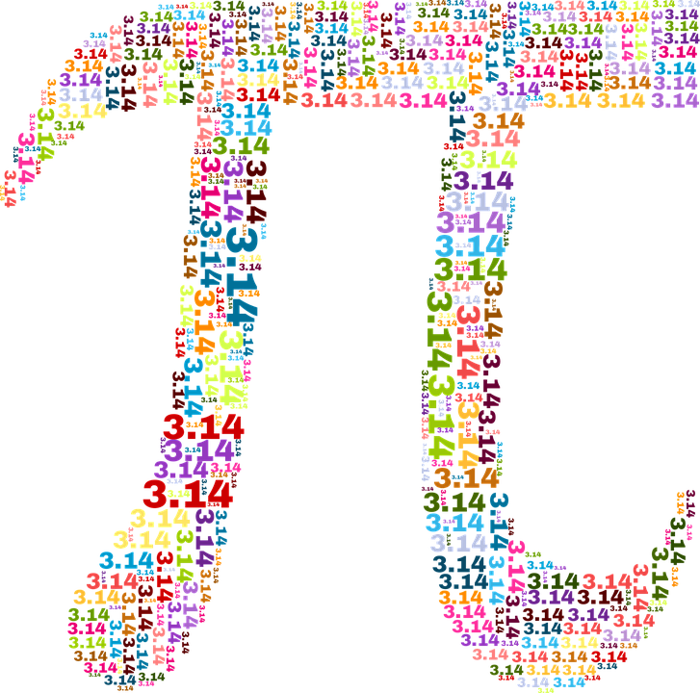
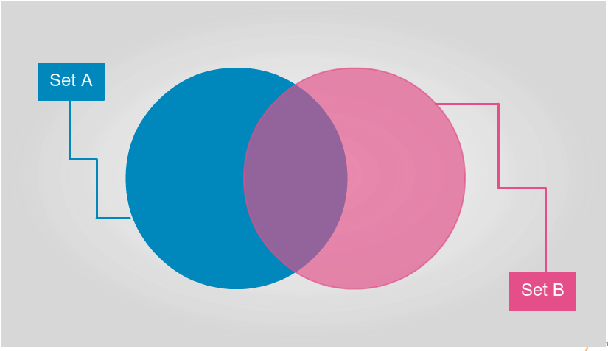
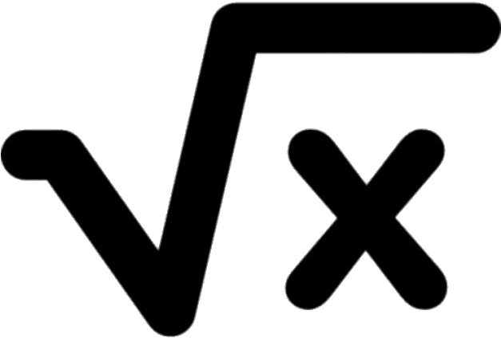
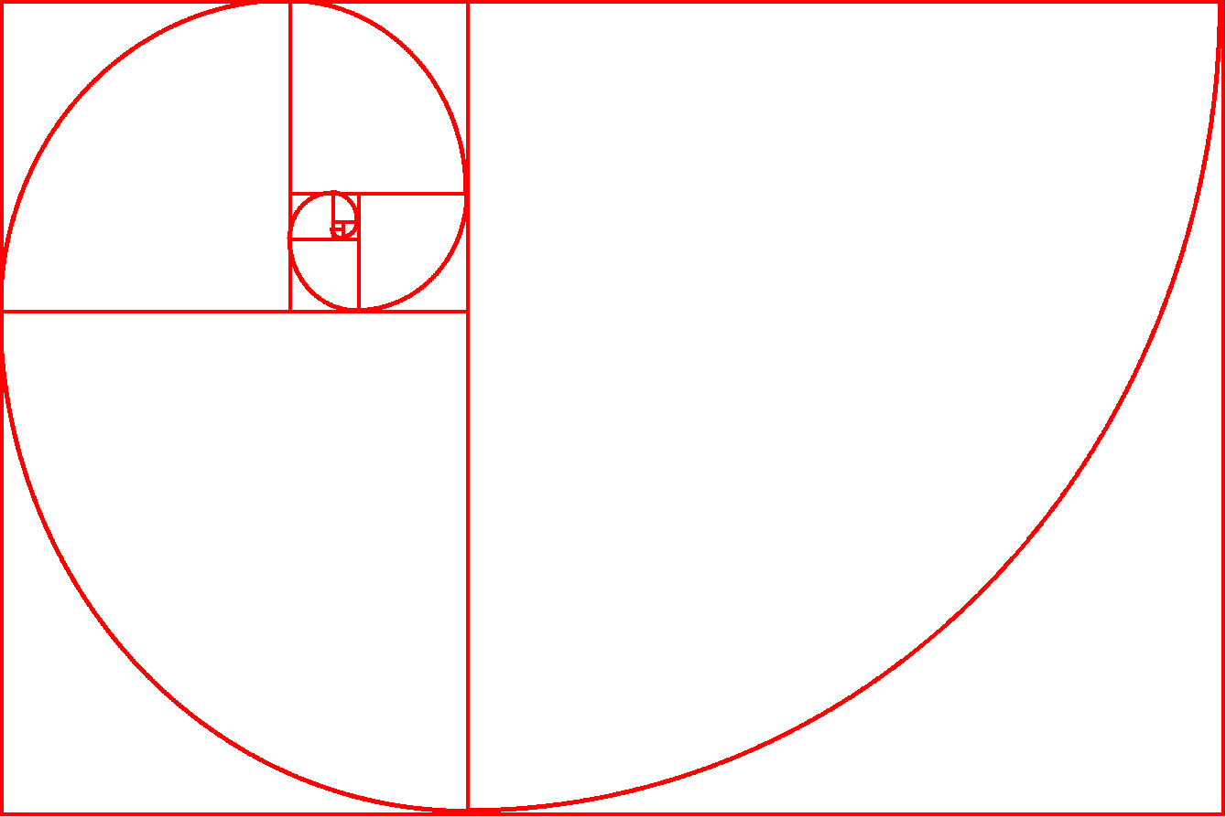
9
Data Handling & Measures of Location
Area of Trapezia & Circles
Angles in Parallel Lines & Polygons
Standard Index Form
Fractions & Percentages
Ratio & Scale
Multiplicative Change
Working in the Cartesian Plane
Data, Tables & Probability
Brackets, Equations & Inequalities
8
Prime Numbers & Proof
Multiplication & Division
Sets & Probability
Geometric Reasoning
Constructing & Measuring
Directed Number
7
Sequences
Algebra
Place Value
Fractions, Decimals & Percentages
Addition & Subtraction

Slide 2
Year 7
Scheme of Learning | Sequences |  | Algebra |  | Place Value
Knowledge | Predict and check the next term of a sequence Continue numerical and non-numerical sequences Explain the term-to-term rule of a sequence Find missing numbers within sequences |  | Find numerical inputs and inputs for one and two-step function machines Substitute values into one and two-step expressions Find function machines given a two-step expression Generate sequences given an algebraic rule Solve one-step equations Simplify expressions by collecting like terms |  | Understand and write numbers up to 1 billion Compare and order integers Find the range and median of a list of numbers Write large and small numbers in standard form
Sequencing Statements/ Cross Curricular Learning | Year 8 - Sequences |  | Year 6 - Algebra Year 8 – Brackets, Equations & Inequalities |  | Year 5 – Place Value Year 6 – Place Value Year 8 – Standard Index Form
Enrichment Opportunities and British Values
Back

Slide 3
Year 7
Scheme of Learning | Fractions, Decimals & Percentages |  | Addition & Subtraction |  | Multiplication & Division
Knowledge | Convert between fractions and decimals Convert fluently between fractions, decimals and percentages Use and interpret pie charts Find fractions and percentages of amounts Add and subtract fractions including mixed numbers Add and subtract simple algebraic fractions |  | Add and subtract decimals and integers Solve problems involving perimeter Solve problems involving tables and timetables Solve problems involving bar charts and line charts |  | Understand and use factors and multiples Multiply and divide by 10, 100 and 1000 Multiply by 0.1 and 0.01 Use formal methods to multiply and divide integers and decimals Understand and use BIDMAS Solve problems involving the area of rectangles, parallelograms triangles, trapezia Solve problems using the mean
Sequencing Statements/ Cross Curricular Learning | Year 5 – Fractions Year 6 – Fractions Year 8 – Multiply and Divide Fractions |  | Year 5 – Shape Year 6 - Statistics |  | Year 5 – Multiplication and Division Year 6 – Area, Perimeter & Volume Year 8 – Area of trapezia & circles
Enrichment Opportunities and British Values
Back

Slide 4
Year 7
Scheme of Learning | Directed Numbers |  | Construction and Measuring |  | Geometric Reasoning
Knowledge | Add and subtract negative numbers Multiply and divide negative numbers Substitute negative numbers into expressions Solve two-step equations with negative solutions Roots of positive numbers |  | Draw and measure line segments including geometric figures Draw and measure angles up to 360 degrees Recognise types of triangle and quadrilateral Identify polygons up to a decagon Construct triangles Draw and interpret pie charts |  | Understand and use the sum of angles at a point and on a straight line Know and apply the sum of angles in a triangle and quadrilateral Find and use the angle sum of any polygon Investigate angles in parallel lines Understand and use angle rules in parallel lines
Sequencing Statements/ Cross Curricular Learning | Year 6 – Algebra Year 8 – Brackets, Equations & Inequalities |  | Year 5 – Shape Year 6 – Shape Year 8 - Angles in Parallel lines and Polygons |  | Year 6 – Shape Year 8 – Angles in parallel lines and polygons
Enrichment Opportunities and British Values
Back

Slide 5
Year 7
Scheme of Learning | Sets & Probability |  | Prime Numbers & Proof
Knowledge | Identify and represent sets Interpret and create Venn Diagrams Understand and use the union and intersection of sets Generate sample spaces for single events Calculate the probability of a single event Understand and use the probability scale |  | Recognise and identify prime, square and triangular numbers Find common factors of a set of numbers including the HCF Find common multiples of a set of numbers including the LCM Write a number as a product of prime factors Use Venn diagrams to find the HCF and LCM
Sequencing Statements/ Cross Curricular Learning | Year 8 – Data, Tables & Probability |  | Year 5 – Multiplication and Division Year 7 – Sets & Probability
Enrichment Opportunities and British Values
Back

Slide 6
Year 8
Scheme of Learning | Ratio & Scale |  | Multiplicative Change |  | Working in the Cartesian Plane
Knowledge | Understand and use ratio notation Solve problems involving ratio Divide in a given ratio Write ratio in its simplest form Compare ratios and fractions Understand and use Pi and gradient |  | Solve problems involving direct proportion Explore conversion graphs and convert between currencies Explore relationships between similar shapes Understand and use scale factors, scale diagrams with ratio |  | Work with coordinates in all four quadrants Identify and draw lines that are parallel to the axes Recognise and use the line y=x and y=kx Recognise and use lines of the form y=x+a Explore graphs with negative gradient Link graphs to linear sequences Plot graphs of the form y=mx+c Explore non-linear graphs Find the midpoint of a line segment
Sequencing Statements/ Cross Curricular Learning | Year 6 – Ratio Year 8 – Multiplicative change |  | Year 6 – Measures, Ratio Year 8 – Ratio & Scale |  | Year 5 – Position & Direction Year 8 – Working in the Cartesian Plane
Enrichment Opportunities and British Values
Back

Slide 7
Year 8
Scheme of Learning | Data, Tables & Probability |  | Brackets, Equations & Inequalities |  | Fractions & Percentages
Knowledge | Draw and interpret scatter graphs Understand and describe linear correlation and use line of best fit Identify non-linear relationships and different types of data Read and interpret ungrouped and grouped frequency tables Represent discrete and continuous data Construct and interpret two-way tables and sample spaces for one or more events Find probabilities from sample spaces, two-way tables and Venn diagrams Use the product rule for finding the total number of possible outcomes |  | Form algebraic expressions Use directed number with algebra Multiply and factorise into a single bracket Expand multiple single brackets and a pair of binomials Form and solve equations, including with brackets Understand and solve simple inequalities Form and solve equations and inequalities with unknowns on both sides Identify and use formulae, expressions, identities and equations |  | Convert fluently between key fractions decimals and percentages Calculate fractions, decimals and percentages of an amount using calculator methods Calculate percentage increase and decrease using a multiplier Express one number as a fraction or a percentage of another Find the original amount given the percentage less than 100%
Sequencing Statements/ Cross Curricular Learning | Year 5 – Statistics Year 6 - Statistics Year 7 – Sets and probability |  | Year 6 – Algebra Year 7 - Algebra |  | Year 5 – Fractions, Decimals & Percentages Year 6 – Fractions, Decimals and Fractions, Decimals & Percentages Year 7 – Add & Subtract Fractions
Enrichment Opportunities and British Values
Back

Slide 8
Year 8
Scheme of Learning | Standard Index Form |  | Angles in Parallel Lines & Polygons
Knowledge | Work with large and small numbers in standard form Compare and order numbers in standard form Add, subtract, multiply and divide numbers in standard form Use a calculator to work with numbers in standard form Understand and use negative and fractional indices |  | Understand and use basic angle rules and notation Investigate angles between parallel lines and the transversal Identify and calculate with co-interior, alternate and corresponding angles Solve complex problems with parallel line angles Constructions triangles and special quadrilaterals Identify and calculate with sides and angles in special quadrilaterals Understand and use the sum of exterior angles and interior angles in any polygon Construct an angle bisector and a perpendicular bisector of a line segment
Sequencing Statements/ Cross Curricular Learning | Year 7 – Place Value |  | Year 5 - Shape Year 6 – Shape Year 7 – Constructing and Measuring
Enrichment Opportunities and British Values
Back

Slide 9
Year 8
Scheme of Learning | Area of Trapezia & Circles |  | Data Handling & Measures of Location
Knowledge | Calculate the area of triangles, rectangles and parallelograms Calculate the area of a trapezium Calculate the perimeter and area of compound shapes Investigate the area of a circle Calculate the area of a circle and parts of a circle with and without a calculator |  | Set up a statistical enquiry Design and criticise questionnaires Draw and interpret pictograms, bar charts and vertical line charts, multiple bar charts, pie charts and line graphs Choose the most appropriate diagram for given set of data Represent and interpret grouped quantitative data Find and interpret the range Compare distributions using charts Understand and use the mean, median and mode Find the mean from a grouped and ungrouped frequency table Identify outliers Compare distributions using averages and the range
Sequencing Statements/ Cross Curricular Learning | Year 6 - Shape |  | Year 5 – Statistics Year 6 - Statistics
Enrichment Opportunities and British Values
Back

