Slide 1
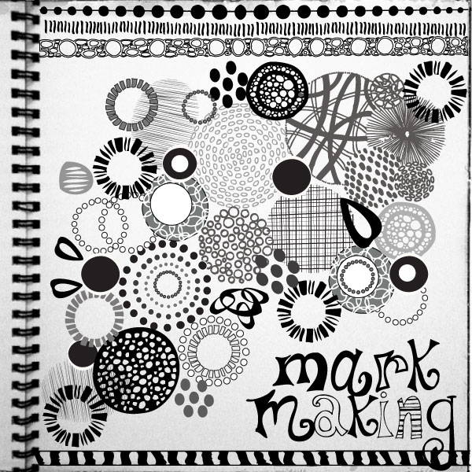
STARTER
On the A4 Paper
Doodle lines, shapes
and patterns of your choice.
All drawings and paintings start with a ‘mark’
Today you are going to practise making different types of marks with 4 different types of pencil.
L.O. DEVELOPING DRAWING SKILLS
To investigate and experiment with mark making.
To practise using a range of pencils to make artistic marks.

Slide 2
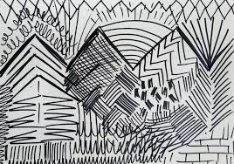
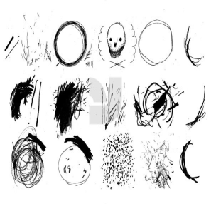
Experimenting with pencils.
Divide your paper into quarters and on the back Practise making marks/lines with the 4 pencils provided.
B
2H
4B
2B
Which pencil do you think makes the greatest range of shades ?
What do you know about different types of pencils?
Which is your favourite to use and why?
Why do you need different types of pencils?
L.O. DEVELOPING DRAWING SKILLS
To investigate and experiment with mark making.
To practise using a range of pencils to make artistic marks.

Slide 3
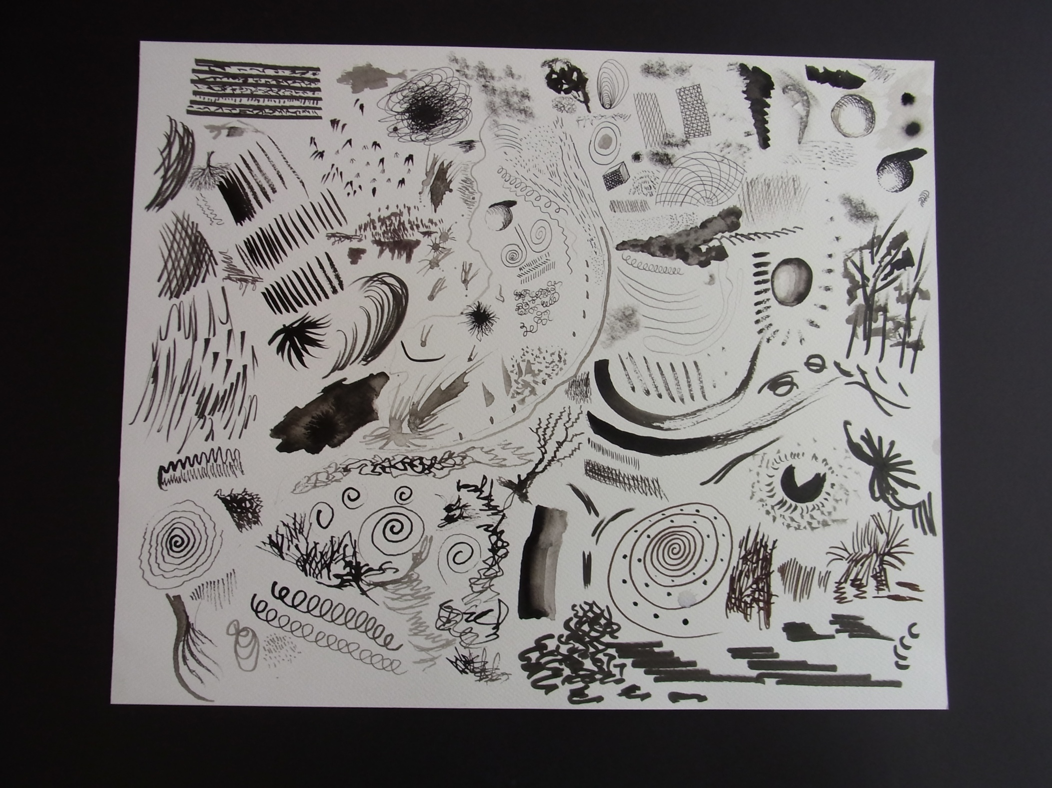
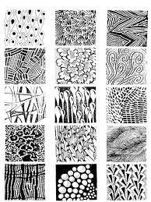
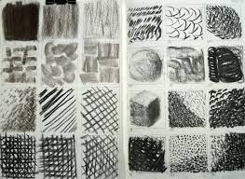
On the sheets provided
Fill each box with a different pattern or texture or line.
Try to create dark and light shades.
Use a rubber to create further shades or use it as a drawing tool.
L.O. DEVELOPING DRAWING SKILLS
To investigate and experiment with mark making. To practise using a range of pencils to make artistic marks.

Slide 4
