Slide 1



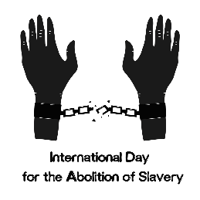



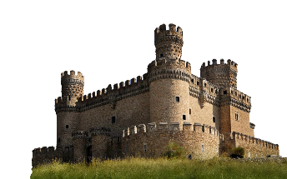
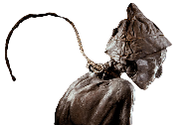
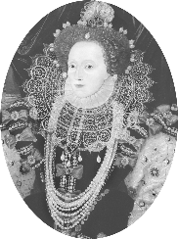

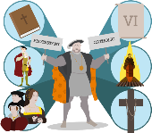

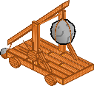
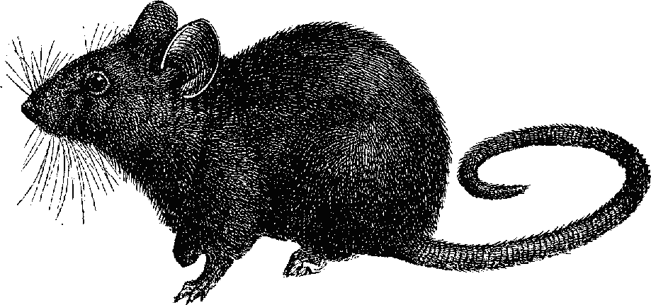







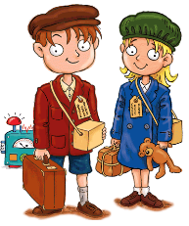
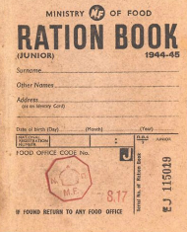

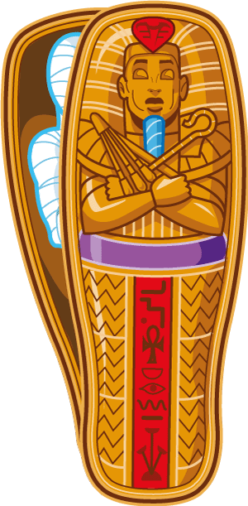
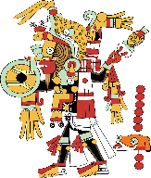




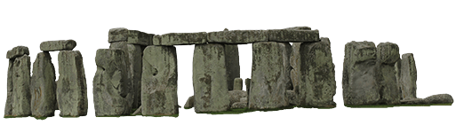

9
Public Health in History
What was Europe like after World War 1?
Why did a ‘Great War’ happen?
Industrial Revolution and Booming Population
Why was Enslavement allowed to happen?
Why did the Tudor monarchs have problems with the church?
8
Crime and Punishment through History
What was daily life like in Medieval Britain ?
(Depth Study)
What challenges did Elizabeth I face?
How were the Ancient Egyptians and the Incans similar?
7
What was life like during World War 2?
(Depth Study)
How do historians use evidence and how does bias affect sources?
6
5
What is chronology and why is it significant in History?
How have leisure & entertainment activities changed over time?
(Thematic Study)
What was it like to live in the Stone Age?
Who were the Maya and where did they Live?

Slide 2



Year 5
Scheme of Learning
Knowledge | To demonstrate understanding of chronology. To understand the significance of the findings at Skara Brae. To recognise the way of life for people during the Iron Age. To identify different interpretations of the uses of Stone Henge. To reflect on the different evidence surrounding the Druids. |  | To reflect on the various ways we enjoy leisure activities. To establish a comparison with historical interests against today’s society. To begin to identify continuity and changes in the way we have consumed media and content within the previous century. Be able to debate the impacts of technology use in today’s society. |  | To understand the ritual elements of Maya religion and be able to describe some of the gods in good detail. Research information that allows them to judge the significance of corn and chocolate. Describe the different features of Maya cities and what it might have been like to live there. To identify the writing and number system used by the Maya people and be able to apply it to communicate using words and completing mathematical sums.
Sequencing Statements/ Cross Curricular Learning |  |  | Drama – Design your own movie posters (Year 8)
Enrichment Opportunities and British Values | Fieldwork study to Stone Henge.
What was it like to live in the Stone Age?
How have leisure & entertainment activities changed over time?
(Thematic Study)
Who were the Maya and where did they Live?
Back

Slide 3



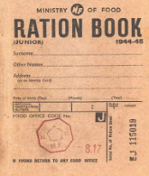
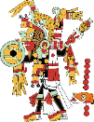
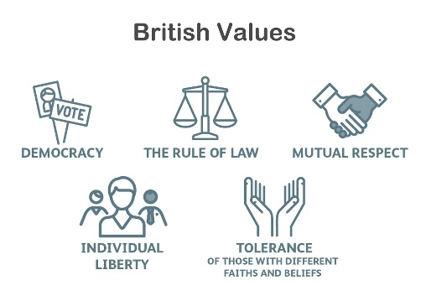
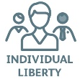
Year 6
Scheme of Learning
Knowledge | Identify and describe different types of historical evidence Explain how evidence helps us understand the past Evaluate the reliability and usefulness of different sources in regards to bias. |  | Identify and compare key aspects of Ancient Egyptian and Incan civilisation, including religion, architecture, and daily life. Explain similarities and differences in how Ancient Egyptians and Incas expressed power and belief through artefacts. Explore careers in history and museum work, understanding the roles of curators, historians, and archaeologists. |  | To recognise the key events in chronological order of World War 2 and begin to evaluate the significance of long term impacts. To recognise the role of women in WW2 Understand what it would have been like to as an evacuee during the war. To understand how the jobs of soldiers compare to being in the military today.
Sequencing Statements/ Cross Curricular Learning |  |  |  |  | What is Chronology and how can we build our Historical Skills? (Year 6) Why did a ‘Great War’ happen? (Year 8) Careers – Research of the Army and Navy websites to compare job roles historically.
Enrichment Opportunities and British Values
How were the Ancient Egyptians and the Incans similar?
How do historians use evidence and how does bias affect sources?
What was life like during World War 2?
(Depth Study)
Back

Slide 4
Year 6
Scheme of Learning
Knowledge | Identify the common foods available through rationing and begin to reflect on potential impacts of the shortages. Understand what it would have been like to as an evacuee during the war. To understand the effectiveness of propaganda in WW2.
Sequencing Statements/ Cross Curricular Learning | Why did a ‘Great War’ happen? (Year 8)
Enrichment Opportunities and British Values
What was life like during World War 2?
(Depth Study)
Back

Slide 5
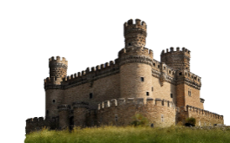


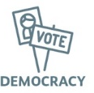
Year 7
Scheme of Learning
Knowledge | Identify changes in the nature of crimes. Identify the purpose of punishment. Consider the effects of the creation of modern policing on British society. Evaluate how progress and technological progression in Britain has changed crime and punishment. Consider the connection between social inequalities and the nature of crime within different historical contexts. |  | To campaign for the right candidate to win the throne of England in 1066. To reflect on the impacts of battles in 1066 for all involved. To learn about how William controlled England under his Norman reign. To identify on the methods of castle development throughout the middle ages. To understand what life was like for medieval peasants in towns and villages. To consider the impacts of the Black Death on the world. To determine if Robin Hood was fact or fiction.
Sequencing Statements/ Cross Curricular Learning | What is Chronology and how can we build our Historical Skills? (Year 6) Types of Evidence (Year 6) Careers – Which jobs use evidence? |  | Public Health in History (Year 8)
Enrichment Opportunities and British Values |  |  | Create a Castle Competition
 | To reflect on who led the country during the Tudor reign. To reflect on how and why Henry took away the power from the Catholic church. To examine the different interpretations of Mary I’s reign as Queen.
 | What was life like in Medieval Britain ? (Year 7)
Why did the Tudor monarchs have problems with the church?
Cont…
Crime and Punishment through History
What was life like in Medieval Britain ?
(Depth Study)
Back

Slide 6
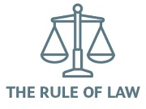

Year 7
Scheme of Learning
Knowledge | To reflect on who led the country during the Tudor reign. To reflect on how and why Henry took away the power from the Catholic church. To examine the different interpretations of Mary I’s reign as Queen. |  | To identify the use of portraits by Elizabeth to communicate with her people. To evaluate the challenges Elizabeth faced as Queen during her reign as fallout from the Reformation. To understand why the relationship with Spain broke down and the reasons as to why the Armada failed. To reflect on Elizabeth’s successes as Queen.
Sequencing Statements/ Cross Curricular Learning | What was life like in Medieval Britain ? (Year 7) |  | Why did the Tudor monarchs have problems with the church? (Year 7)
Enrichment Opportunities and British Values
Why did the Tudor monarchs have problems with the church?
What challenges did Elizabeth I face?
Back

Slide 7


Year 8
Scheme of Learning
Knowledge | To understand the origins and development of the transatlantic slave trade, including the roles of Britain, Africa, and the Americas. To examine the experiences of enslaved people, including daily life, resistance, and cultural survival, using a range of historical sources. To evaluate the economic, social, and moral justifications used to support slavery, and critically assess their impact on contemporary views and values. To explain how and why the transatlantic slave trade came to an end, considering the role of abolitionists, enslaved people's resistance, and economic change. |  | To recognise the most significant changes between British towns between 1750-1900. To be able to describe and explain the population changes in towns during these years. To recognise the issues that were caused by a sudden shift of rural to urban migration. To explain the conditions faced by workers during this period and how laws changed to attempt to improve them. |  | To identify the causes of World War 1 in both the long and short term. To understand the powerful nations in the build up to the conflict. To reflect on how propaganda was used to recruit. To understand the conditions faced by soldiers in the trenches. To begin to evaluate the posthumous pardons of 2006. To reflect on the consequences of the conflict. To decide if it truly deserves the title ‘The Great War’.
Sequencing Statements/ Cross Curricular Learning | Music – Blues (Year 8) PSHE – Protected Characteristics |  | Public Health in History (Year 8) Geography - Why do people migrate? |  | What was life like during World War 2? (Depth Study) English – War poetry and Attitudes to War
Enrichment Opportunities and British Values
Why was Enslavement allowed to happen?
Industrial Revolution and Booming Population
Why did a ‘Great War’ happen?
Cont…
Back

Slide 8

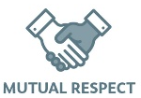


Year 8
Scheme of Learning
Knowledge | To understand the motives behind the terms of the Treaty of Versailles. To reflect on the severity of the punishments awarded to Germany. To analyse the longer term consequences of WW1 on Europe and the world. To reflect on whether WW1 was worth winning. To understand what the Weimar Republic was. To look at hyperinflation in Germany in the 1920s. To understand what is meant by the term ‘Great Depression’. |  |  |  | To identify significant events in the history of medicine. To reflect on the practices of medicine throughout different eras. To understand the developments of surgery in the early 19th century. To use evidence to solve the mystery of Cholera in British towns.
Sequencing Statements/ Cross Curricular Learning | Why did a ‘Great War’ happen? (Year 8) What was life like during World War 2? (Depth Study) |  |  |  | What was life like in Medieval Britain ? (Year 7) Industrial Revolution and Booming Population (Year 8) Introduction to KS4 concepts (Year 9+)
Enrichment Opportunities and British Values
What was Europe like after World War 1?
Public Health in History
(GCSE Taster Sessions)
Back

