Slide 1
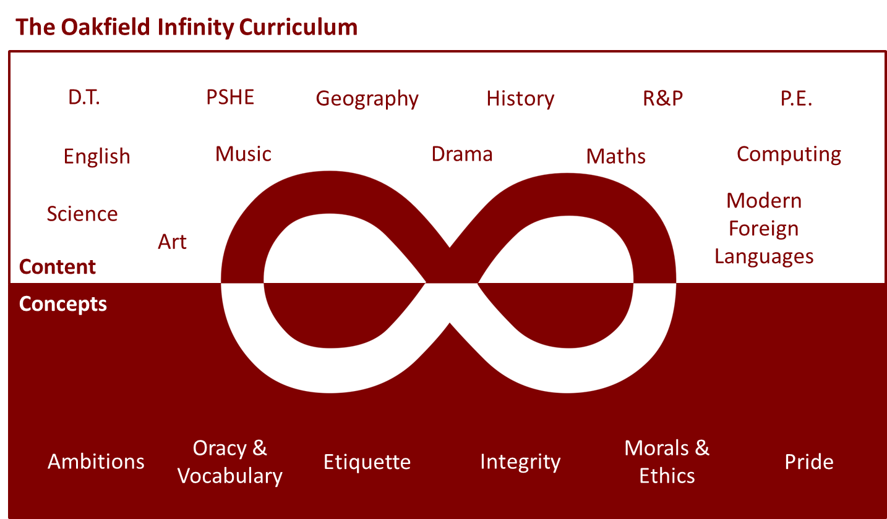

Slide 2
In Mr McGrath’s latest assembly he asked you about what you strongly believe in.
What would you fight for?
Who or what would you stand up for?

Slide 3
How much do you know about what has sparked the recent protests in the US and around the world?
This article on the Newsround website gives a really clear history of what has happened over the last few weeks since an unarmed Black man was murdered by police in the US. His name was George Floyd.
If you haven’t seen much about it in the news, click this link to read more and you’ll find videos posted by celebrities such as Beyoncé too.

Slide 4
Protests
Demonstrators right across the UK have been taking part in protests. People all over the world are calling for an end to racism and inequality.
Click through the following images – read the messages on the placards and think about why these adults and children are there and how much it means.

Slide 5
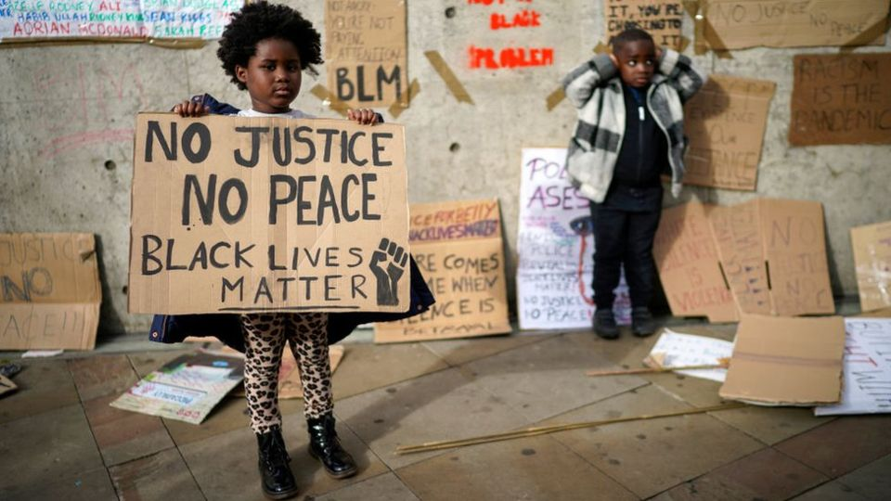

Slide 6
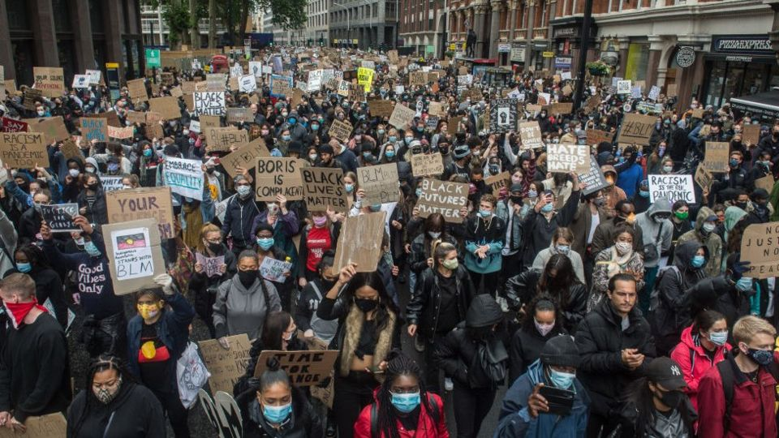

Slide 7
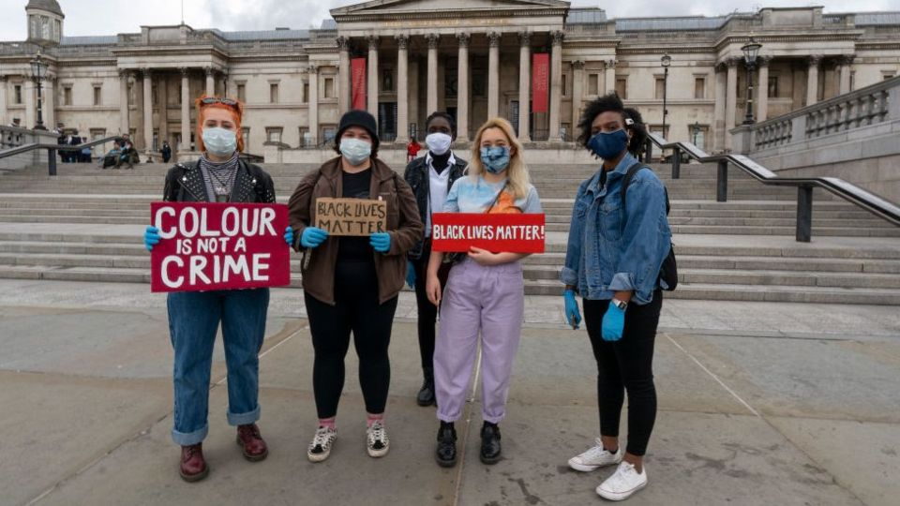

Slide 8
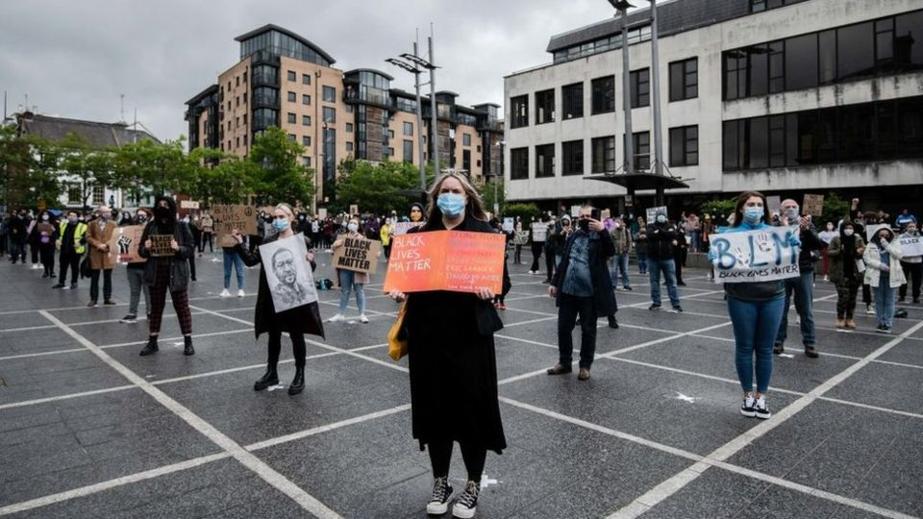

Slide 9
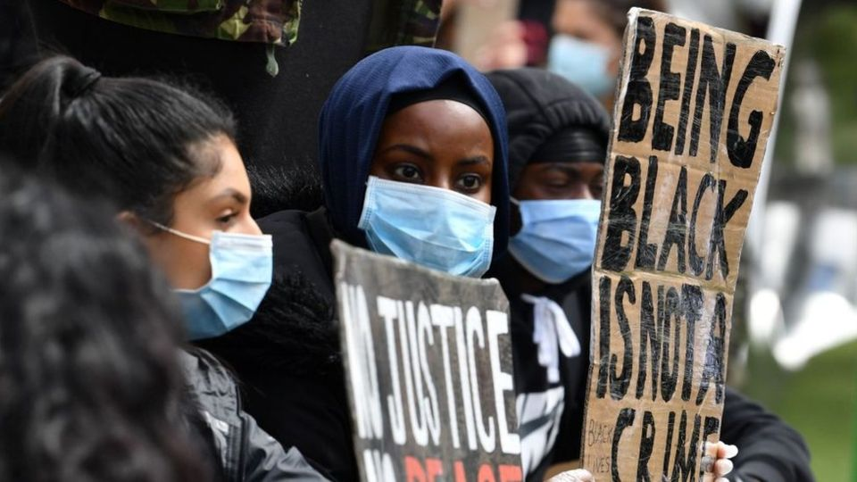

Slide 10
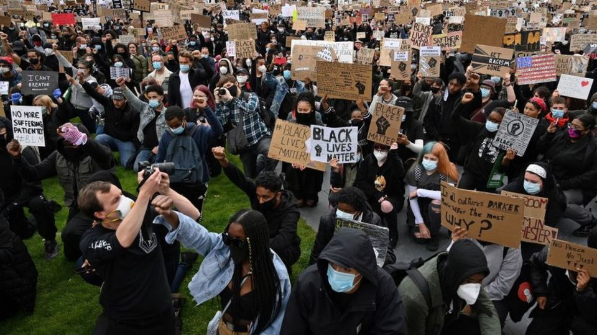
Thousands of people knelt at this protest in Manchester. The action is called ‘taking the knee’.
It has become an important symbol during the current protests but it was first made popular by black NFL players back in 2016 who were taking a stand against racial inequality and police brutality in America.

Slide 11
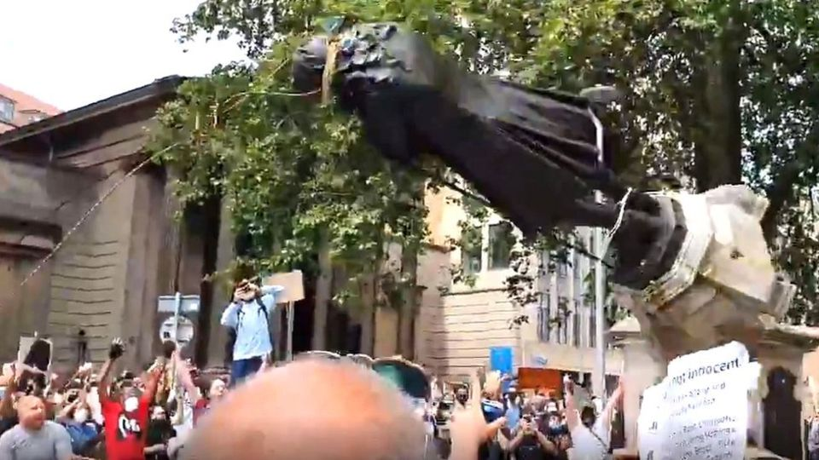
Protestors in Bristol tore down a statue of Edward Colston who was a slave trader in the 17th Century.
The statue was then dragged through the streets of Bristol and thrown into the harbour. Many people think the statue should have been removed a long time ago but other say this is an act of vandalism.
What do you think?

Slide 12
How people feel here in the UK
https://www.bbc.co.uk/newsround/52936388
This link takes you to a video from the Newsround website where children in the UK have been talking about what these protests mean to them.
If you would like to read some powerful speeches from people around the world this week, click here to see what Clara Amfo, Megan Markle, Barak Obama, Terrance Floyd and Coco Gauf have been saying in reaction

Slide 13
What can you do to become anti-racist?
One of the quotes from Clara Amfo’s speech this week on radio 1 was ‘There is a false idea that racism and in this case anti-Blackness is just name calling and physical violence, when it is so much more... than that’. It is not enough to not be racist. We need to ensure that we are all anti-racist.
So how do we become anti-racist?
learning more about racism and Black History
having conversations with our friends and family about the protests (it’s OK if those conversations are uncomfortable – it means we are challenging each others thinking)
reading books about people from diverse backgrounds

Slide 14
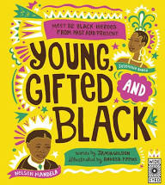
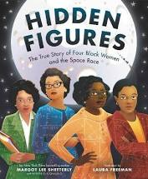
Suggested reading list:
Hidden Figures – The true story of four Black Women and the Space Race by Margot Lee Shetterly
Young, Gifted and Black – Meet 52 Black heroes from past and present by Jamia Wilson
Planet Omar – Funny comic-style book about Omar and his muslim family by Nasaya Mafaridik

Slide 15
Suggested reading list:
Have you read a good book we could add to this list?
Send in your suggestions from home (use your year team email address) and we will add them to the lesson.

