Slide 1
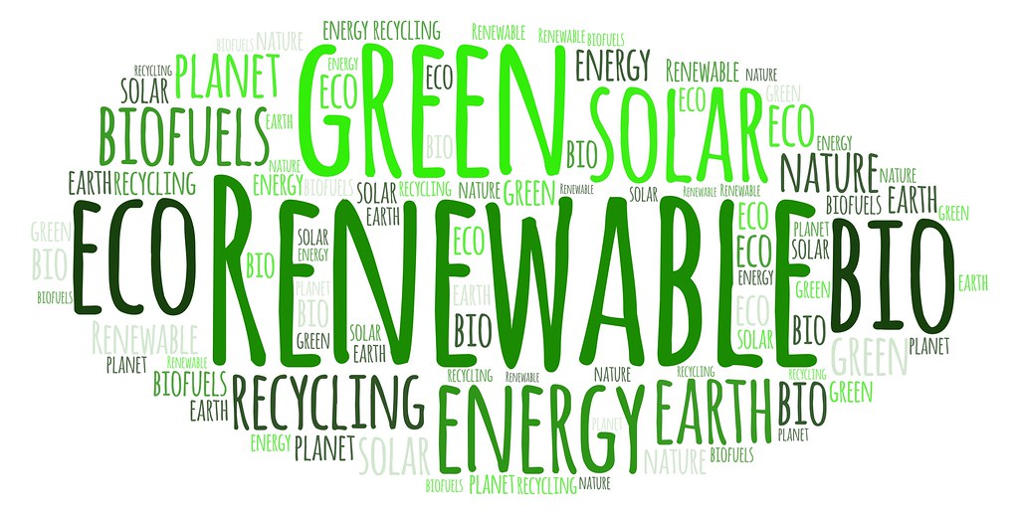
Renewable Energy Knowledge Organiser
Learning Objective: To identify how to use and display information to summarise learning.

Slide 2
What does a Knowledge Organiser Look Like?
Visuals/ Diagrams
Subtitles/ Subheadings
Key Words
Examples of places that use the energy
Short concise information

Slide 3
Renewable Energy Knowledge Organiser
Using the research from last weeks ‘Little Lesson’ on renewable energy create your own knowledge organiser. For each type of energy be sure to include
What it is called
How it works
Advantages and disadvantages
Examples of places that use that energy.
Remember to include images/ diagrams to help show your learning.
To help you, there are some examples on the following slides…

Slide 4
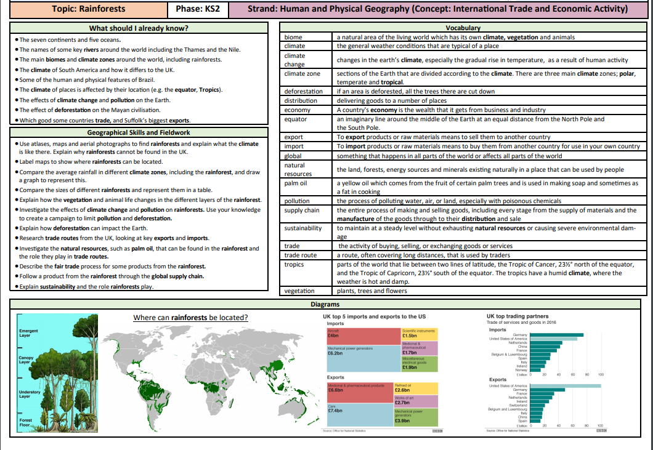

Slide 5
