Slide 1
MOT: Rosenshine’s Principles in Action
Attempting to bridge the gap between research and classroom practice (We hope!!)

Slide 2
Evidence Based Research on Effective Teaching and Learning
Study spanned 4 decades
Consisted of
Research into cognitive science
Research into the classroom practice of ‘Master Teachers’ (!)
Research on cognitive supports to help students learn complex tasks

Slide 3
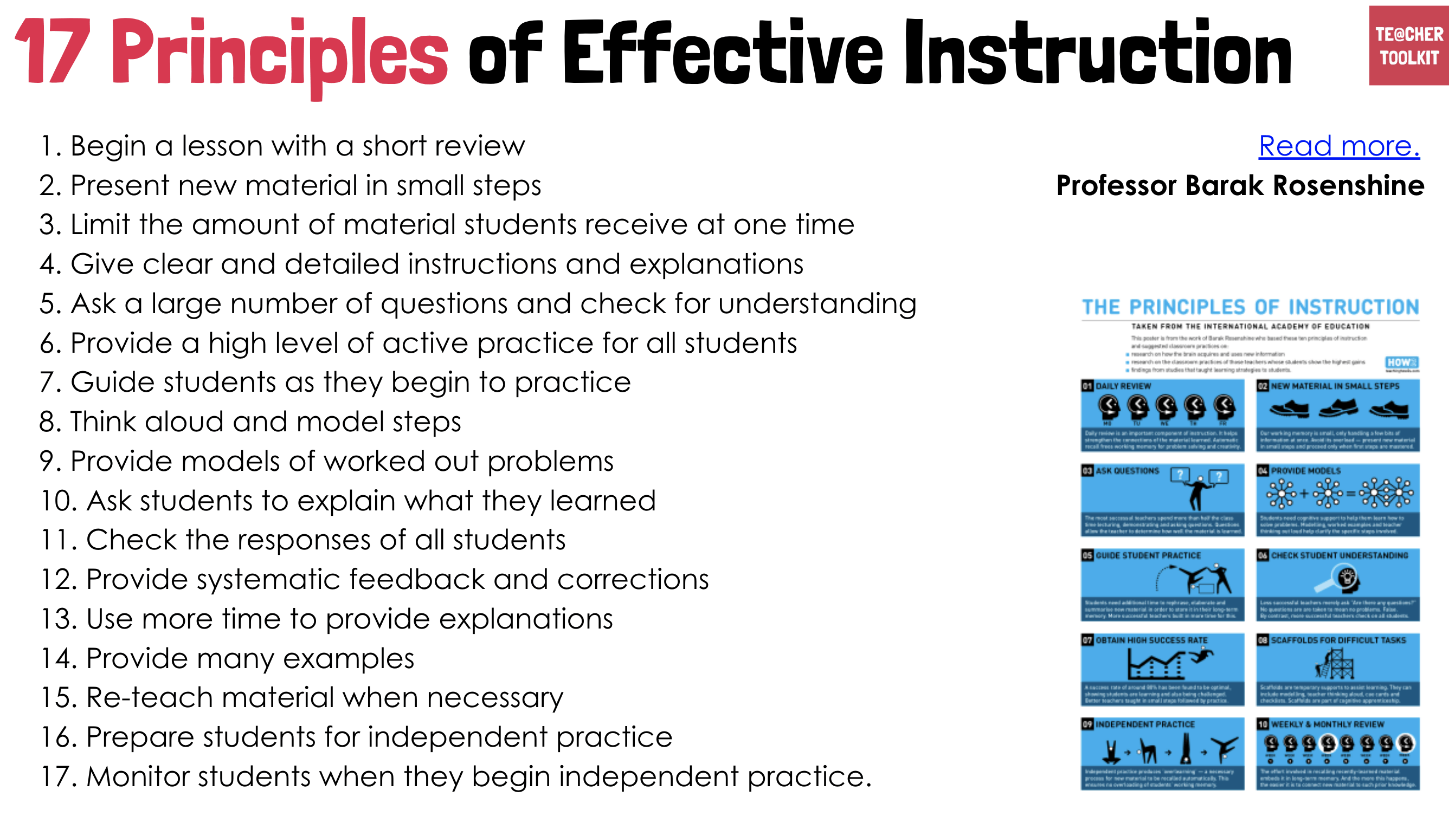
17 Teaching Principles of Effective Instruction

Slide 4
Breaking down into 10 principles and subsequently 4 strands
Daily Review (retrieval)
Present new material using small steps
Ask questions
Provide models
Guide student practice
Check for understanding
Obtain a high success rate
Provide scaffolds for difficult tasks
Independent practice
Weekly and monthly review

Slide 5
Daily Review (retrieval)
Present new material using small steps
Ask questions
Provide models
Guide student practice
Check for understanding
Obtain a high success rate
Provide scaffolds for difficult tasks
Independent practice
Weekly and monthly review
Sequencing concepts and modelling
2.Present new material using small steps
4.Provide models
8.Provide scaffolds for difficult tasks
Questioning
3.Ask Questions
6.Check for Student Understanding
Reviewing material
1.Daily Review (retrieval)
10.Weekly and monthly review
Stages of Practice
5.Guide student practice
7.Obtain a high success rate
9.Independent pracitce

Slide 6
Rosenshine makes an important statement based on the research, do you agree?
‘The most effective teachers ensured that their students efficiently acquired, rehearsed and connected background knowledge by providing a good deal of instructional support’

Slide 7
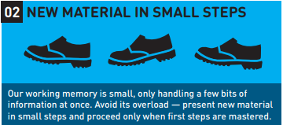
Not to cognitively overload pupils
Recognise the limitations of the working memory
How often do we mix the generic instruction with the curriculum content in practice?

Slide 8
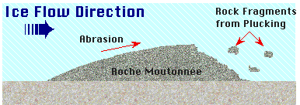
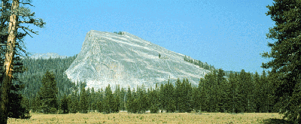
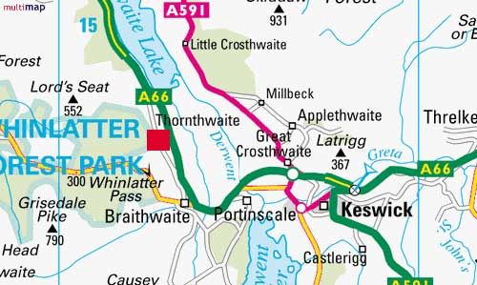
Where have we seen these terms before?
Now you have learnt about Roches moutonnées
RAG your understanding of the key term in your books
Definition: rock hills shaped by the passage of ice to give a smooth up-ice side and a rough, plucked and cliffed surface on the down-ice side. The upstream surface is often marked with striations.
Now locate the Roches moutonnées example on your maps

Slide 9
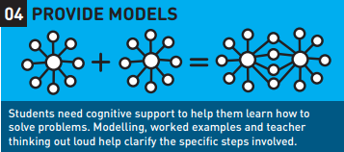
Physical Representations
Conceptual Models
Explicit Narration/Thinking Aloud

Slide 10
Worked examples: A quick Think, Pair, Share for us….
Model the general pattern
Provides a strong basis from which to learn
What worked examples would we provide in;
A maths lesson on solving problems with Multiplication and Division?
A DT lesson focusing on cooking a Healthy Meal?
A History lesson about an artefact brought in by the teacher
A French lesson on the past tense

Slide 11
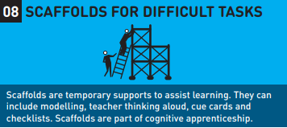
PEEL: Point, Evidence, Explain, Link
SQuID: Statement, quotation, Inference, Development
PETAL: Point, Evidence, Technique, Analyse, Link
We don’t still ride bikes with stabilisers do we?

Slide 12
Scaffolds can be examples or problems to solve
What fraction is shaded?
Most problem solving subjects have a relatively small set of archetypal problems.
If pupils can become familiar with them, cognitive load is greatly reduced.
Multiple exposure increases capacity to problem-solve

