Slide 1
Key Individuals in History
Learning Objective: To identify and research a significant individual in History

Slide 2
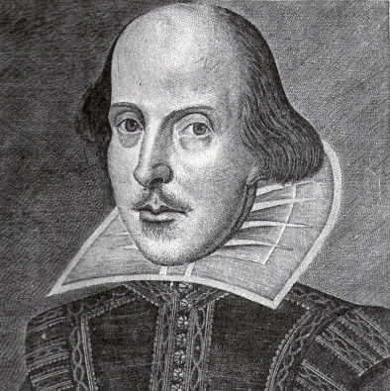
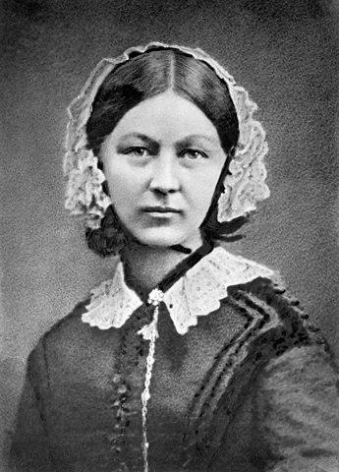
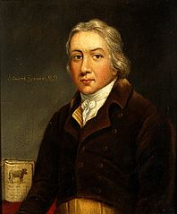
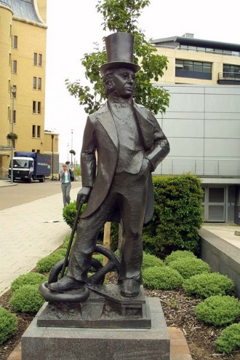
Select one of these key individuals and complete the template on the following slide
William Shakespeare
Florence Nightingale
Edward Jenner
Isambard Kingdom Brunel

Slide 3
Name:
Portrait of Individual:
What are they known for?
When and where were they born? What was their childhood like?

Slide 4
# Timeline of their Life: (Try to build in at least 5 key events)

