Slide 1
Censorship
One of the main issues soldiers faced when sending letters home from the trenches was that it may have been censored before it reached their friends/family.
The sorts of things that would be censored included:
Specific details including locations of troops
Descriptions of hard living conditions
Information that may help the enemy.
Highlight using 3 different colours, any information that might have been censored by the authorities had this letter been checked.
For each of the reasons, explain why these references might have been censored in the first place.
Question: Using source B, detail what life was like for the soldiers in the trenches and evaluate their biggest hardships. (6 marks)

Slide 2
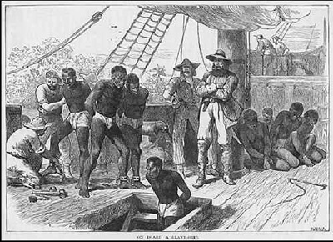
A
Conditions Aboard the Middle Passage
Using Source A and prior learning, describe what conditions were like for the slaves aboard the middle passage journey.
Referring to Source A, explain and reflect on the harshest conditions that slaves would face during the journey.
Source B is an extract from a book about the journey of slaves during the slave trade. Refer to this source and explain how these conditions came to be and what motives the slaves may have had for their actions.
Question: Detail what life was like for the slaves aboard ship during the middle passage. How and why would conditions change during the latter stages of the passage?
Source B: From Bea Stimpson’s ‘Black Peoples of the Americas’
‘Some died of dysentery, “the bloody flux”. Others died of harsh treatment and poor food. Some with infectious diseases such as smallpox, were thrown to the sharks. Others went mad and were clubbed to death. Some committed suicide by hanging themselves or jumping ship.’

Slide 3
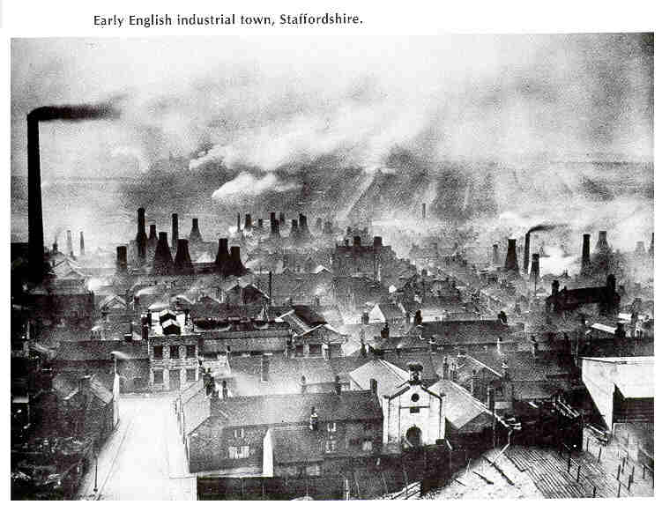
Identify 5 features of what life would have been like in an industrial town in 1900 Britain.
[3 marks]
How were houses developed and what were the reasons behind these developments?
[4 marks]
How did people benefit from living in these towns as opposed to rural towns of previous years? [3 marks]
Source B: Conditions in factories, 1864
‘Little boys and girls are seen at work at the machines and their fingers are in constant danger of being cut off. “They hardly ever lose a whole hand,” said one of the owners. “it only takes off a finger at the first or second joint. They’re just careless.”
Question: What does source B tell you about the attitude of the factory owners towards their staff? Why are working conditions different today?
[5 marks]

Slide 4
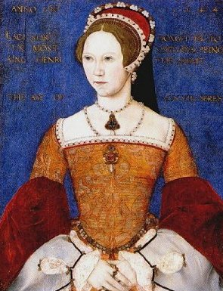
‘Mary married the Catholic King Philip of Spain’, but this was seen as a bad move. Philip and the Spanish were very unpopular in England. Would this Spanish King interfere in the running of the country?’
Why do you think that Mary, upon being crowned Queen would want to develop a relationship with Spain? [2 marks]
Why were people nervous at this time about Philip having influence over their country? [3 marks]
‘About 300 people were burned to death all over the country because they refused to worship the Catholic way. Most of these were humble shopkeepers, carpenters, farmers and housewives.’
History Alive 1 1485-1714, Peter Moss (1980)
Why did Mary act so aggressively and violently towards people who remained Protestant in her Catholic country?
[3 marks]
To what extent is Mary seen as one of the worst monarchs Britain has ever seen?
[4 marks]
‘The Tudor reformation was carried out for selfish reasons.’ To what extent do you agree? [8 marks]

