Slide 1
Difficulties are just things to overcome, after all Sir Ernest Henry Shackleton: Explorer, legend, personal hero of mine!!

Slide 2
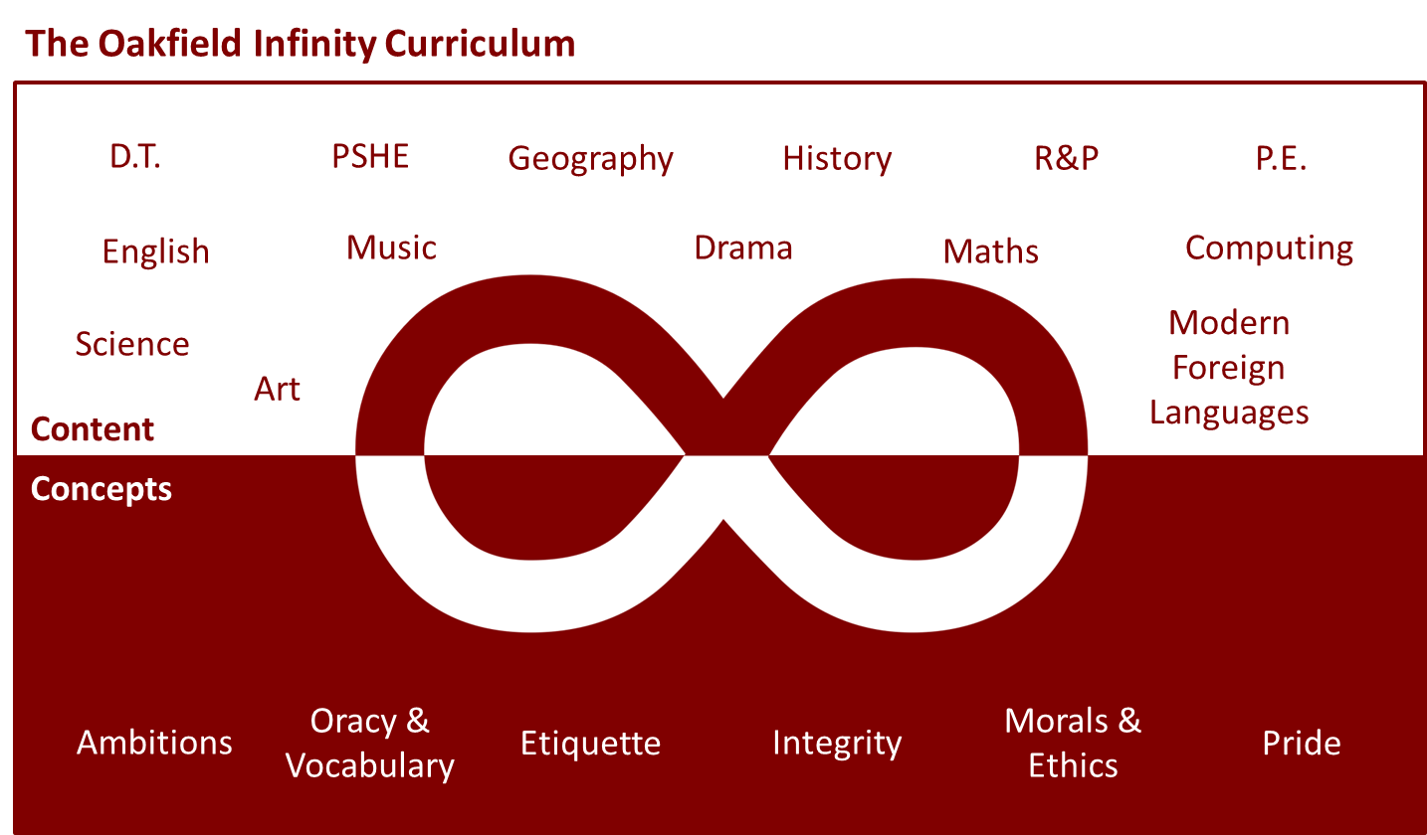
Never have these core concepts been so important

Slide 3
Our Days here at Oakfield
9:00am: Joe Wicks Workout
11:00: David Walliams Stories
Just a mixture of activities to support us all in these surreal and odd times

Slide 4
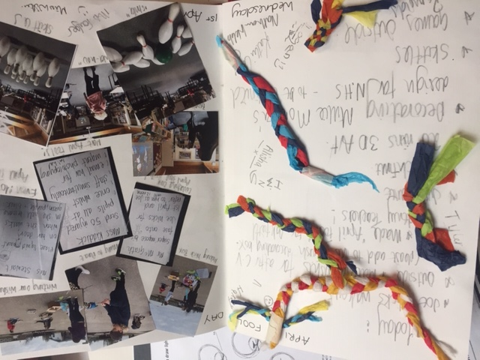
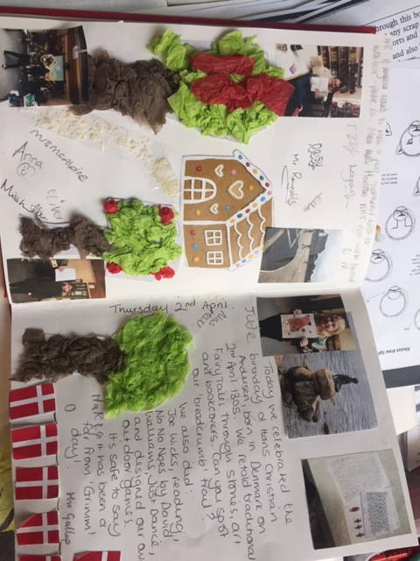
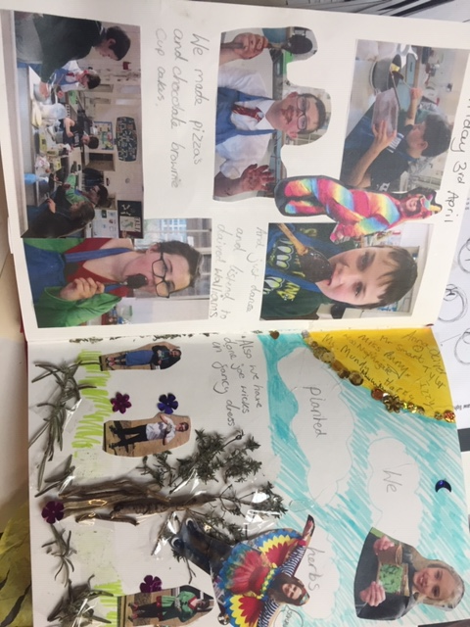
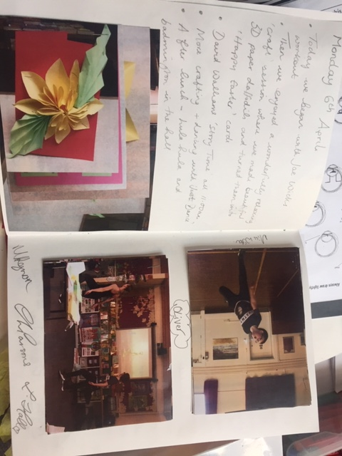
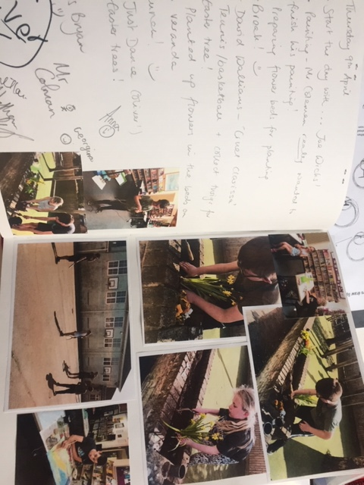
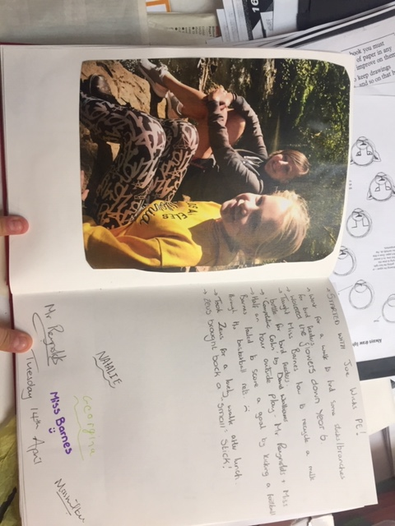

Slide 5
Your Days at Home

Slide 6
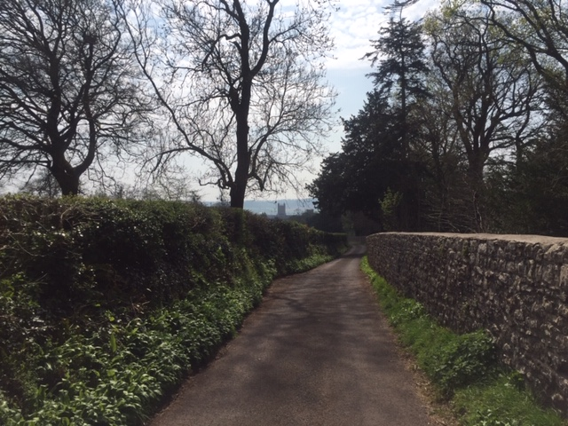
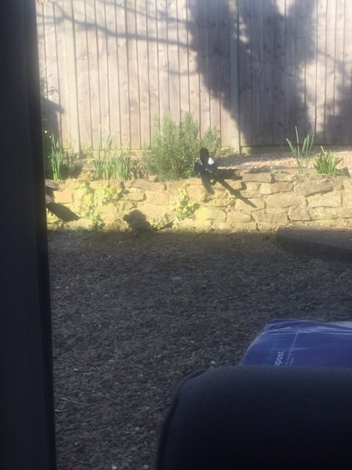
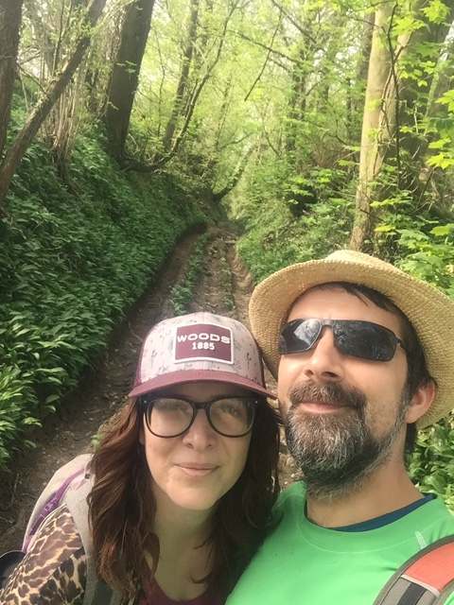
My Experience….
Lots of walking

Slide 7
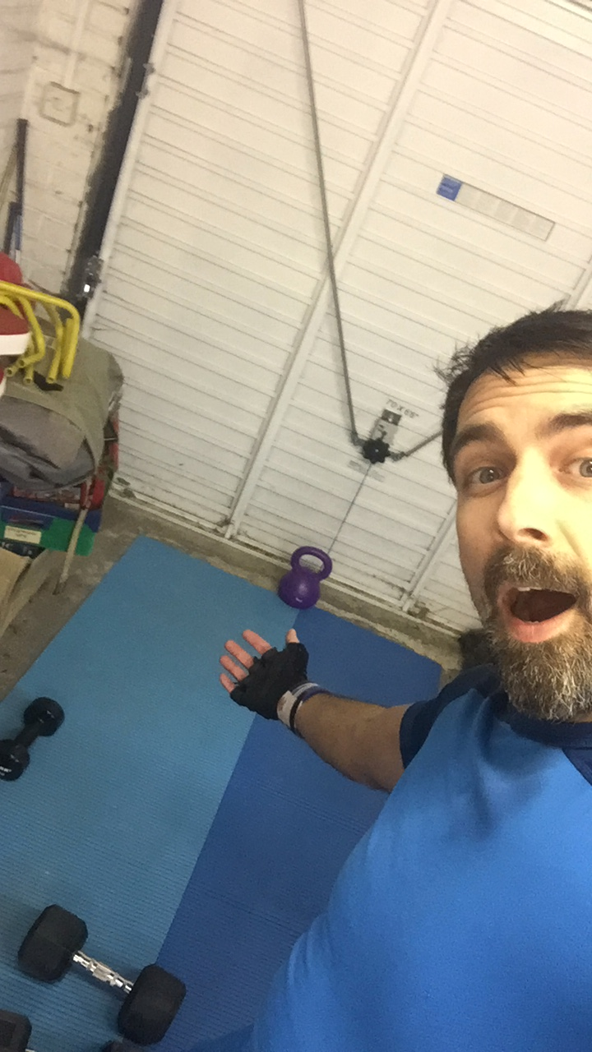
My Experience….
Cleaning (well sort of )

Slide 8
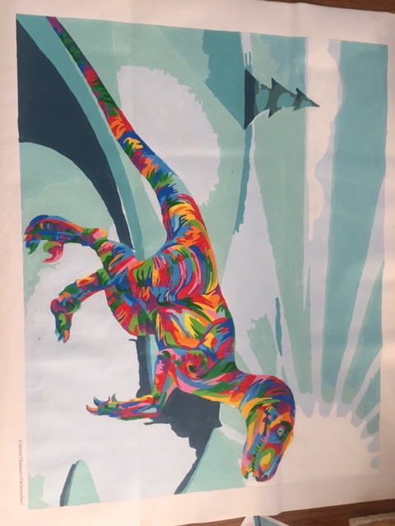
My Experience….
Cooking/Eating/painting!!

Slide 9
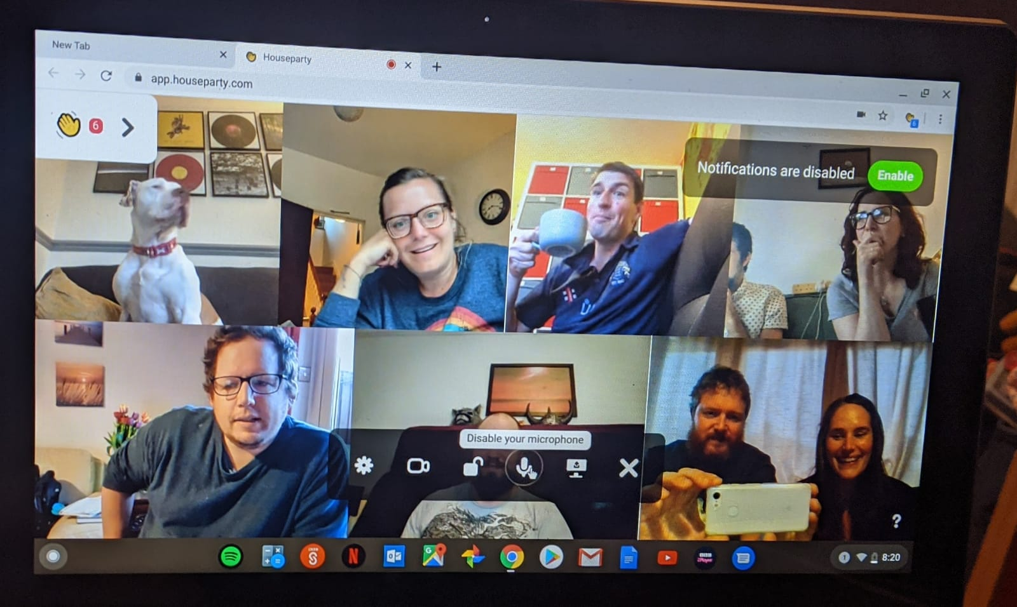
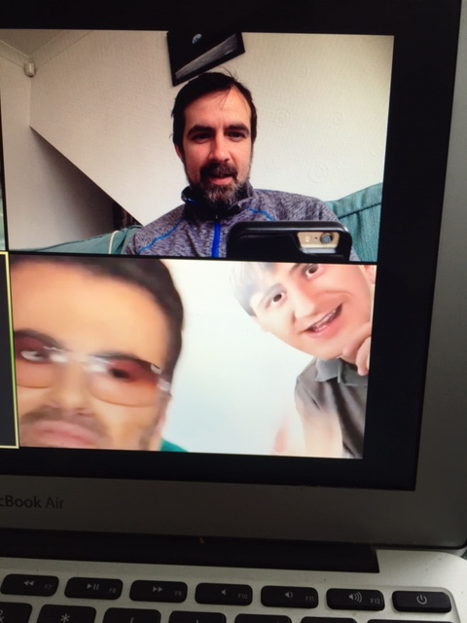
My Experience….
And keeping in touch with friends and family

Slide 10
These Core Concepts form a huge part of our Academy; We want you to be able to demonstrate them in and out of school

Slide 11
A positive attitude towards Morals and Ethics (knowing right and wrong and how to communicate that)
We are Ambitious and will always want to improve
We have Pride in being part of Oakfield Academy
This is just what we do at Oakfield Academy and into the wider community. We have….
Great Oracy and Vocabulary (being confident in speaking and listening)
Great Integrity (being honest and doing the right thing)
Good Etiquette & Manners

Slide 12
Your Home Learning: Its all here under Little Lessons

Slide 13
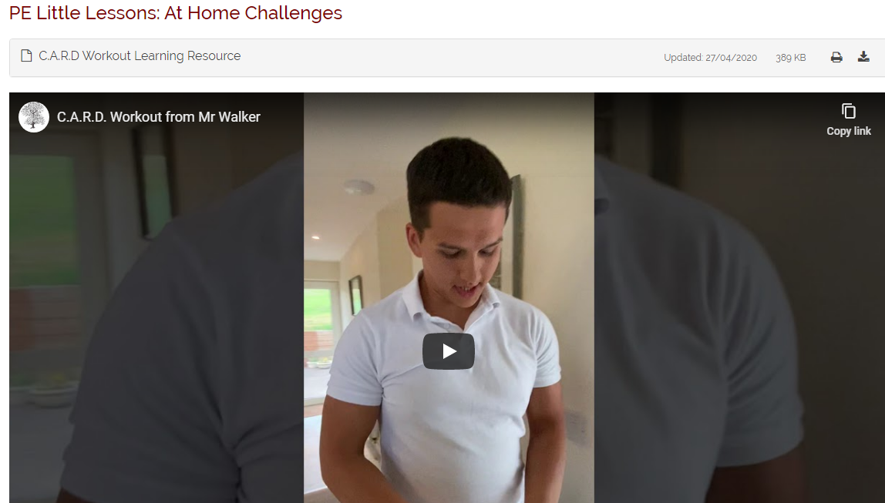
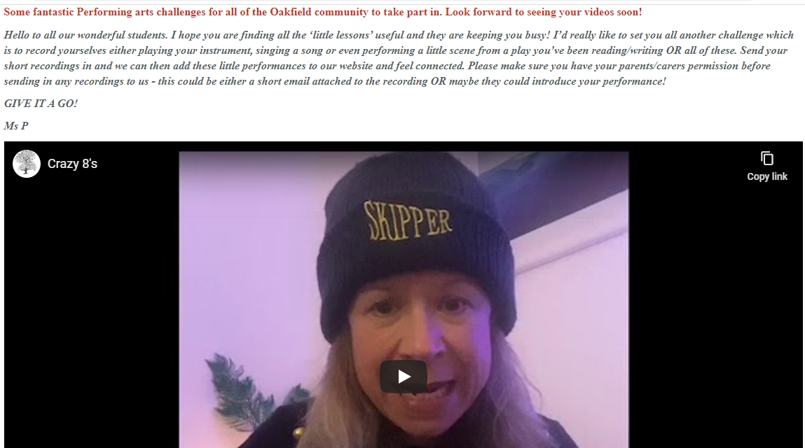
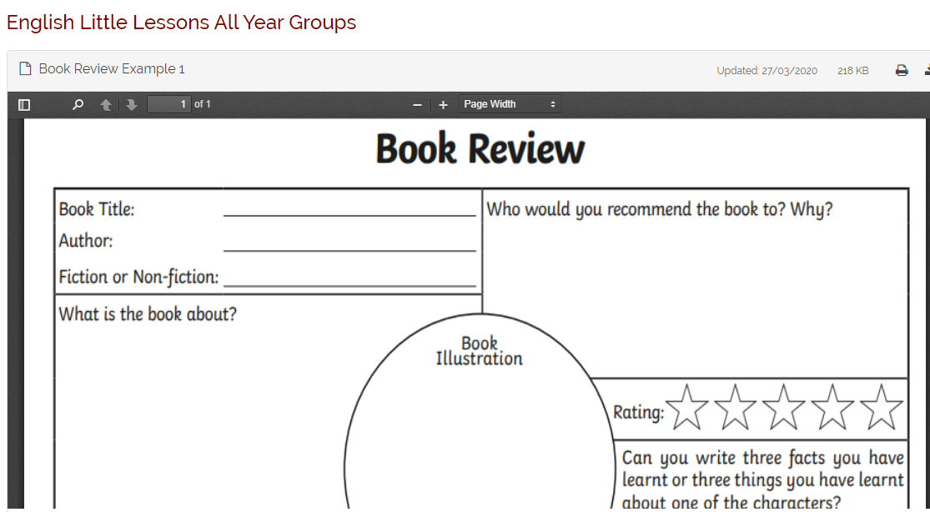
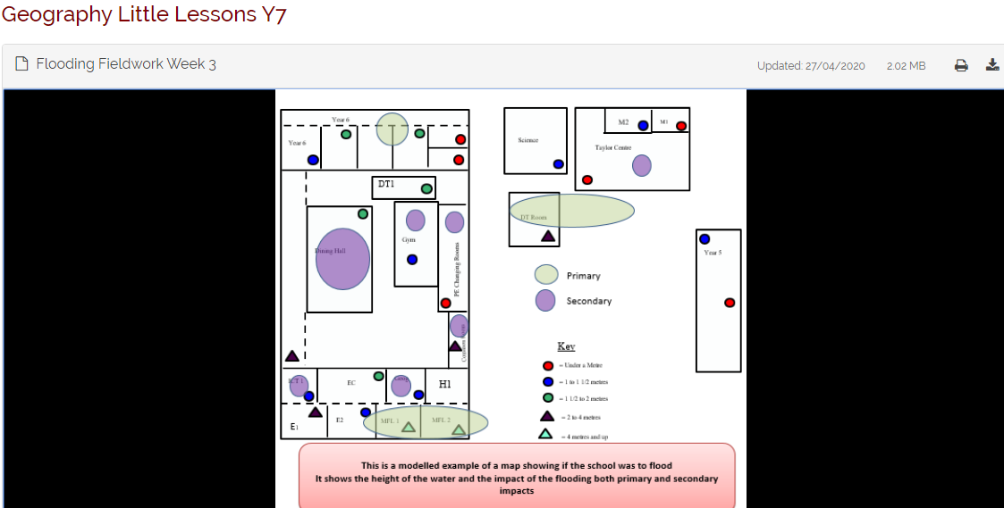
What does the home learning offer look like?
If you can aim to engage for 1-3 hours a day with learning
The offer here is unique to Oakfield pupils
But learning can be found in lots of other areas

Slide 14
We as teachers want to see your achievements and give you feedback to support your learning

Slide 15
Musicians for next weeks assembly
If you would like to record yourself playing a musical instrument and send to us ready for assembly next Wednesday that would be fabulous!!
oakfieldacademy@educ.somerset.gov.uk

Slide 16
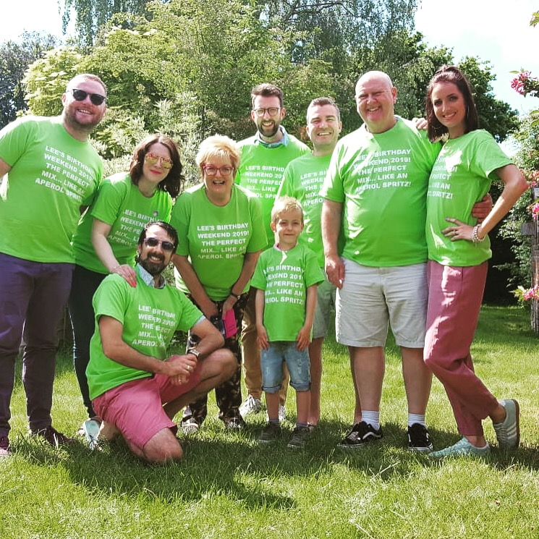
We all can’t wait for the time we are back together
Until then continue to demonstrate those core concepts outside of Oakfield and communicate all your successes so we can celebrate them

