Slide 1
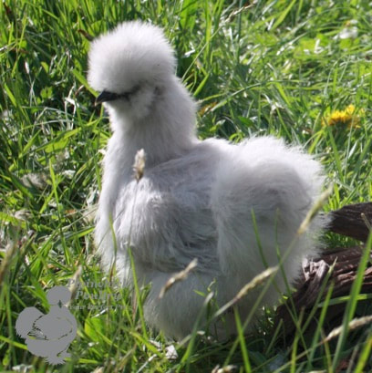
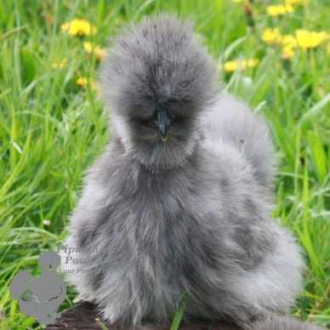
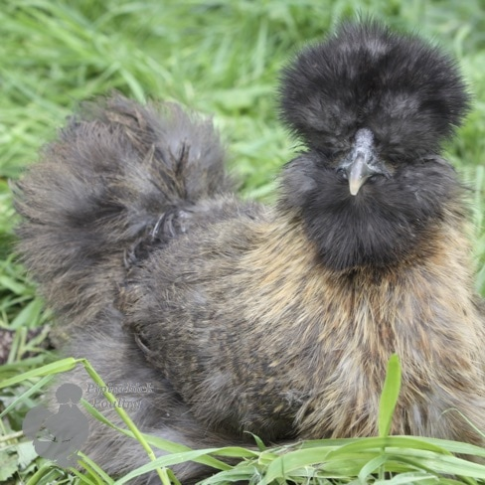
Miss Nightingale is about to add three new members to her household

Slide 2
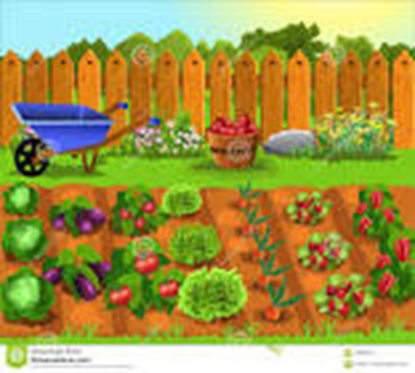
However, she already has three teenagers in the house so there’s no room at the inn. Can you help her to design somewhere for Rachel, Phoebe and Monica to live
(she didn’t choose the names!).

Slide 3
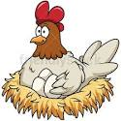
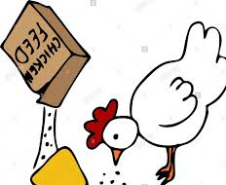
Design Brief
Design a chicken coop for three chickens.
Points to consider
Miss nightingale wants it to look good in her garden.
Silkies aren’t very good at climbing and don’t fly.
The chickens need protection from Mr Fox.
They need somewhere warm to cuddle at night
They like to perch on a rung (a low pole)
They need somewhere to lay their eggs
Some days it won’t be possible to let them out in the garden so they need a safe outside space to scratch around in
Miss Nightingale needs to get in to clean and feed the girls
They need somewhere to put their food and water so they won’t make a mess

Slide 4
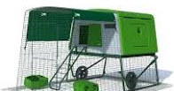
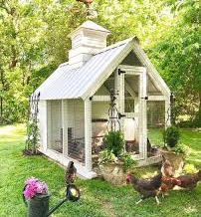
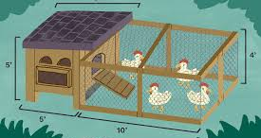
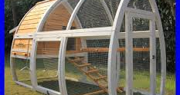
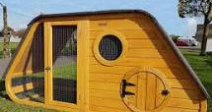
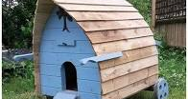
Let’s look at some designs available to inspire us. Consider the good and not so good points.

Slide 5
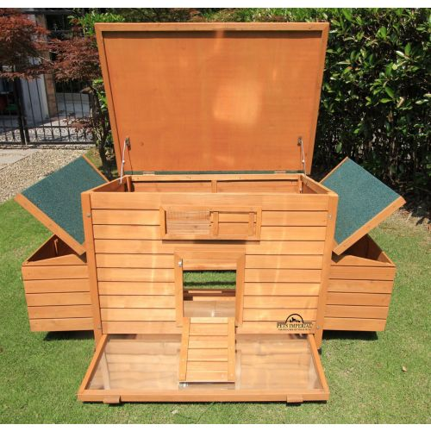
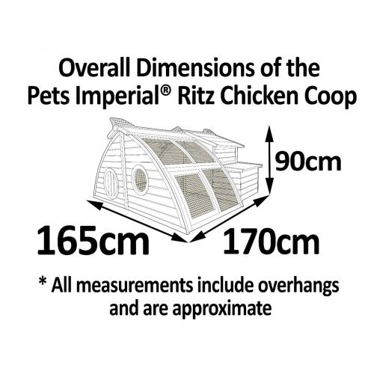
Man made materials – easier to clean
Cleaning tray – slides out
What materials would work best? Are they easy to clean? What size should it be? How will you collect the eggs? How will the chickens stay dry? Does it look good?

Slide 6
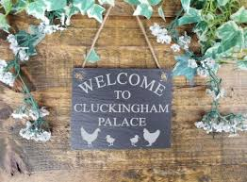
Use an A3 or A4 piece of paper for your final design. Don’t forget, go large, it’s easier to add detail and colour.
Colour should be neat and within the edges. Tip your crayon so it’s at an angle and use the side rather than the tip. This helps get a more even coverage.
This is a design project so annotate (label) around the edges to explain your ideas.
Use a ruler for all straight lines.
Press lightly with your pencil so you can rub out easily if needed.
Be creative, anything goes, even cluckingham palace!

