Slide 1
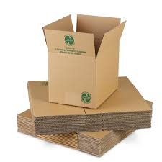
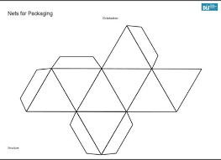
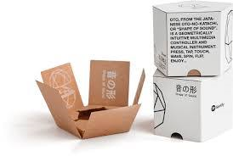
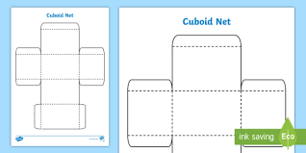
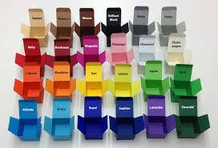
Packaging Design Project

Slide 2
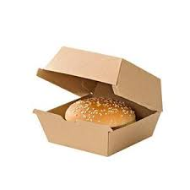
Mind map as many types of packaging as you can:
List as many types of materials that can be used for packaging, that you can think of:
Look at each reason for why we need packaging and write them down on your worksheet. Give one or more reason why each of them is important:

Slide 3
Ideas for take away packaging – what’s it for? Is it original? Is it easy to eat the food?
Draw your design here. Show all views and make detailed notes to explain your ideas.
Look at your design critically:
3 best points:
3 things to improve:

Slide 4
On this sheet design a sticker that promotes recycling.
Next week bring one or two items of packaging with you to evaluate.

Slide 5
Look at the packaging you have brought to school.
Gently pull open the NET – did it go together well? Was it simple? Did it use multiple pieces? How might you improve it?
Look at the decoration/font – is the colour scheme eye-catching? Does it promote the product well? What information is included? Is there anything missing?
Draw the net in the space provided. Take time to consider the size and placement of any tabs. Look at where the information is and where the main design features are placed.

Slide 6
Do your packaging design on this sheet. Show all aspects; front, sides, back, top and bottom. Include all relevant information. Remember what you looked at on the packaging you brought in to school.
Suggestion – draw your packaging as a net showing all the tabs. Draw your design images on to the faces of your net then draw a smaller 3d image of the end product. Focus on presentation and use a further sheet if necessary.

Slide 7
Suggestion – draw your packaging as a net showing all the tabs. Draw your design images on to the faces of your net then draw a smaller 3d image of the end product. Focus on presentation and use a further sheet if necessary.

Slide 8
Look at your finished product critically and evaluate the end result
Look at the NET – did it go together well? How could you improve it?
Look at the decoration – did the colour scheme work? What were your main selling points? Have you added enough information?
Write down a minimum of three things that you would do differently if you did this project again.
Write down three things that you thought worked really well and why.

