Slide 1










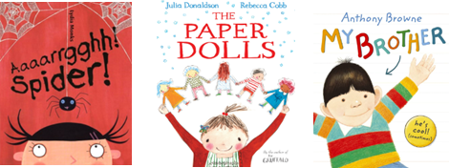



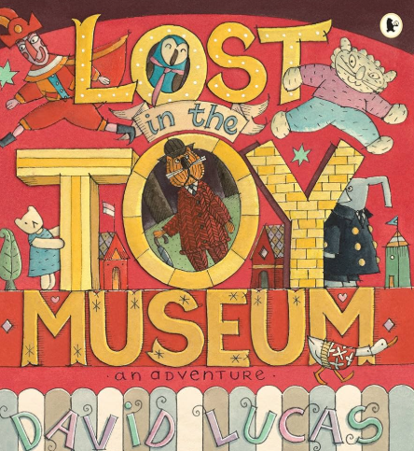
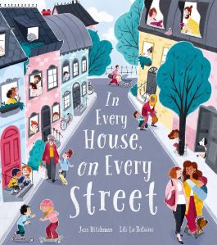









The Bumble Bees at The Hive Autumn 2025
Our learning this term
In Autumn 1, our theme will be ‘All about me’.
We will be focusing on these texts:
Autumn key learning
My Communication
We will be exploring characters, setting and the theme of friendship. We will be looking at time travel texts.
We will be looking at sensory storytelling, sequencing activities, sentence writing, and creative tasks.
My World
We will be exploring our family and where we live and our locality. We will also learn about how homes were built and what homes around the world look like. We will apply our knowledge of what materials could be used to build our own homes.
We will also be learning all about what makes humans and plants grow and all about spiders.
My Personal Development
We will be focussing on settling in, making new friends, our behaviour for learning targets and our personal independence targets.
We will be developing our footballing skills by learning to kick a ball, dribble and pass.
Special events
In Autumn 2, our theme will be ‘Toys and homes
From the past’.
These will be our focus texts:
My Creativity
My Thinking
We will be looking at early number skills, counting, place value and measurement (capacity & volume).
Phonics
We will be learning songs about our bodies, making our own spiders, drawing self portraits, taste testing foods we like from home and making our own paper dolls.
We will be learning about rhythm and beat using sticks, stones and body percussion to make our own Stone Age soundscapes
Bonfire Night
Diwali
Halloween
Christmas
In phonics, we will continue in our groups, with some pupils looking at Phase 3 sounds and some pupils looking at Phase 5.

Slide 2





Bumble Bees at The Hive Autumn 2025
Talk about the book together and ask questions:
Discuss the pictures. Can you find a…? What can you see…?
Make a prediction. What do you think will happen next?
Make links with the story and their own experiences. For example, if the book is about a birthday, can they tell you about a birthday party they have had or been to?
PE
Our PE days are Tuesday and Wednesday.
On these days, your child should come to school in their PE kit: a plain white t-shirt, black joggers or leggings and a school jumper or fleece.
Instagram
We have a new class Instagram page which you can follow. We’ll be sharing and celebrating our learning with you at:
OakfieldHyde_BumbleBees
.
Supporting your child at home
Reading
Your child will bring home two reading books every Friday. One will be a Little Wandle phonics book and one will be a library book.
Little Wandle phonics book:
This book will be carefully matched to your child’s reading level. Initially, your child will have a wordless book and, when they have begun to learn graphemes and how to blend them together to read words, they will then have books with words. If your child is reading it with little help, please don’t worry that it’s too easy – your child needs to develop fluency and confidence in reading and to develop their storyteller voice! Listen to them read the book daily, if possible. Give them lots of praise – celebrate their success! If they can’t read a word, remind them to sound it out and if they still struggle, read it to them.
Library book:
This book has been chosen by your child from the school library. This will contain tricky words that your child will not be able to read by themselves. It is a book to enjoy together.
.

