Slide 1











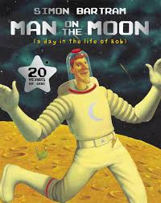






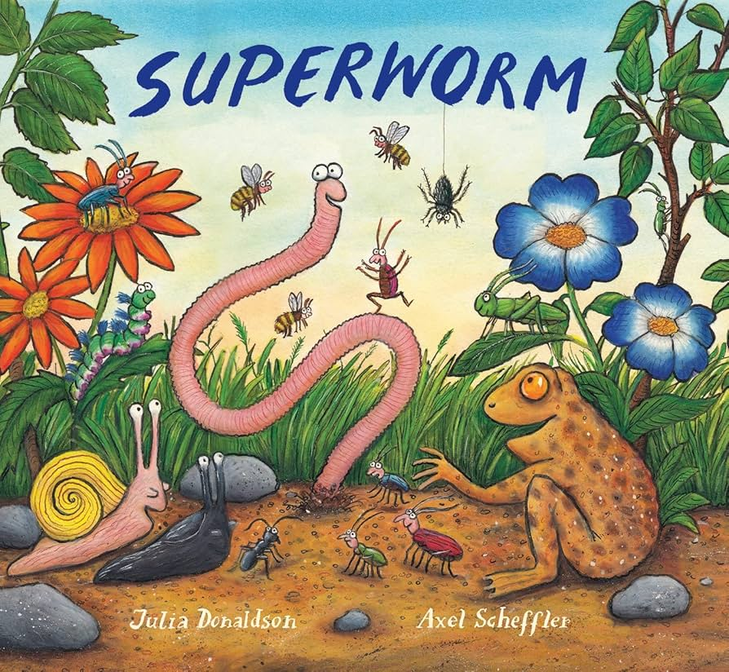






The Bumble Bees at The Hive Spring 2026
Our learning this term
In Spring 1, our theme will be ‘3,2,1 Blast off!’.
We will be focusing on these texts:
Spring key learning
My Communication
We will be exploring characters, setting and the theme of Space.
We will be looking at sensory storytelling, sequencing activities, sentence writing, and creative tasks.
My World
We will be learning all about space and the solar system and life during the spring for insects and animals.
We will be exploring famous figures of history, such as Neil Armstrong and his importance as being the first man on the moon.
We will explore seasonal changes during the spring and enjoy learning about the life cycle of a butterfly.
My Personal Development
We will be focussing on fine and gross motor development through pencil control, cutting skills, Squiggle while you wiggle and Dough Disco interventions.
We will focus on social and emotional development through targets such as turn taking and being a part of a class and how we can build relationships with others.
We will be developing our balancing and dance skills through P.E.
Special events
In Spring 2, our theme will be ‘In the Garden’.
These will be our focus texts:
My Creativity
My Thinking
We will be looking at early number skills, counting, place value, time, money, measurement and shape concepts.
Phonics
Chinese new year
Pancake day
Valentine’s Day
Mother’s Day
Red Nose Day
Easter
Neurodiversity week
We will be focusing on artists such as Jackson Pollock and Peter Thorpe to create art in response to Space
In phonics, we will be continuing with the Little Wandle phonics programme at individualised levels.

Slide 2





The Bumble Bees at The Hive Spring 2026
Talk about the book together and ask questions:
Discuss the pictures. Can you find a…? What can you see…?
Make a prediction. What do you think will happen next?
Make links with the story and their own experiences. For example, if the book is about a birthday, can they tell you about a birthday party they have had or been to?
PE
Our PE days are Monday and Tuesday.
On these days, your child should come to school in their PE kit: a plain white t-shirt, black joggers or leggings and a school jumper or fleece.
Instagram
We have a new class Instagram page which you can follow. We’ll be sharing and celebrating our learning with you at:
OakfieldHyde_BumbleBees
.
Supporting your child at home
Reading
Your child will bring home two reading books every Friday. One will be a Little Wandle phonics book and one will be a library book.
Little Wandle phonics book:
This book will be carefully matched to your child’s reading level. Initially, your child will have a wordless book and, when they have begun to learn graphemes and how to blend them together to read words, they will then have books with words. If your child is reading it with little help, please don’t worry that it’s too easy – your child needs to develop fluency and confidence in reading and to develop their storyteller voice! Listen to them read the book daily, if possible. Give them lots of praise – celebrate their success! If they can’t read a word, remind them to sound it out and if they still struggle, read it to them.
Library book:
This book has been chosen by your child from the school library. This will contain tricky words that your child will not be able to read by themselves. It is a book to enjoy together.
.

