Slide 1







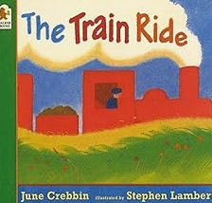
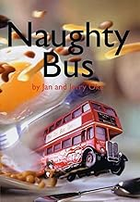















Nursery Spring 2026
Our learning this term
How can we make vehicles move?
Wind up and pull back cars
Forces – can you feel pushes and pulls?
Celebrations
Valentines day
Chinese New Year
Creative
Children to make their own 3D planes and buses.
Maths
Sorting and matching, counting, numbers 1,2, 3, 4, measurement - mass
Phonics
Environmental sounds
Nursery rhymes
alliteration
Initial sounds
Spring 1 key learning
Understanding the world
What do they look like?
What can you see on a bus, train or plane?
Do they have windows, wheels, wings, an engine?
Do they have a pilot or a driver?
Hove you ever been on a bus or a plane?
What was it like?
What jobs are linked to transport?
Train driver
Bus driver
Pilot
In Spring 1, our theme will be ‘Transport’.
We will be focusing on these texts:
In Spring 2, our theme will be ‘Growing’.
These will be our focus texts:
Spring 2 key learning
Understanding the world
What do plants look like?
Different plants, Different leaves,
Flowers, fruits,
Growing from Seeds
Seeds to plant
What do plants need to grow?
How do we care for them?
Grow our own plants
Observe changes
Plants that we eat
Growing vegetables
Creative
Children to create collage flowers
Artist - Arcimboldo
Maths
Numbers 1, 2, 3, 4, 5,
Subitising
2D Shapes – triangle, circle, square, rectangle
Measurement - capacity
Phonics
Nursery Rhymes,
Alliteration,
Iniitial sounds
Special events
Ramadan and Eid
Mother’s Day
Easter
Notes:
sh

Slide 2





Nursery Spring 2026
.
Supporting your child at home
Reading
Your child will bring home a library book every Friday.
This book will have been chosen by your child from the school library. It is a book to enjoy together.
Talk about the book together and ask questions:
Discuss the pictures. Can you find a…? What can you see…?
Make a prediction. What do you think will happen next?
Make links with the story and their own experiences. For example, if the book is about a birthday, can they tell you about a birthday party they have had or been to?
.
PE
Our PE day is on Friday
On these days, your child should come to school in their PE kit: a plain white t-shirt, black joggers or leggings and a school jumper or fleece.
Instagram
We have a new class Instagram page which you can follow. We’ll be sharing and celebrating our learning with you at:
OakfieldHyde_Nursery

